Slide 1
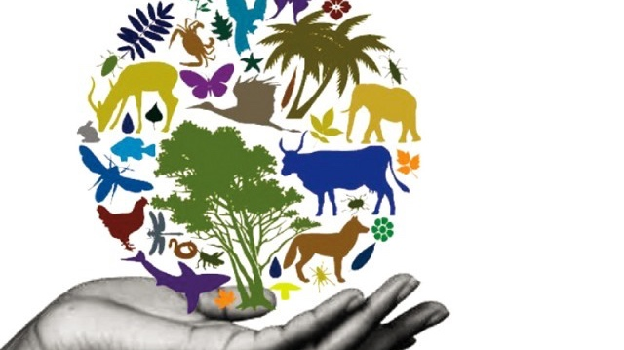
Biodiversity and human impact
4th grade
amazing earth
Notes:
Presentation should take about 15-20 minutes to allow ample time for the experiment.
There are a lot of slides in this presentation since it includes the activity steps. Please keep an eye on the clock.
TIPS:
Have students sit on the carpet so the presentation can be set up at their desks.
Limit questions or the number of students who can answer a question if time runs short.
Ask helpers to:
set up during the presentation
familiarize themselves with the activity and its goal
Thank you for making Amazing Earth possible!
Updated 5/1/23

Slide 2
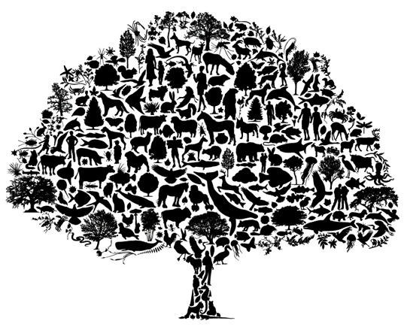
What is biodiversity?
Bio means life.
Diversity means many different types.
So bio-diversity means… many different types of life.
Notes:
ASK: Who knows what Biodiversity means?
If no one guesses correctly, prompt them by breaking it down and asking: Who knows what “diversity” means or what the pre-fix “bio” means?
ADVANCE to reveal.

Slide 3
Why is it important to have biodiversity?
the environment needs many different species to be healthy.
Our Food and medicine comes from plants and animals.
Healthy environments recover better when disasters happen.
Every species depends on other species to survive.
It is important to maintain the balance of nature.
Notes:
ASK: Why is it important to have biodiversity?
ADVANCE to reveal. Review the points and the interdependency slide (easiest to begin at Grasshoppers and move around the cycle).
EXPLAIN by giving an example such as: Many people do not like snakes. But snakes eat mice. If we didn’t have snakes we’d have a terrible problem with mice.
Biodiversity means maintaining the balance of nature so that no one species becomes too powerful and bad for the other species.

Slide 4
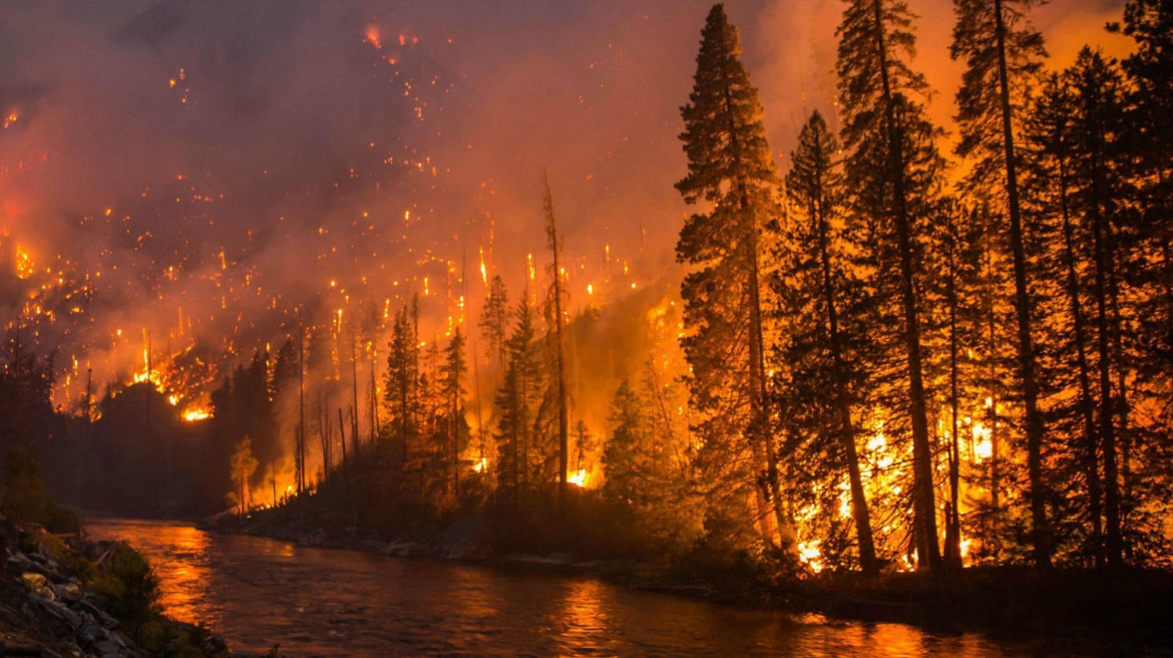
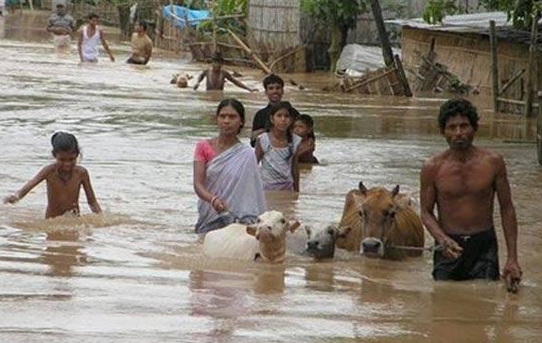
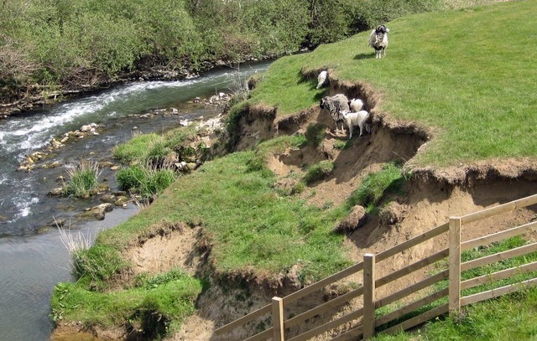
natural events can affect biodiversity
fire
floods
Disease
erosion

Slide 5
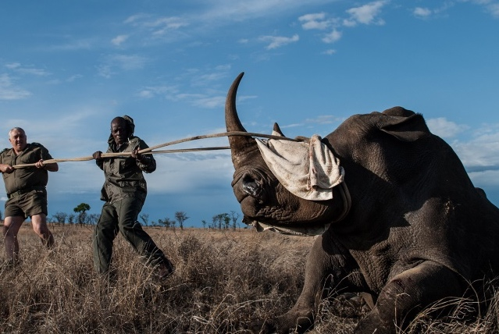
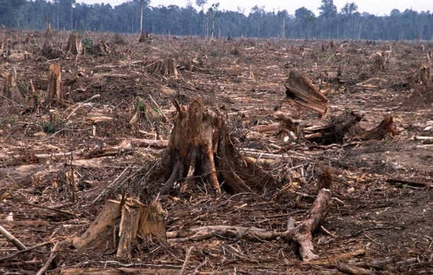
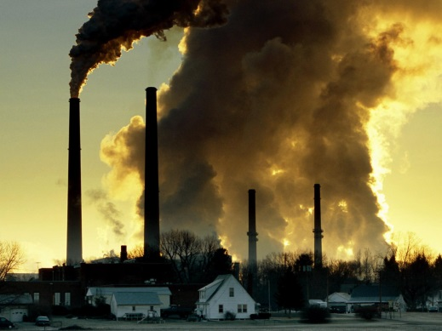
How do people impact biodiversity?
Changing the Land
overHunting and overfishing
Pollution and oil spills
Plant, animal, or insect species can become endangered or extinct if the impact is too much.
Notes:
ASK: Can anyone think of ways people affect biodiversity?
ADVANCE to reveal points and images.
SAY:
Human activities are responsible for most of the loss of biodiversity throughout the world.
As the Earth’s population grows, we are using more and more natural resources to feed everyone and to give them homes. We are also driving more, using more energy in our homes, and buying many more products than we need.
Let’s look at each of these in more detail and the conservation efforts that are used to try to protect the animals and their habitats.

Slide 6
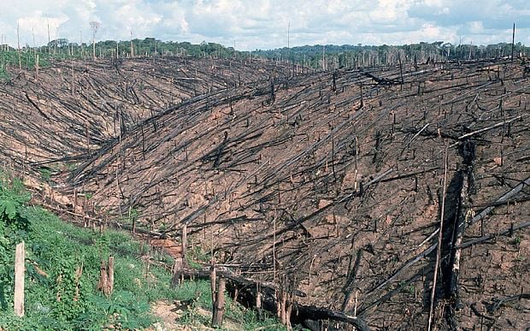
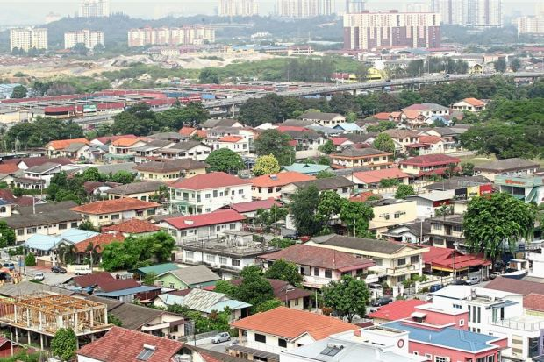
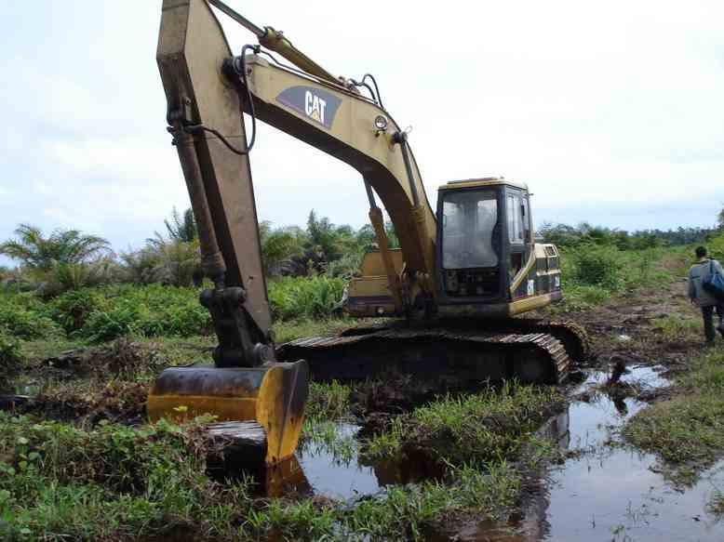
Changing the Land
change forests to farm land
Change Wilderness areas into cities, homes, highways and roads
Drain swamps to create farmland
Efforts to help the environment
Re-plant trees and forests
protect wildlife areas from change
Changing land affects where plants and animals live and creates problems for animals when they migrate.
Notes:
REVIEW slide
SAY: These changes to the land affect where plants and animals live and create problems for animals when they migrate.
ADVANCE to next point and review the efforts organizations take to help the environment

Slide 7
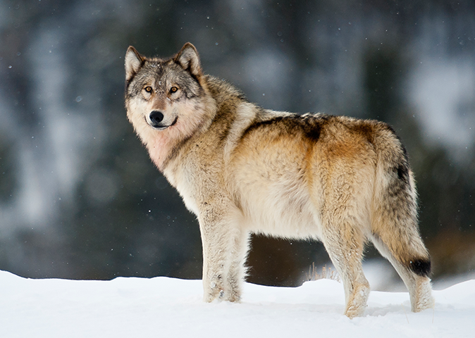
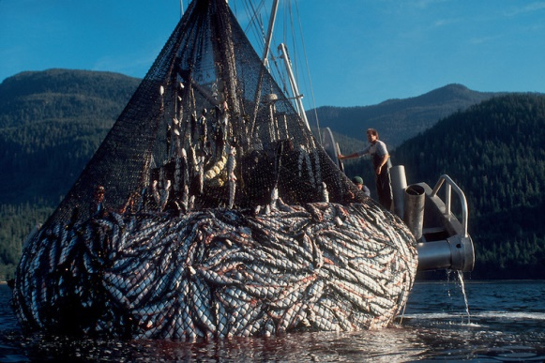
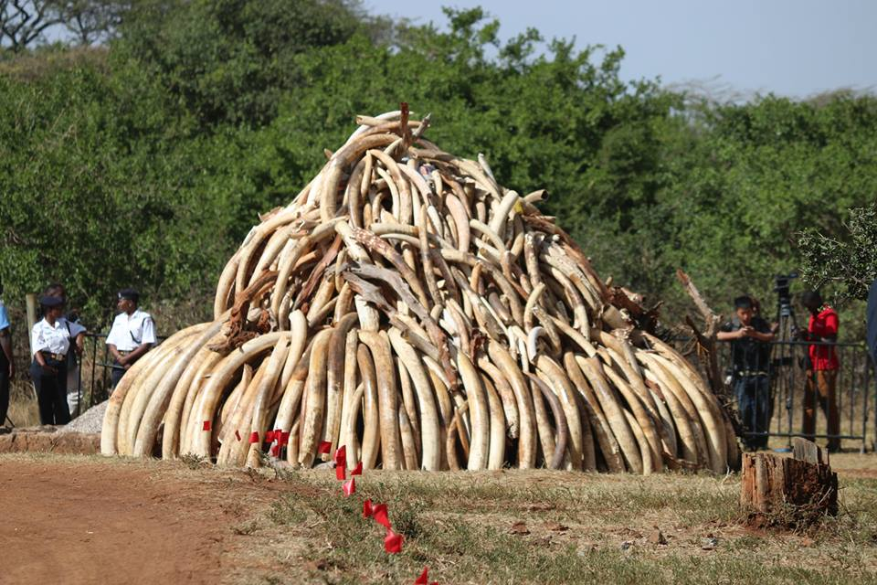
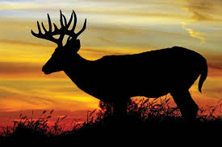
OverHunting and overfishing
Overhunting game animals (like deer) or predators (like wolves)
Species Trading (elephant tusks/ivory)
Too much fishing in one place
Efforts to protect wildlife
Hunting and fishing are managed to try to keep a balance
Special protections and care for Endangered Species
Notes:
REVIEW slide
SAY: Remember every species depends on other species to survive. Overhunting and overfishing cause a species imbalance.
OPTIONAL explain the bullet points and pictures by saying:
Species trade is a very big problem in many countries.
Plants and animals (some already endangered) are taken from their natural habitats and sold, traded or made into various products.
Products like gifts made of ivory from elephant tusks, coral, sea turtle shells and reptile skins or traditional Chinese medicines.
Commercial overfishing uses massive fishing nets that result in “bycatch”.
Unwanted fish are caught in nets and then thrown away (like sharks).
Also nets have heavy weights that drag across the bottom of the ocean destroying coral reefs.

Slide 8
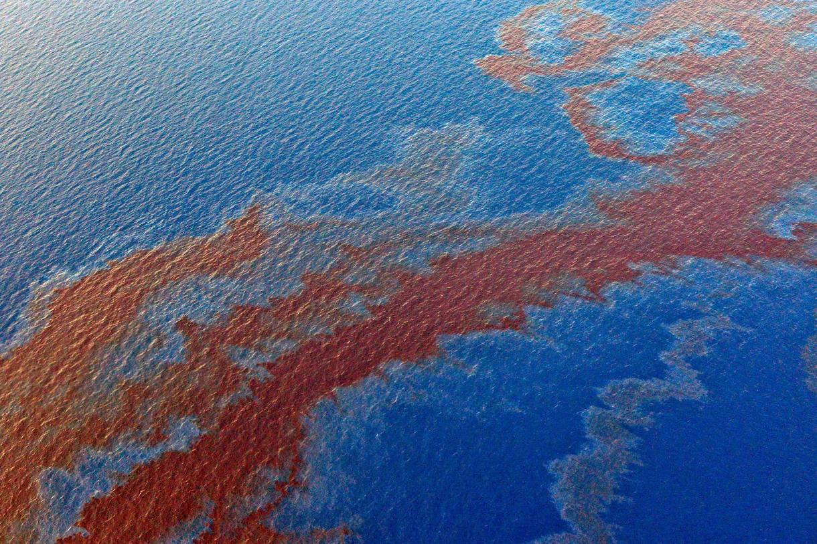
Pollution and Oil spills
Pollution is found in the air, water and on land.
Can be very Difficult to clean up:
  spreads quickly
  Takes a long time
  Expensive
Efforts to protect environment
When people make a big mess we make them clean it up.

Slide 9
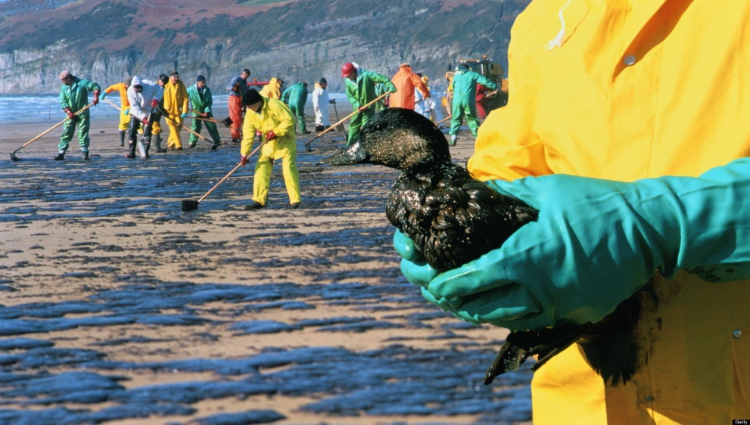
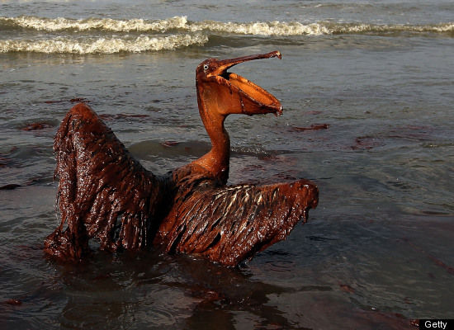
oil spills
Oil is used to fuel cars, heat homes, make plastics and many other everyday products.
oil crosses the ocean in shipping tankers… spills can happen.
SOME past SPILLS had millions of gallons of oil.
oil is harmful to fish, birds, and other animals.
Cleanup can require thousands of workers, tons of equipment, and years of hard work – it’s a real mess!

Slide 10
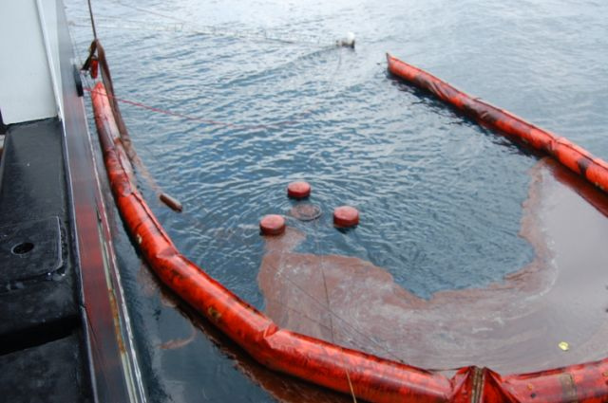
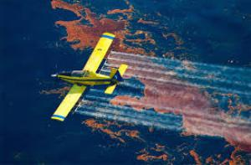
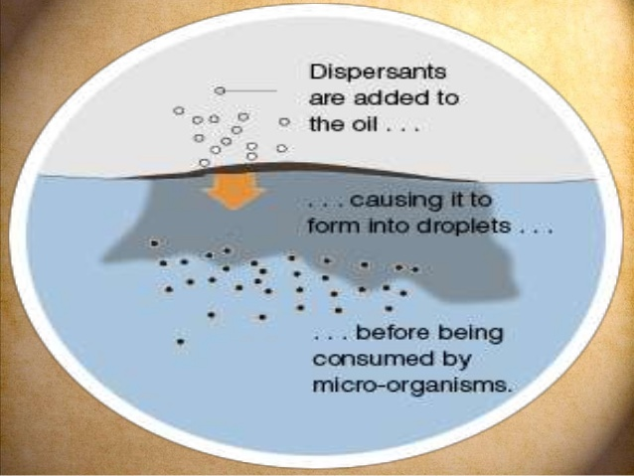
How do you clean an oil spill?
Use a floating boom to keep the oil from spreading.
Scoop the oil up by “skimming” it off the top of water.
Use a “dispersant” to spread it out, so it is not concentrated in one area.
Wait for ocean organisms to eat the oil (Natural breakdown).
Spread little organisms (Biological agents) into the water to eat the oil.
Notes:
ASK: Does anyone have any ideas for how you clean up an oil spill?
ADVANCE to reveal bullet points and pictures.

Slide 11
Let’s try an experiment
Pretend You are a group of environmental engineers who have been asked to clean up an oil spill.
Together We will use different methods to contain and clean the spill.
Each group of engineers have the same materials to create an oil spill inside a boom and attempt to remove oil by skimming, absorbing, and dispersing.
BUT FIRST…
Notes:
REVIEW the experiment while the students are STILL SEATED at the carpet.

Slide 12
What is a hypothesis?
A hypothesis is an idea you can test.
Scientists make a hypothesis and then test it with an experiment.
What is your hypothesis to the following question:
Will skimming, absorbing, or dispersing
be the best method for clean up?
Raise your hand when I say the one you predict will work the best.
One last thing, Before going back to your seats…
Notes:
ASK: What is a hypothesis?
REVIEW slide

Slide 13
Instructions & materials
I am the lead environmental engineer.
The whole class does each step together as I explain what to do.
Everyone gets a turns to try all the methods.
Please don’t touch the items at your table until I say.
Now let’s Go back to your seats.

Slide 14
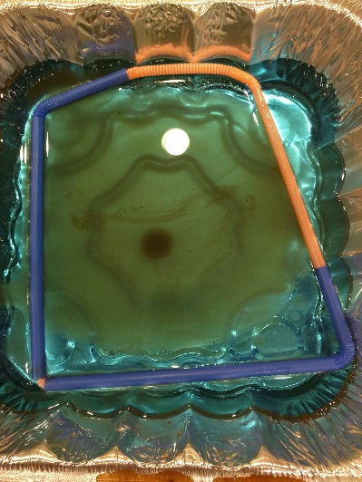
CREATE your oil spill inside the boom
Make sure your boom lies flat on the table (no raised corners).
Put your boom in the ocean.
slowly pour all of the “oil spill” mixture inside the boom.
Notes:
The presenter will walk the students through the experiment step by step.
Helpers assist at the tables.
Review the steps with the students as they follow along.

Slide 15
Observations
Does the oil sink or float?
Does the oil stay together or separate and spread?
How well is the boom working?

Slide 16
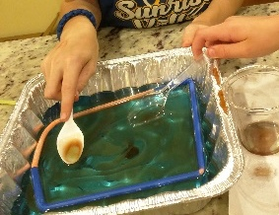
Skim
Clean up method one
Take turns Using the plastic spoons.
skim oil from the surface.
Avoid skimming water.
Put oil back in the “oil spill” cup.
Notes:
After everyone has had a turn, move on to method two.

Slide 17
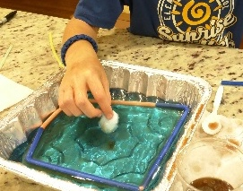
absorb
Clean up method two
Use one cotton ball at a time to absorb the oil. Avoid absorbing water.
squeeze the oil into the cup.
Leave used cotton balls on the table.
observations
  What do you notice about your oil spill cup?
  Do you have more oil or water?
Wash hands with soap after absorption method.
Notes:
After everyone has had a turn, move on to method three.
What do you notice about your oil spill cup? The oil and water separate.

Slide 18
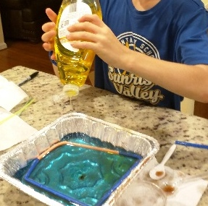
DISPERSE
Clean up method Three
Everyone watch the oil when the first drop of soap touches the oil spill.
YOUR TEAM WILL GET a syringe filled with dish soap.
add two drops TO THE CENTER OF THE OIL SPILL and THEN take turns adding the REST.
observations
  What DID THE DISPERSANT DO TO THE OIL?
Notes:
After everyone has had a turn, move on to method four.

Slide 19
Final observation
Were you able to collect all of the oil from the surface of the water?
cleaning up any mess can be hard, expensive, and take a long time.

Slide 20
Questions for discussion
Which of the three methods worked best: skim, absorb or disperse?
Was your hypothesis correct?
What is one important thing you learned?
humans can have a big impact on biodiversity, so we have to be careful and take steps to protect our environment.

