Slide 1
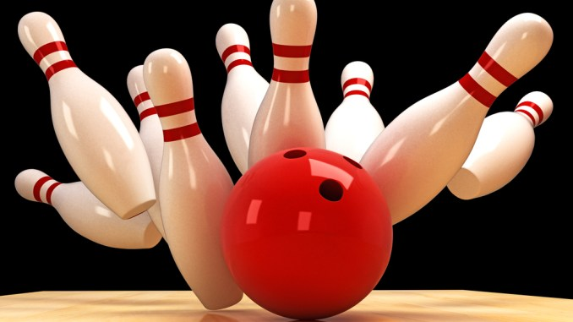
Force and Motion
Amazing Earth
1st Grade
Notes:
Presentation should take about 15 minutes to allow ample time for the activities. Please keep an eye on the clock.
TIPS:
Have students sit on the carpet so the presentation can be set up at their desks.
Limit questions or the number of students who can answer a question if time runs short.
Ask helpers to:
set up during the presentation.
familiarize themselves with the activity and its goal.
Thank you for making Amazing Earth possible!
Updated 12/12/19

Slide 2
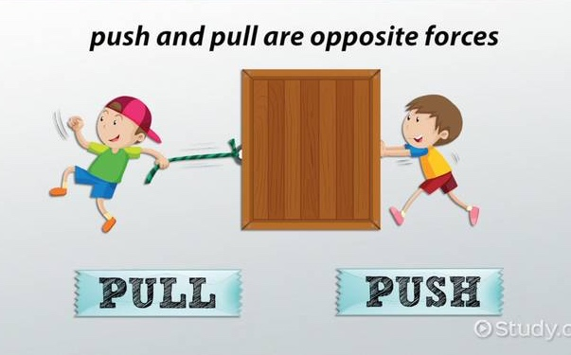
What is a force?
A force is a push or pull.
Force happens around us all the time.
Notes:
ASK: what is a force?
ADVANCE to reveal the bullet points.

Slide 3
What is motion?
Motion is moving from one place to another.
Motion is caused by force.
Push the swing and the swing moves.
Pull the wagon and the wagon moves.
Notes:
ASK: what is motion?
ADVANCE to reveal bullet points.

Slide 4
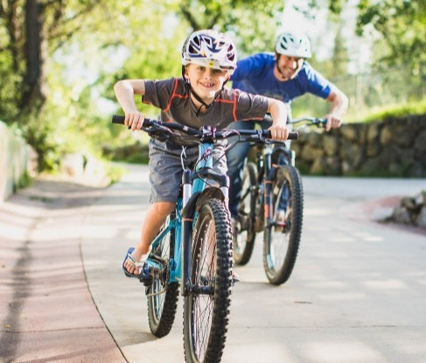
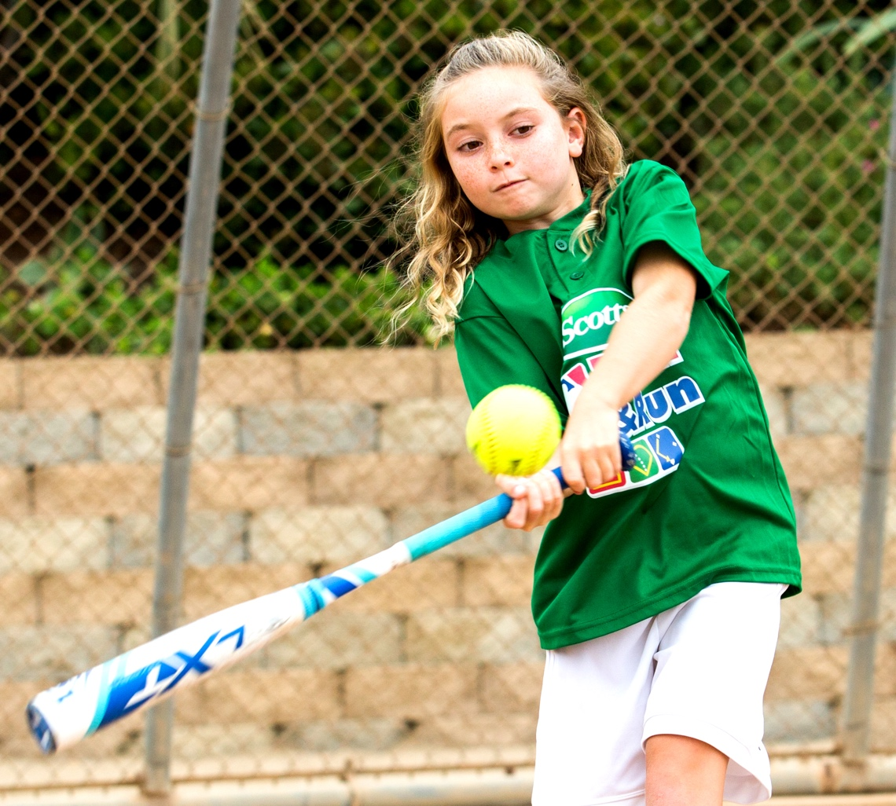
What happens when…
You push the bicycle pedals
harder and harder?
You hit or kick a ball?
Notes:
ASK the students and emphasize these answers:
The bike moves faster.
The ball changes direction.

Slide 5
Force and Motion
Pushes and pulls (force) can change speed and direction. Force can:
  Start or stop motion.
  Speed motion up or slow motion down.
  Change the direction of the motion.
Hitting the ball changes the direction of the ball’s motion.
A bigger push or pull makes things speed up or slow down more quickly.

Slide 6
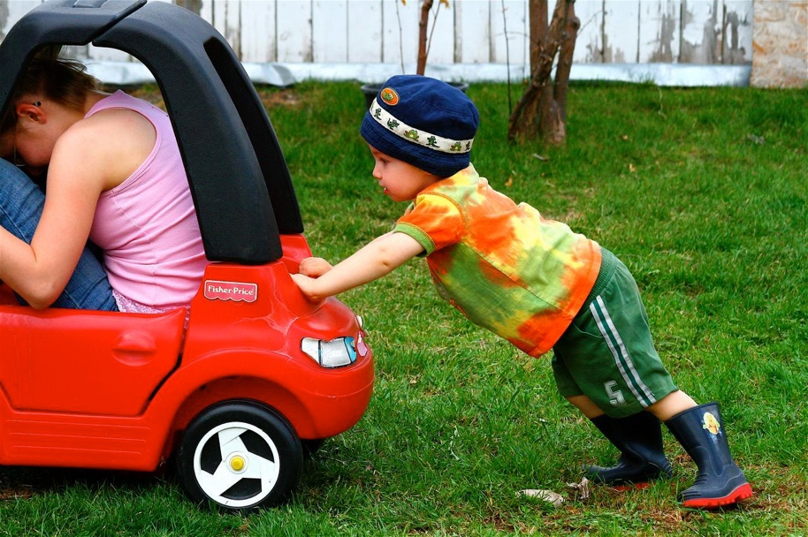
Types of forces that set an object in motion
An object can be set in motion by forces that come from:
Direct Contact
Moving Air
Magnets
Gravity
Notes:
Gravity is pulling an object down toward the Earth.

Slide 7
Friction
Friction slows down moving objects!
Do you walk faster in a swimming pool or on the street?
Do you ski (or sled) faster on snow or on grass?
That’s friction slowing you down!
Notes:
Optional description. In depth review of friction is not advised.
Friction is force that works in the opposite direction.
When you’re trying to push through the water, the water is pushing back, slowing you down.

Slide 8
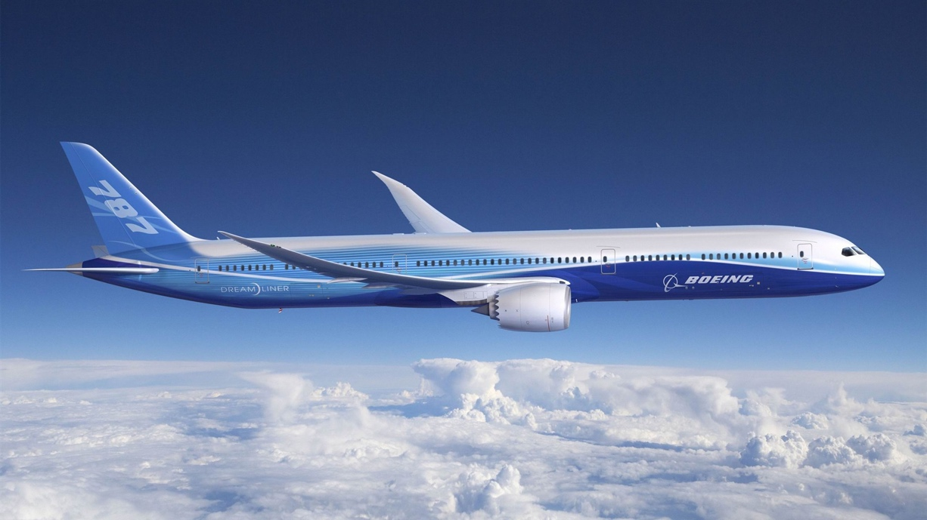

Some ways objects move
Straight
Spin
Back and forth
And many more!

Slide 9
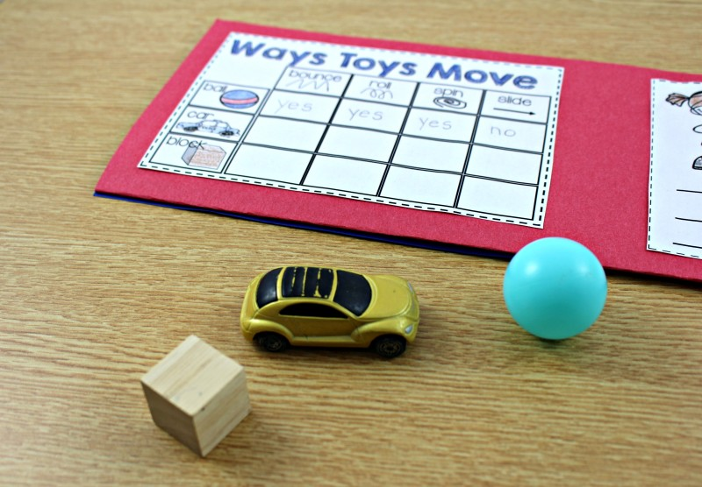

Force and Motion Stations
Four groups rotate through four stations:
Station 1: Move the metal ball.
Station 2: Friction, it’s always slowing me down!
Station 3: Build and fly paper airplanes.
Station 4: Ways toys move.
Notes:
Break the students into four groups and rotate through the stations as time allows.

Slide 10
Review
What is one thing you learned today?
Notes:
As time allows, invite the students back to the carpet for a quick review while helpers clean up.

