Slide 1
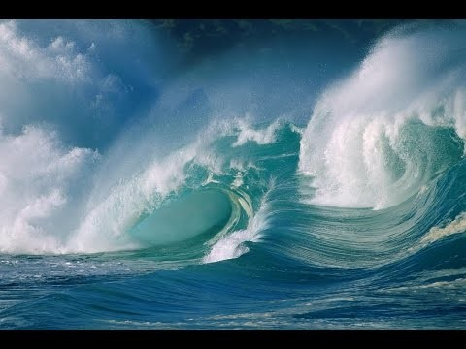
OCEANS
4th grade Amazing Earth
Notes:
Presentation should take about 15-20 minutes to allow ample time for the activities. Please keep an eye on the clock.
TIPS:
Have students sit on the carpet so the presentation can be set up at their desks.
Limit questions or the number of students who can answer a question if time runs short.
Ask helpers to:
set up during the presentation
familiarize themselves with the activity and its goal
Thank you for making Amazing Earth possible!
Updated 1/12/23

Slide 2
What is an Ocean?
An ocean is a large body of saltwater that fills the space between continents.
Oceans cover around 71% of the Earth’s surface.
The ocean is divided up into 5 major oceans, but they are actually all connected together.
Earth’s Surface is:
Take a Guess
30% - Pacific Ocean
29% - Continents & Islands
20% - Atlantic Ocean
14% - Indian Ocean
4% - Southern Ocean
3% - Arctic Ocean
Of all the Earth’s water, what percentage is saltwater vs freshwater?
97% vs 3%
Notes:
Ask: what is an ocean?
Click to advance.
Most of the Earth’s freshwater is frozen in Glaciers and Ice Caps.

Slide 3
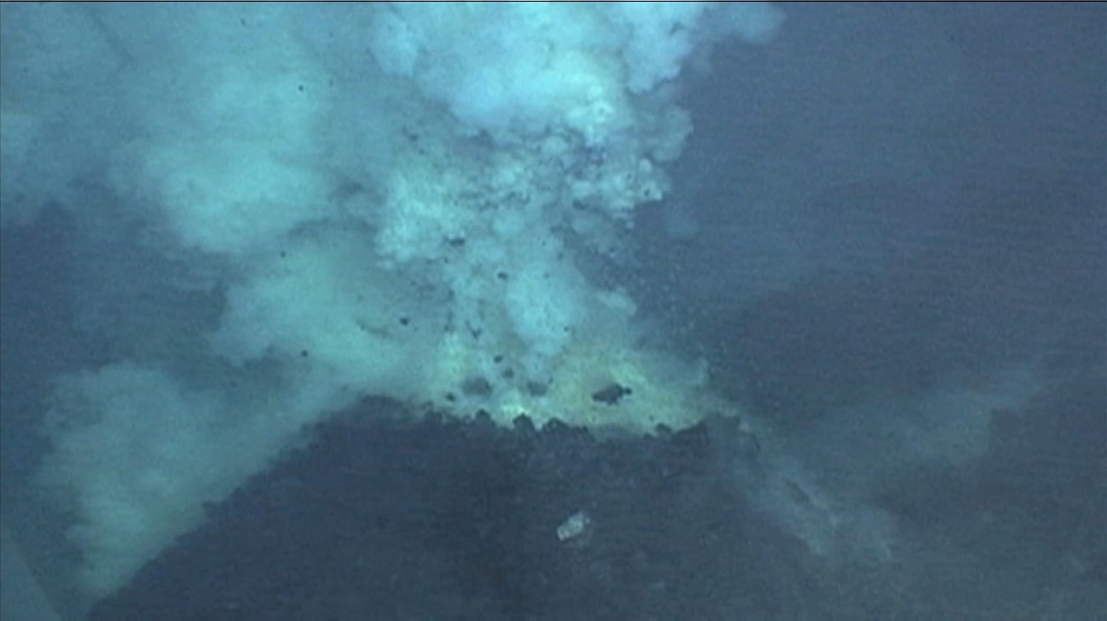
Beneath the World’s Ocean
Rugged mountains
Active volcanoes
Vast plateaus
Almost bottomless trenches

Slide 4
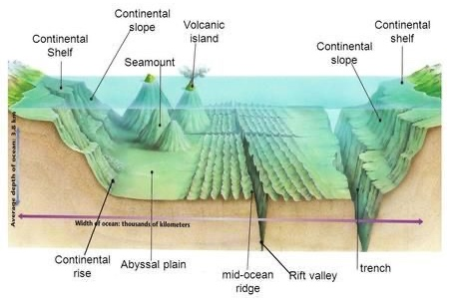
Ocean Floor
Important features include:
continental shelf (relatively shallow)
continental slope
continental rise
abyssal plain (flat area)
ocean trenches
The deepest ocean trench, the Mariana Trench, could easily swallow up Mt. Everest, the tallest mountain on land.
Notes:
36,000 ft (7 miles) vs Mt Everest at 29,000 ft (5.5 miles)

Slide 5
Ocean Zones and Ocean Life
The Ocean is divided up into different zones based on the distance from the shore and the depth of water.
Ocean life is very different in each zone because of:
the amount of sunlight and nutrients in each zone; and
the water pressure, temps and salinity (how much salt is in the water).
Let’s take a look at each zone on the next slides…
Sunlight Zone
Twilight Zone
Midnight Zone
Notes:
Intro slide to the concept. Explain the zones on the next slides.

Slide 6
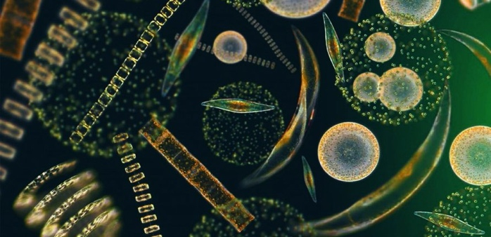
Sunlight Zone
0 ft
to
650 ft
Plant organisms
Animal organisms
90% of marine life and plants live here; also find coral reefs.
Fairly stable temperatures, low pressure and good oxygen.
Contains plankton, free-floating aquatic organisms. They are usually microscopic and form the base of every ocean food web.
Fun fact: Like plants on land, phytoplankton perform photosynthesis to convert the sun’s rays into energy. They also generate about half of the earth’s oxygen.

Slide 7
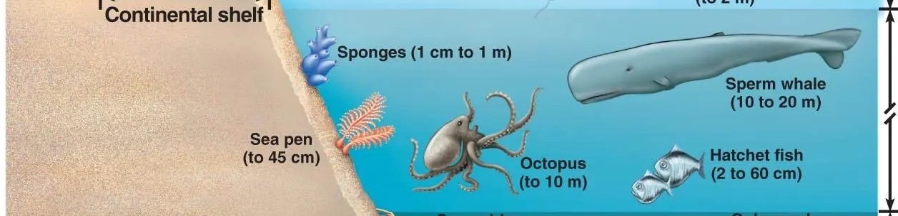
Twilight Zone
650 ft to 3,300 ft
Small amount of light, increased pressure, and temp is 40°F.
No plants since there is not enough light for photosynthesis.
Larger fish like, whales and giant squid dive here to feed.
Only animals adapted to little light survive, like bioluminescent fish and all sorts of bizarre looking fish.

Slide 8
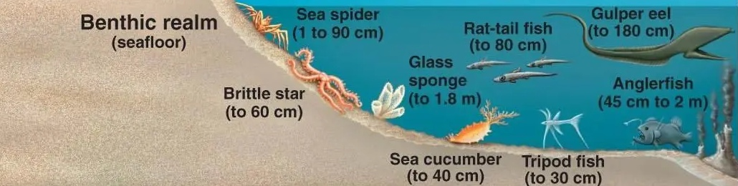
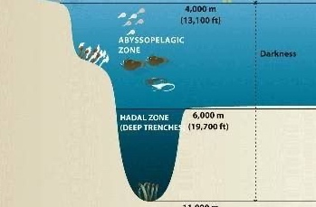
Midnight Zone
3,300 ft
to
36,000 ft
90% of the ocean is in this zone.
No light penetrates; temps 32 to 43 °F.
Water pressure is extreme (4,000 lbs/sq inch).
Mostly there are invertebrates like starfish and tube worms but fish, eel & other life exists in the upper level of the midnight zone.
The few animals that live in the trenches (sponges, sea cucumbers, tubeworms) rely solely on dead matter that falls from oceans above.
Fun Fact: pressure in the trenches can reach 16,000 pounds per square inch. That is like holding the weight of 48 huge airplanes in your hand.

Slide 9
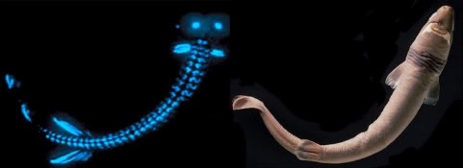
What types of Adaptations are there for
Survival and Feeding in the Dark?
Bioluminescence
ability to create light. It is a chemical reaction inside a light producing organs.
Echolocation
ability to produce a sound or sonar click that is reflected back when it strikes an object.
Lateral lines
series of tiny sensory organs that help detect the movements and vibrations in the sea.
Notes:
SAY: Predators in the deep sea must be either very efficient or should be capable of enduring for long periods without food.
ASK: Can you think of any adaptations or features that deep sea fish have for survival against the harsh darkness and scarcity of food?
ADVANCE for answers.
Cookie Cutter Shark. ­ The bioluminescent belly helps the shark lure prey close enough to attack itself via suction
Lateral Lines. – the purple marking indicates the lateral line along the fish and the green indicates the water movement

Slide 10
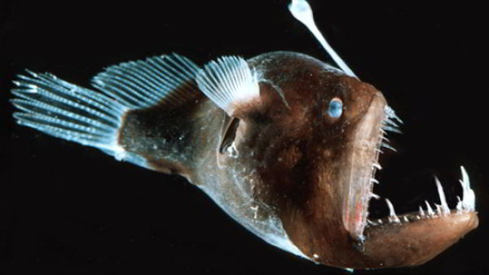
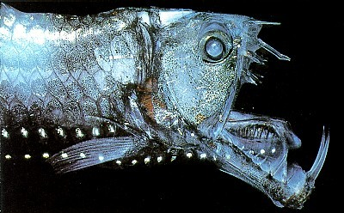
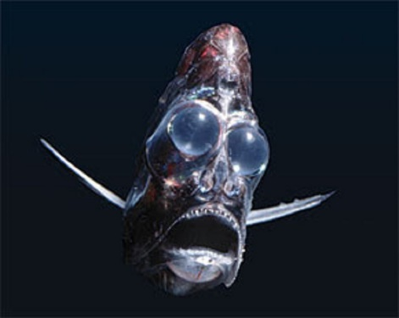
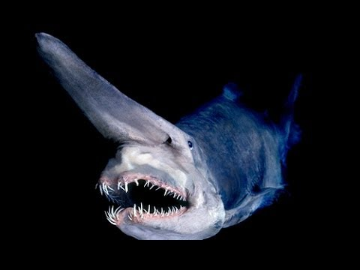
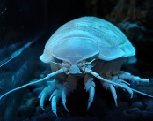
STRANGE CREATURES OF THE DEEP!
Viperfish
Anglerfish
Deep Sea Hatchet Fish
Goblin Shark
Giant Isopod

Slide 11
More Fun Facts
Coral reefs are the most diverse of all marine ecosystems.
Reefs cover less than 2% of the ocean bottom, yet amazingly, 25% of all ocean species depend on reefs for food & shelter!
Coral is not rock. It is tiny little animals that live on the outside of the reef.
The Dead Sea is one of the saltiest bodies of water at 34% vs ocean’s average of 3.5%.
The Dead Sea’s high salinity levels mean that people can easily float on its surface due to its natural buoyancy.
Less than 5% of the Earth’s oceans have been explored.
While there are hundreds of thousands of known marine life forms, scientists estimate that about one million species of animals live in the ocean.

Slide 12
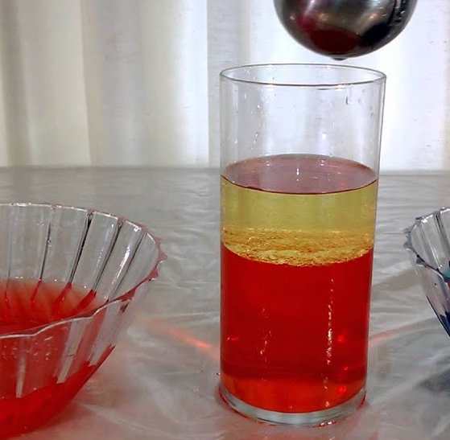
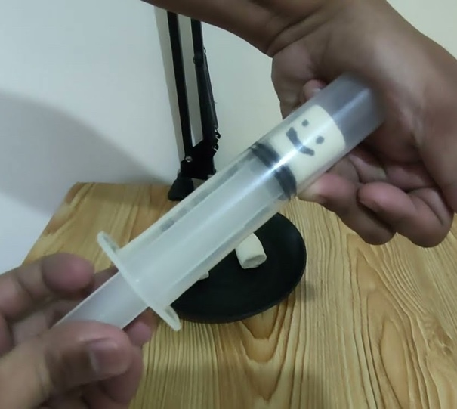
Ocean Activity Stations
Three Stations:
Sink or Float? A closer look at buoyancy and salinity.
The Salty Seas: How does salt content affect the weight and density of seawater?
Oh the Pressure! A closer look at the effects of low and high pressure environments.
Notes:
Break the students up into three groups to rotate through the stations as remaining time allows.

Slide 13
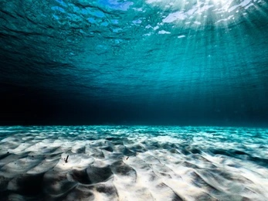
Review
What is one thing you learned about Oceans today?
Notes:
If time allows, invite the students back to the carpet for a review, while the helpers clean up.

