Slide 1
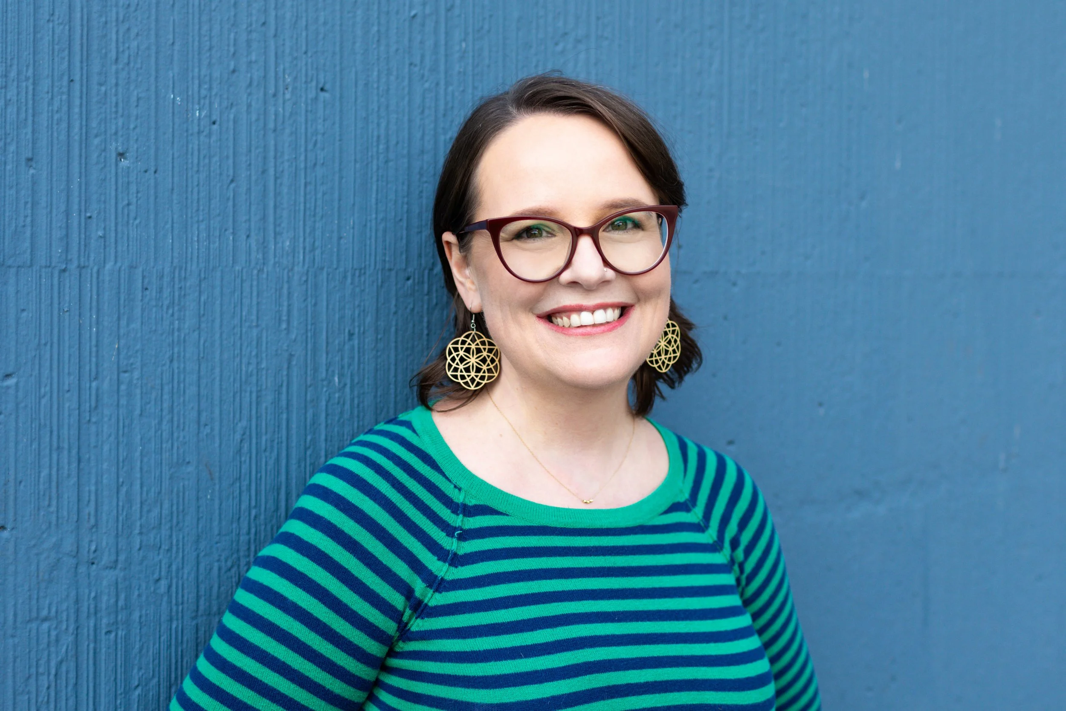
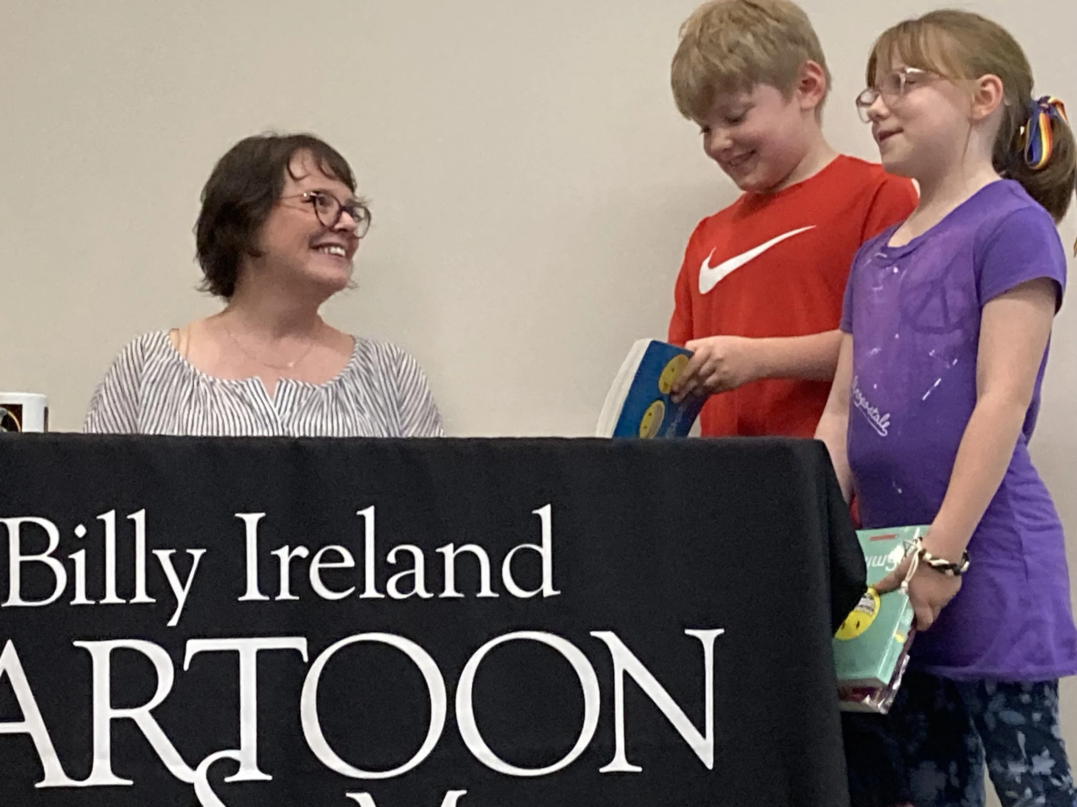
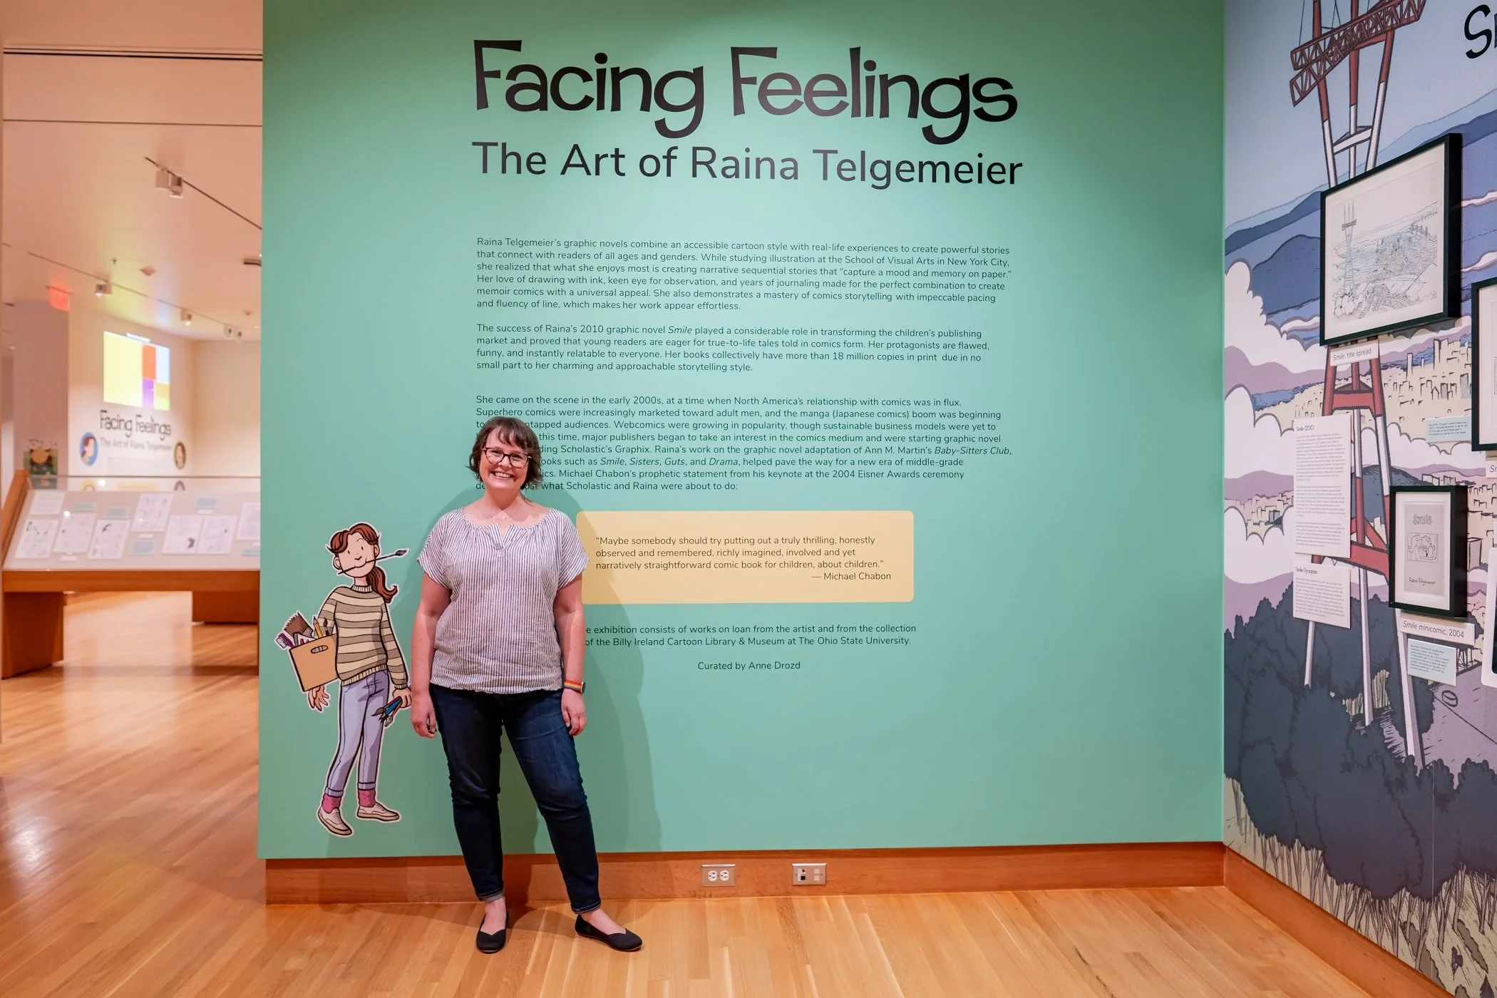
Raina Telgemeier
WHO IS
RAINA TELGEMEIER?
Notes:
1st photo – Photograph of Raina Telgemeier, GoRaina!, www.goraina.com
2nd photo – Raina Telgemeier stands against a wall that reads Facing Feelings: The Art pf Raina Telgemeier at the Billy Ireland Cartoon Library & Museum in Columbus, OH.
3rd photo – Raina signing books for two excited readers.
Many photos and information from Raina Telgemeier’s website: GoRaina!, www.goraina.com
PRESENTER NOTES:
Allow 10-15 minutes for presentation. Please feel free to cut and shorten where needed, focusing on the 3 BIG IDEAS.
BIG IDEA #1: Raina Telgemeier is a famous American cartoonist. She writes and illustrates popular graphic novels. Many of her graphic novels are best sellers and have earned multiple awards.
Does anyone recognize Raina Telgemeier’s name? Can you name any of her graphic novels? Have you read any of her graphic novels? What else do you know about Raina Telgemeier?
Her well-known works include the autobiographical novels Smile and Sisters.
She also wrote the fictional stories: Drama, Ghosts, and Guts.
. Raina Telgemeier was born on May 26, 1977. She is currently 48 years old.
She grew up in San Francisco, CA, and has two younger siblings.
Raina started reading comics in her local newspaper, The San Francisco Chronicle, when she was nine years old. Her favorites were Calvin and Hobbes and For Better or For Worse. She started making my own comic strips around the same time, and realized she liked putting pictures and words together to tell stories.
After high school, Raina studied illustration in college. She attended the School of Visual Arts in New York.

Slide 2
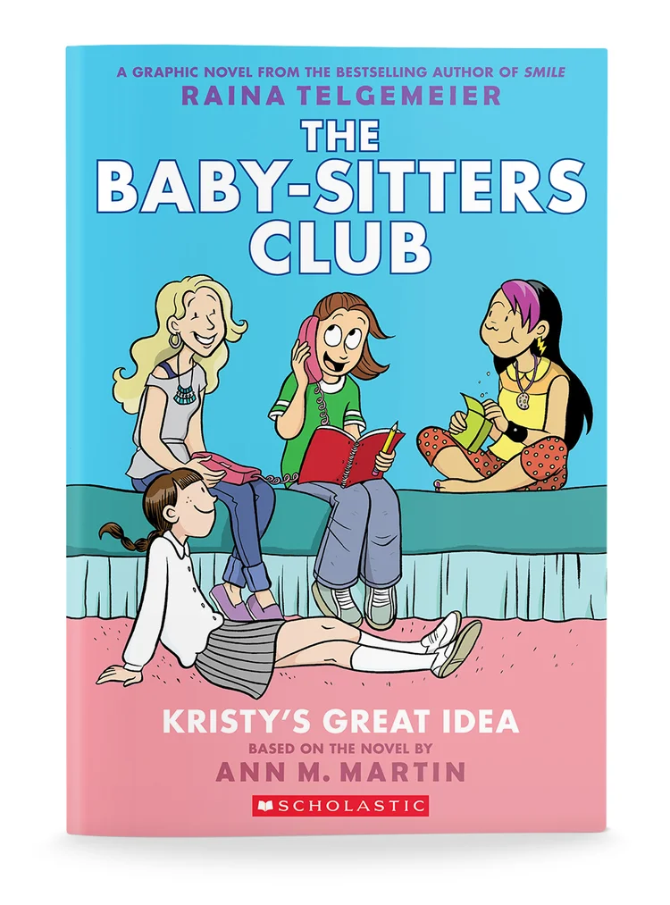
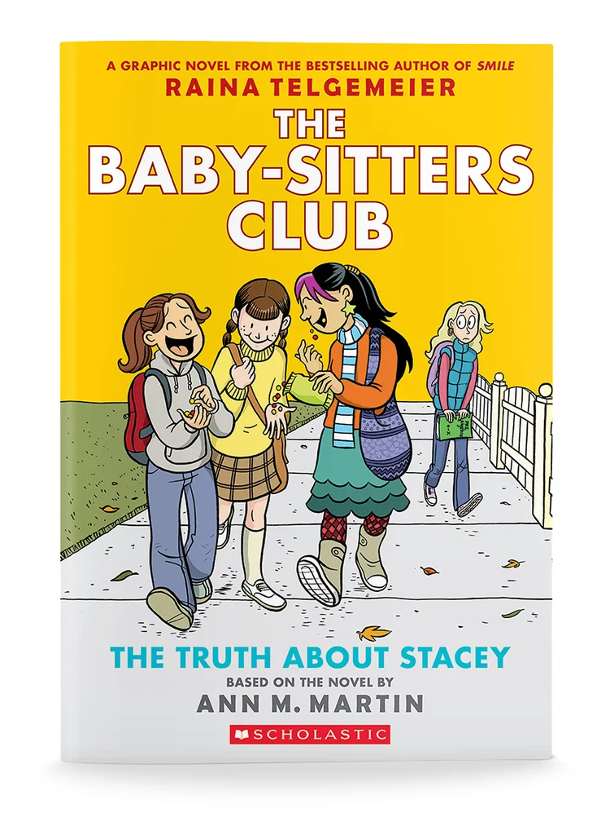
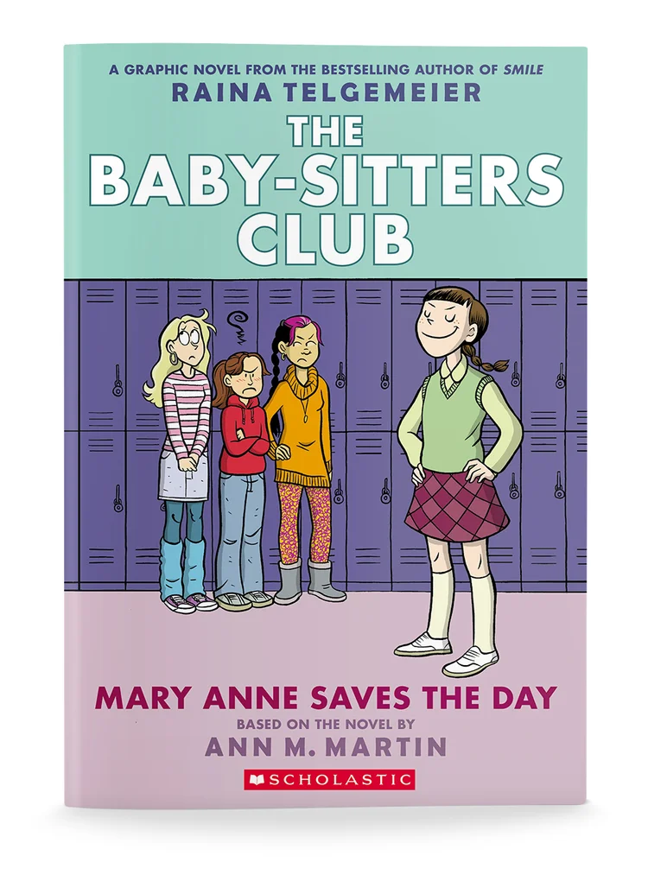
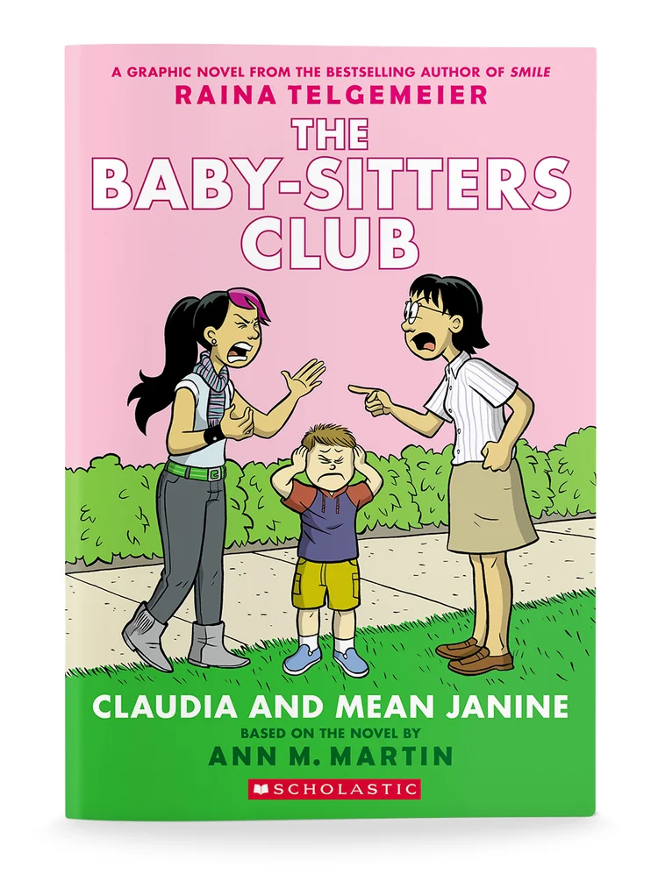
RAINA TELGEMEIER:
GRAPHIC NOVELS
Notes:
Covers of Raina Telgemeier’s graphic novels
Raina's big break came from adapting The Baby-Sitters Club novels. She met an editor from Scholastic in 2004. Scholastic was planning to start a graphic novel section.
Raina told them she was a big fan of Ann M. Martin’s The Baby-Sitters Club series, and that she read the series when she was young. Scholastic asked her to create a graphic novel version.

Slide 3
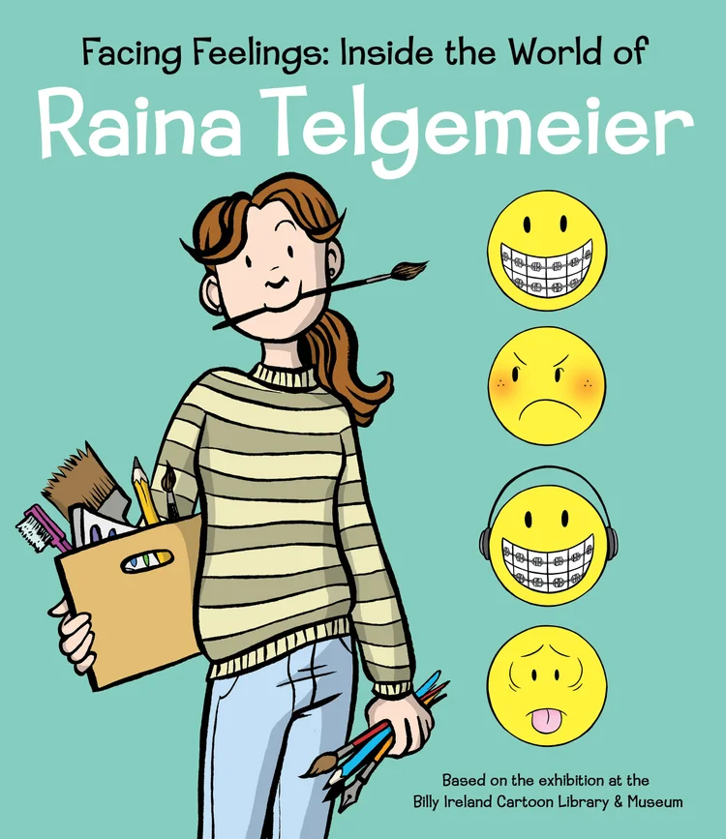

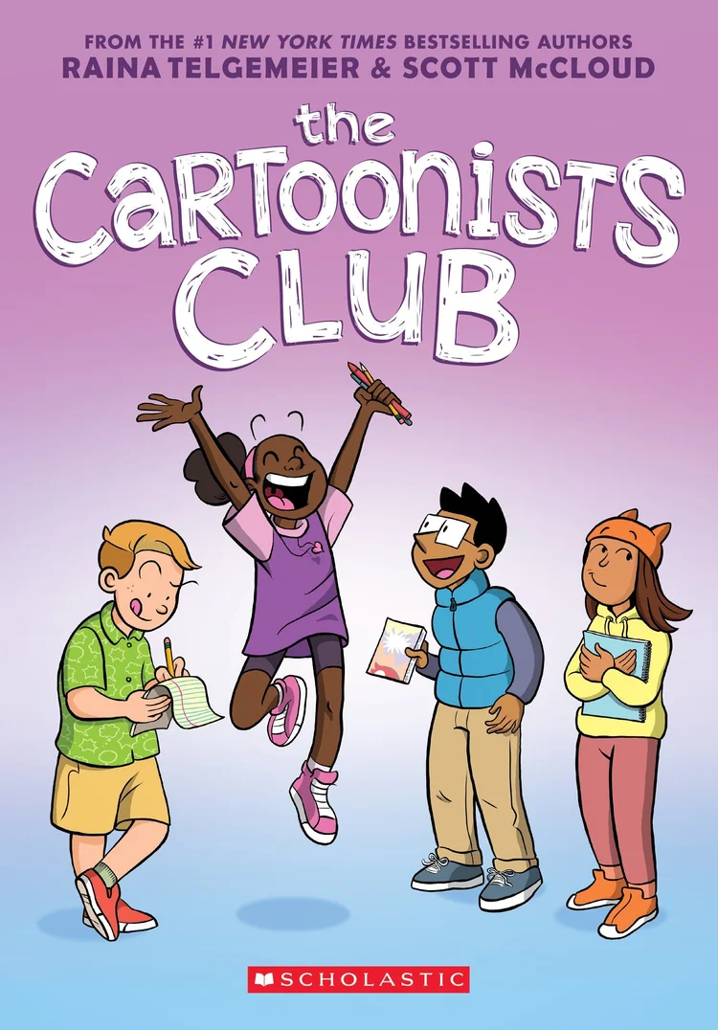
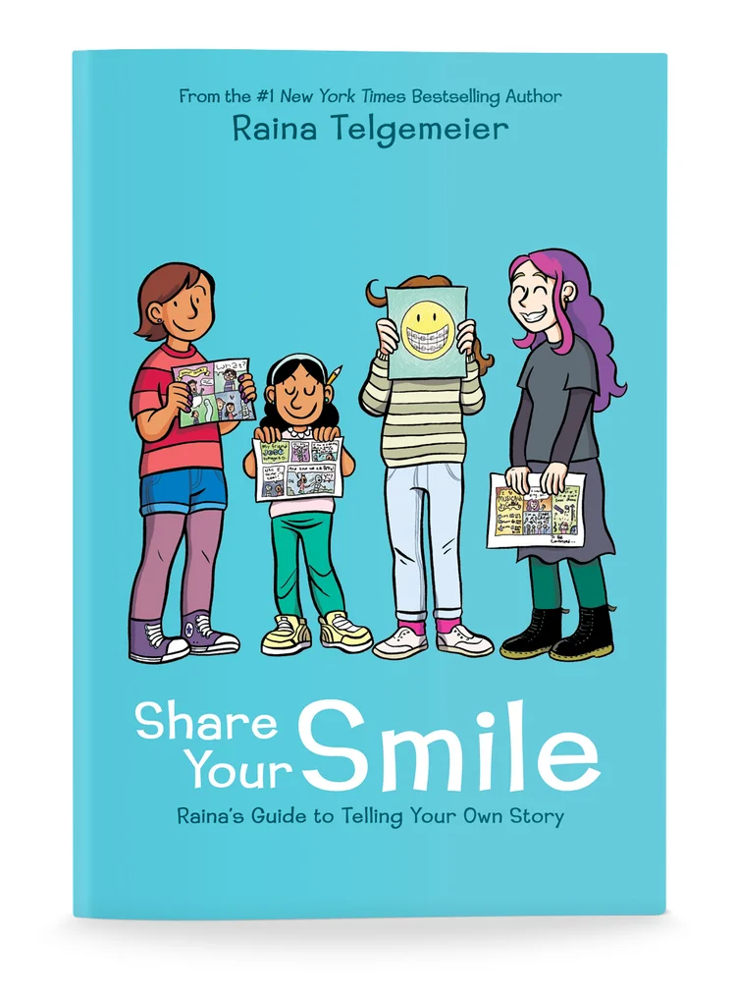
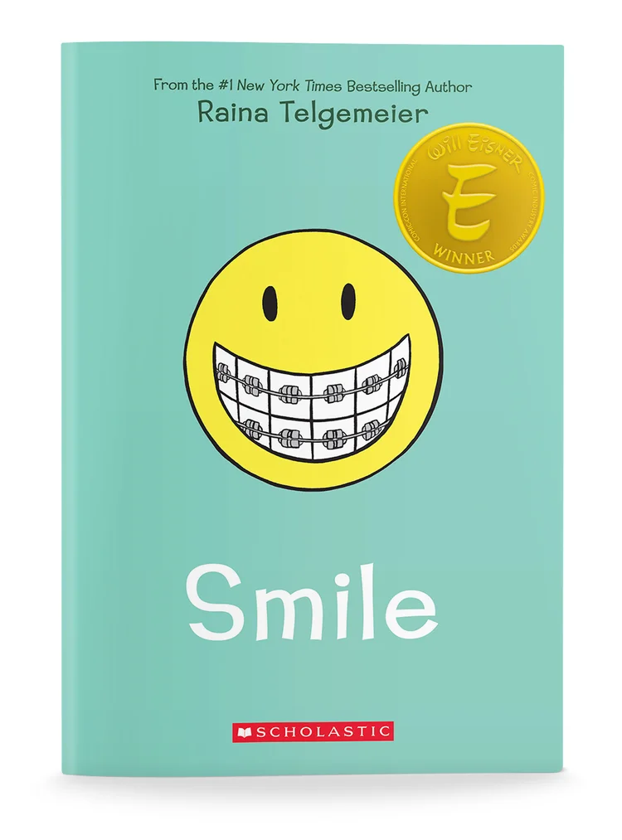
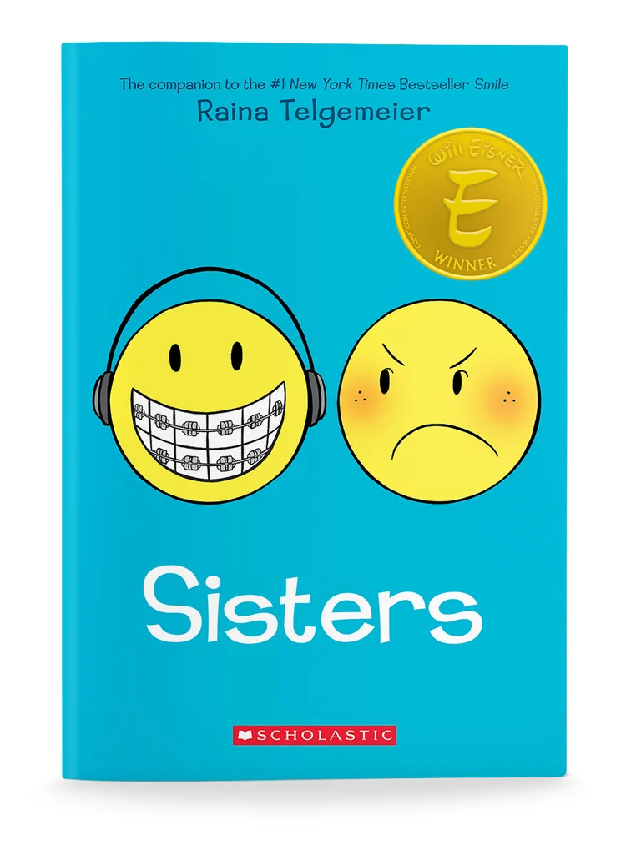
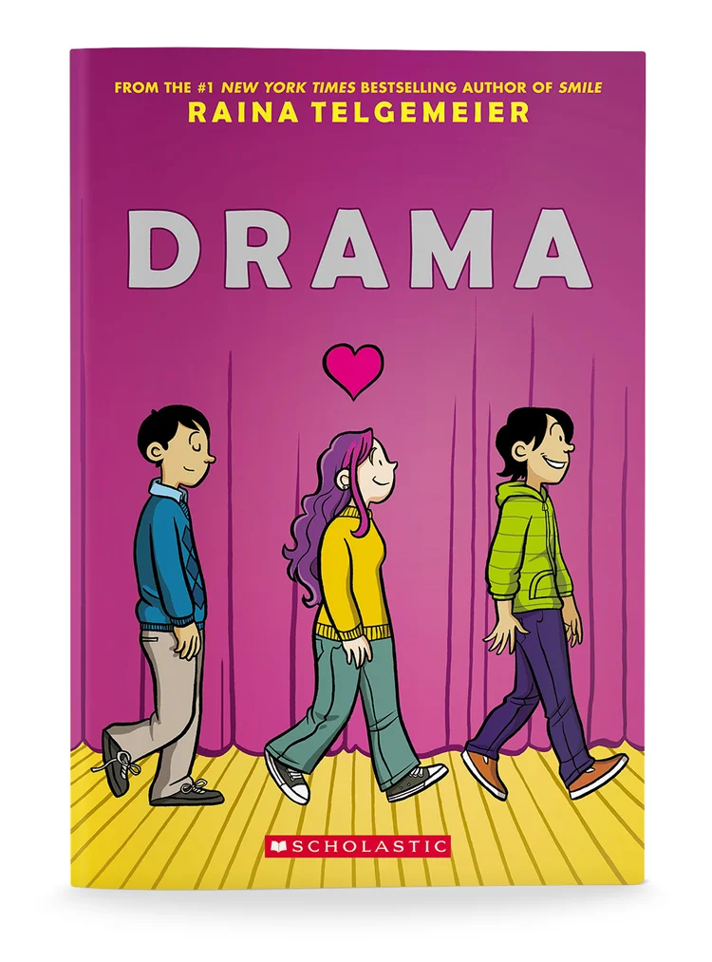
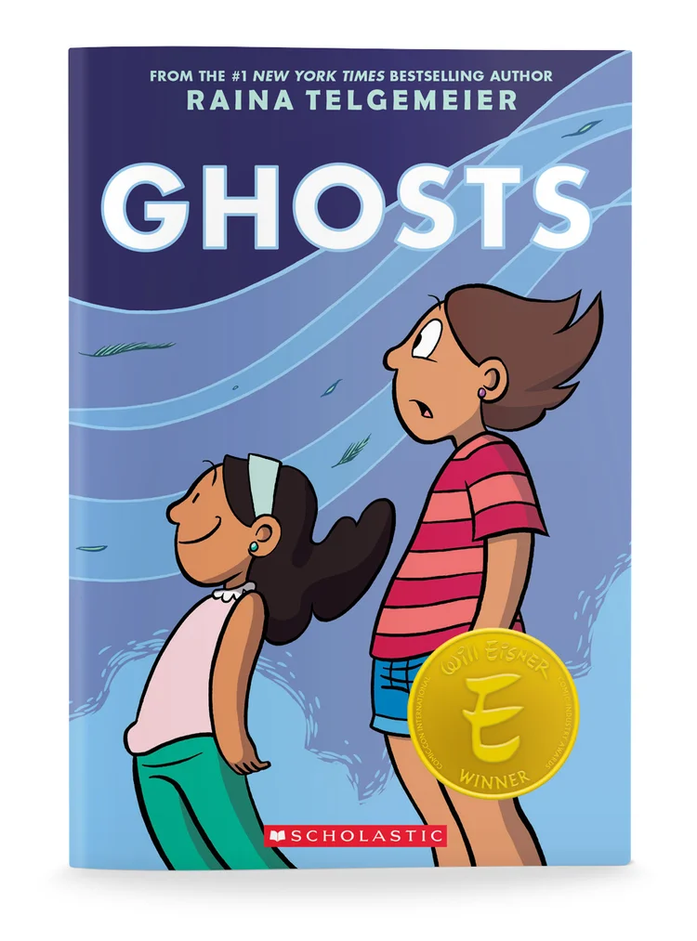
RAINA TELGEMEIER: GRAPHIC NOVELS
Notes:
Covers of Raina Telgemeier’s graphic novels
BIG IDEA #2: THEME and INSPIRATION
Raina Telgemeier’s work is mostly drawn from her life. Raina Telgemeier: “Simply put, my life inspired my work.”
She makes graphic novels, but there are many different types of graphic novels. Some of Raina’s graphic novels are considered autobiography and memoir, and some are considered realistic fiction.
Graphic novels are a format and medium. There are many different types (genres) within graphic novels.
Smile, Sisters, and Guts are considered autobiography and memoir, and sometimes non-fiction.
Smile is a true story about Raina’s childhood dental experiences, inspired by real events. The main character is Raina, and she relies on her memories to tell the story.
In Sisters, Raina uses her true-life stories for inspiration.
Drama was also inspired by real people in Raina’s life, as well as her love of theater. However, the story itself was made-up.
Drama is considered realistic fiction and slice-of-life.
Ghosts is realistic fiction with a supernatural flavor.
The Baby-sitters Club graphic novels are considered realistic fiction and slice-of-life.
QUESTIONS:
Can you name some types of graphic novels? Do you have a favorite type of graphic novel? Do you have a favorite genre (autobiography, non-fiction, fiction, etc)? What are your favorite graphic novels?

Slide 4
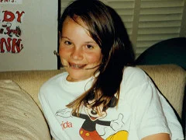
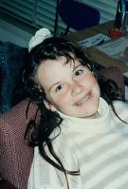
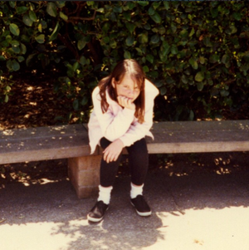
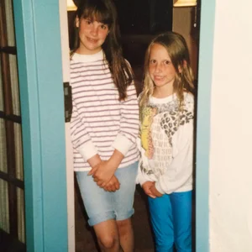
PHOTOS OF RAINA TELGEMEIER FROM THE TIME OF
SMILE AND SISTERS
7TH GRADE
8th GRADE
TWEEN RAINA
RAINA AND HER SISTER, AMARA
Notes:
Photos of Raina from the time of Smile and Sisters.
Smile Sisters are both based on Raina’s life.
In sixth grade Raina fell and knocked out her teeth, and since then she has had braces and surgeries. The comic Smile began as way for Raina to tell her story and share her experiences on paper, since she spent so much time telling people what had happened!
In Sisters, Raina uses her true-life stories for inspiration. She really does have a sister. And if you are familiar with this graphic novel—her family did take a road trip from San Francisco to Colorado Springs when she was 14. And Amara really did have a pet snake named Mango that got loose in the car.

Slide 5
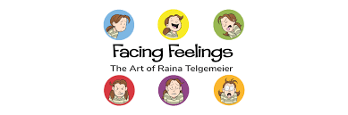
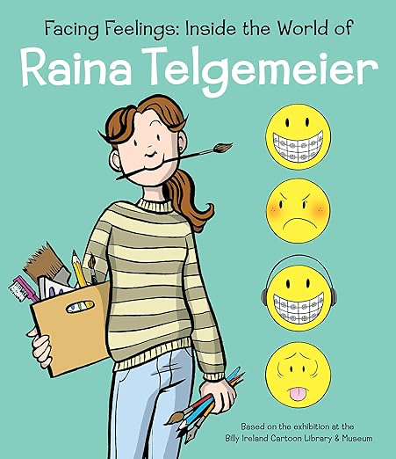
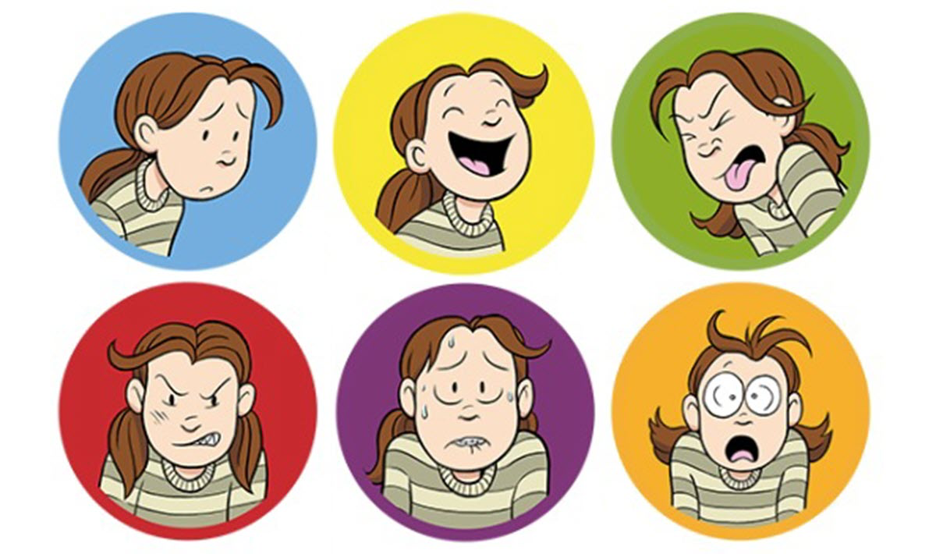
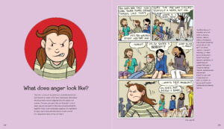
Facing Feelings
Notes:
Images from Facing Feelings
Raina’s popular books depict feelings and emotions young people may not want to or even know how to talk about with adults, like anger, anxiety, loneliness and embarrassment.
Raina believes it is very important to talk to people in your life about how you feel! She believes you can express yourself by writing it down, drawing pictures or comics, making music or plays, or simply sharing with your friends.
Her graphic novels spotlight feelings and what is going inside, with hopes that young readers can relate and see that it is okay to express yourself. Show how you are feeling on the outside.
Raina’s characters’ express feelings. She uses a variety of facial expressions to showcase emotions.
How can you tell if a character is sad, happy, sick, angry, scared, worried? What do you look for? Can you tell how a character is feeling by their eyes, nose, mouth, etc?
Facial Expressions: she focuses on the nuances of facial muscles to display anger, stress, and frustration.
Mirroring Emotions: she intentionally creates faces that allow readers to "reflect" the feeling back, making the reader feel what the character is experiencing.
The ”complex" nature of emotions: she demonstrates that emotions are not simple. For instance, presenting anger in combination with anxiety and vulnerability, particularly in, for example, her autobiographical works like Guts.

Slide 6
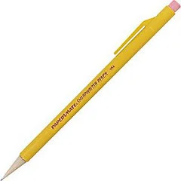
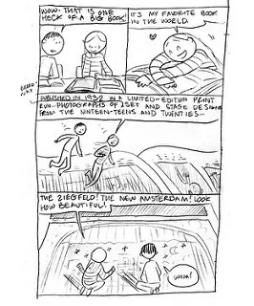
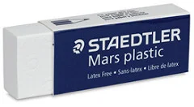
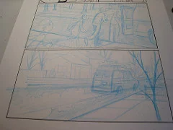
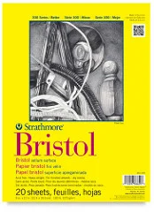
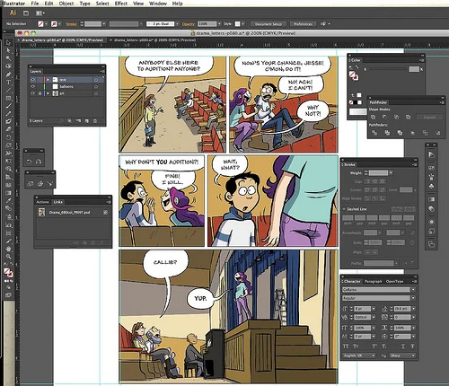
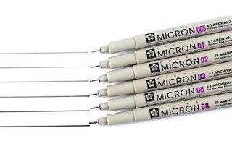
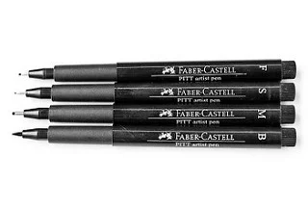
TOOLS
& MATERIALS
Notes:
Photos Raina’s supplies and tools she uses to make comics
BIG IDEA #3: TOOLS AND MATERIALS
IMPORTANT: Raina says there is no wrong way to make comics. Cartoonists use lots of different methods and mediums to create stories.
These are the tools and materials Raina uses: pencils, paper (plain white paper and thicker paper), eraser, special markers, a scanner to scan in her hand drawn images, and a computer.
For initial sketch: plain 8.5 x 11 paper
Then she creates a full-sized version of those sketches on Bristol board, using a Col-erase light blue colored pencil.
Finally, she inks over the penciled drawings with Dr. Martin's waterproof India ink and a no. 2 Windsor & Newton sable brush. After the inking she erases the pencil lines with a Staedtler Mars plastic eraser.
Her finished pages are scanned into a computer, and panel borders, lettering, and colors are all added digitally.
QUESTIONS:
What tools and materials do you like to use when you make comics or art?

Slide 7
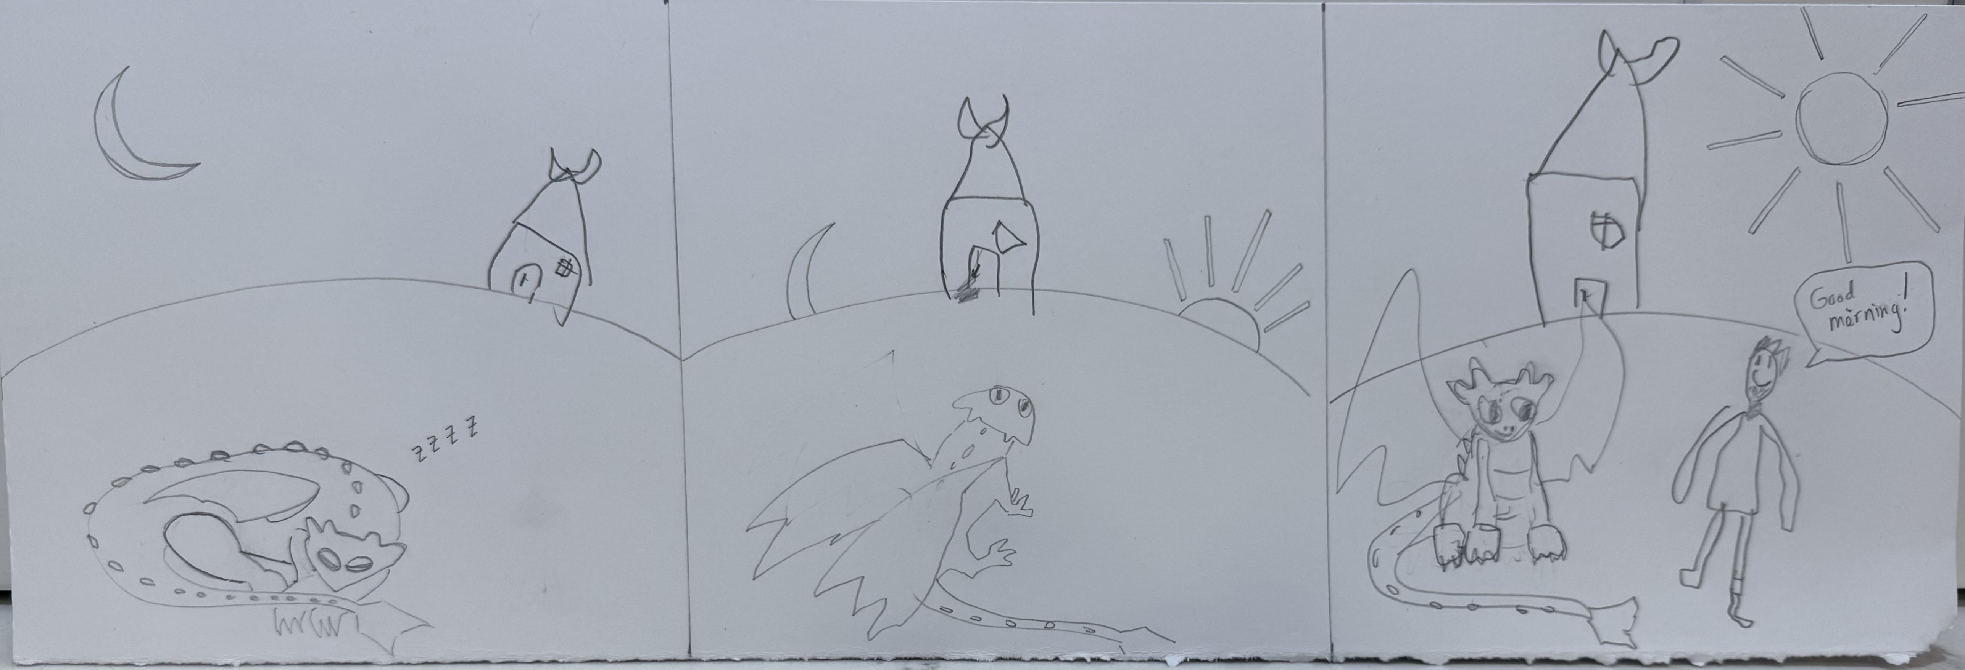
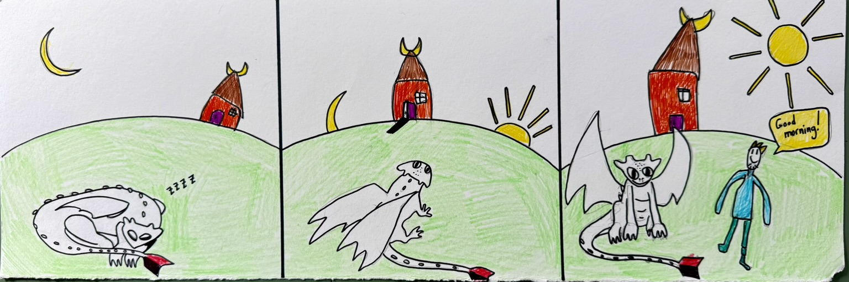
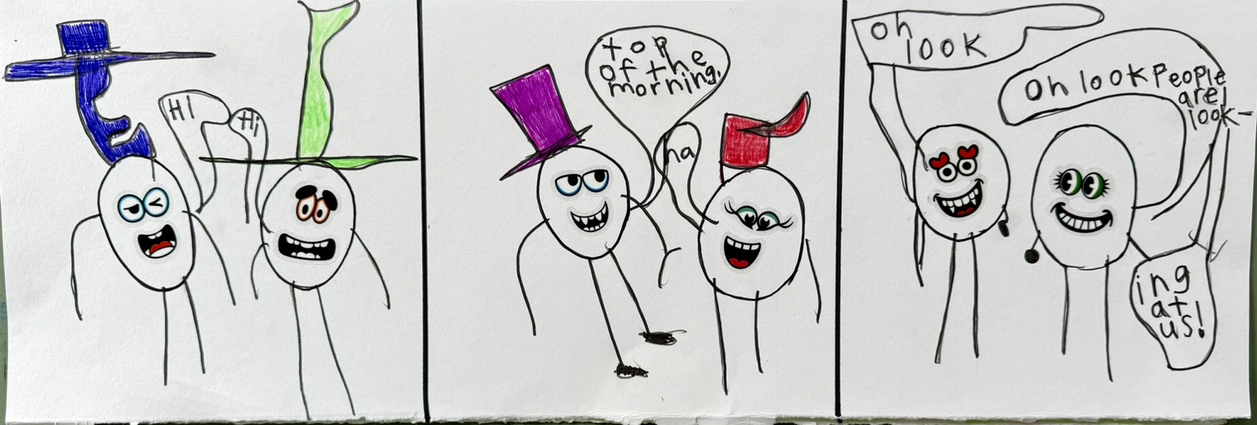
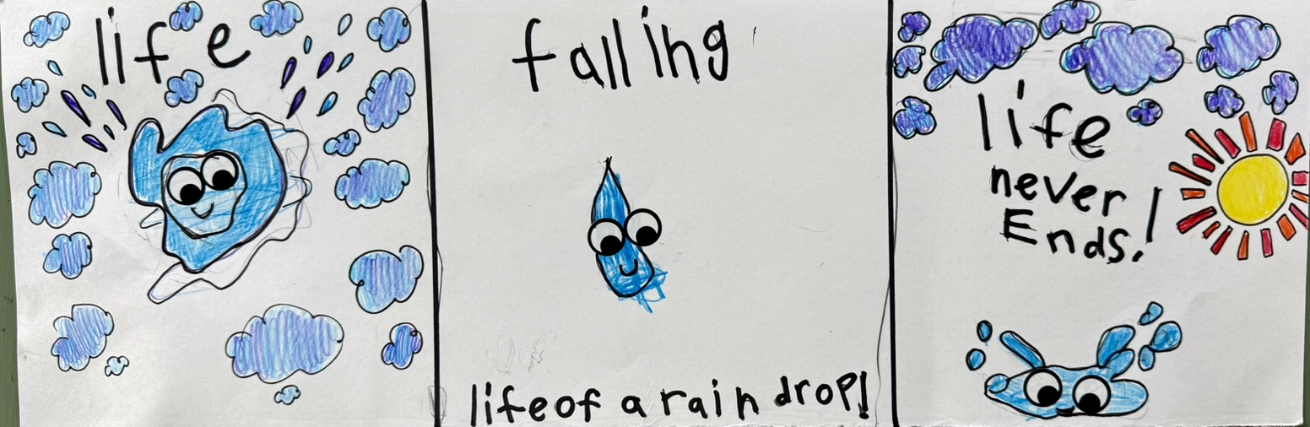
Art Project: Let’s be inspired by Raina Telgemeier!
Create your own comic.
Many of Raina’s comics are inspired by her own life and experiences. Is there a story from your life you want to tell? Something that has happened to you to use as inspiration?
Raina believes it is important to express your feelings. Can you make a comic about different emotions?
Notes:
Great Art Project Instructions – Raina Telgemeier
Project Description:
Students will learn about Raina Telgemeier and create their own comic inspired by Telgemeier.
Many of Telgemeier’s comics are drawn from her own life experiences and desire to express emotions.
Raina Telgemeier is a famous American cartoonist. She is the writer and illustrator of popular graphic novels, such as Smile and Sisters.
Grades: K - 6
Art Project: using white paper, markers, colored pencils, graphite pencils, various face (eyes, nose, mouth) stickers, students will create their own comic.
Optional: the art may be collected and displayed (dependent on the teacher’s approval) at the end of the session.
Reminders: remind students to sign their artwork.
Materials: all grades will use the same project materials, except K-2 will have some pre-drawn comic strip panels.
Per student: one sheet of white paper
Shared by students: markers, colored pencils, graphite pencils, rulers, face stickers
Considerations/ideas:
Use these supplies to create your own comic.
Raina was inspired by events in her life to make her comics. Is there a story you want to tell? Real or imagined?
Raina also likes to share her feelings. How could you create a character that shows different feelings? How do you draw someone sad or happy?
Experiment and have fun!

