Slide 1
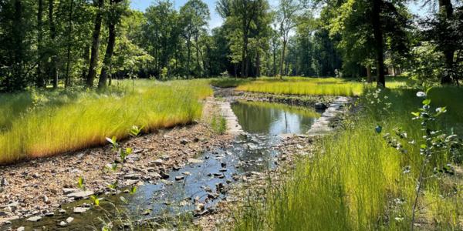
Ecosystems
Amazing Earth - 4th Grade
Notes:
Today we are going to explore ecosystems and how relationships within ecosystems can lead to balance or imbalance.
An ecosystem includes all the living organisms and the nonliving, abiotic, components of habitats.
The world is composed of many natural ecosystems in which plants and animals interact with one another and the nonliving environment.

Slide 2
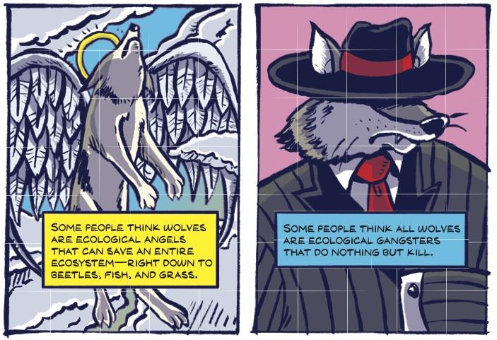
Ecological Angels?
Ecological VillAINS?
Notes:
With different species interacting with others in their ecosystem, could some species be considered undesirable or harmful to their ecosystem? Do you think some species could be removed from their natural ecosystem?
Let’s take the wolves in the Greater Yellowstone Ecosystem in Yellowstone National Park.
Are wolves ecological angels or ecological villains?
If you think they are angels who save ecosystems, move to the right side of the carpet.
If you think they are villains who are harmful to ecosystems, move to the left side of the carpet.
If you are unsure, move to the middle.
[Give the students a minute to move.]
Ok, let’s watch a video to learn more.

Slide 3
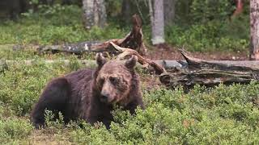
Notes:
[Click to play a 5 minute video on the wolves of Yellowstone.]
[If needed, video link: youtube.com/watch?v=Ql3rY-XyQ3k&embeds_referring_euri=https%3A%2F%2Fdocs.google.com%2F&embeds_referring_origin=https%3A%2F%2Fdocs.google.com&source_ve_path=MzY4NDIsMjg2NjY ]

Slide 4
Ecological Angels?
Ecological VillAINS?
Notes:
Has anyone changed their mind after watching the video?
Would anyone like to switch sides?
[Give the students a minute to switch sides if they want.]

Slide 5
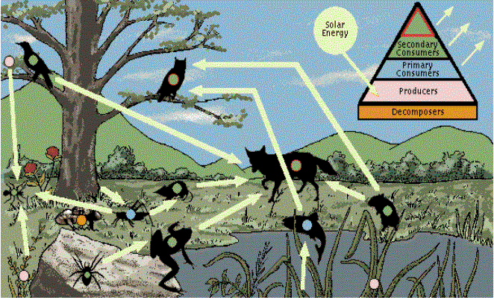
Notes:
Every animal either eats plants directly or depends on other species for food, which in turn depend upon plants.
These relationships form food chains in which energy is transferred from one organism to another.
Because most animals have multiple food sources, they are included in many possible food chains. Together, related food chains form complex food webs.
The sun is the energy source that fuels all food webs.

Slide 6
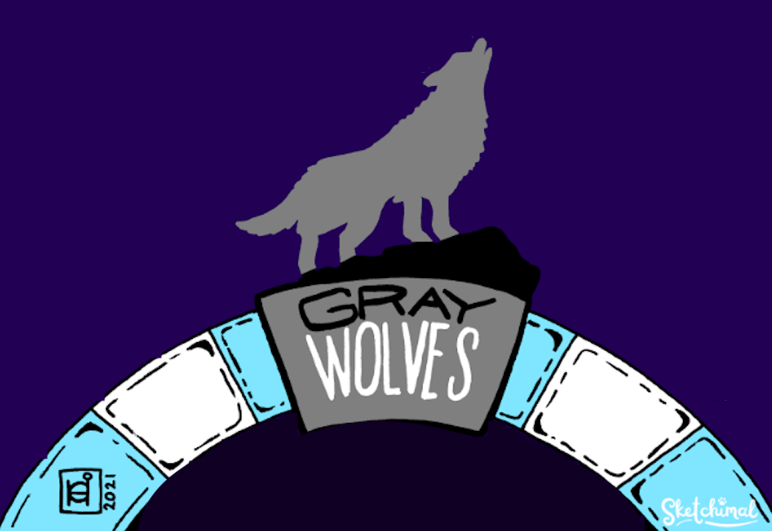
Notes:
Each species has a niche within the ecosystem and each is dependent on the others for survival.
Some species play an outsized role in their ecosystem.
In the Greater Yellowstone Ecosystem, wolves are one of these important species.
They are called keystone species.

Slide 7
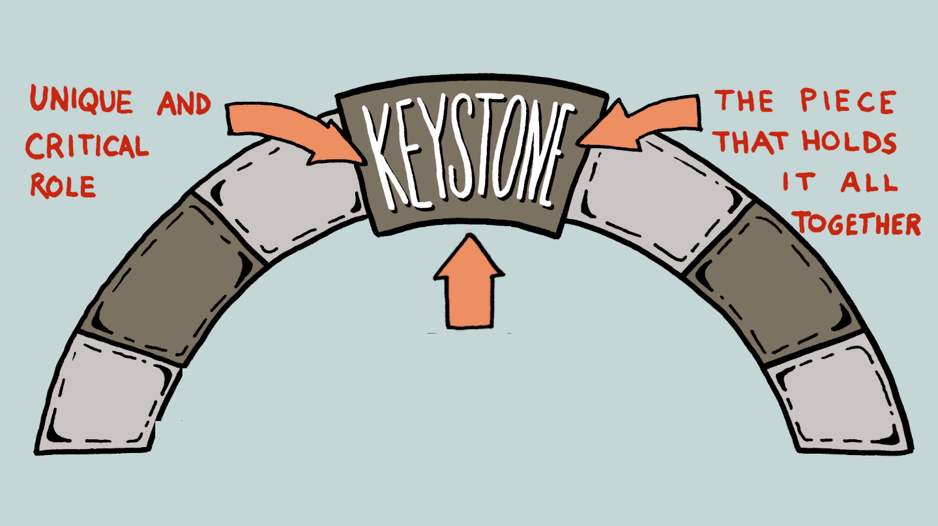
Notes:
A keystone is the stone at the top of an arch, that locks the whole arch together.
The keystone’s weight keeps the entire structure stable.
In ecology, a keystone species has a major impact on its ecosystem.
Keystone species play a very important role in keeping the ecosystem working.

Slide 8
Are there keystone species in Virginia?
Notes:
Are there keystone species here in Virginia?
[Let the students answer.]
We do not have to go all the way to Yellowstone National Park to see keystone species in action. We have amazing examples right here in our state and even in Reston.
Let’s look at one of our most important ecosystems, the Chesapeake Bay ecosystem.
Here are just a few of the many keystone species identified by the Virginia Department of Wildlife Resources and Fairfax County.

Slide 9
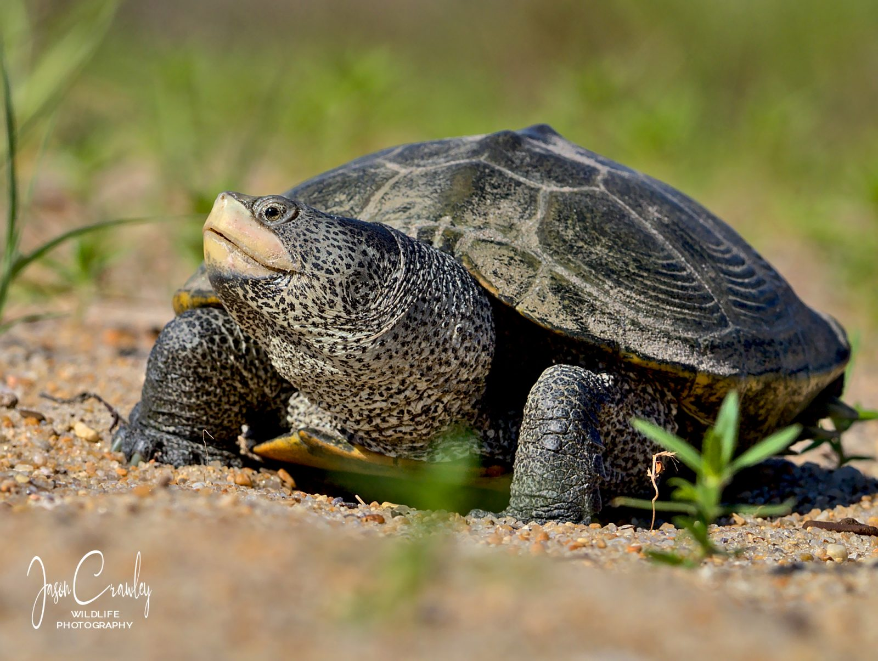
Notes:
The Northern Diamond-backed Terrapin.

Slide 10
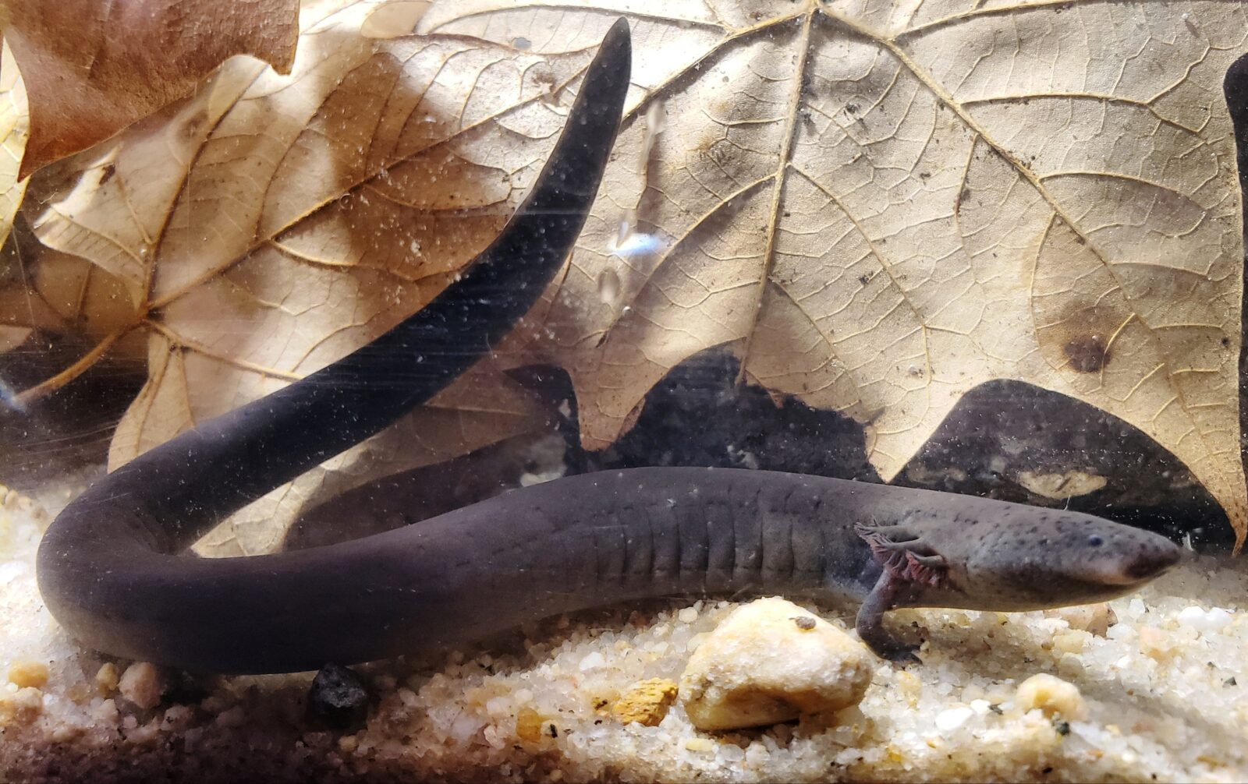
Notes:
The Eastern Lesser Siren Salamander.

Slide 11
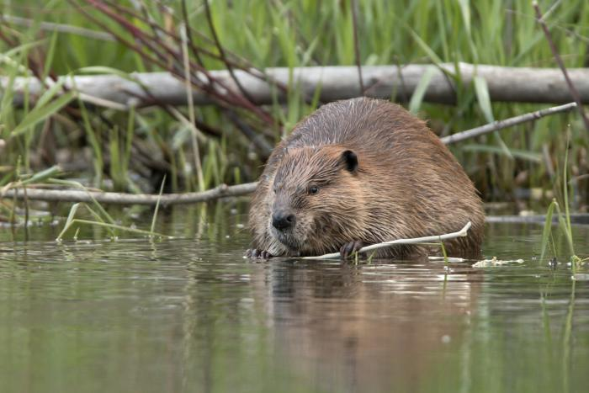
Notes:
The North American Beaver.

Slide 12
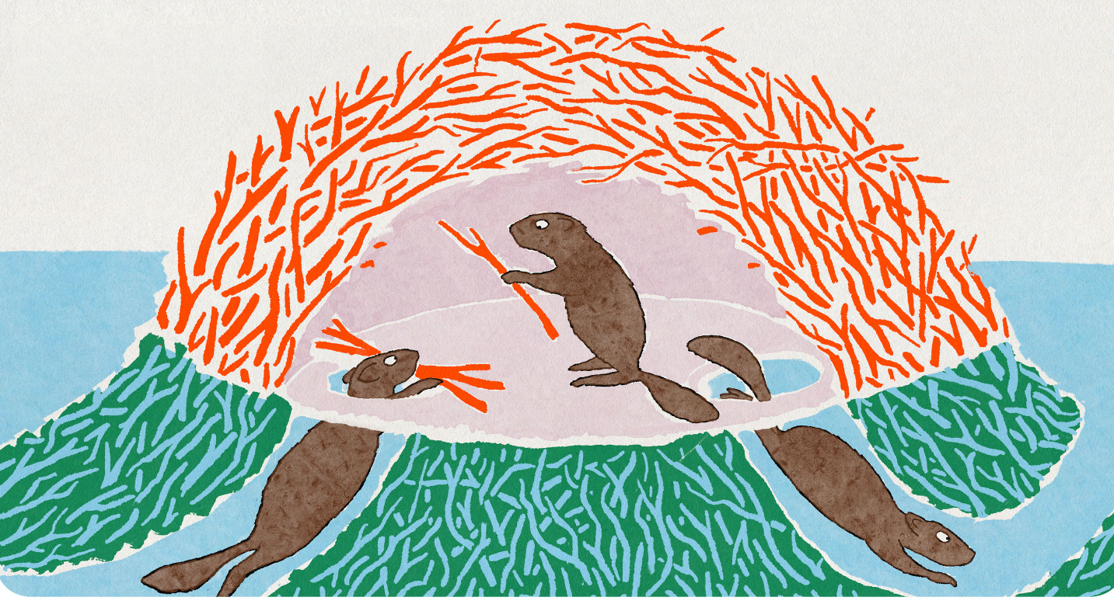
Ecosystem Engineers
Notes:
Beavers are both keystone species and ecosystem engineers.
They can profoundly shape environments to suit their ecological needs.

Slide 13
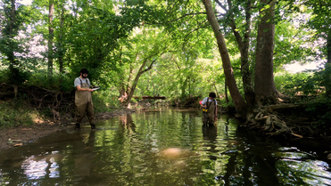
Notes:
Let’s hear about one species that scientists at Virginia Tech are studying right now.
Scientists believe this species is not only a keystone species but also an ecosystem engineer.

Slide 14
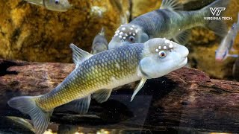
Notes:
[Click to play a 2 minute video on the Bluehead Chub.]
[If needed, video link: youtube.com/watch?v=5500PjlqfgI&embeds_referring_euri=https%3A%2F%2Fdocs.google.com%2F&embeds_referring_origin=https%3A%2F%2Fdocs.google.com&source_ve_path=Mjg2NjY

Slide 15
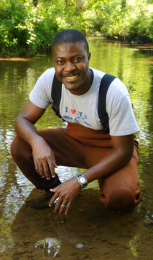
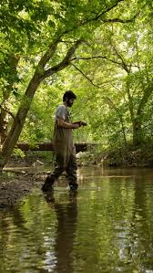
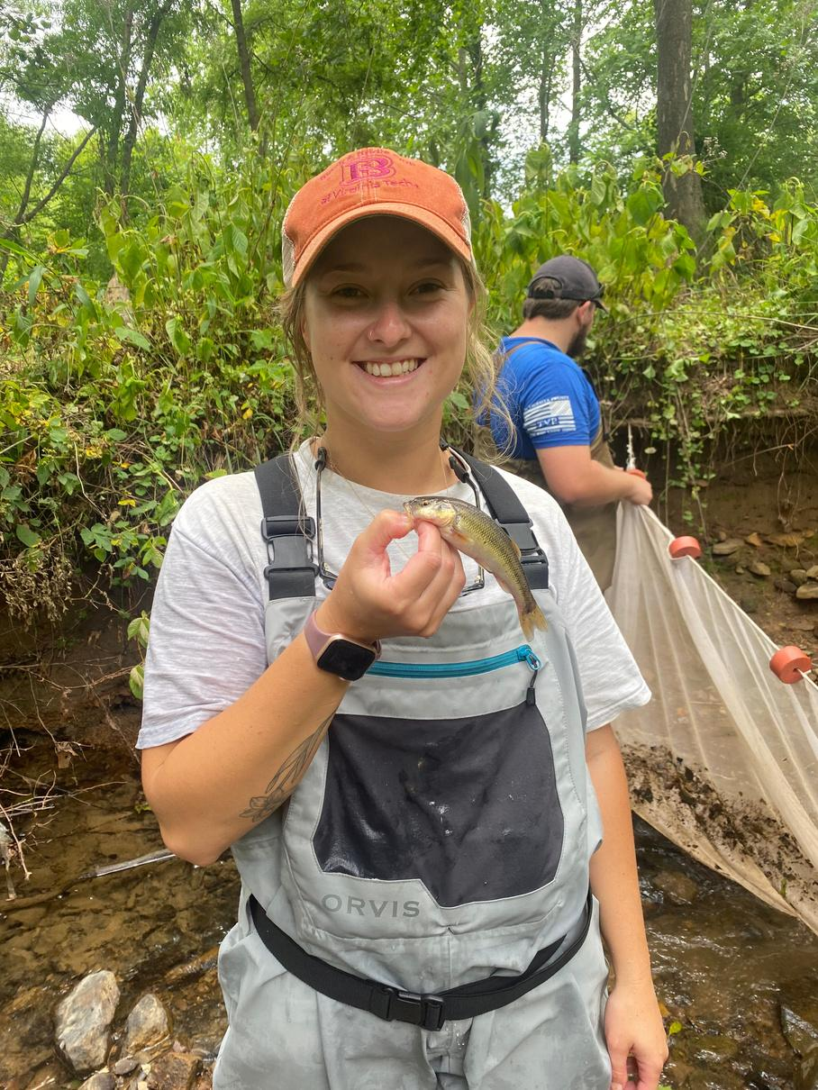
Notes:
Scientists have found a direct relationship between the size of the nest and the number of species that use the nest.
Scientists have also found a direct relationship between number of species that use the nest, and egg survival.
Now we are going to be fisheries biologists and investigate how bluehead chubs affect their ecosystem.

Slide 16
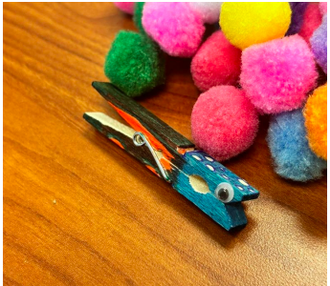
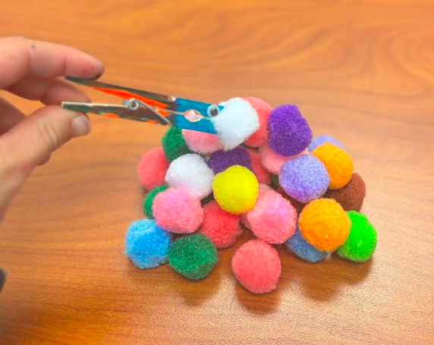
Notes:
[Before the students go back to their desks, go over the steps.]
First you are going to make your own bluehead chub.
You will each be given a clothespin and a set of googly eyes.
Then you are going to build a nest using your bluehead chub clothespins to grab “rocks” aka pompoms as fast as you can.
You will record data on your nests using the handout and at the end we will see who can build the tallest nest, the widest nest and the nest with the most pebbles.

Slide 17
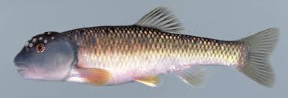
Bluehead Chub Have…
a blue head with white spots
a green and orange body
big lips to help carry rocks
Notes:
Please go back to your desks and spend a few minutes decorating your bluehead chub.
[Leave this slide up as they decorate their fish.]
[Share as they are decorating:]
Bluehead chub are minnows that are typically 2.8 to 6.7 inches long.
Bluehead chub is one of about 10 species, out of 34,000 species of fish that we know of globally, that is actually able to carry pebbles in its mouth to build a mound nest.
Bluehead chub carefully move each individual pebble to its new location up to 10 feet away - they do this 20,000 to 100,000 times per nest!

Slide 18
Notes:
Bluehead chub build their nest in a dome-shaped mound.
Bluehead chub have an urgency when building a nest with predators around and bad weather coming.
You will have 60 seconds to build your nest!
We are going to see who can build the tallest nest, who can build the widest nest and who can use the most pebbles.
[Leave this slide up as they build their nests.]

Slide 19
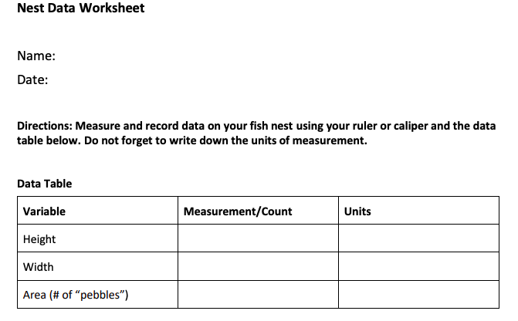
Notes:
Now record data on your nests using the handout.
Measure the height and width using a ruler.
You must be careful not to disturb the nest or move any pebbles, so you have accurate measurements, just like the scientists!
Then get an estimate of area by counting and recording how many pompoms are in your nests.

Slide 20
Do bluehead chub affect other fish populations?
Notes:
Before we get the results on how our nests did, let’s ask a a few questions.
Do you think bluehead chubs affect other fish populations? Why or why not?
[Let the students answer.]
ANSWER: Yes. If other species depend on the bluehead chub nest to lay their eggs, if there are no nests, that may affect other species’ ability to reproduce.

Slide 21
Will the number of supported species change as the nest size changes?
Notes:
What do you think will happen to the number of species on the nest as the nest size increases?
[Let the students answer.]
What if it decreases?
[Let the students answer.]

Slide 22
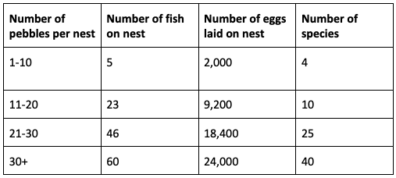
Notes:
Use this chart to see how many fish are in your nest, the number of eggs laid on your nest, and the number of species in your nest.
You can see that as the nest size increases, the number of fish in the nest will increase. If the nest is smaller, the number of species able to use the nest will be less.
Now let’s see whose nest supported the most species!
[Ask the students who thinks they had the tallest nest. See if anyone was taller. Do the same for width and number of pebbles. ]
[*** If asked: This chart does not use real data but is proportional to real data sets. ***]

Slide 23
Are bluehead chubs keystone species?
Notes:
Do you think bluehead chubs are keystone species? Why or why not?
[Let the students answer.]
ANSWER: Yes, bluehead chubs seem to have a significant impact on other species in their habitat, which would qualify them as keystone species.

Slide 24
What is the benefit to bluehead chub?
Notes:
Chub nests are more than single-family dwellings; they’re condo complexes for a variety of fishes.
While this is great for the other fish, how could the bluehead chub also benefit from this?
[Let the students answer.]
ANSWER: Scientists have observed a mutualistic relationship with other fish species because they create and maintain pebble nests that benefit both themselves and their "nest associates".
The chubs get a "dilution effect" where their eggs are less likely to be eaten by predators because so many other fish eggs are also present.
The nest associates benefit from the nest’s protection and are able to keep their eggs safe from silt and predators.

Slide 25
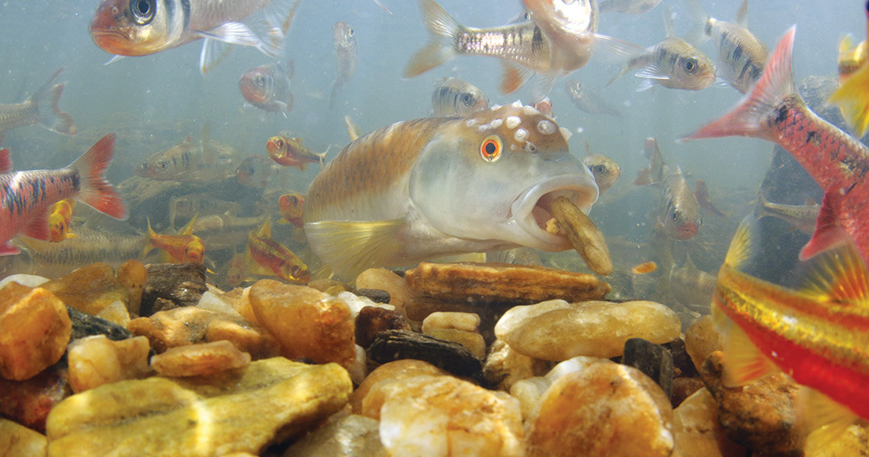
Notes:
The bluehead chub are incredibly important to supporting aquatic biodiversity.
Let’s give a round of applause for these amazing underwater builders.
Before we go, let’s go back to the wolves we started with.

Slide 26
Ecological Angels?
Ecological VillAINS?
Notes:
We asked are they angels or villains?
We learned they are incredibly important keystone species in the Yellowstone Ecosystem.
But what happens if they leave the natural ecosystem and encroach on ecosystems humans control such as farms and ranches?
Let’s watch one more video.

Slide 27
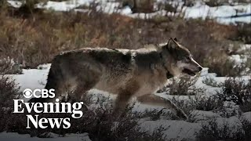
Notes:
[Click to play a 3 minute video on the impact of wolves on ranchers in California.]
[If needed, video link: https://www.youtube.com/watch?v=8KpuTT8Tspg ]

Slide 28

Notes:
Like other wild animals, wolves are neither superheroes nor villains.
In their ecosystems they play critical roles, but when wolves encroach on other ecosystems, or humans try to control ecosystems, conflict can occur.
This conflict can be costly to taxpayers, individuals, wildlife, and ecosystems.
As you heard, work is underway to manage this in a way that protects both parkland ecosystems and ranchers.
Maybe you will be the next conservationist to find a way for all to benefit and stay protected.
Or maybe you will be the next Virginia Tech biologist to study the amazing ecosystems in our streams and creeks.
There is so much more scientists can learn about the complex interactions within ecosystems and the effect humans have on the delicate ecosystem balance,

