Slide 1
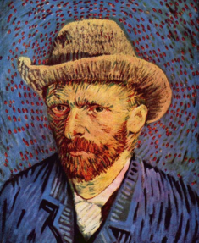
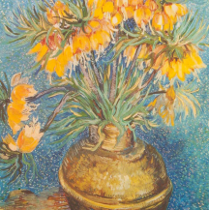
VINCENT VAN GOGH
1853-1890
born in the Netherlands
Notes:
Self-Portrait with Grey, Felt Hat, 1887-88
Fritillaries in a Copper Vase, 1887
Info: https://www.tate.org.uk/kids/explore/who-is/who-vincent-van-gogh
PRESENTER NOTES:
Allow 10-15 minutes for presentation. Please feel free to cut and shorten where needed, focusing on the 3 BIG IDEAS.
BIG IDEA #1: Vincent van Gogh is one of most influential artists of the 20th century.
Today, most people know the name Vincent van Gogh. However, when he was alive, he was not very famous at all.
Since his death, he has become one of the most successful painters in history. People across the world have admired his unique style.
In total, Van Gogh made around 2,100 artworks.
QUESTIONS:
Do you know the artist Van Gogh? If so, what do you know about him? Do you recognize any of these paintings?

Slide 2
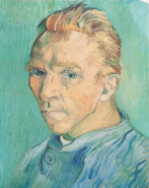
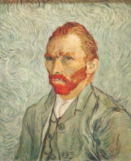
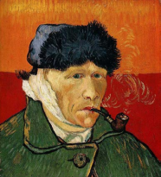
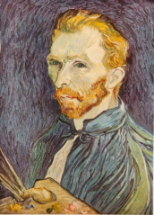
Van Gogh decided to become an artist at 27 years old
Notes:
Images left to right:
Self-Portrait, 1889
Self-Portrait with Bandaged Ear and Pipe, 1889
Self-Portrait, 1889
Self-Portrait, 1889
Early Training, work, and inspiration:
Van Gogh was born in the Netherlands. However, he travelled across much of Europe (France, Belgium and England).
When he was in London, he was inspired by all the art he saw in galleries.
Van Gogh’s brother, Theo, worked in an art gallery and introduced Van Gogh to many artworks. Van Gogh was interested in painters who were painting everyday life.
It wasn’t until he was 27 years old that he decided to become an artist. Up until then, he had been a teacher, a shop assistant and had dreams of working for the Church.
Van Gogh’s many experiences inspired his work.

Slide 3
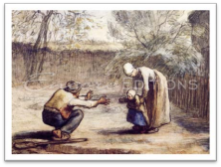
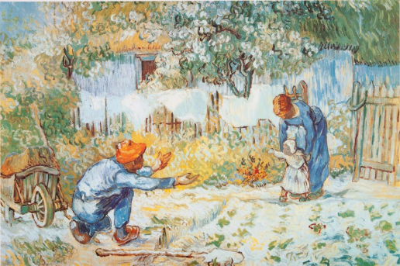
Van Gogh studied other artists’ work, and used their work as inspiration for his artwork
Notes:
Jean-Francois Millet, First Steps, ~1873
First Steps, after Millet, 1890
Great artist often will repeat the same themes and study each others work. This way of working was critical to Van Gogh’s development as an artist.
This painting was for his brother and his wife when their first child was born. The child in the painting was named Vincent after his uncle.
QUESTIONS:
What inspires your artwork? Do you have themes that you often use in art or writing?

Slide 4
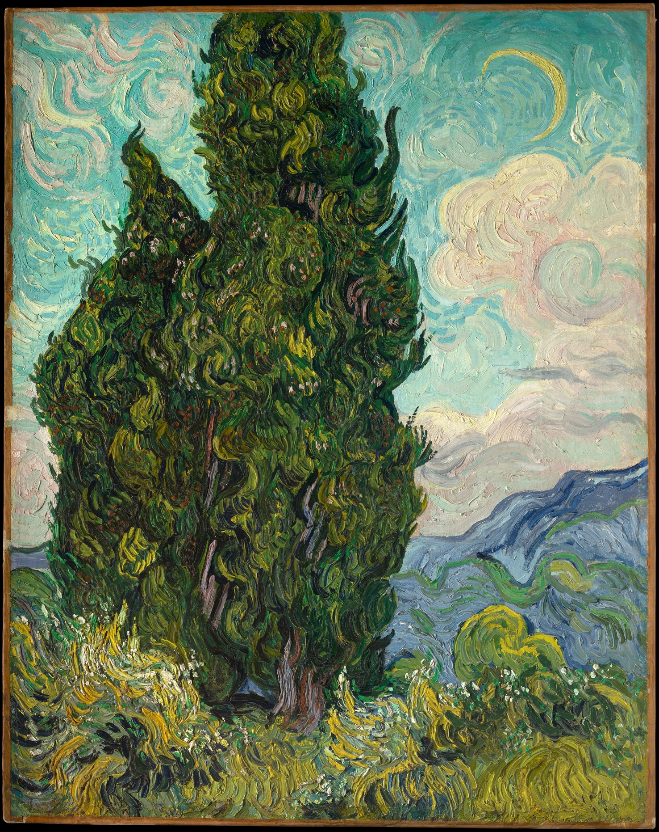
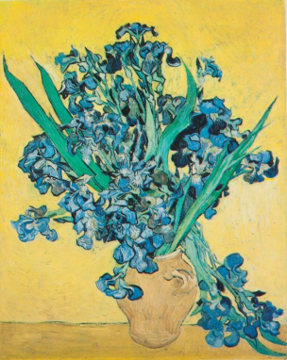
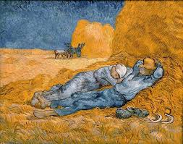
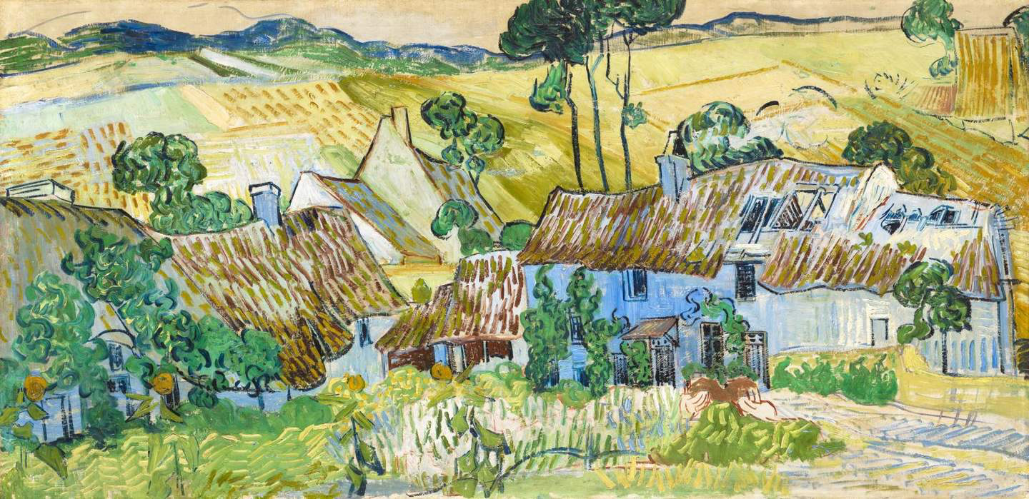
Many of
Van Gogh’s paintings reflect his love of nature
Notes:
Images left to right:
Still-Life: Irises, 1890
Noon: Rest from Work (After Millet), 1890
Cypresses, 1889
Farms near Auvers, 1890
BIG IDEA #2: Many of his paintings reflect his love of nature.
He painted the sun and moon, sky, people, animals, tree, flowers, stars.
Van Gogh liked to paint the places he visited. When you look at his paintings, you can almost imagine you are there with him.
In Farms near Auvers Van Gogh used bright colors. This painting was made towards the end of Van Gogh’s career. Earlier, he had used darker colors. As he grew older, he liked using lighter colors.
Van Gogh suffered from mental illness and was a very sensitive person; he identified very strongly with the pain and suffering of the poor.

Slide 5
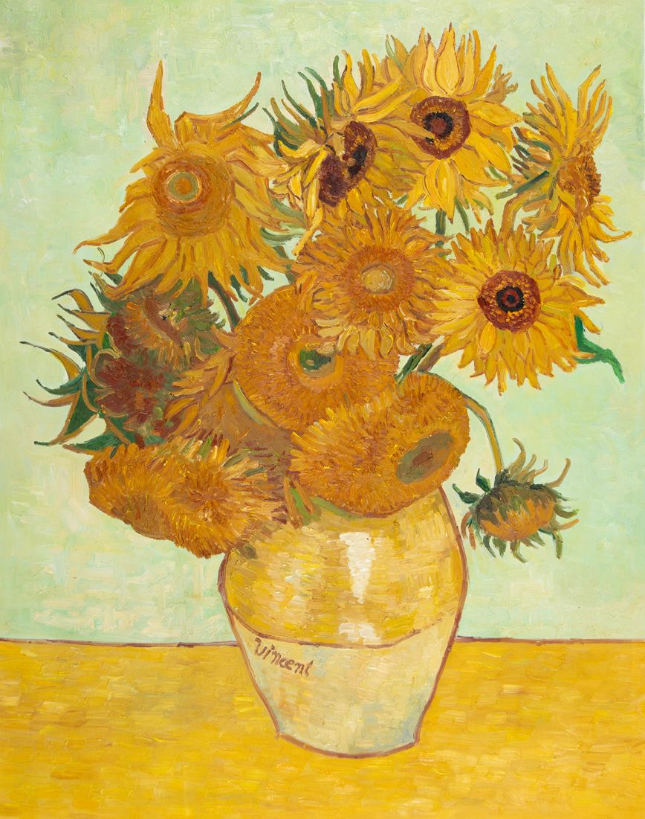
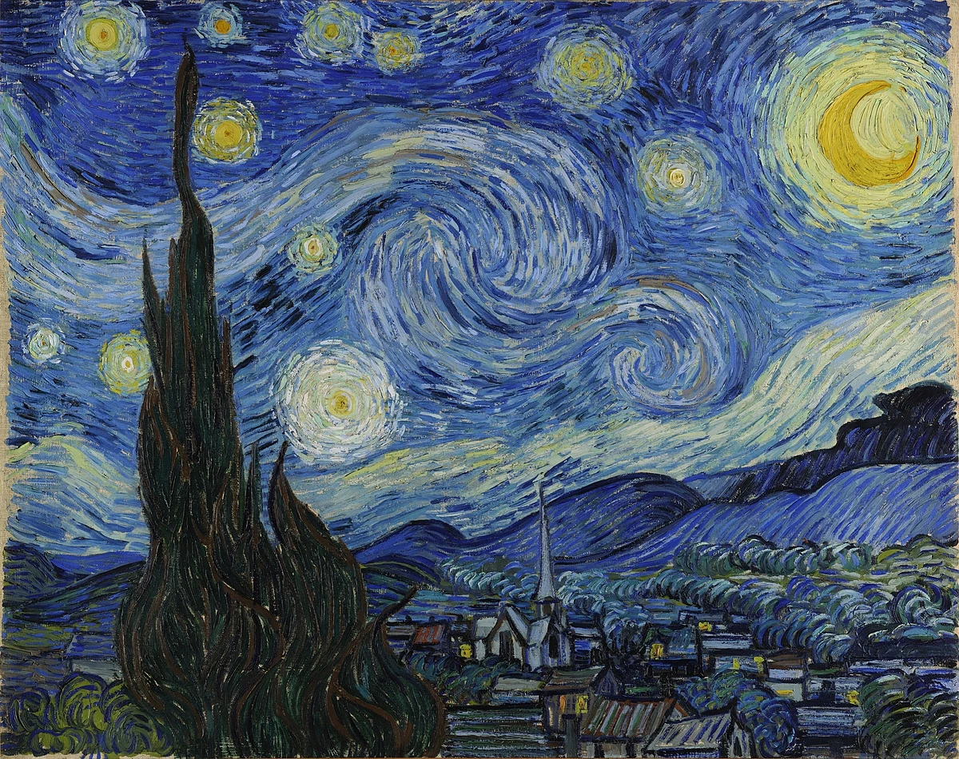
Some of Van Gogh’s most famous paintings!
What makes Van Gogh’s paintings so unique?
Notes:
Still-Life: Sunflowers, 1888
Starry Night, 1889
BIG IDEA #3: Van Gogh used bright and bold colors, and his short brushstrokes were expressive. Van Gogh’s brushstrokes were heavy—thick with paint (IMPASTO). He strived to capture emotions and thoughts, instead of making everything realistic.
IMPASTO technique – thick paint application. A painting technique where paint is applied thickly to create texture and depth (create a three-dimensional effect).
Van Gogh’s Sunflowers And Starry Night are very famous.
OBSERVATIONS/QUESTIONS:
Look closely at these two paintings, what do you notice?
Bright and bold colors. Contrasting colors. Use of yellows, blues, oranges. Vibrant. Sense of movement with small brushstrokes. Texture, thick brush marks.
What do you notice specifically about the brushstrokes?
The brushstrokes are broken up. It is as if you can imagine each time Van Gogh brought the brush to the canvas. Single, individual brushstrokes. Small, swirling strokes. Expressive. Texture, thick strokes. Circular motions.
Look at the bright yellows. What do you notice? Can you see that all 14 sunflowers are painted differently?

Slide 6
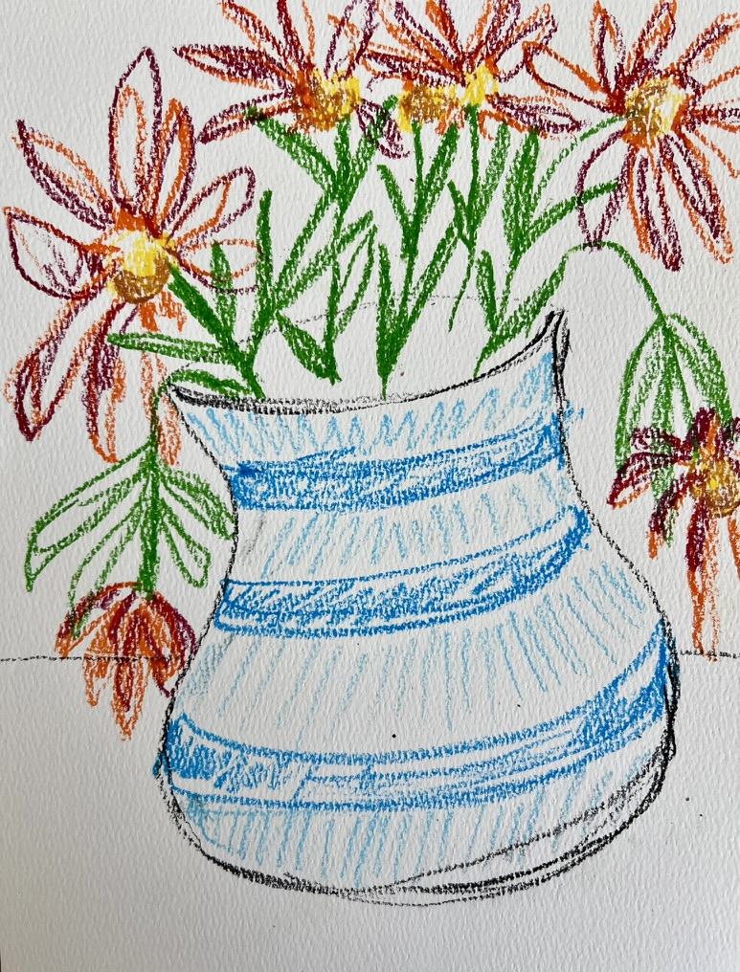
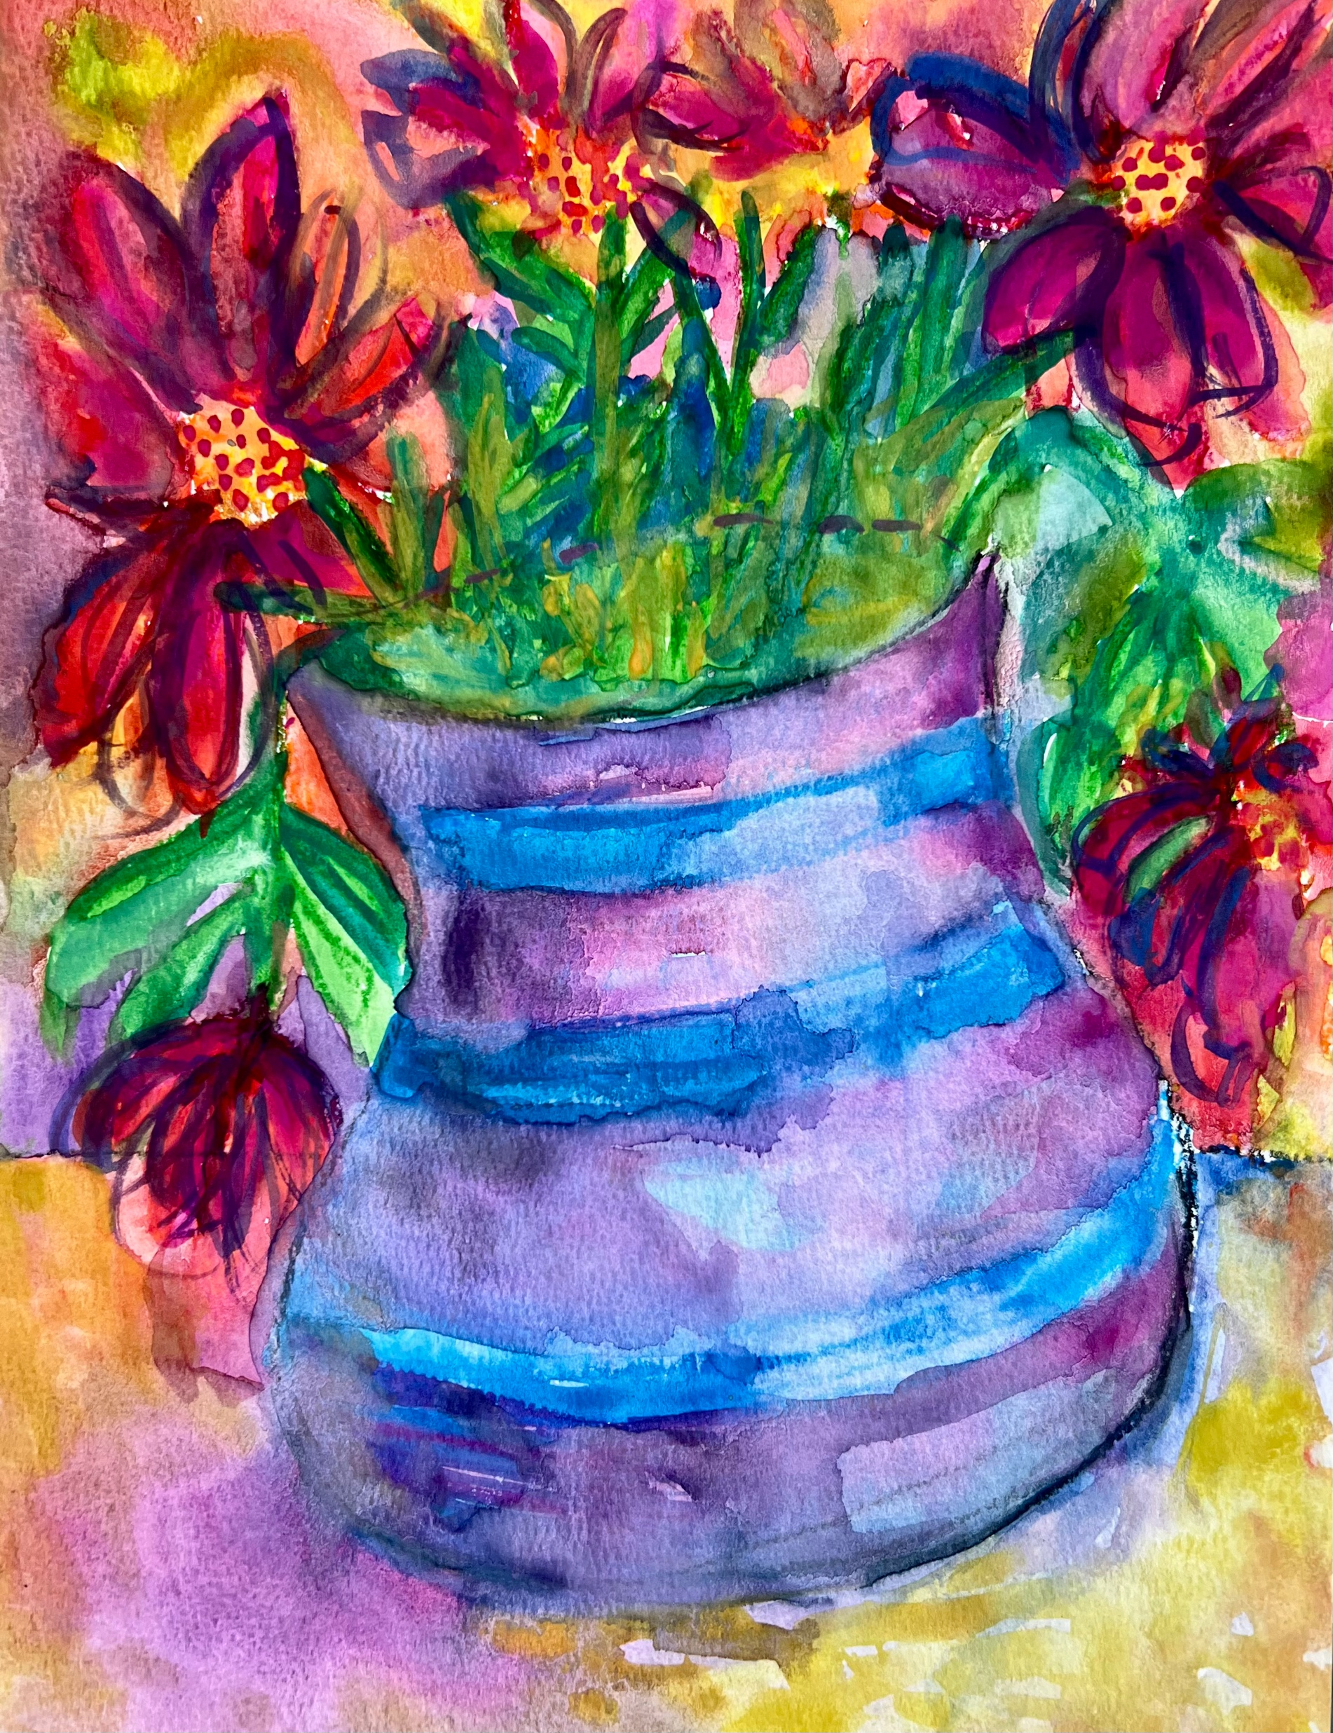
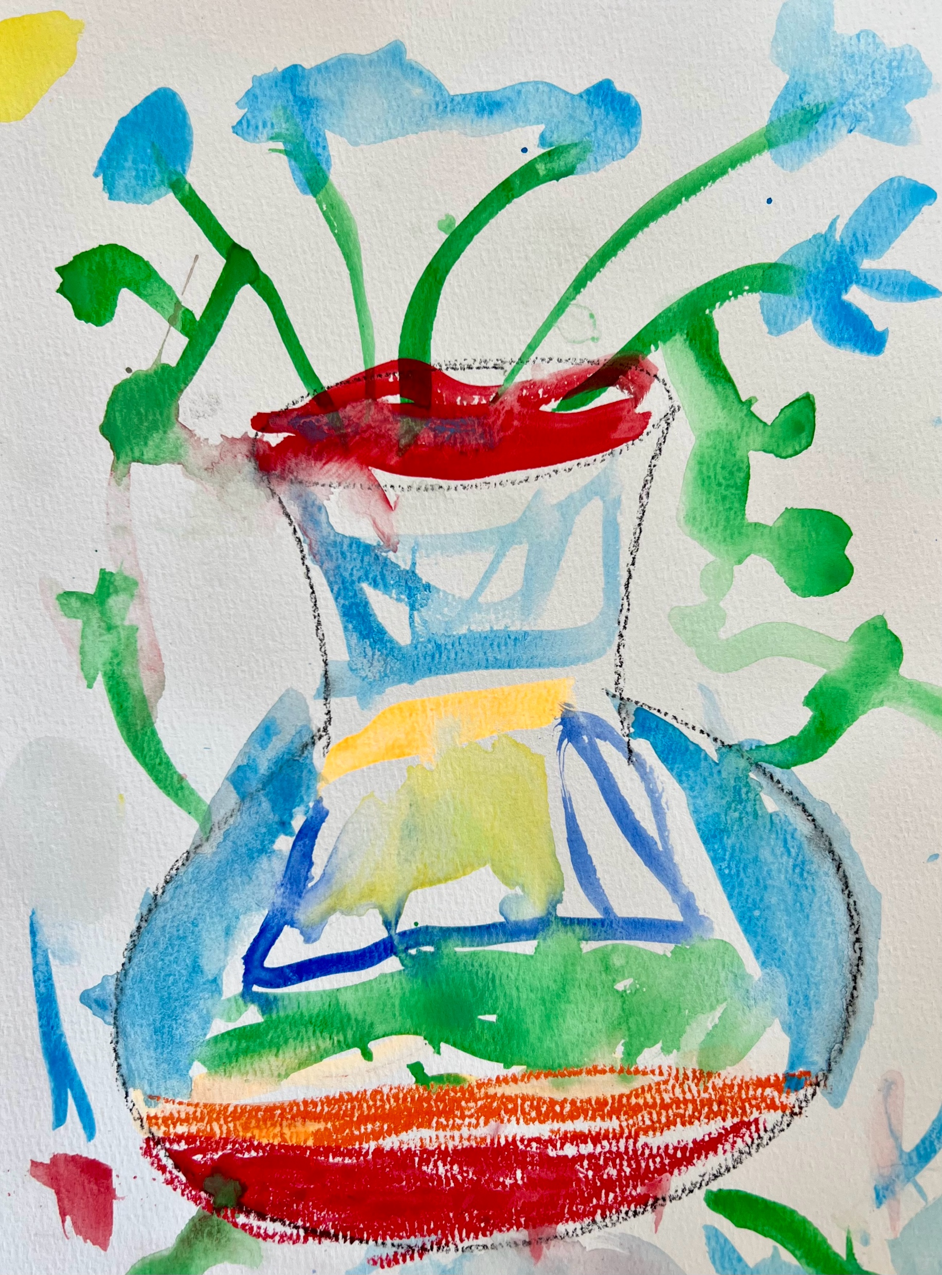
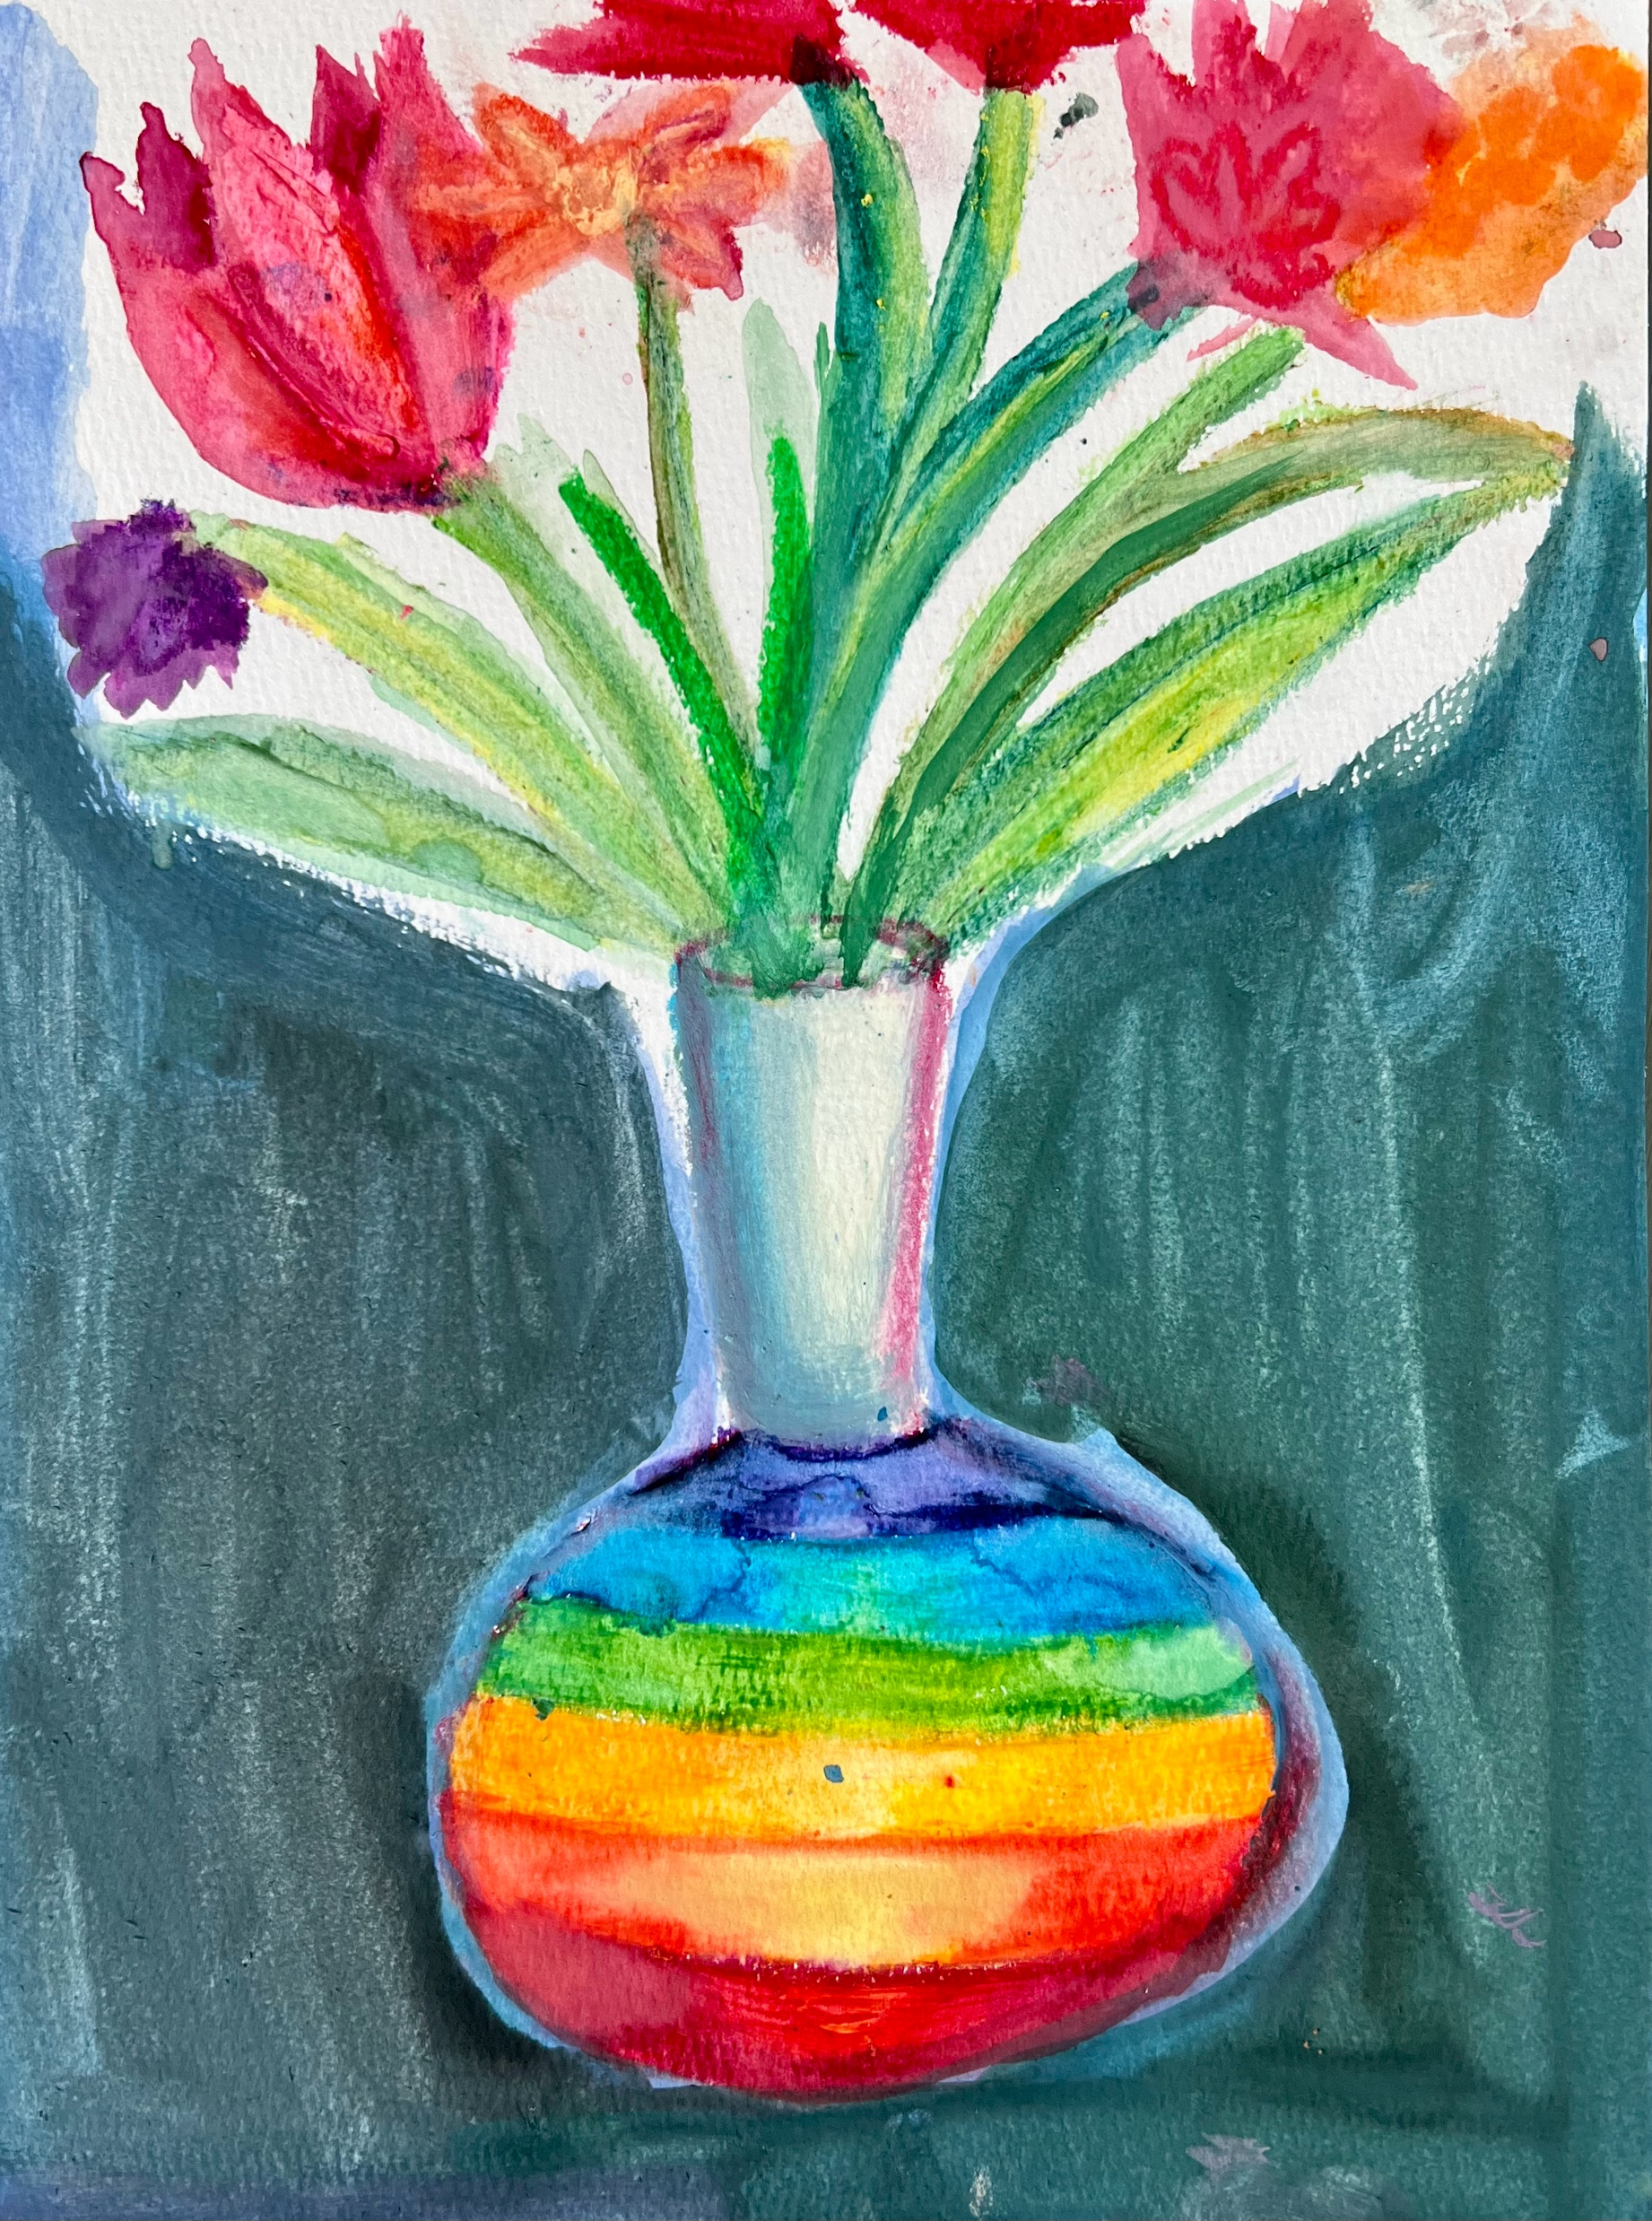
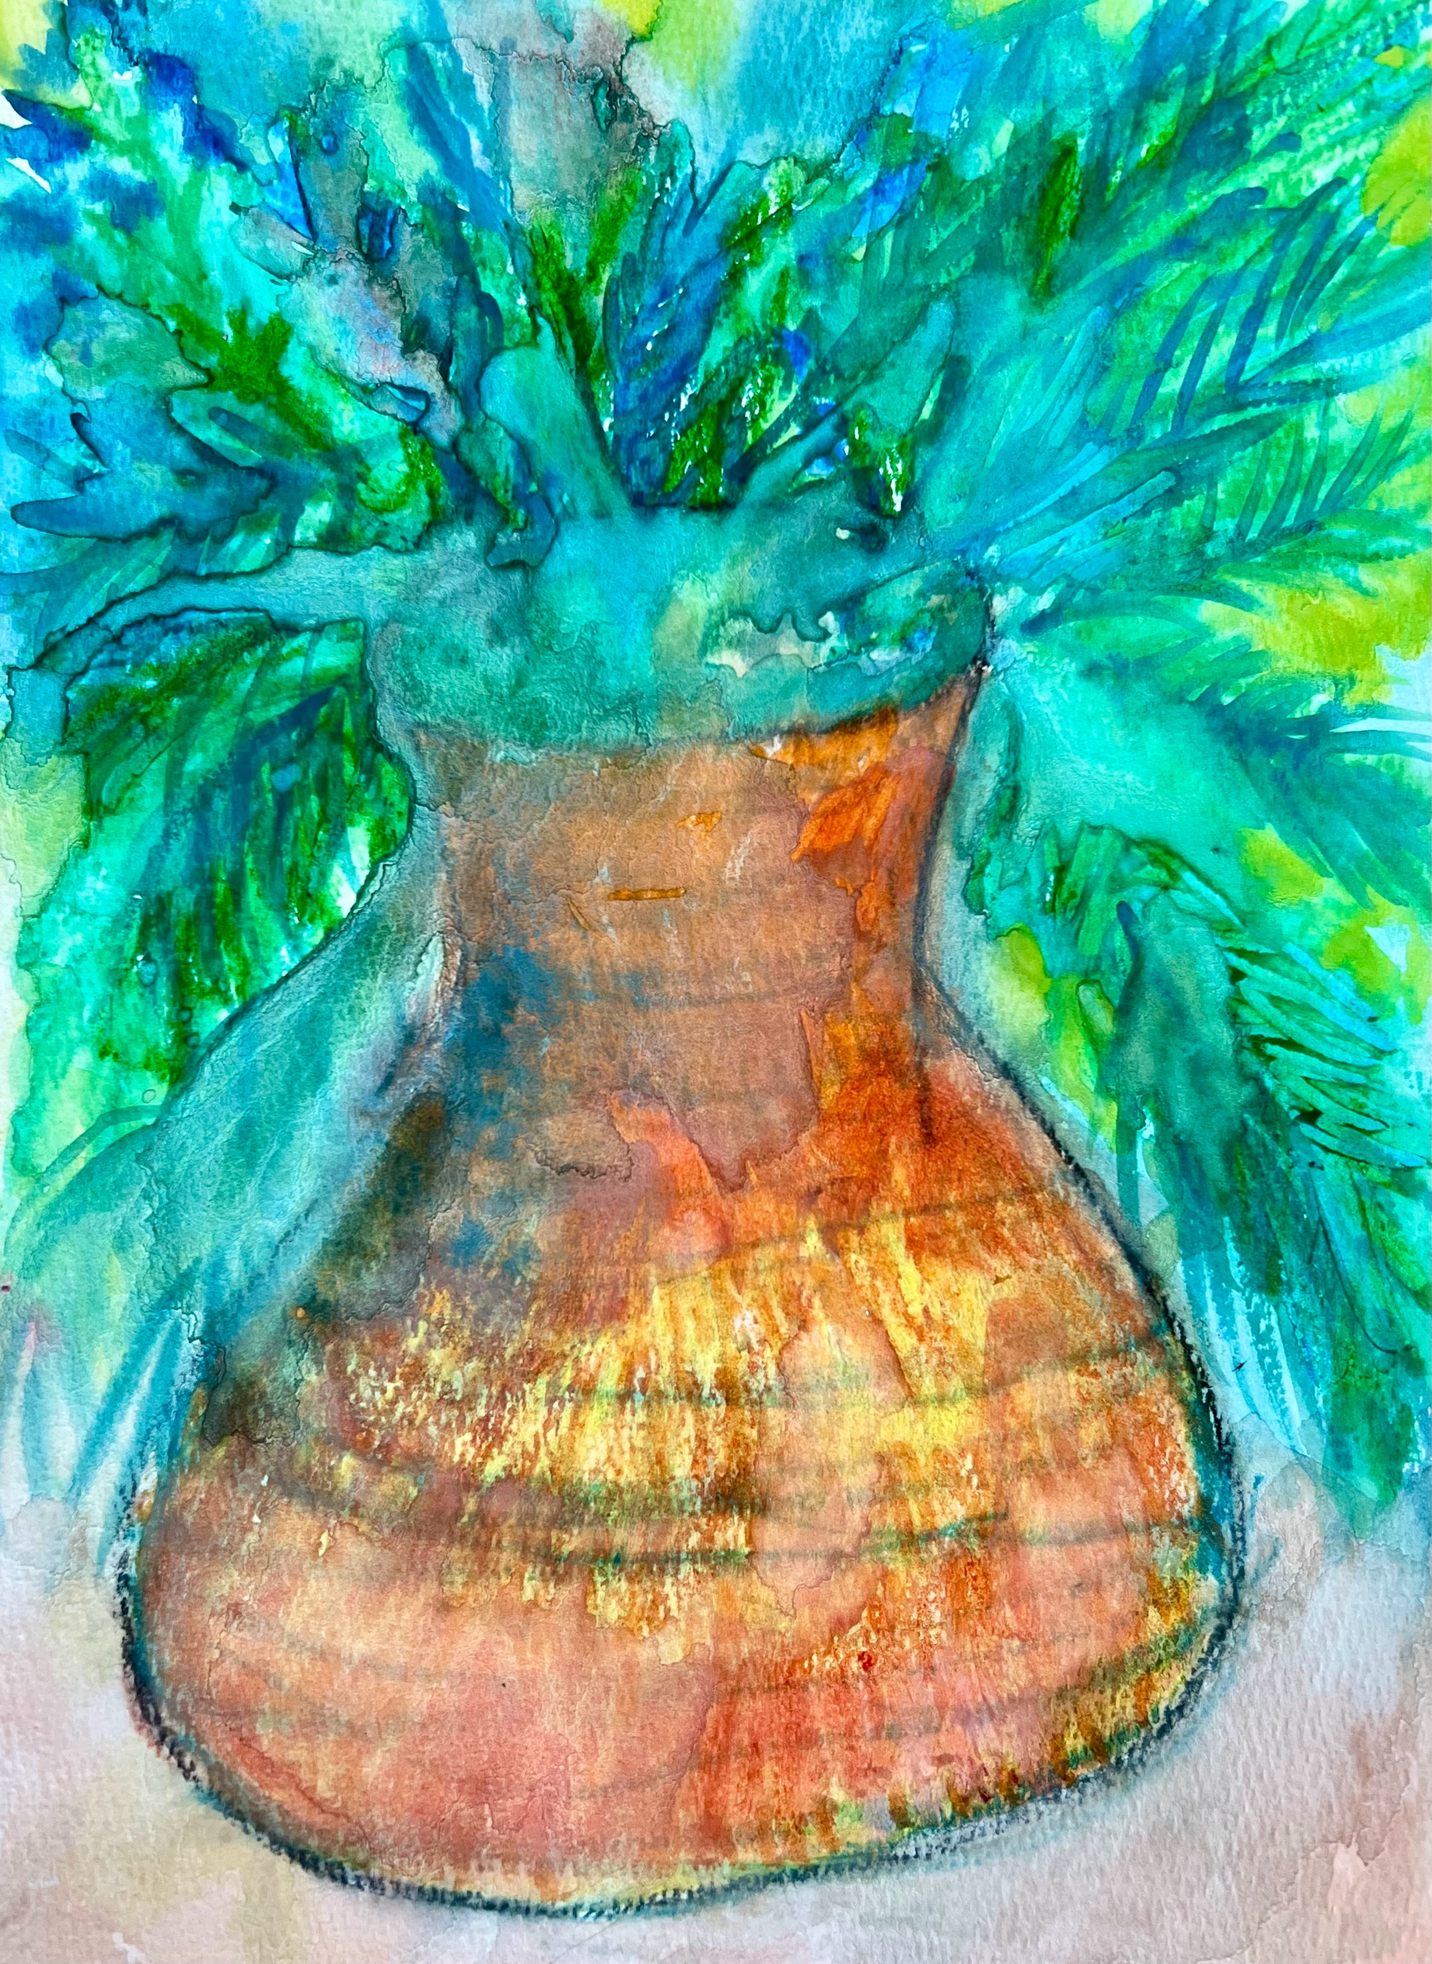
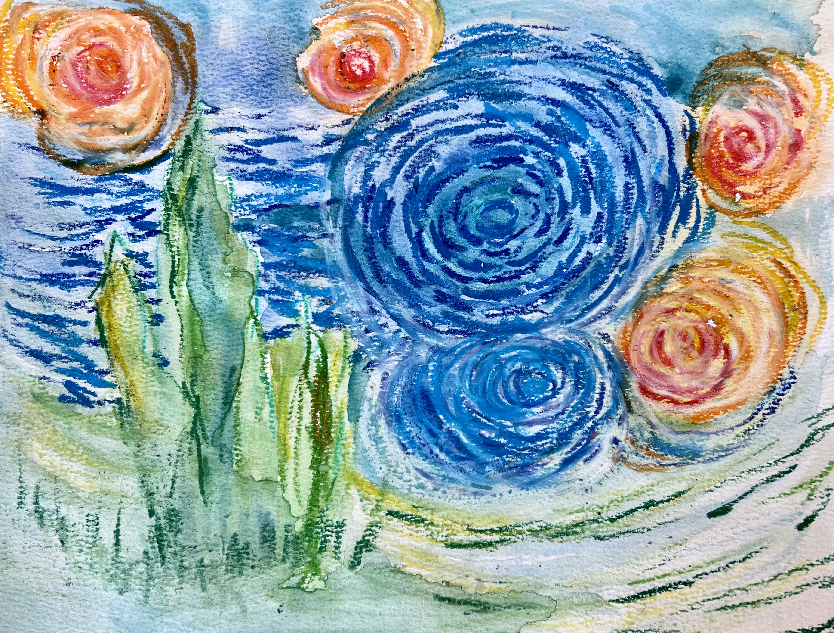
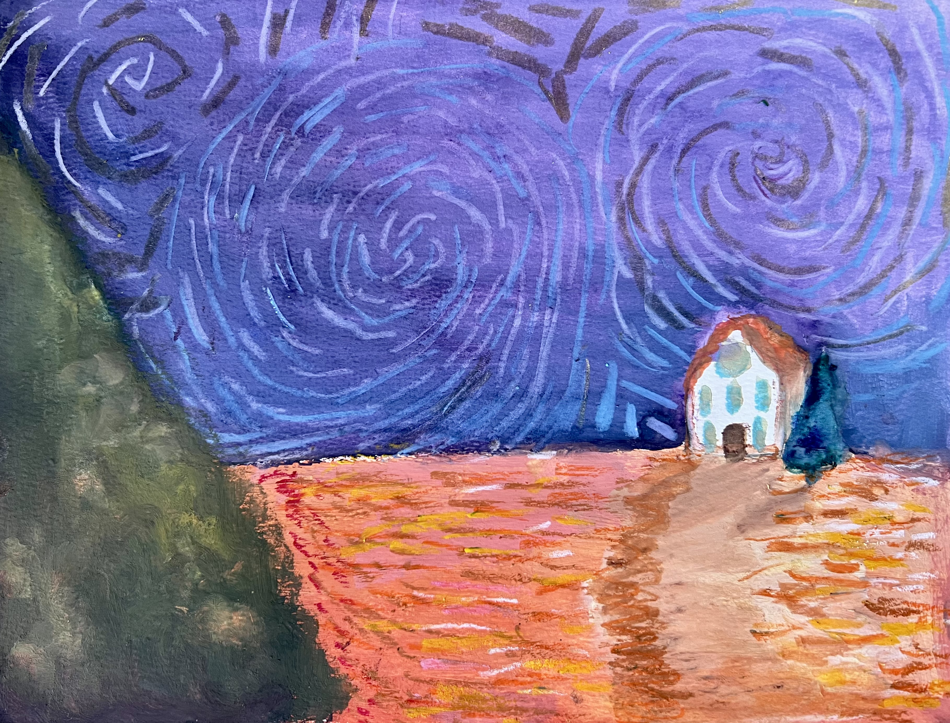
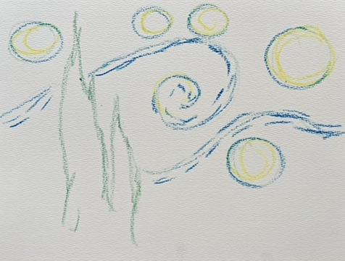
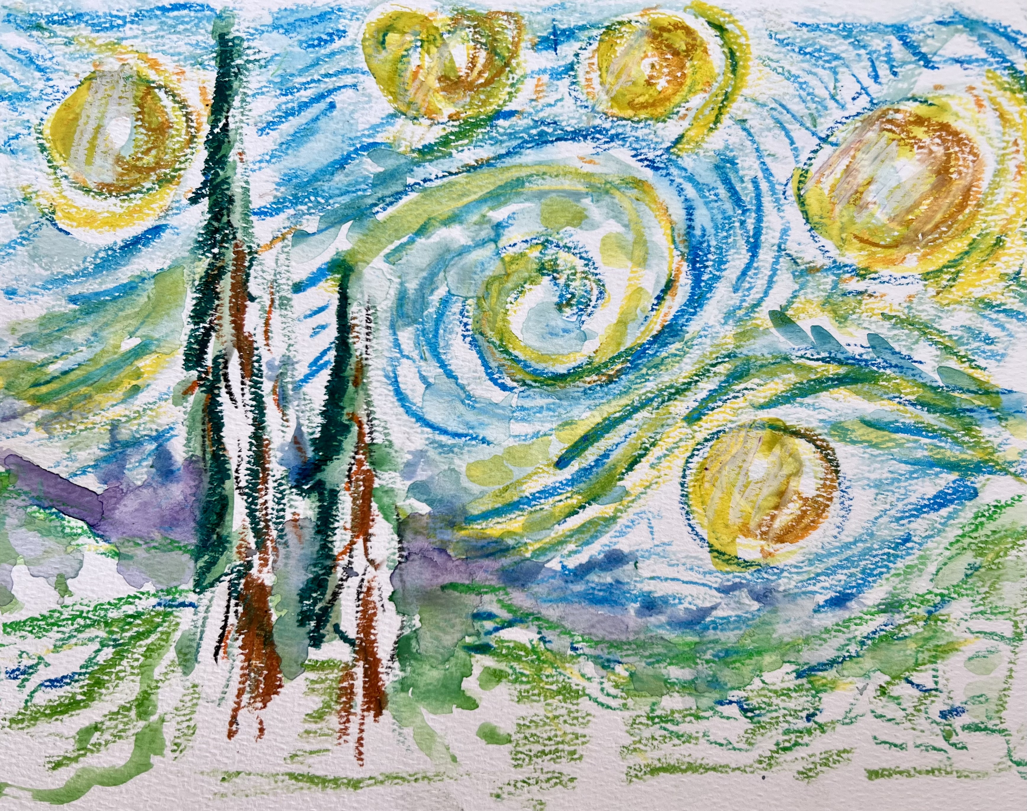
Art Project: Create a painting inspired by Van Gogh.
Use bright colors, thick and short brushstrokes, and expressive lines!
Notes:
Great Art Project Instructions – Van Gogh
Project Description:
Students will learn about Vincent van Gogh and create their own painting inspired by the famous artist. Van Gogh is one of most influential artists of the 20th century.
Grades: K - 6
Art Project: using tempera paint and oil pastels, create your own Van Gogh inspired painting.
Optional: the art may be collected and displayed (dependent on the teacher’s approval) at the end of the session.
Reminders: remind students to sign their artwork.
Materials: all grades will use the same project materials.
Per student: one sheet of watercolor paper
Shared by students: tempera cakes, paintbrushes, oil pastels
Cup for water, per student/or can share
Clean up: rinse off tempera cakes, clean brushes, rinse out and return cups (we reuse cups for water). Thank you!
Considerations/ideas:
Use these supplies to create your painting? What inspires you? Van Gogh was inspired by nature, and used bright colors, and short brushstrokes.
You can start with oil pastels to sketch out your image or use paint first. Move back and forth between using oil pastels and paint. Think about adding details.
Experiment and have fun!

