Slide 1
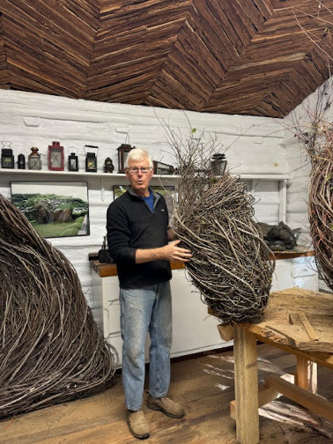
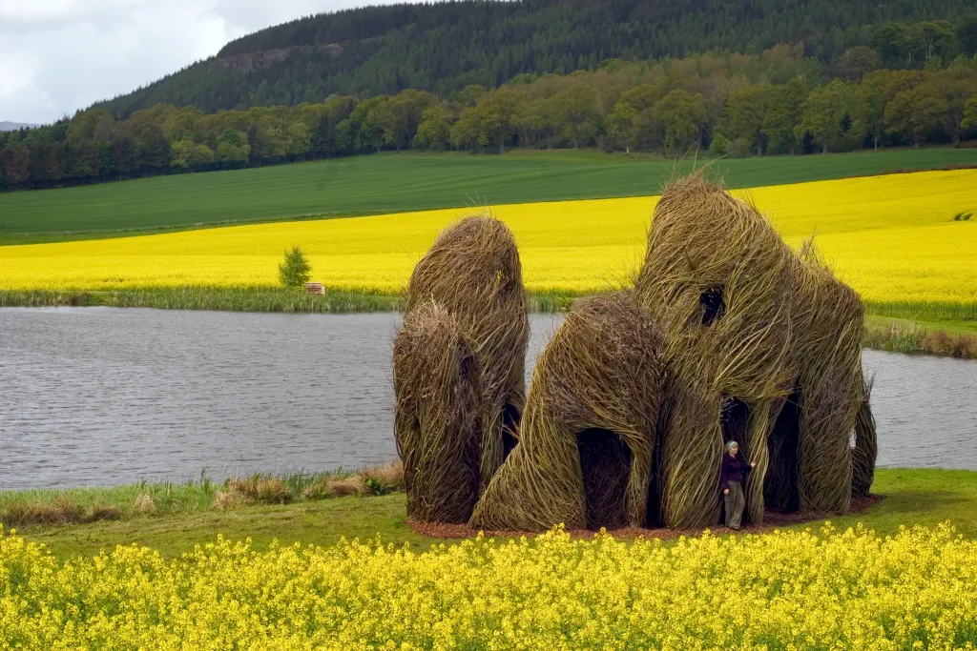
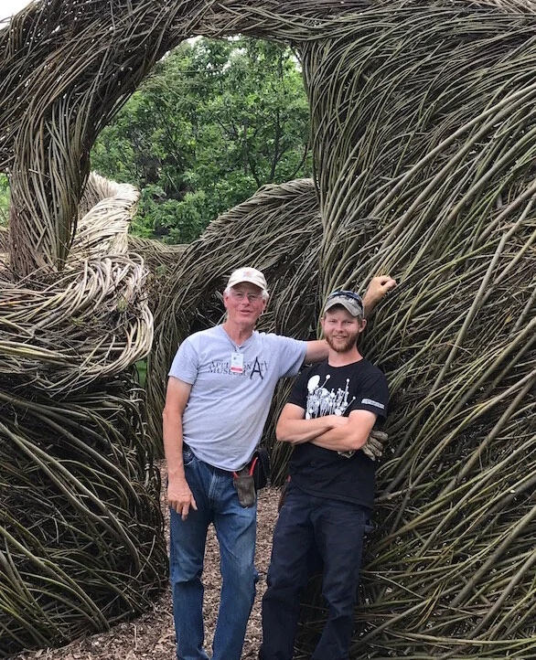
Patrick Dougherty
Born in Oklahoma in 1945.
He currently lives in North Carolina.
Notes:
1st photo – Close Ties (2006) Patrick Dougherty, Scottish Basketmakers Circle, Dingwall, Scotland
2nd photo – Patrick Dougherty in his home studio
3rd photo – Patrick Dougherty with his son, Sam
PRESENTER NOTES:
Allow 10-15 minutes for presentation. Please feel free to cut and shorten where needed, focusing on the 3 BIG IDEAS.
BIG IDEA #1: Patrick Dougherty is a famous American artist known for his large-scale, environmental sculptures built with sticks and saplings. He is known as the “Stickman.”
Does anyone remember the artist we studied last fall for Great Art?
We studied Andy Goldsworthy last fall. Patrick Dougherty works in a similar way. Dougherty works in nature and with nature.
Over the last 40 years, Dougherty has built over 330 large-scale works using natural materials.
He has built these installations all over the world, from Scotland to Japan to Brussels, and all over the United States.
QUESTIONS:
What is an environmentalist? What do you think an Environmentalist Artist means?
A person who wants to protect and care for the environment around them.
Dougherty uses saplings and sticks to build his sculptures/installations. He uses materials around him – for example, underbrush and woods are near his home in North Carolina.
His works bring the viewer in direct contact with nature.

Slide 2
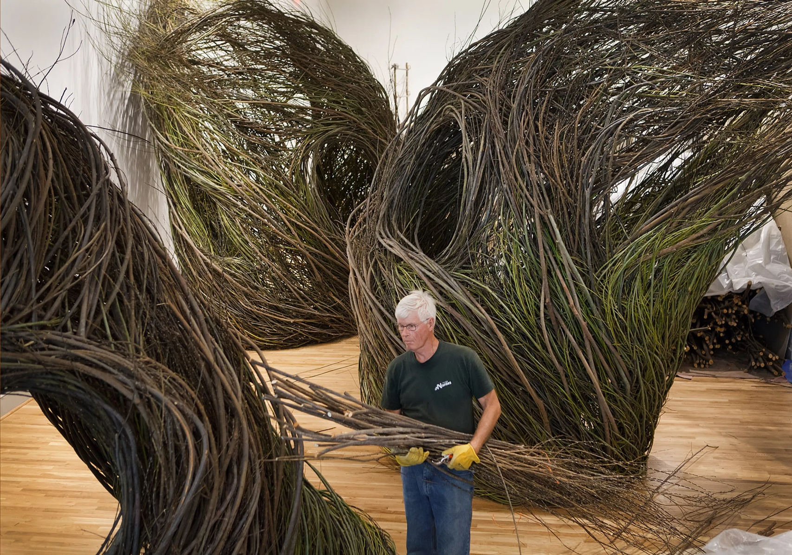
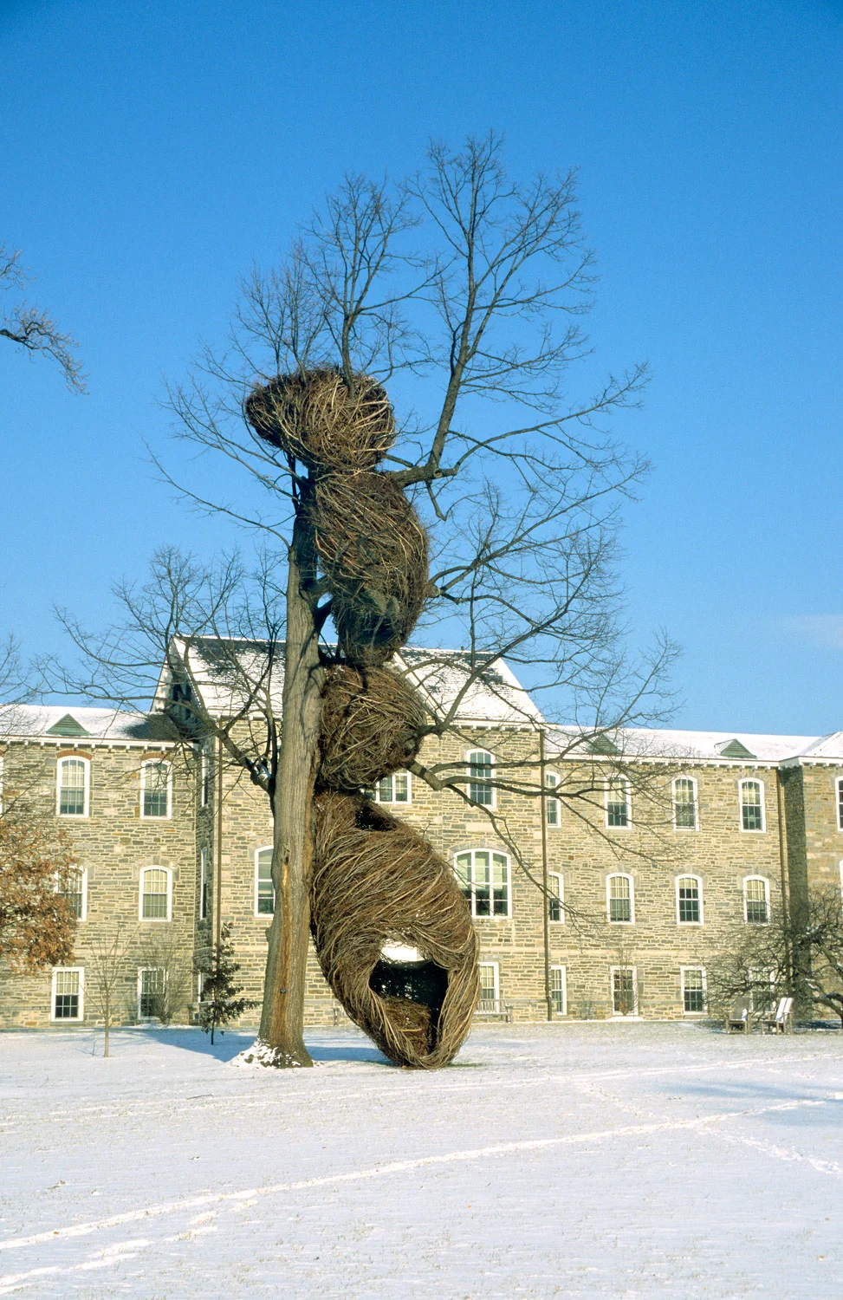
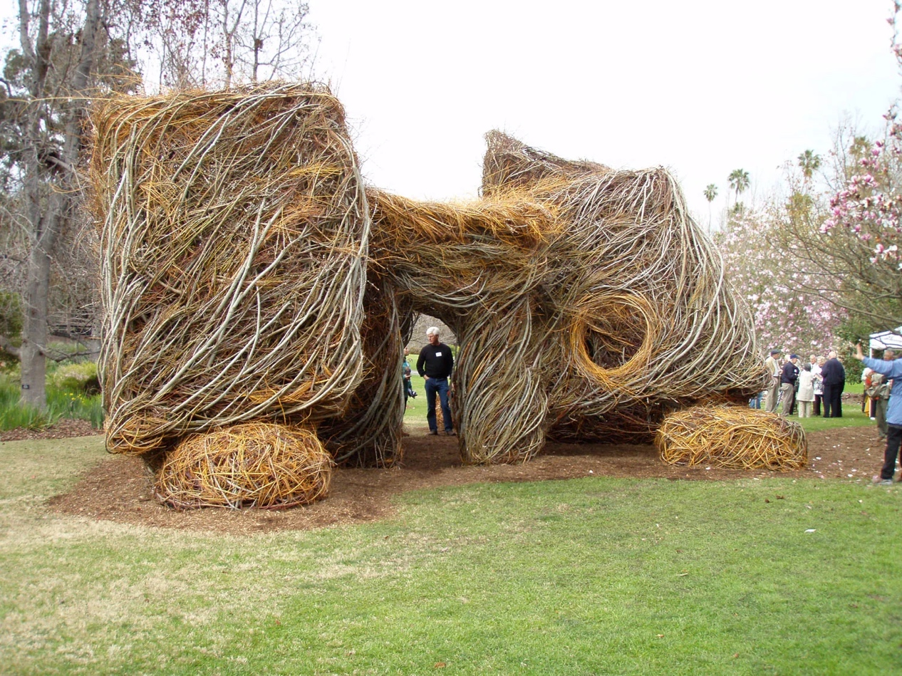
Patrick Dougherty: Branching Out
Notes:
1st photo – Patrick Dougherty installing his work, Shindig, for the WONDER exhibition at the Renwick Gallery in 2016
2nd photo – Abracadabra, Swarthmore College, Swarthmore, PA, 2000
3rd photo – Catawampus, Los Angeles County Arboretum and Botanic Garden, Arcadia, CA, 2008
Early Training and Work:
Dougherty was born in Oklahoma in 1945 and raised in North Carolina. He went to college at the University of North Carolina; and then graduate school for Hospital and Health Administration at the University of Iowa.
He changed his career path. He felt becoming an artist was his calling. He returned to North Carolina to study art history and sculpture at the University of North Carolina.
He found his artistic voice using natural materials (sticks, saplings, and branches). He combined his carpentry skills and his love of nature.

Slide 3
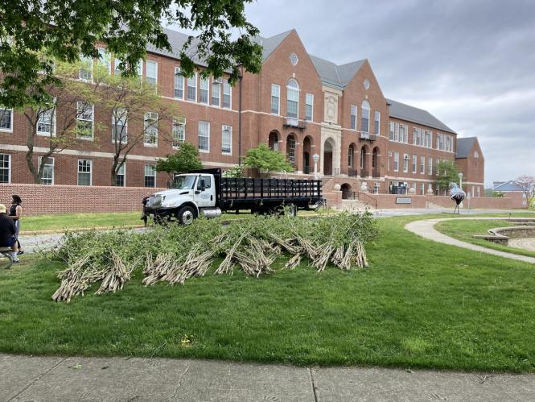
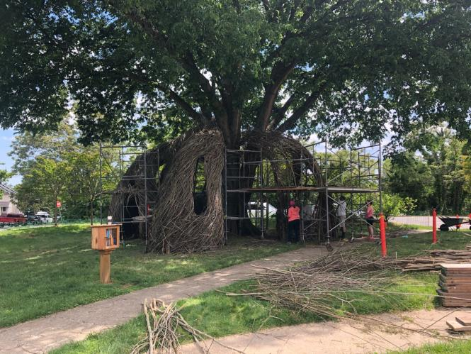
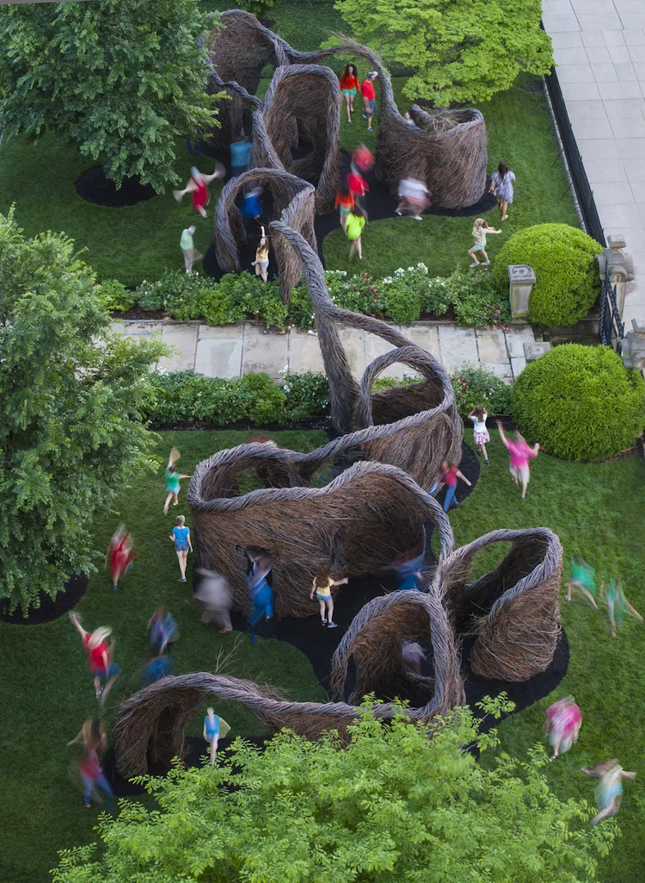
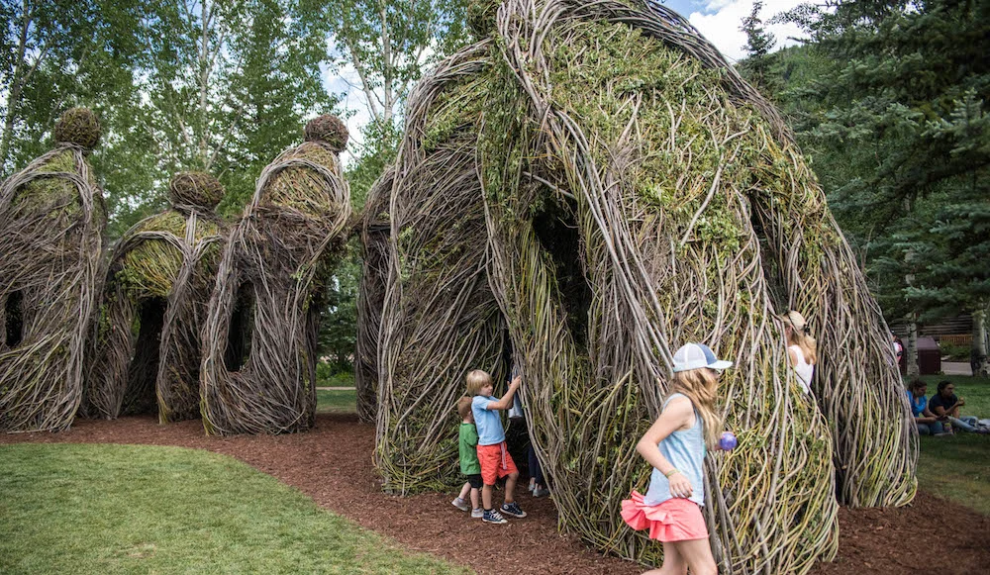
Dougherty uses sticks and saplings to build his installations known as STICKWORK sculptures
Notes:
1st photo – The sculpture begins to take shape
2nd photo – Saplings being laid out in preparation for the Patrick Dougherty Sculpture at Maryland Hall
3rd photo – Hodgepodge, Town of Vail, CO, 2018
4th photo – Far Flung, Taft Museum of Art, Cincinnati, OH, 2018
BIG IDEA #2: MATERIALS
Dougherty makes large outdoor sculptures/installations using saplings and branches coined as STICKWORK sculptures.
Dougherty describes his use of building with sticks the same as the act of drawing. “Everything you can do with a pencil you can do with a stick,” said Dougherty.
Sticks are imaginative objects – as children, we use sticks to build forts, play games – our imagination plus sticks can lead us anywhere.
His works brings the viewer into direct contact with nature. People of all ages have interacted with the installations. Look at how the children walk/run through and explore the sculptures.
His designs allow for the reeds and branches to be woven and shaped in ways that appear natural. He creates curves and shapes that are unique with a bit of whimsy, and different from their natural form.
Dougherty weaves together saplings like a bird creates a nest. Dougherty’s installations are sturdy and rock solid when touched.
QUESTIONS:
What do Dougherty’s installations make you think of?
How is his work a collaboration with nature?
Uses what he finds in nature. Responds to a site.
What is an art installation?
Artworks that are often designed for a specific place (site-specific), three-dimensional, and can transform a space.

Slide 4
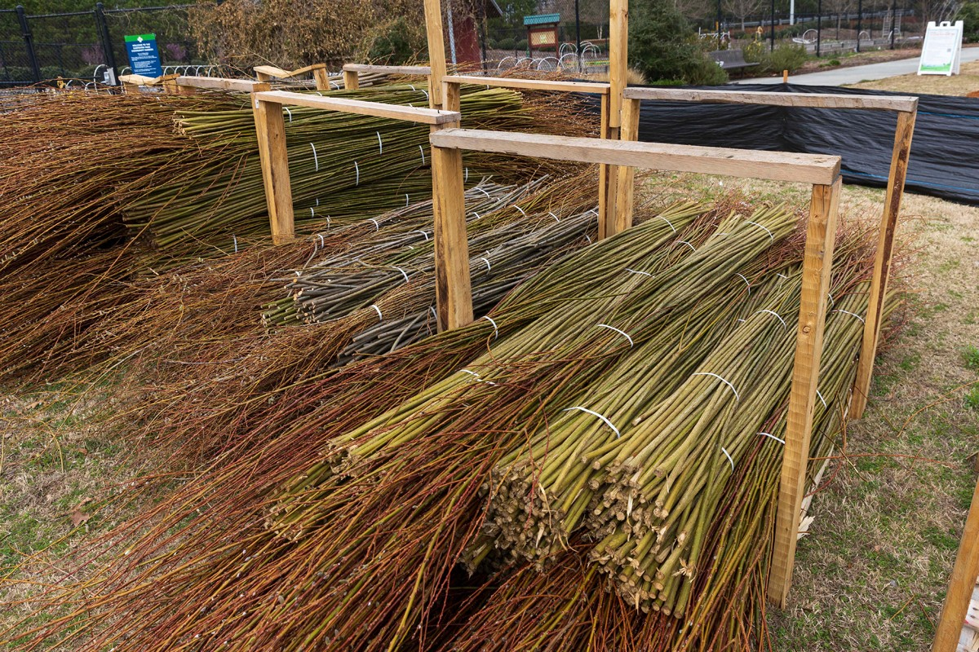
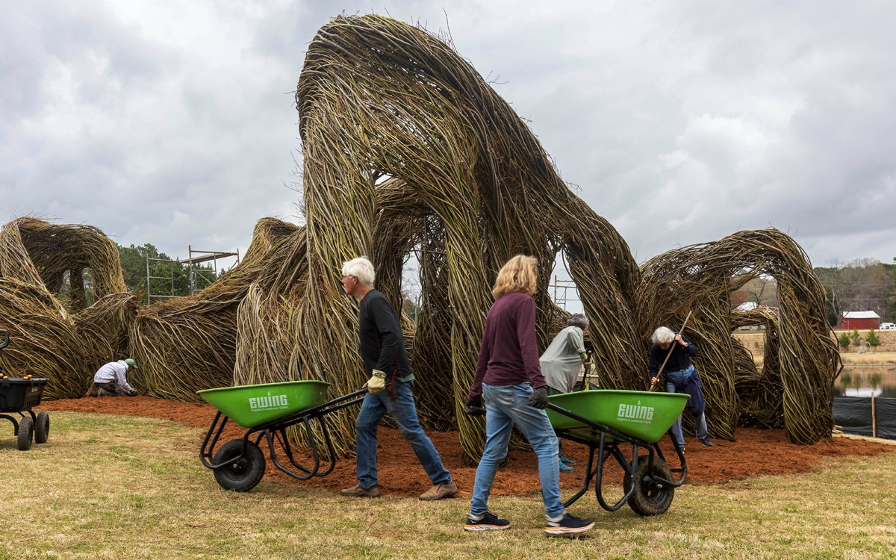
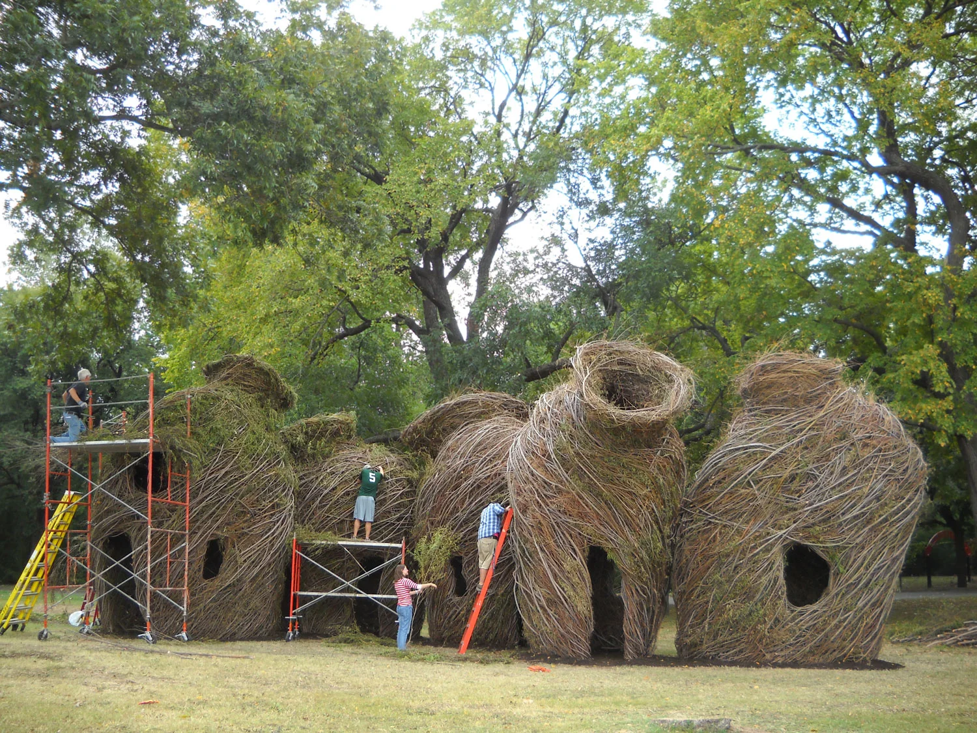
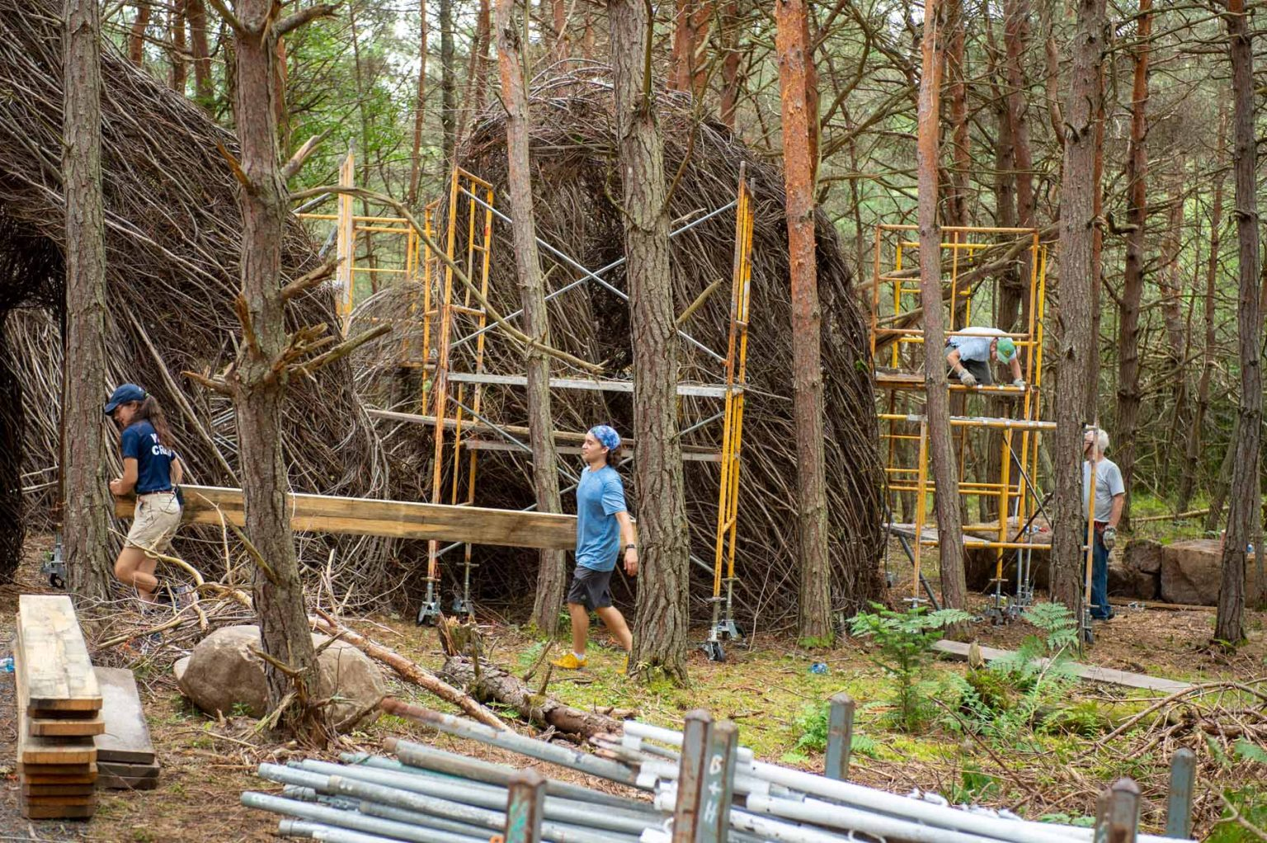
COLLABORATION
Notes:
1st photo – Willow from a farm in Canada was trucked to Cary, NC for the creation of the Carpenter sculpture in Chapel Hill.
2nd photo – Patrick Dougherty hauls mulch with volunteers.
3rd photo – Hopscotch, a stickwork creation
4th photo – River Vessels, Waco Arts Festival, Waco, TX, 2010
BIG IDEA #3: COLLABORATION
Dougherty partners with organizations and volunteers to help gather materials and build his installations.
Some of his installations require many saplings. They are carried to site by the truckload!
The installations often require many volunteers – at times up to 100-150 helpers. They help harvest saplings and then help to weave the saplings into a sculpture.
He sets up parameters of the work, laying out the footprint and projecting how the final product should feel in its site. Dougherty sometimes makes a drawing or small model so that everyone can see the idea.
Dougherty often handles the exterior work, as those sticks are crucial to the finished look.
Dougherty enjoys working with volunteers and is energized by working together.
QUESTIONS:
Have you built anything with sticks? Have you ever worked with a friend to build something with sticks?
Do you think it would be challenging to work with others on an art project? What would be the positives and negatives?
Dougherty collaborates with volunteers to help with collecting materials and building his Stickwork installations.

Slide 5
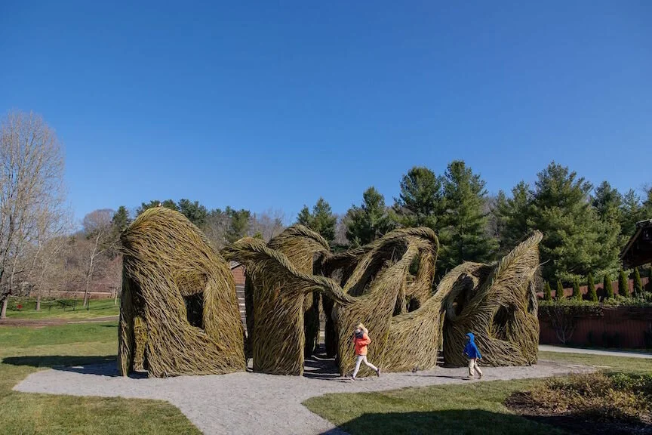
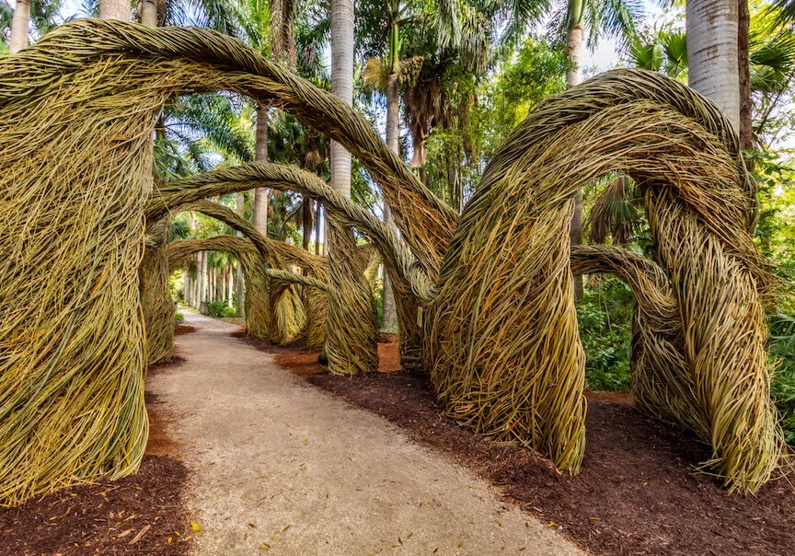
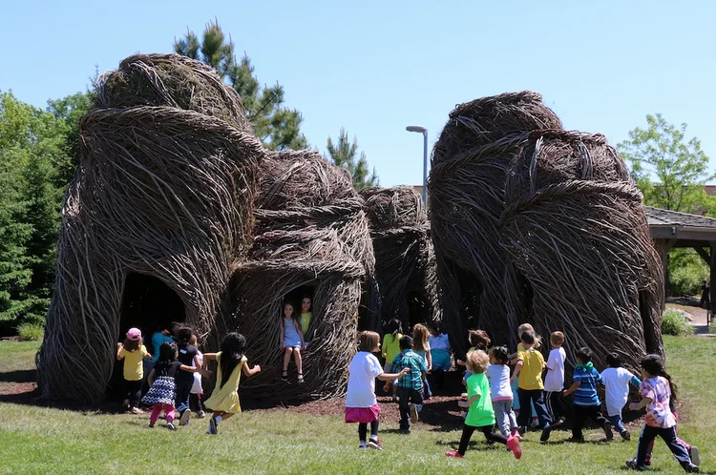
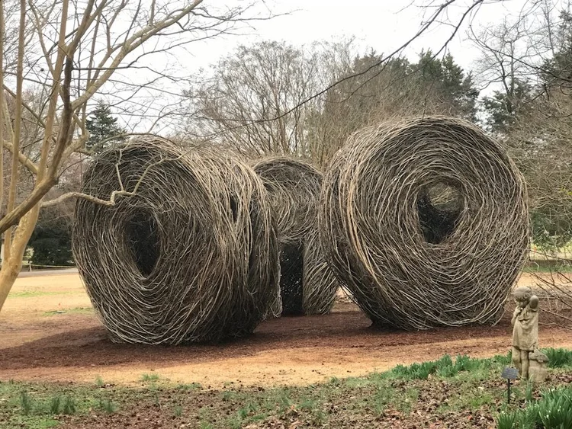
Notes:
1st photo – Free as a Bird, Biltmore, Asheville, NC, 2021
2nd photo – Grand Central, Mckee Botanical Garden, Vero Beach, FL, 2020
3rd photo – Roly Poly, Huntsville Botanical Garden, Huntsville, AL, 2022
4th photo – Tangle Town, Children’s Museum of South Dakota, Brookings, SD, 2017
Dougherty creates his outdoor sculptures/installations knowing that they will be temporary. They last a few months to a couple of years.
The sculpture will remain in place typically for one to three years, depending upon the natural elements. Dougherty will often teach staff and volunteers how to do the minimal maintenance that is required. Mother Nature will determine how long the sculpture is ultimately enjoyed.
His installations are meant to capture the imagination of a viewer, encourages engagement and exploration.
Dougherty draws inspiration from architecture, basket making, flower arrangements, structures built by children, bird nests…
Dougherty’s installations strive to reconnect the viewer with nature. He thinks about how to live in harmony with plants and animals, and he hopes his sculptures made from twigs will raise environmental awareness.
QUESTIONS:
Dougherty’s sculptures are temporary. What does temporary mean?
Not permanent, will not last forever.
Thinking about Goldsworthy, his installations sometimes only lasted a day. However, Dougherty’s installations can last for a few months to years.
What does Dougherty’s art make you think about?
Does it make you feel connected to nature?
Does the work make you want to explore it, run through it, touch it?

Slide 6
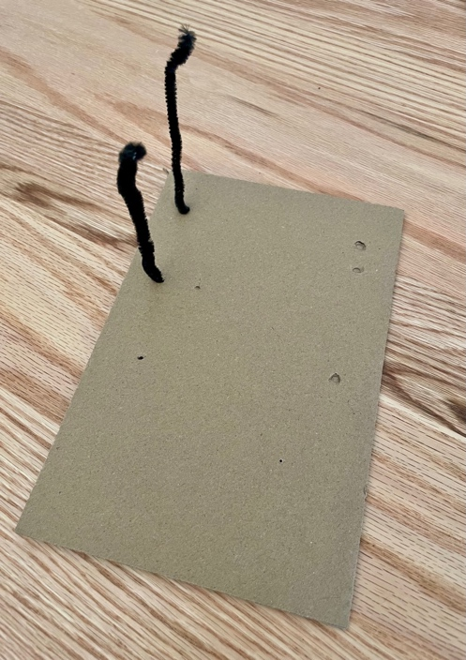
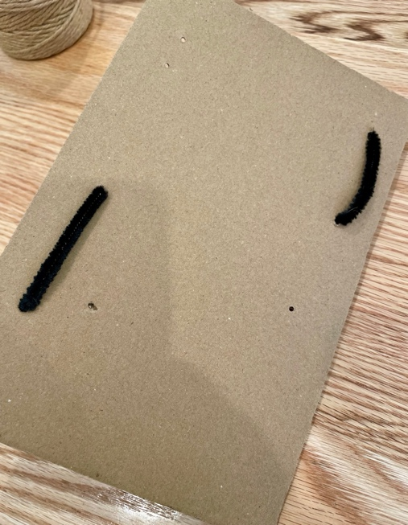
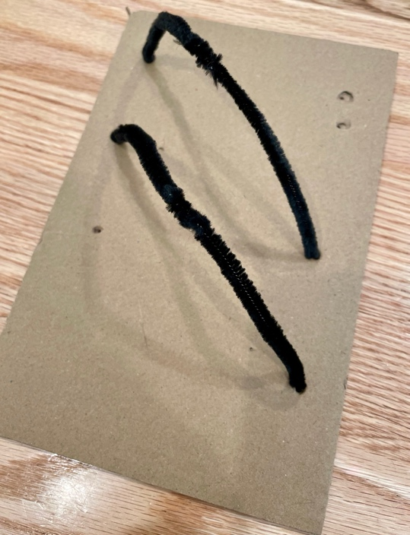
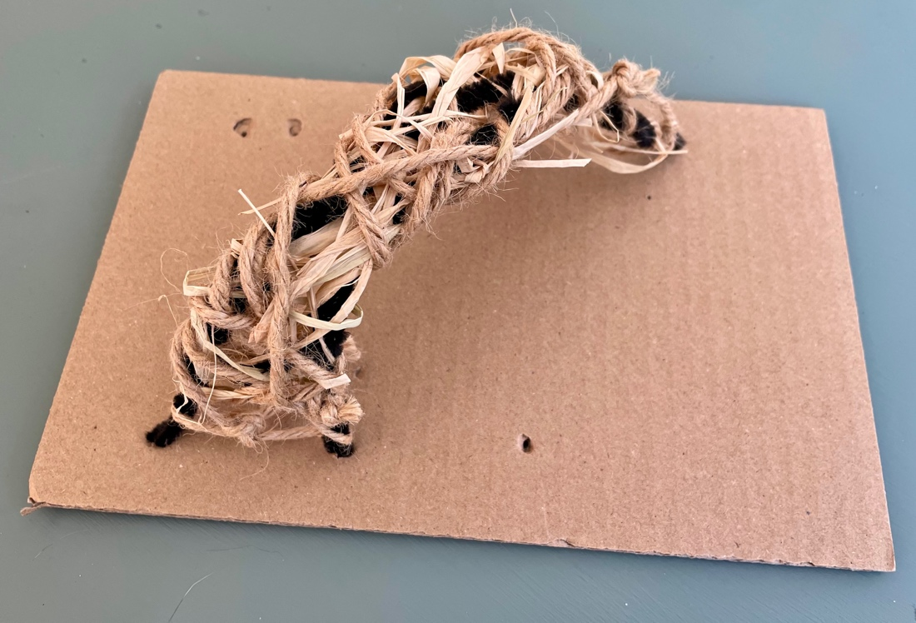
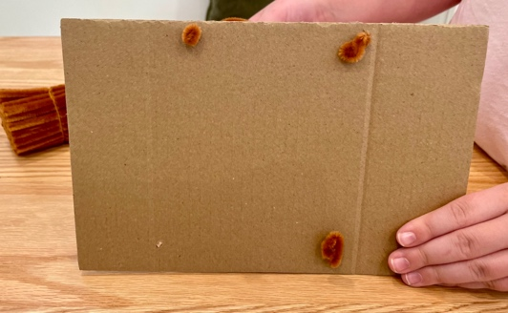
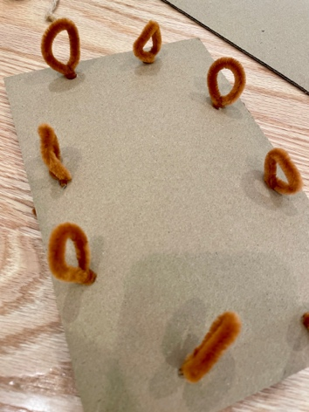
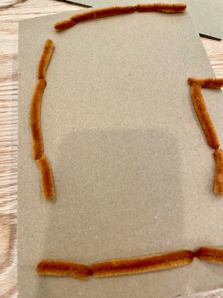
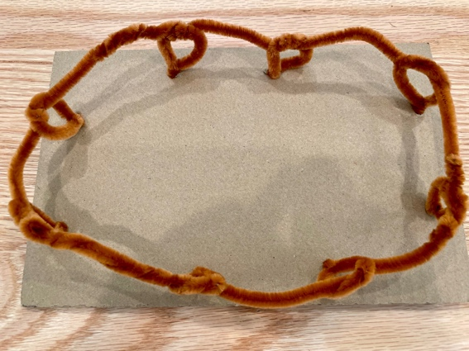
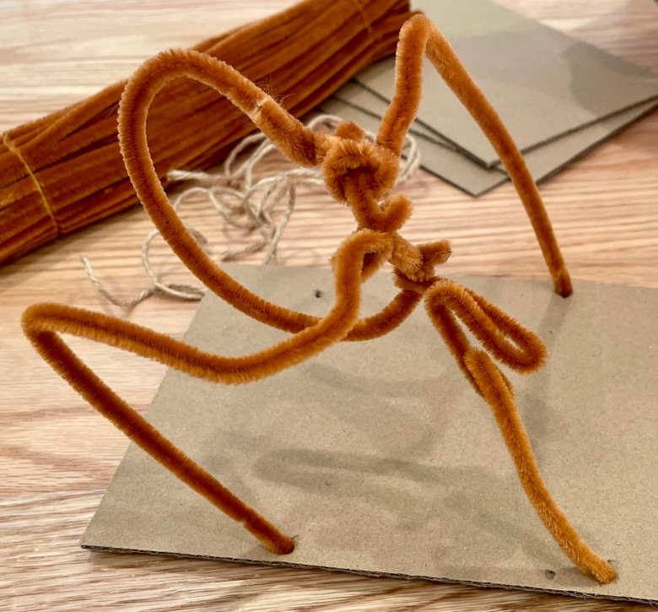
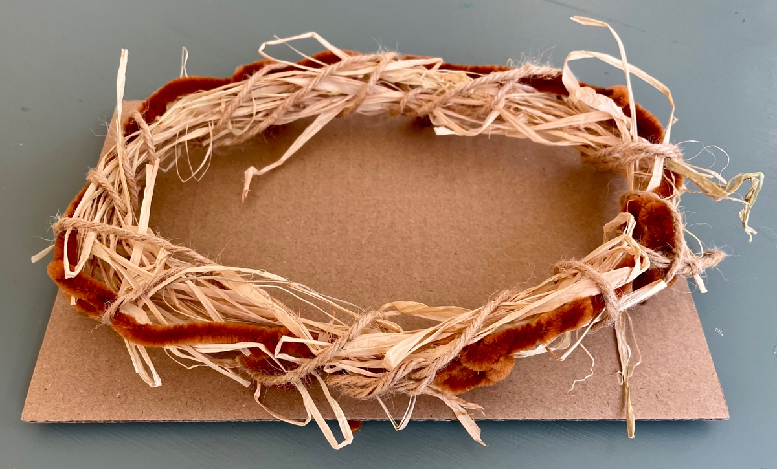
Art Project: Be inspired by Patrick Dougherty! Create your own mini sculpture.
Using the collage materials provided, imagine you are outside, what would you make?
Back
Front
Thread pipe cleaners through holes
Weave twine and raffia between the pipe cleaners
Think nests, towers, forts, mazes, animals, etc. Use your imagination. You can make anything!
Back
Front
Back
Front
STAY TUNED! We hope to build our own outdoor installation inspired by Dougherty near the NEST. More information to come soon – we’ll need everyone’s help!
Notes:
Great Art Project Instructions – Patrick Dougherty
Project Description:
Students will learn about Patrick Dougherty “Stickman” and construct mini sculptures inspired by Dougherty’s “stick works.” Dougherty is an American environmentalist artist known for creating over 300 sculptures and installations using sticks and saplings.
Grades: K - 6
Art Project: using pipe cleaners, twine, and raffia, students will create their own Dougherty inspired “stick work.”
Optional: the art may be collected and displayed (dependent on the teacher’s approval) at the end of the session.
Reminders: remind students to sign their artwork.
Materials: all grades will use the same project materials.
Per student: one sheet of cardboard. Cardboard has been punched in advance to make weaving the pipe cleaner through the cardboard easier. Students can add extra holes; lower grades may need assistance.
Shared by students: scissors, a variety of collage materials including pipe cleaners, twine, and raffia.
Considerations/ideas:
If we were outside, what would you make? Could you find sticks and saplings like Dougherty to make an art installation?
What did Dougherty like to make? Think nests, towers, forts, mazes, animals, etc. Use your imagination. You can make anything! Let the materials inspire you.
Use these supplies to imagine what you would make outside. Experiment and have fun!
STAY TUNED! We hope to build our own outdoor installation inspired by Dougherty near the NEST. More information to come soon – we’ll need everyone’s help!

