Slide 1
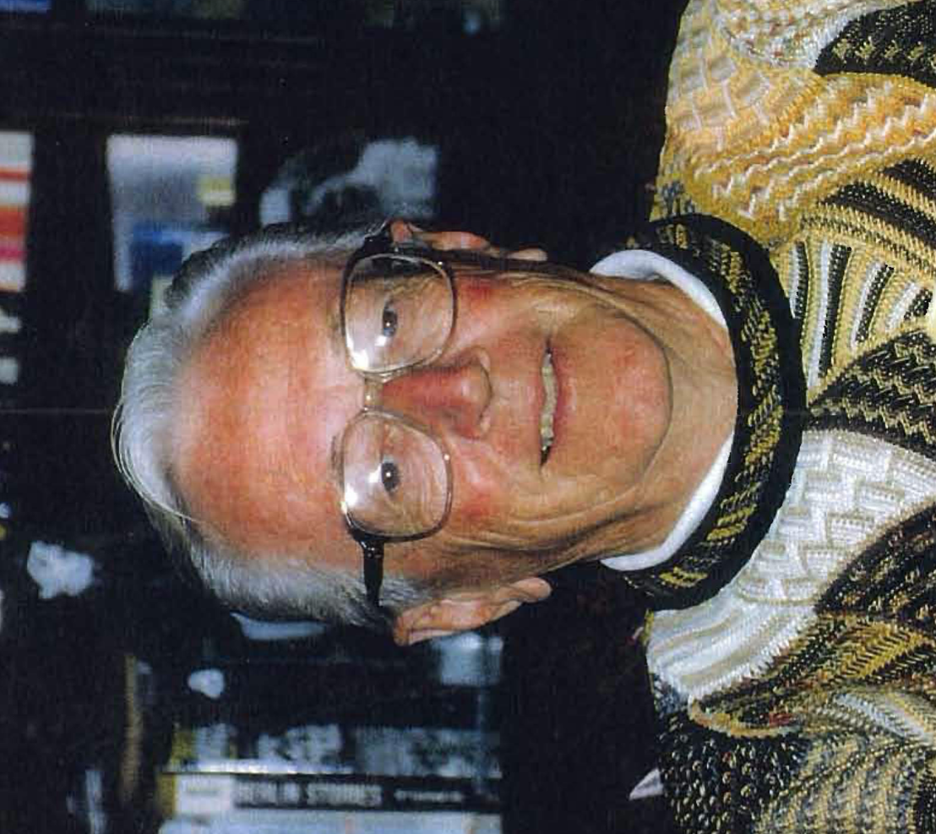


CHARLES
M. SCHULZ
1922-2000
Notes:
Image from the Charles. M. Schulz Museum, Santa Rosa, CA
______________________________________________________
PRESENTER NOTES:
Allow 10-15 minutes for presentation. Please feel free to cut and shorten where needed, focusing on the 3 BIG IDEAS.
QUESTION:
Does anyone know what Charles Schulz was famous for drawing?
(Give hints, such as a black and white dog that is owned by someone named Charlie, etc. and see if they can guess. Or you can just tell them Charlie Brown and see if they have any connections to that before moving on.)
BIG IDEA #1: Charles Schulz was a famous American cartoonist best known for the comic strip Peanuts (featuring Charlie Brown, Snoopy, among other well-known characters). He is considered one of the most influential cartoonist of all time. He is cited as a major influence by many later cartoonists.
Charles Monroe Schulz was born in Minneapolis, Minnesota, on November 26, 1922. Does anyone know where Minnesota is? It’s in the USA and borders the states of Wisconsin, Iowa, North Dakota, and South Dakota.

Slide 2
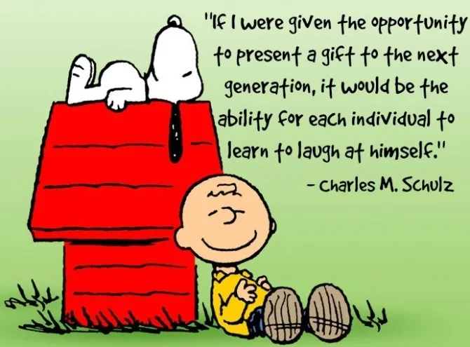
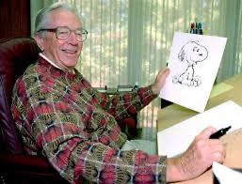
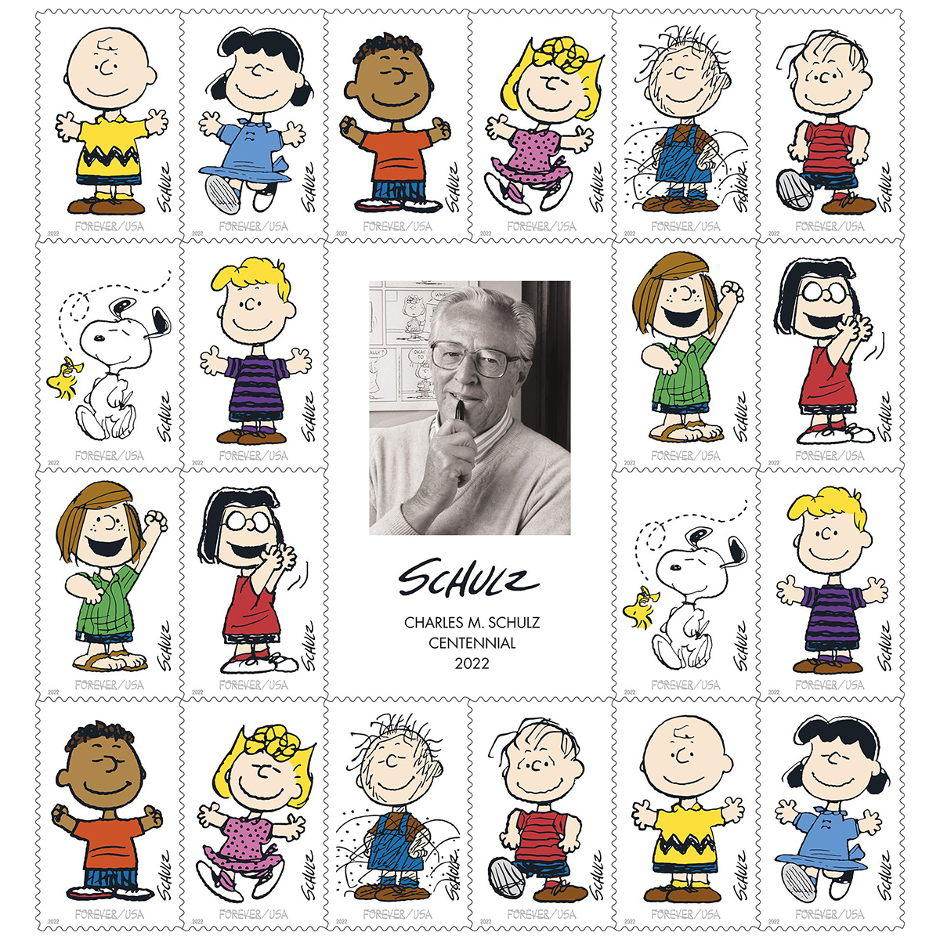
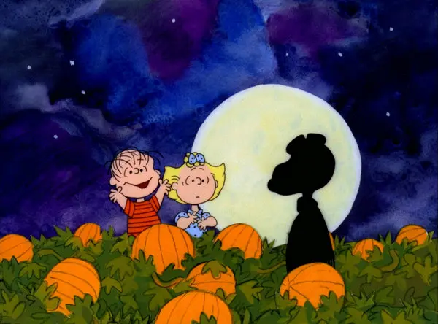
Charles Schulz drew Peanuts for about 50 years
Notes:
Image from Kids Britannica, Charles Schulz holds a drawing of the character Snoopy
from the Peanuts comic strip.
Charles Schulz, philosophy of life
Peanuts Stamps, the United States Postal Service (USPS) saluted the centennial of
Charles M. Schulz with stamps featuring his unforgettable Peanuts characters.
The Great Pumpkin, 1966
______________________________________________
Schulz drew the popular cartoon Peanuts for about 50 years.
At its most popular, Peanuts was published daily in 2,600 papers in 75 countries, in 21 languages. Schulz drew nearly 18,000 strips over the nearly 50 years that Peanuts was
Published. The strips, plus merchandise and product endorsements, produced more than $1 billion per year, with Schulz earning an estimated $30 million to $40 million annually.
QUESTIONS:
Are you familiar with Peanuts? Can you name some of the characters? Do you have a favorite?

Slide 3
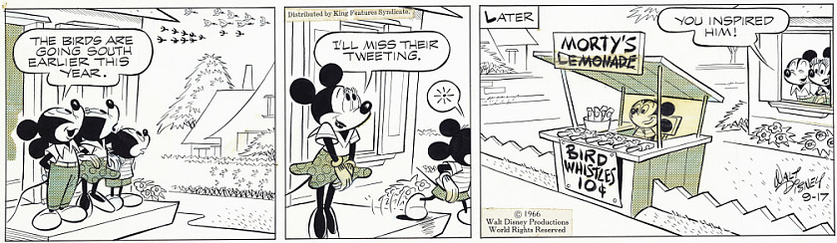
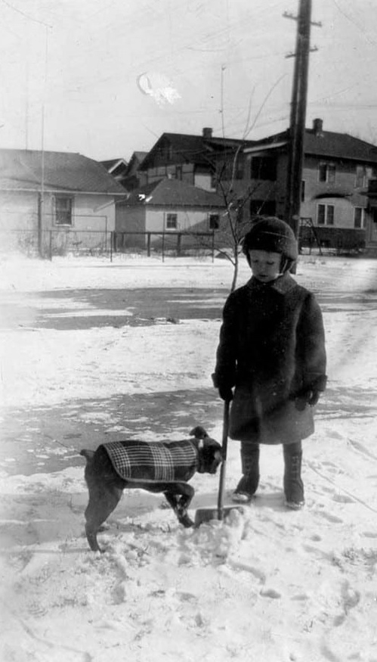
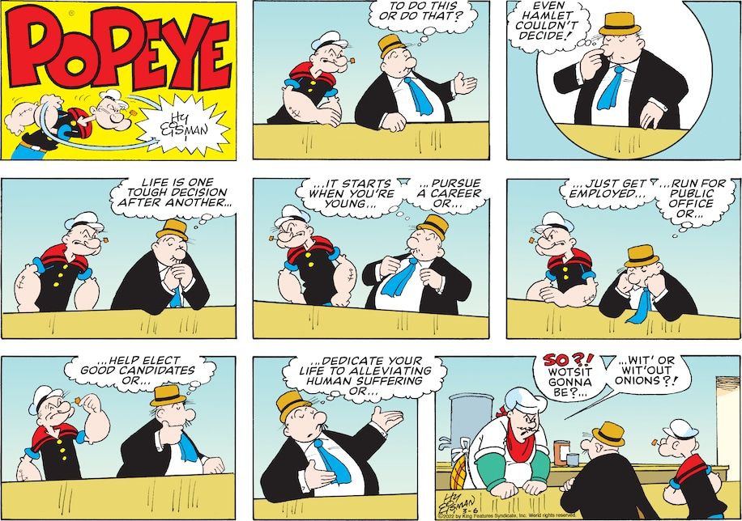

“Charles, you’re going to be an artist”
Young Charles in the cold winter snow
Notes:
Mickey: https://americanhistory.si.edu/collections/search/object/nmah_797660
Skippy: http://www.skippy.com/
Popeye: https://www.washingtonpost.com/comics/2022/06/03/popeye-strip-randy-milholland?
_____________________________________________________________________________________
Throughout his youth, Charles shared a Sunday morning ritual reading the funnies with his father. Charles was fascinated with comic strips like Skippy, Mickey Mouse, and Popeye. In those days, people did not have television or electronic games in their homes.
His family had received a photo from relatives in California. The photo was of a palm tree; Charles had never seen a tree like that before! One day his kindergarten teacher handed out paper and crayons and asked the children to draw something they liked. It was probably a cold winter day as he drew a man shoveling snow off a sidewalk. Then he drew a palm tree in the snowbank. His teacher loved the odd-looking picture and told him, “Someday, Charles, you’re going to be an artist.”
QUESTIONS:
What comics or cartoons do you like?

Slide 4
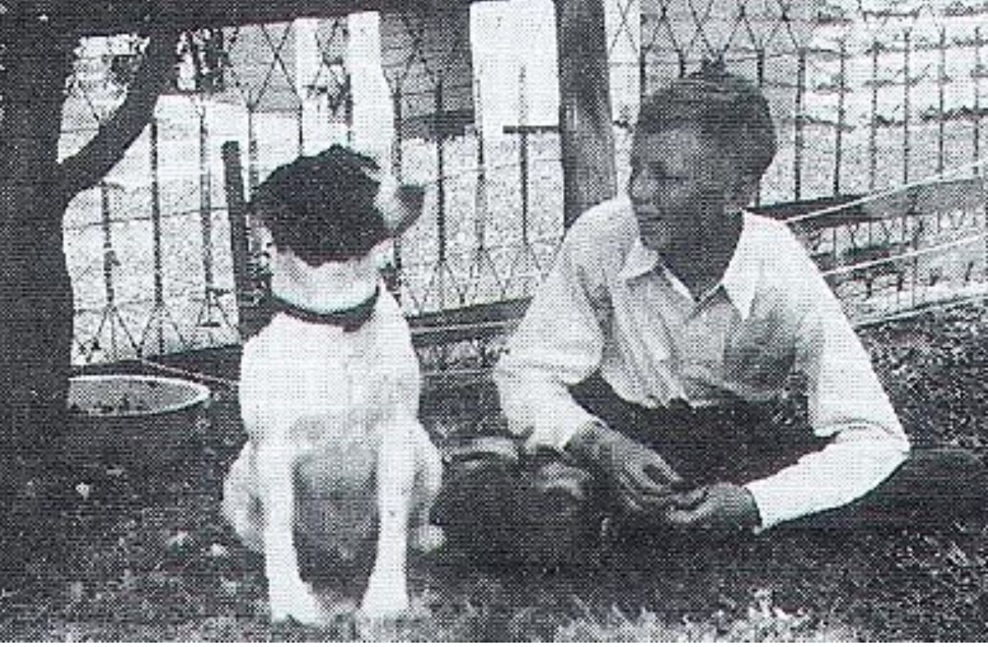
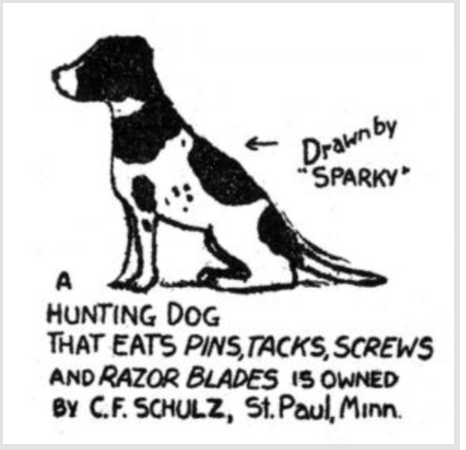
Young Charles Schulz
Charles’s first published drawing
Notes:
Photograph of a young Schulz with his dog, Spike.
Schulz’s first publication of Spike in Ripley’s Believe it or Not.
_____________________________________________________
In the 1930s, Schulz had a black and white dog that later became the inspiration for Snoopy; his name was Spike. Spike was a smart dog who could ring the doorbell, fetch potatoes from the cellar, and eat almost anything without getting sick!

Slide 5
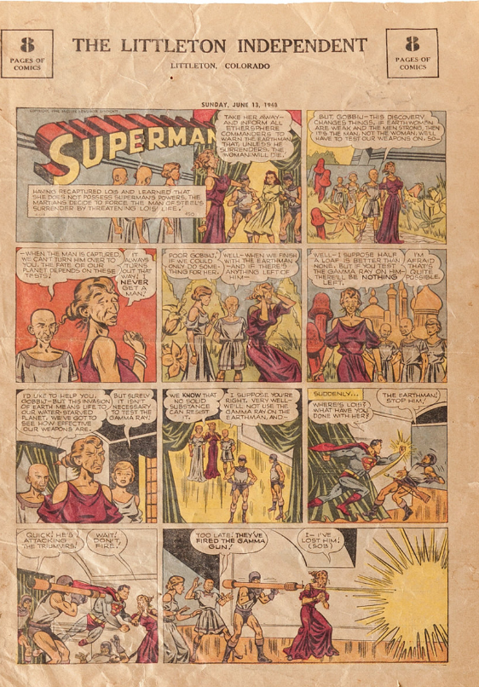
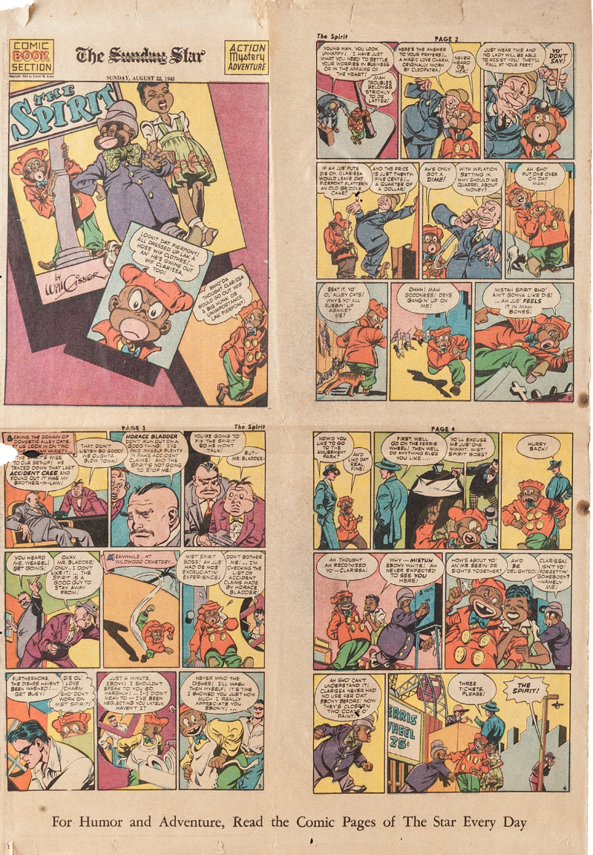
What is a cartoon?
Notes:
QUESTIONS:
What is a cartoon? What are characteristics of a cartoon?
A drawing, or a series of drawings. It can appear in a newspaper or magazine.
A cartoon can also be a film or TV show made by photographing a series of drawings. An animated TV show or film.
It can tell a story. Series of drawings in a narrative strip – comic strip.
Often it is humorous and/or comments on something.
BIG IDEA #2: Charles Schulz drew cartoons and was interested in building a story.
As a child, Charles liked movies, especially action films like cowboy and Tarzan films. Watching films taught him how the action on the screen moved forward, building excitement from scene to scene. He used this same technique later in his comics.

Slide 6
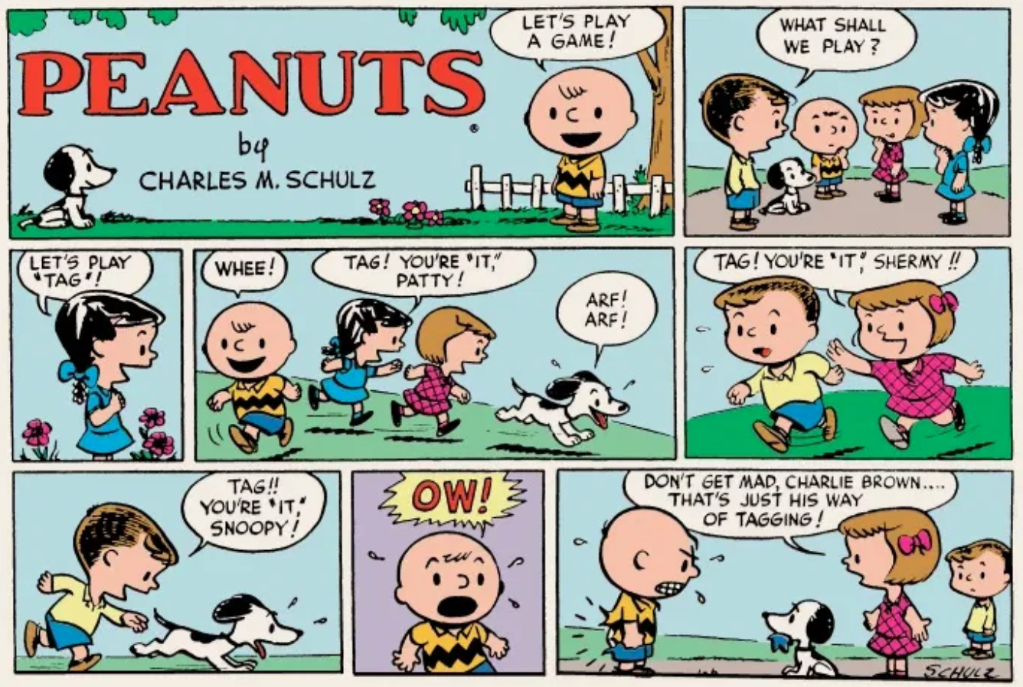
Notes:
Strip from Sunday Peanuts page, 1952-55 United Feature Syndicate, INC.
______________________________________________________________
In 1950, after several rejections, Schulz sold his strip to United Feature Syndicate. The syndicate renamed his strip, Peanuts, a title Schulz never liked.
That year Peanuts debuted in seven newspapers, including the Star Tribune of Minneapolis, The Washington Post, and Seattle Times.
Everyone commented on how unique Peanuts was; it looked so different from other strips. It was not cluttered with details, he left white space, so his characters stood out. He had a horizontal line, a few steps, or maybe a curb for the kids to sit on.
In 1952, the first Sunday Peanuts page was published in color; the strip was then featured in over 40 U.S newspapers.

Slide 7
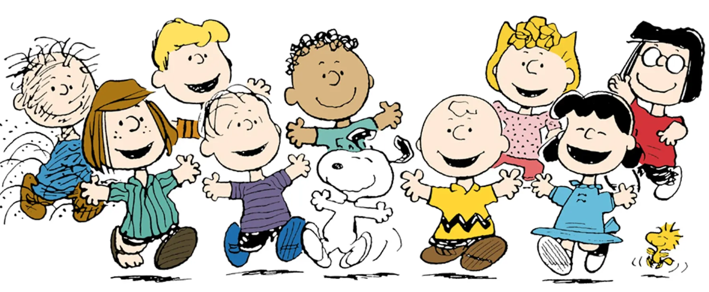
Schulz used real events in his comics
Notes:
Comic strips from Peanuts, United Feature Syndicate, INC.
______________________________________________________
BIG IDEA #3: Charles Schulz used events from his life in his cartoon strips. He made real facts funny. This is what made him stand out among other cartoonists.
When Schulz was lonely, he drew Charlie Brown lonely.
When he was worried about the meaning of life, he drew Snoopy worrying about the meaning of life.
He also used his strip to honor holidays, issues of the time, and special historical dates.
Schulz’s characters were both wise and innocent. This was the magic of Peanuts. An example of this is Linus expressing his opinions about religion and philosophy, while holding onto his “security blanket.”
His humor was at times observational, wry, sarcastic, nostalgic, bittersweet, silly, and melancholy, with occasional flights of fancy and suspensions of reality thrown in from time to time. https://schulzmuseum.org/about-schulz/schulz-biography/
At its peak, roughly 355 million people in 75 countries read Charles Schulz’s strip. The year Schulz retired, 1999, Peanuts appeared in more than 2,600 newspapers worldwide, and over 20,000 products had been developed based on Peanuts.

Slide 8
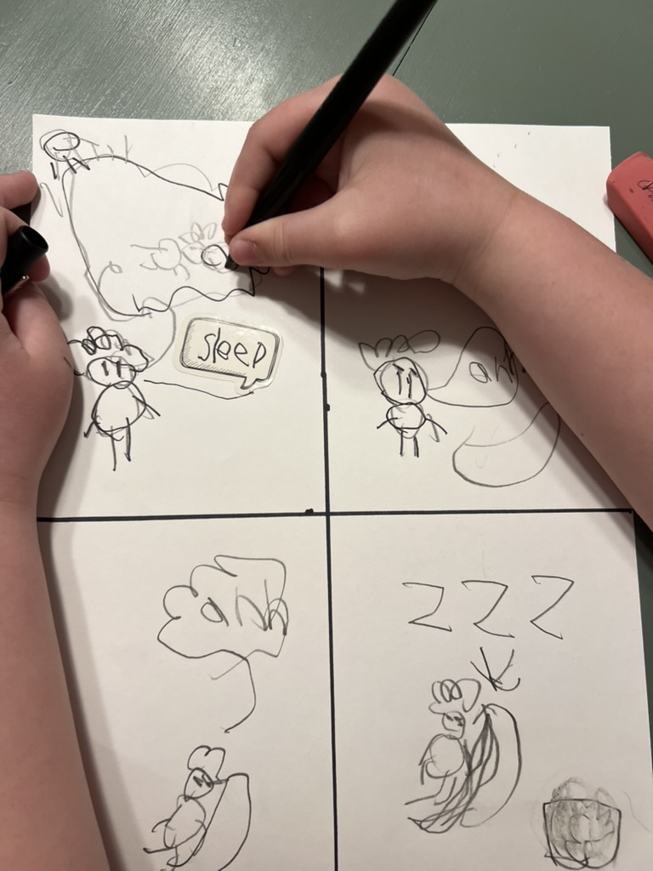
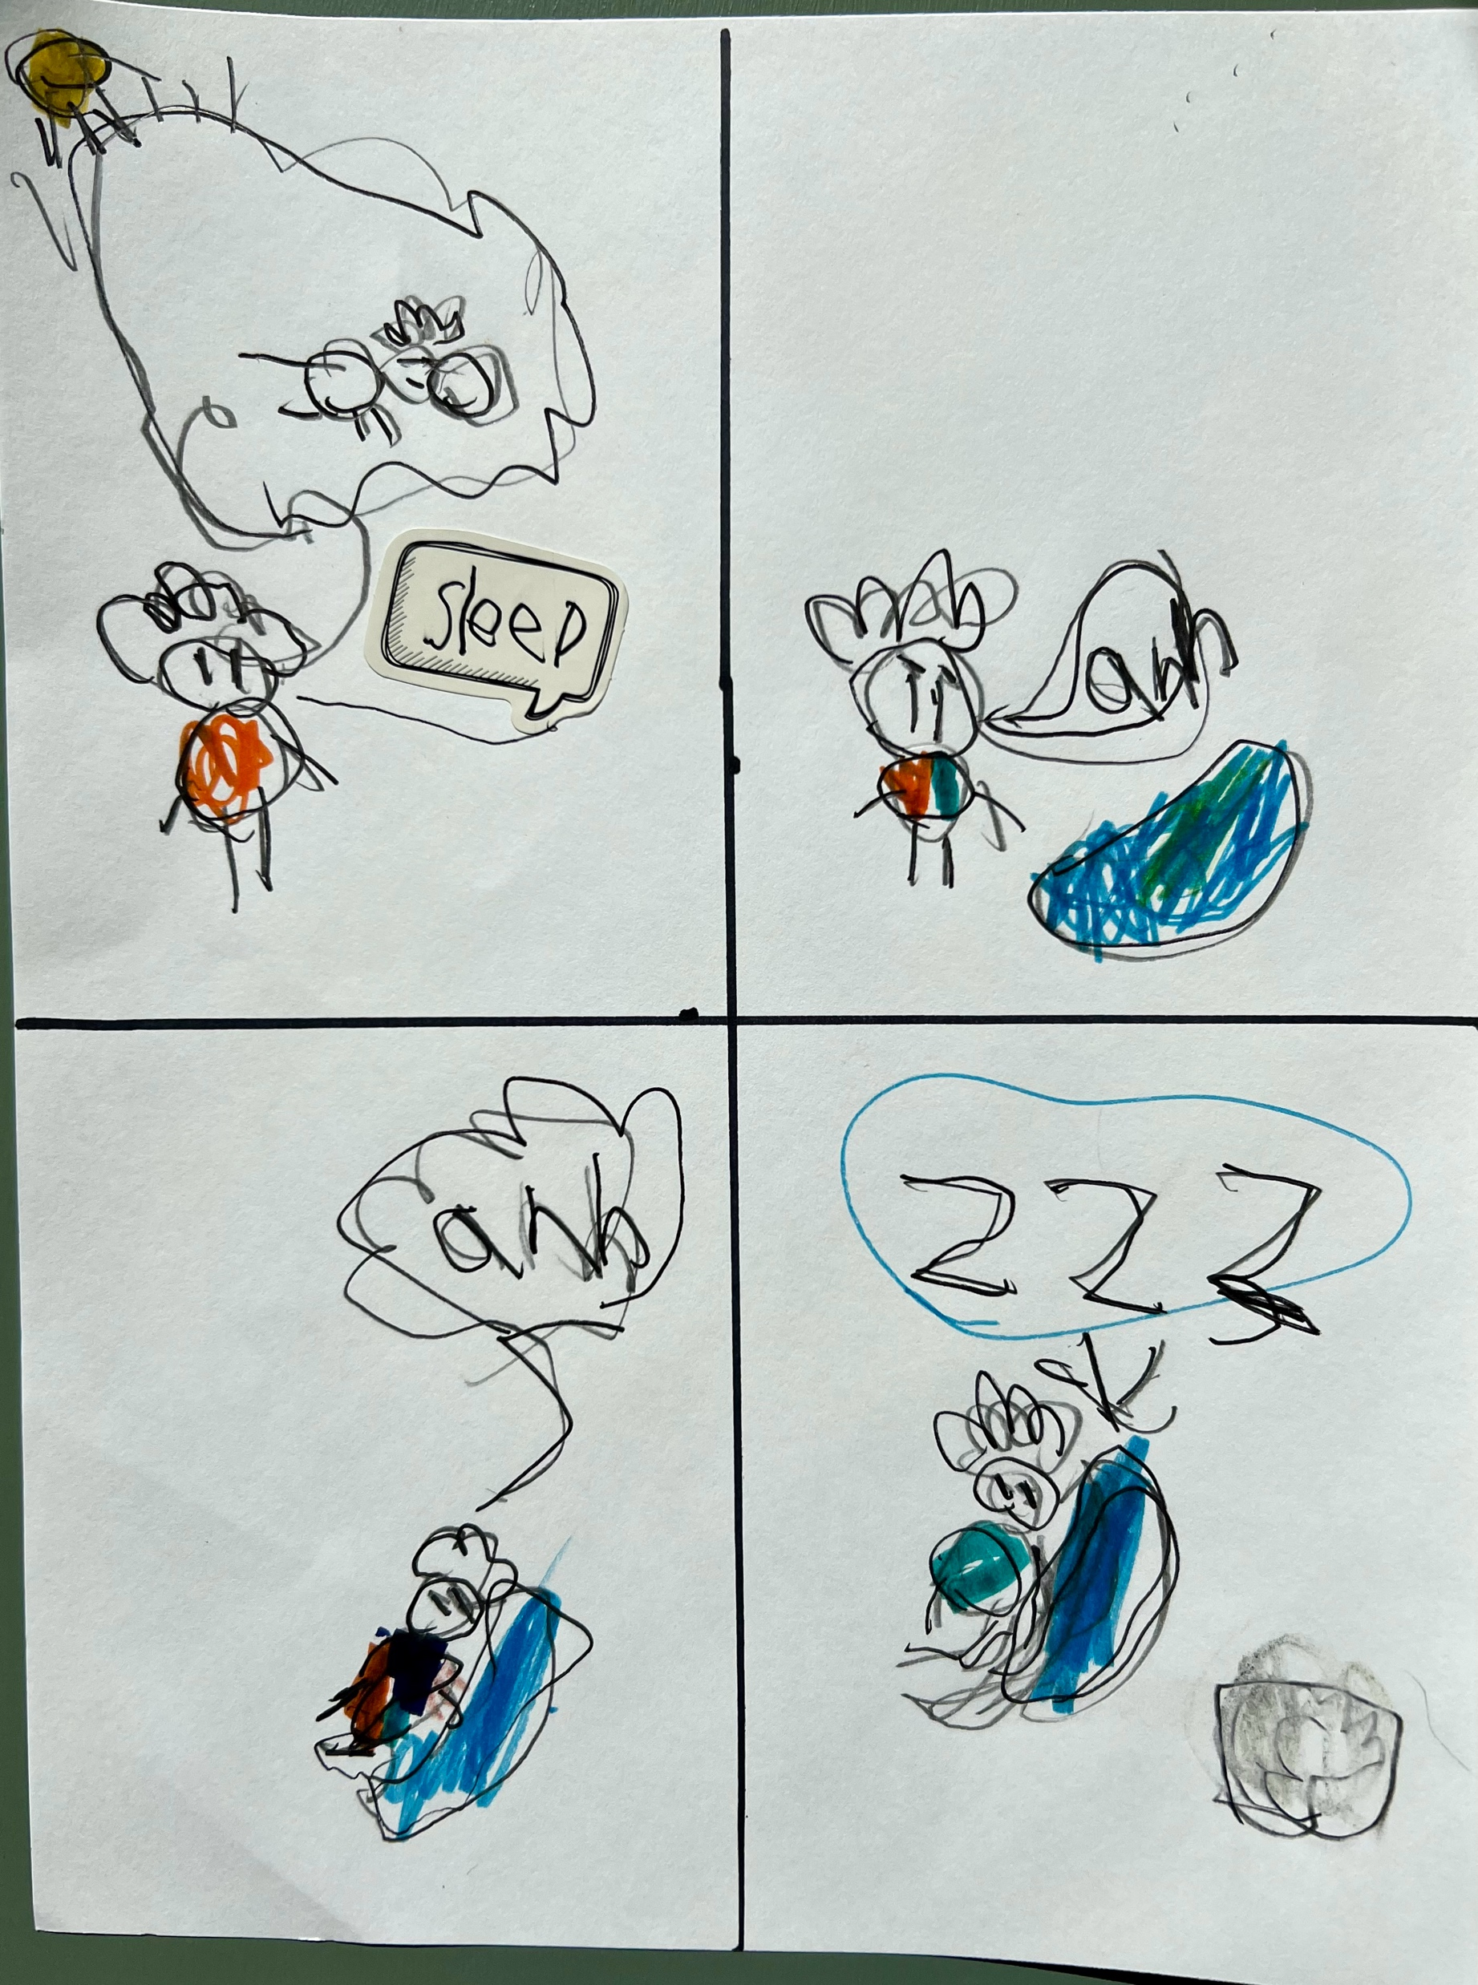
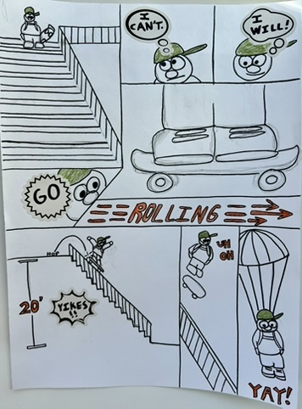
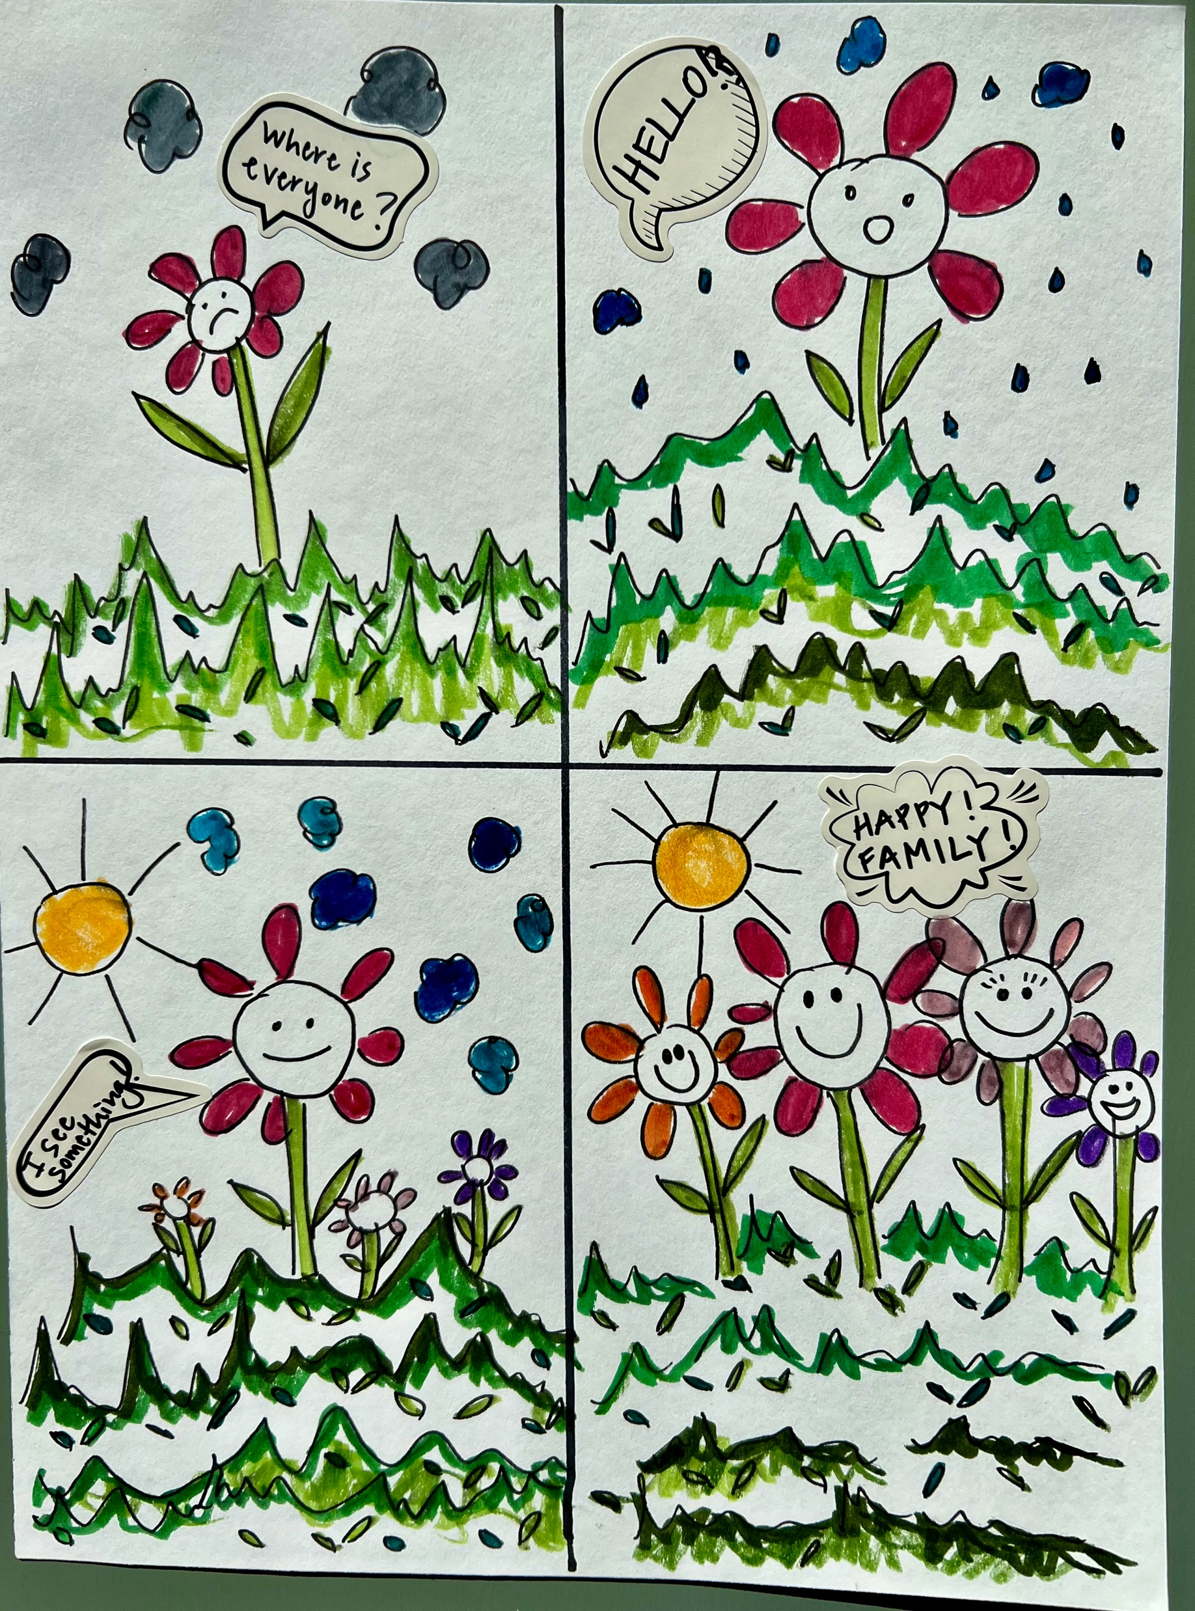
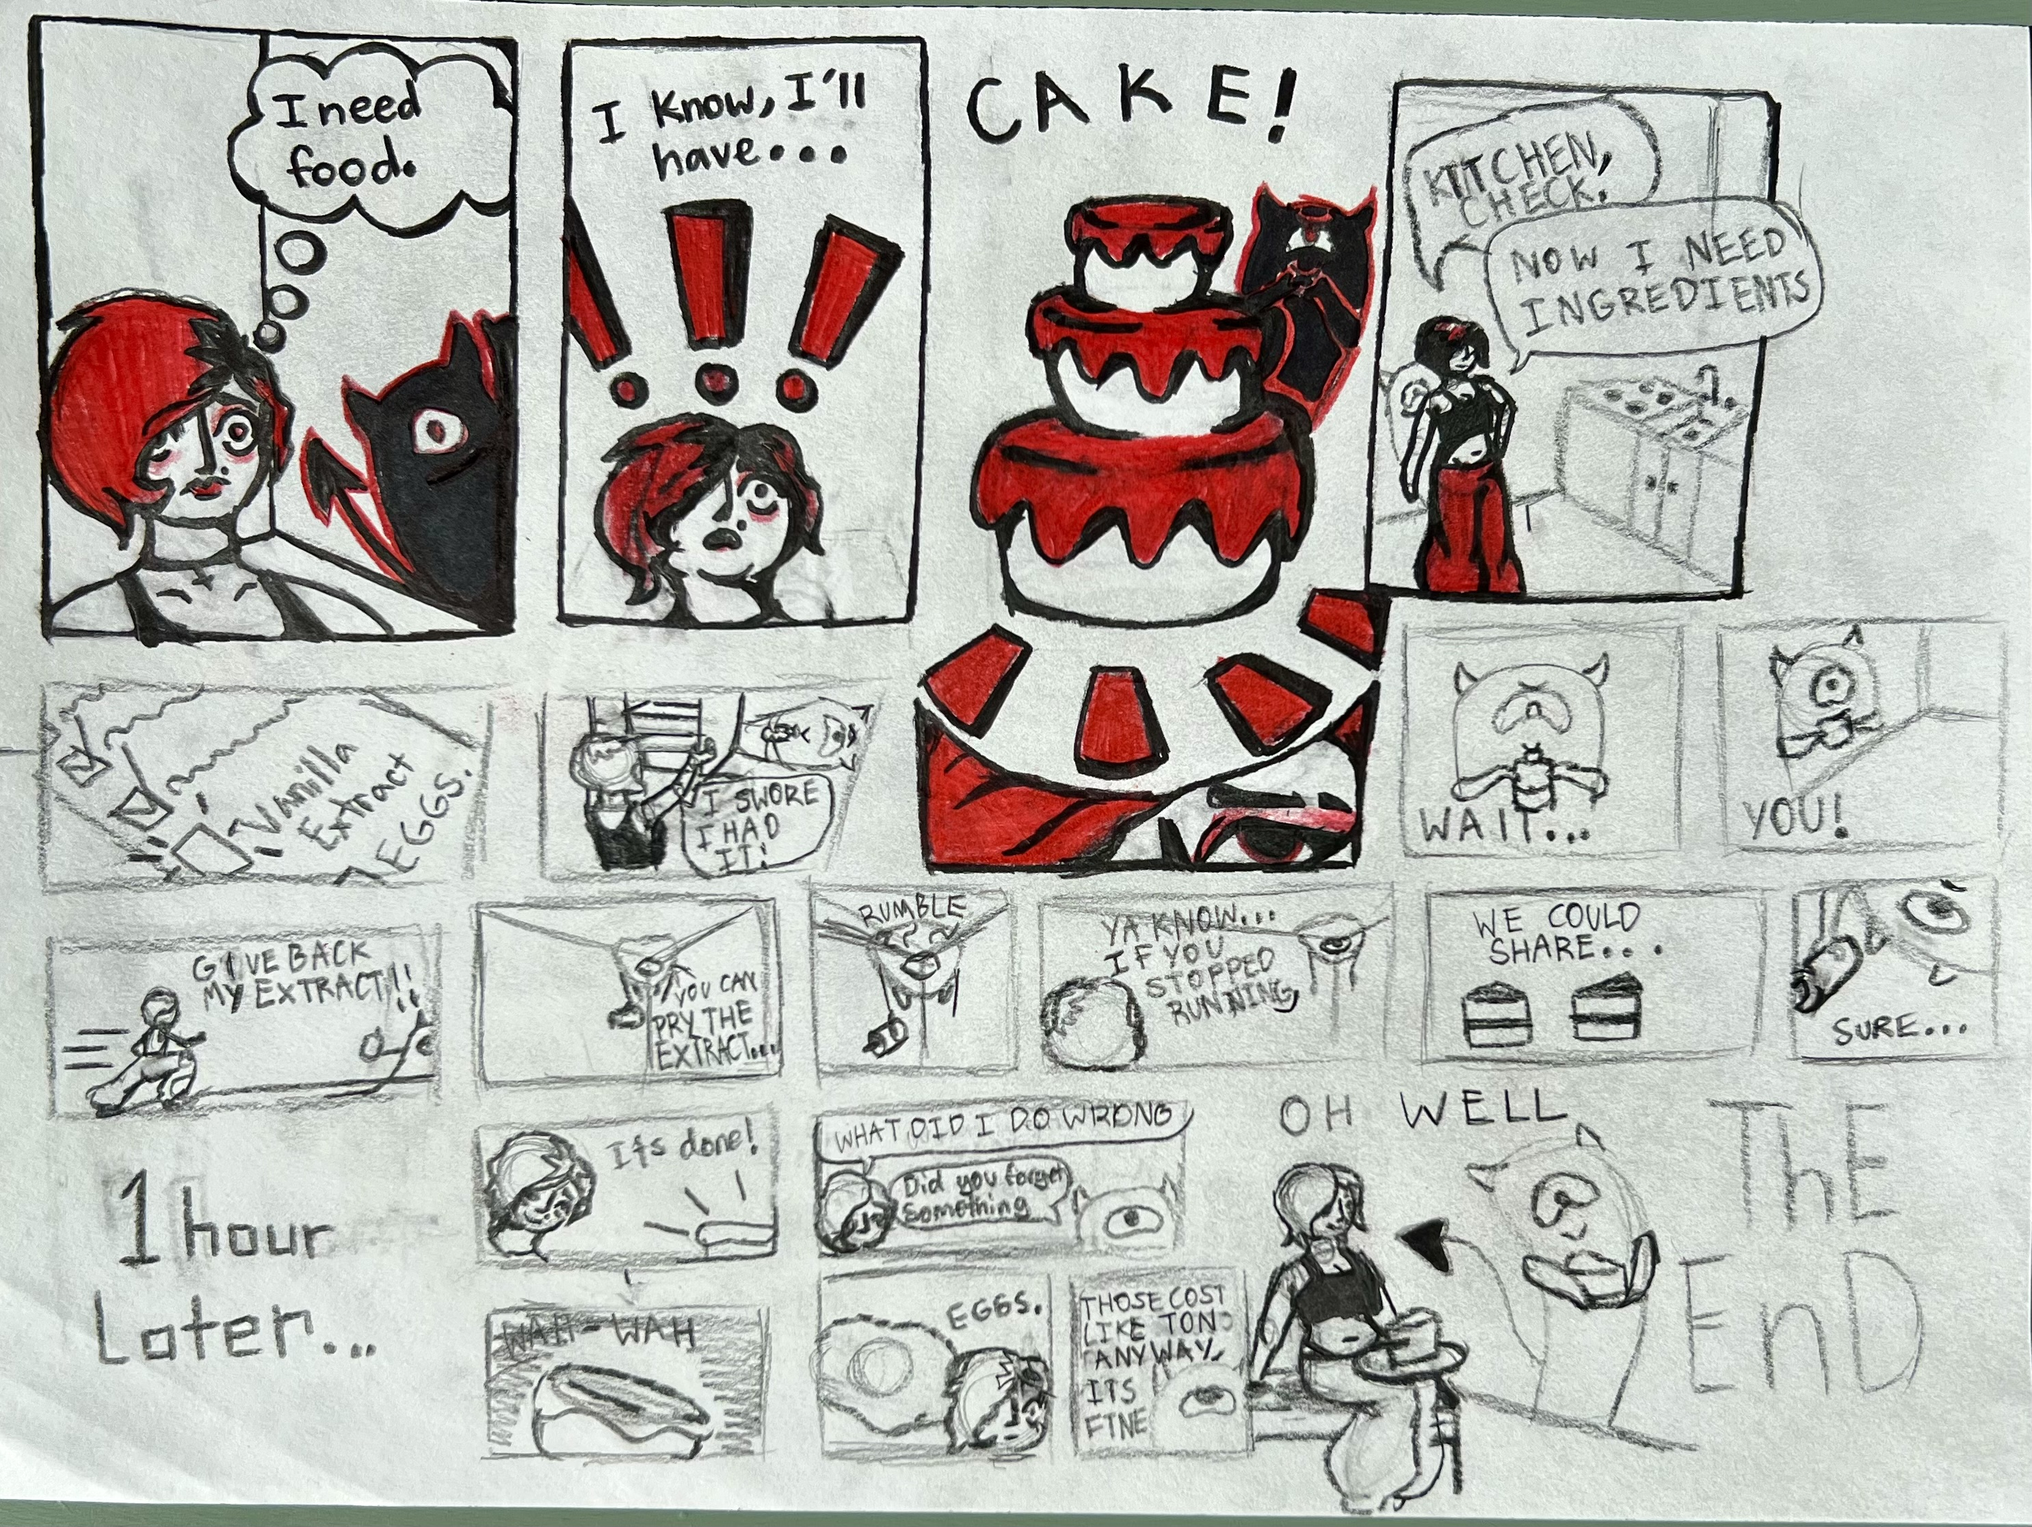
Create your own comic strip!
What makes you laugh?
Notes:
Great Art Project Instructions – Charles Schulz
Project Description:
Students will learn about Charles Schulz and create their own comic. Charles Schulz was a famous American cartoonist best known for the comic strip Peanuts.
Grades: K - 6
Art Project: using white paper, markers/colored pencils, and speech bubbles, students will draw their own comic.
Optional: the art may be collected and displayed (dependent on the teacher’s approval) at the end of the session.
Reminders: remind students to sign their artwork.
Materials: all grades will use the same project materials, except K-2 will have some pre-drawn comic strip panels.
Per student: one sheet of white paper
Shared by students: markers, colored and graphite pencils, rulers, and speech bubbles (stickers)
Considerations/ideas:
Use these supplies to create your own comic.
Schulz was inspired by events in his life to make his comics and added his sense of humor. Is there a story you want to tell? Real or imagined? What makes you laugh?
Experiment and have fun!

