Slide 1
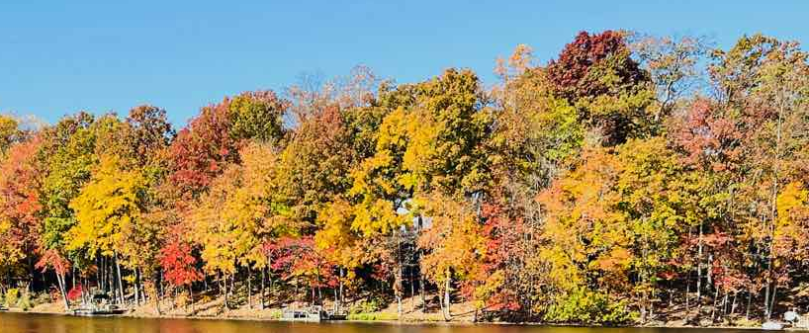
Trees
Amazing Earth - First Grade
Notes:
As we talk about trees, we are going to think like scientists!
We are going to:
Ask questions,
observe,
classify, and
conduct investigations.

Slide 2
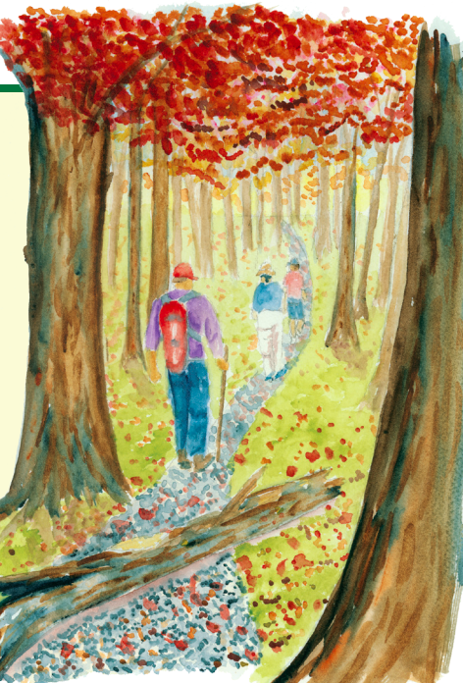
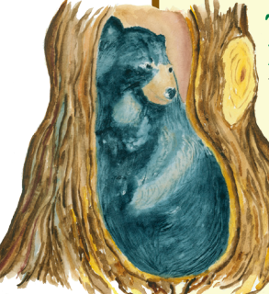
Notes:
Scientists study trees because they are are incredibly important to life on Earth.
ASK “Who can share why trees are important?”
[Let students answer then share]
provide wildlife habitat
produce oxygen that we need to breathe
clean the water and the air
grow food to eat
We also use trees every day!
ASK “Who can share products we use that are made with trees?”
[Let students answer]
Did you know also included are rubber tires made from tree sap and even aspirin made from the bark of the willow tree.
And in the state of Virginia forestry is big business! Trees contribute over $21 billion to the economy and support more than 108,000 jobs.

Slide 3
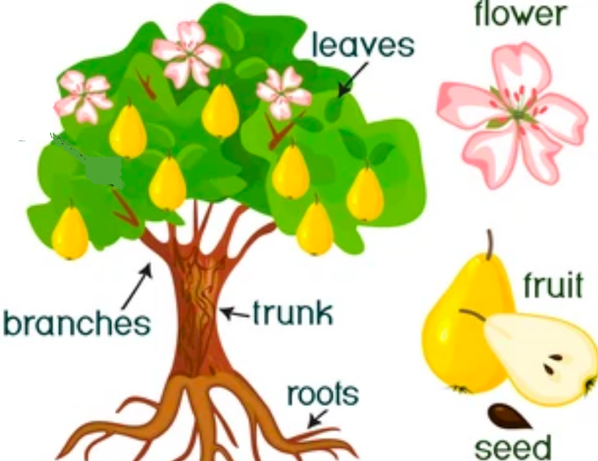
What is a tree?
Notes:
Let’s think like scientists and learn more about trees.
All trees are plants, but not all plants are trees.
Trees have specific parts that make it a tree.
ASK “Who can tell us the parts of a tree?”
[Let the students answer.]
[Click to reveal image with answers labeled]
Trees have:
a single, thick woody stem called the trunk that is covered in bark
branches that extend out from the trunk of the tree
leaves
roots
seeds in cones or flowers with seeds in fruit

Slide 4
How do a tree’s parts work together?
Notes:
The parts of the tree work together so the tree can:
grow,
survive, and
reproduce.
Let’s look at a few!

Slide 5
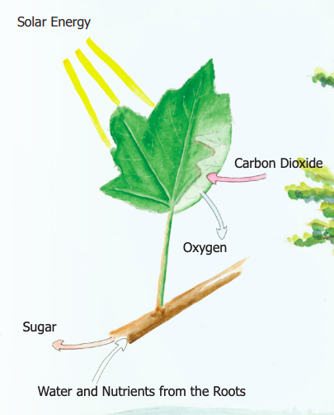
The Tree’s Food Factory
Photosynthesis
Chlorophyll
Sugar & Oxygen
Notes:
In order to grow, trees need food.
And not just any food. They need sugar.
But they can’t get sugar by eating candy. Instead, they make their own sugar!
Welcome to the tree’s food factory - the leaves!
Trees make their own food by photosynthesis.
Photosynthesis takes place in the leaves with the help of a green substance called chlorophyll.
This is why leaves are green!
With the sun’s energy, water and carbon dioxide are combined in the leaf to make sugar and oxygen.
The tree releases the oxygen into the air.
The tree uses the sugar to produce all of its parts and to grow larger.

Slide 6
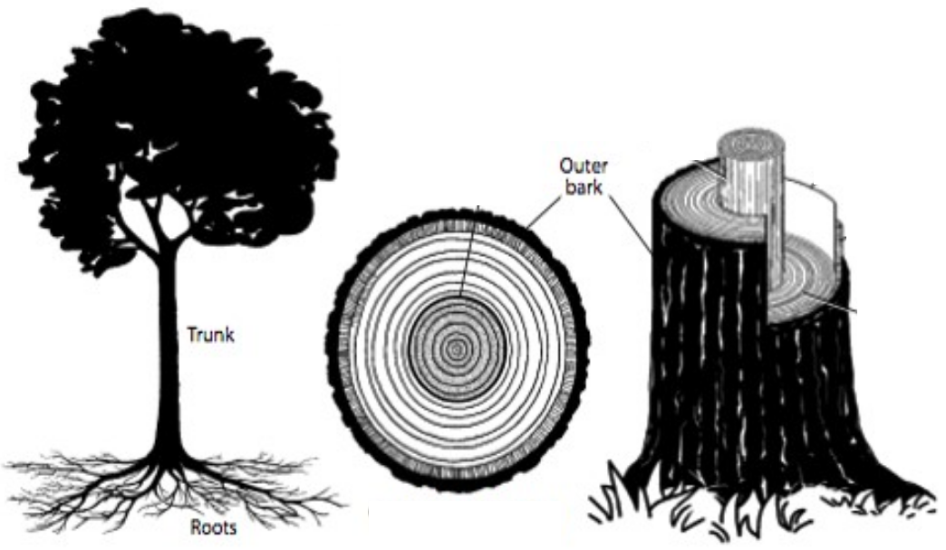
The Tree’s Support System
Notes:
In order to survive, the tree needs support and protection.
This is the tree’s support system:
The trunk is very strong and supports the weight of the tree’s branches.
The trunk also transports food and water and stores energy.
The trunk is covered in a thin, but tough layer called bark.
Bark protects trees from injuries, weather, and critters that can hurt the tree.
The roots grow from under the tree trunk down and out into the ground.
Roots anchor the tree to the ground, and take in water and nutrients from the soil.

Slide 7
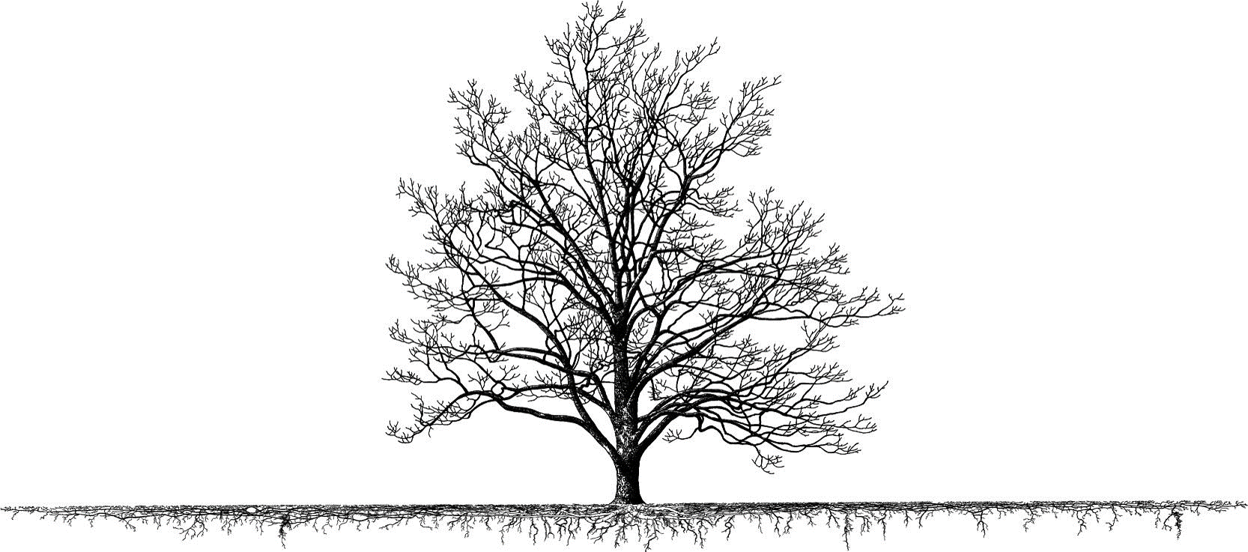
Notes:
Three fun facts about roots:
1. This is what an open grown tree really looks like. Its root network is often wider than the tree is tall to get more water and oxygen.
.
2. Roots absorb water very fast. A big tree’s roots can suck in more than 100 gallons of water from the soil every day!
3. Nutrients and water can transfer from one tree to another tree through their roots.

Slide 8
Are all trees tall?
Notes:
ASK “Raise your hand if you think all trees are tall.”
[Let the students raise their hands. ]
Trees are tall plants.
But trees come in very different sizes.
And tall often depends on what you are comparing it to.

Slide 9
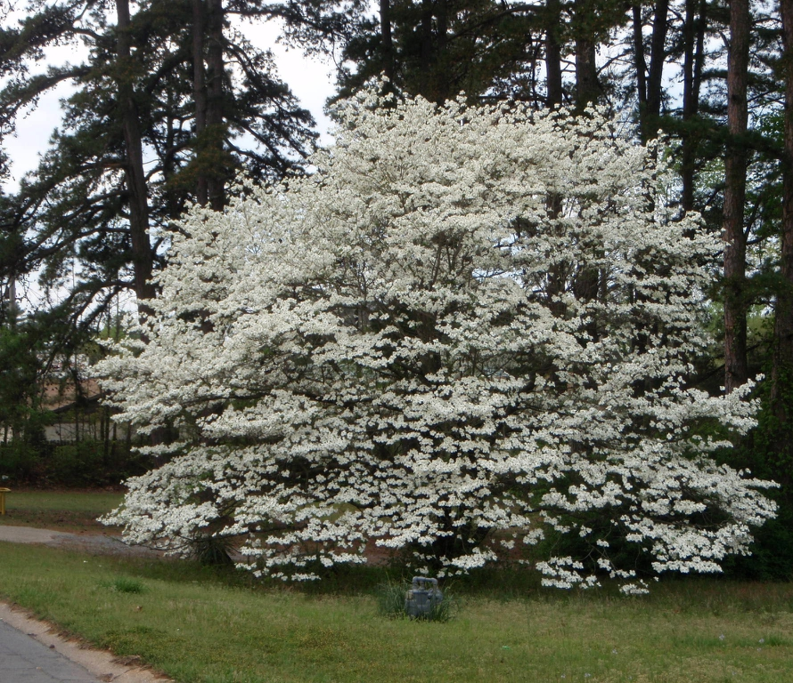
Flowering Dogwood
20 feet tall
Notes:
Our state tree, the Flowering Dogwood, grows to about 20 feet tall,
ASK the students: “Is that tall?”
(Let the students answer)
ASK the students: “What if we compared a Dogwood to a 1st grader. is a Dogwood is tall?”
(Let the students answer)
Let’s see how the Dogwood compares to other trees!

Slide 10
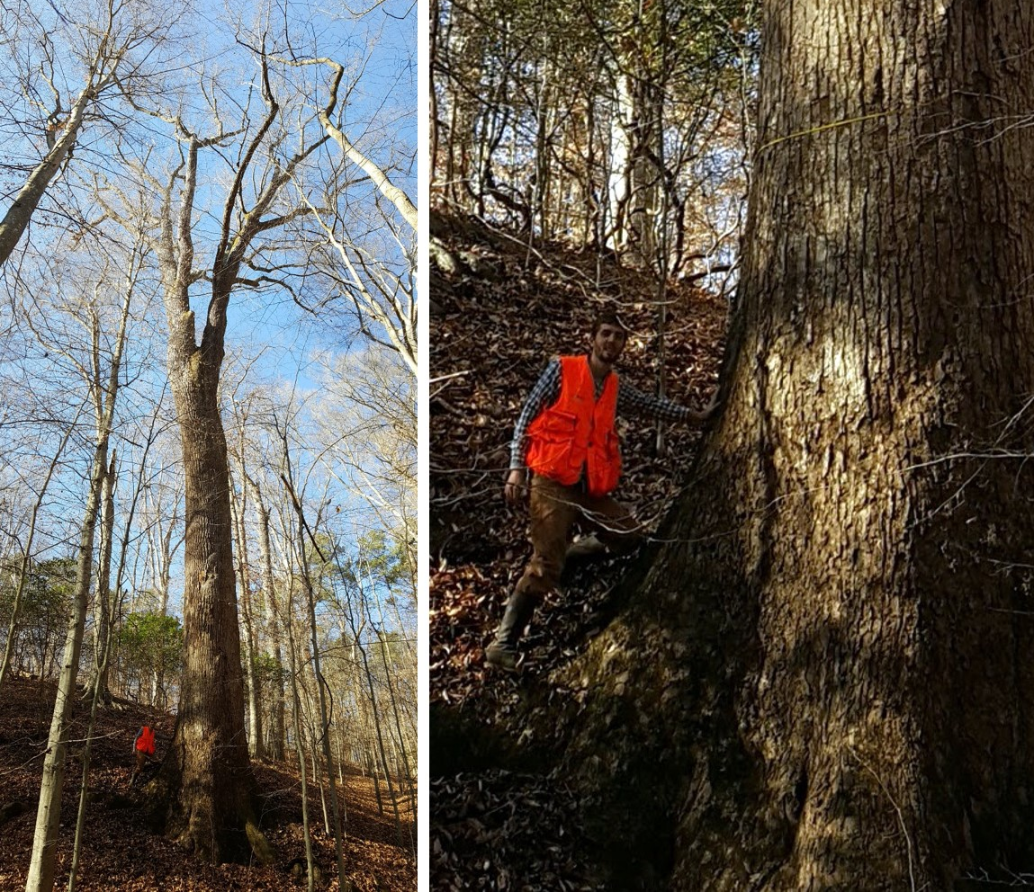
Tallest Tree in Virginia
184 feet tall
Notes:
The tallest measured tree in Virginia is a 184 foot tall Tulip Poplar in Caroline County.
But our trees in Virginia can’t compare to the tallest in the world!

Slide 11
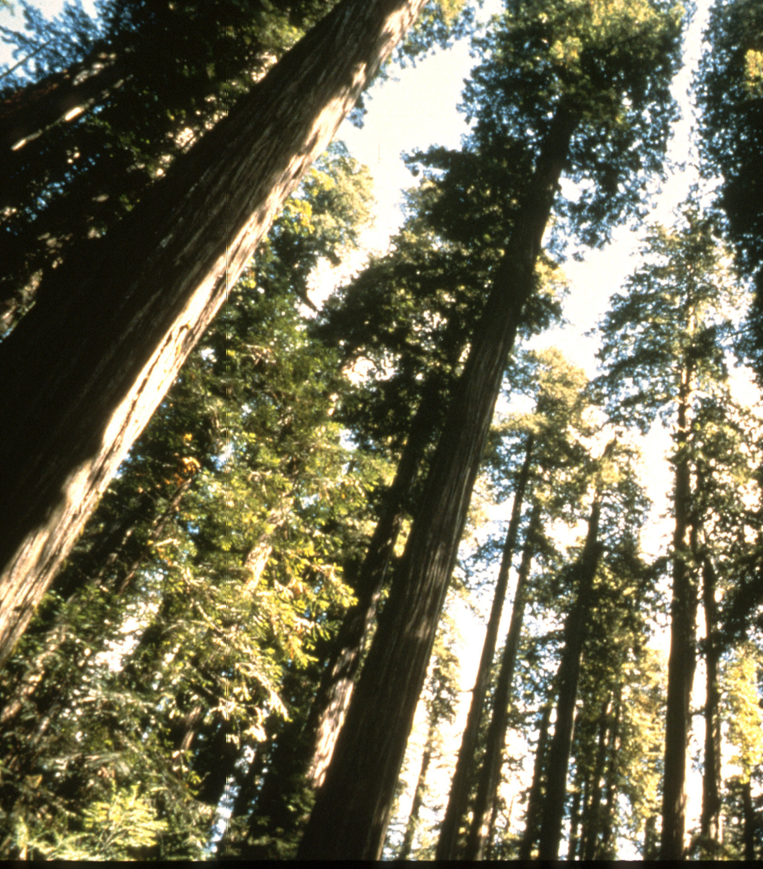
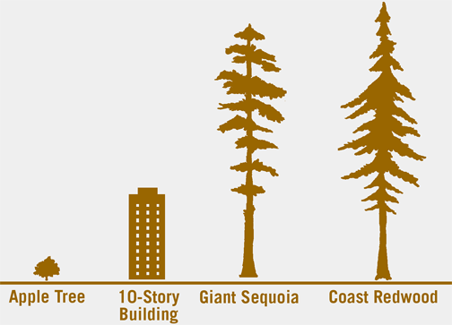
Hyperion
380.8 feet tall
Notes:
The tallest tree in the world is named “Hyperion.”
It is 380.8 feet tall
It is a Coast Redwood in California
[PRESENTER BACKGROUND NOTE: Just in case you are asked. This is a photo of Coast Redwoods, but not of the specific tree, Hyperion, because the National Park Service has not issued an official photo in order to protect the tree from the environmental damage caused by overcrowding and illegal tourism. The exact location of the tree was kept secret and it is illegal to visit. ]

Slide 12
How can we tell one tree from another?
Notes:
There are more than 400 identified native trees and shrubs in Virginia!
Trees have a lot in common, but they also have a lot of differences that we can observe!
ASK “How can we tell on tree from another?”
[Let the students answer.]
.

Slide 13
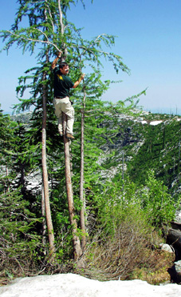
Let’s think like a dendrologist!
Classify
Identify
Notes:
Let’s think like a dendrologist!
A dendrologist is a scientist who studies trees.
This is Dr. John Seiler from Virginia Tech, who goes by the nickname “Dr. Dendro”
ASK “Who would like to climb and study trees for their job as adults?”
[Let the students answer.]
Dendrologists often use leaves to classify and identify trees!

Slide 14
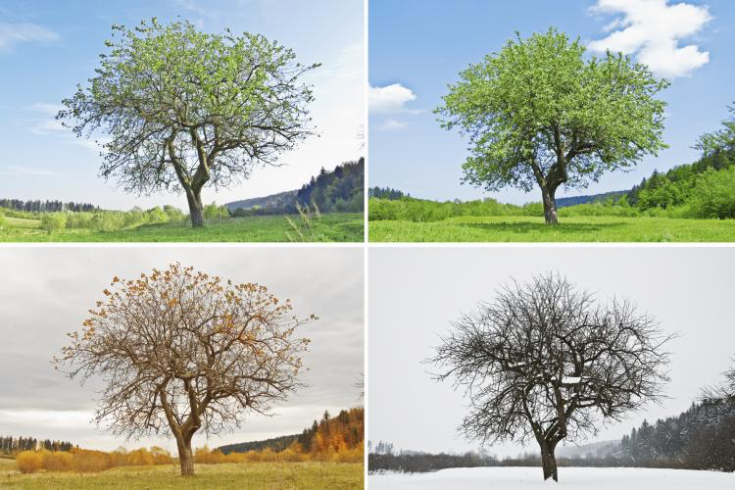
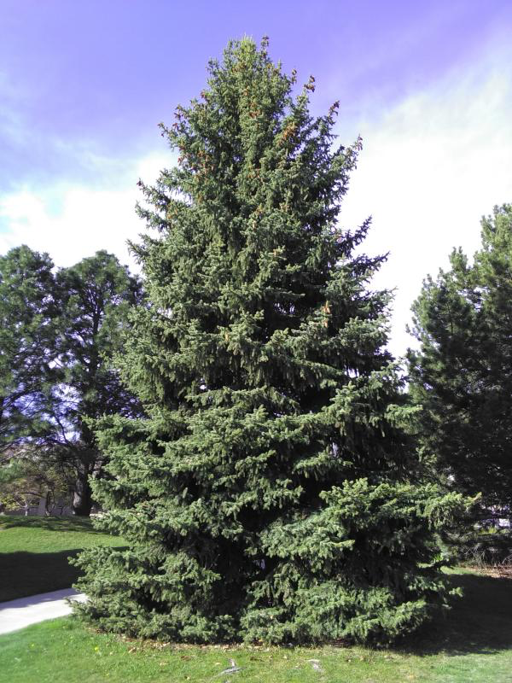
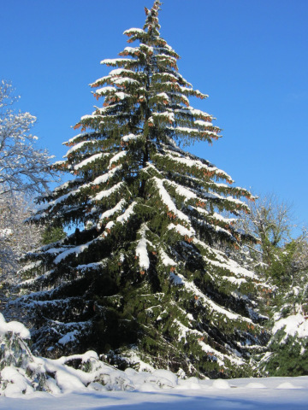
Classify by Leaves
Deciduous Trees.
Evergreen Trees
Notes:
We can classify trees by what they do with their leaves.
Deciduous trees have broad and flat leaves.
They shed all of their leaves in the fall.
These leaves change colors by seasons.
In the spring and summer, the leaves are green because they contain the green chlorophyll
in the fall they do not have chlorophyll, and other colors can be seen instead.
Evergreen trees have leaves that are needle or scale like.
They shed their leaves gradually throughout the year, a few at a time, while also continuously growing new ones.
These leaves can handle cold temperatures and the trees continue to make the green chlorophyll, so the leaves stay green.

Slide 15
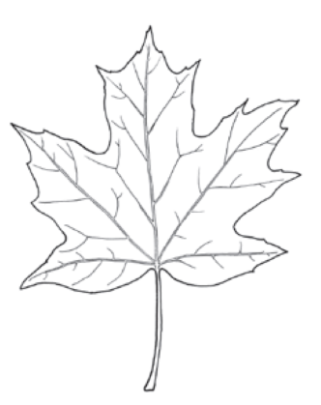
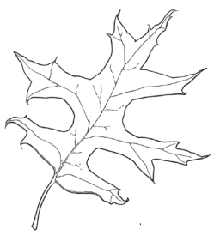
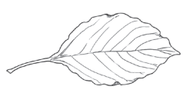
Identify by Leaves
Maple
Oak
Dogwood
Notes:
We can also identify trees by the unique leaf design - each species of tree has its own!
When we look at their shape, size, and features on the leaves, we can determine which kind of tree it came from.
Notice the lines on the leaves.
These are called veins.
They transport water and nutrients and act as the skeleton for the leaf.
ASK “Does anyone recognize these leaves? Can you tell us which tree they come from?”
[Let the students answer.]
[Click once for each leaf to reveal the tree’s name.]

Slide 16
Let’s experiment!
Notes:
Today we learned that a tree has different parts and characteristics.
We learned that trees can grow to many different heights.
We learned that each part of the tree has a job and that water and nutrients are absorbed through roots and can be transferred from one tree to another tree.
We also learned that trees can be classified and identified by their leaves.
Let’s experiment to learn more!

Slide 17
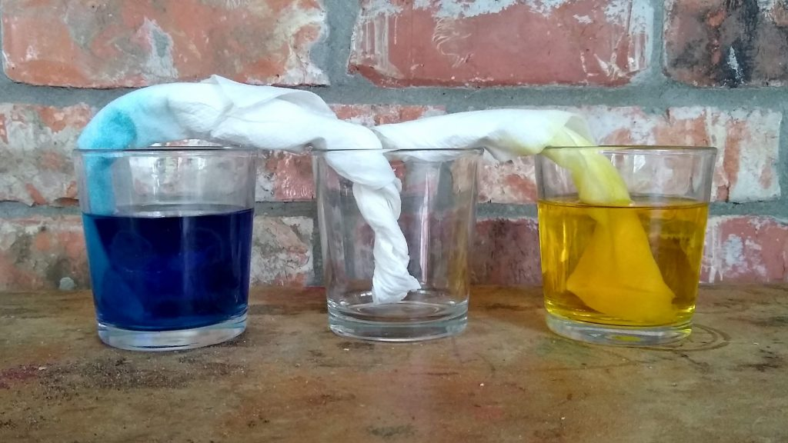
Notes:
(Have an adult helper prepare this activity during the presentation and bring it up when it is time. )
We learned that roots soak up water and nutrients that the tree uses to grow and that can be transferred from one tree to another.
ASK: “How do you think that works?”
[Let the students answer]
Let’s see if we can demonstrate it.
These two paper towels are like our roots. Similar to roots:
The paper towel is made from fibers.
The water is able to travel through the gaps in the fibers.
If we put one paper towel in a cup with blue food dye and the other in a cup with yellow food dye and then we twist and connect the two together in a third empty cup, what will happen?
ASK: “Does anyone have a hypothesis or prediction? We make a hypothesis by saying “I think…because…””
[Let the students give ideas.]
We are going to let this sit here for a bit and check back at the end of the day!

Slide 18
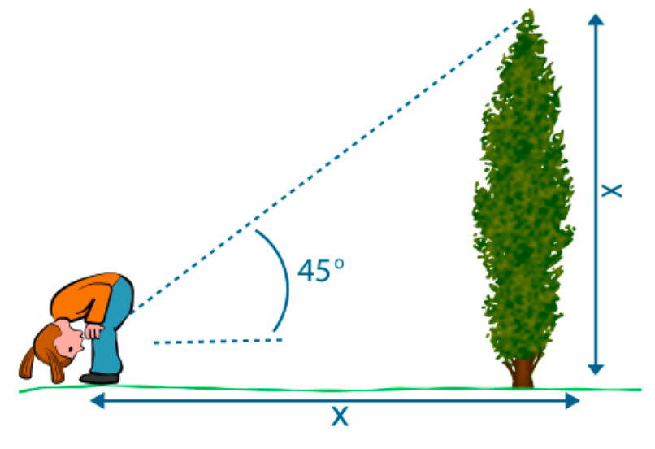
Measure a Tree’s Height
Notes:
For this experiment, we are going to go outside to measure a tree - UPSIDE DOWN!
Using math, we can measure the height of the tree without touching the top of it!
Now, we will cover how this math works in a much later grade..
But today we will spend some time upside down!
Notice how we will be able to measure the distance from your feet to the tree to know the height!
But first we are going to observe and investigate leaves a bit closer.

Slide 19
Identify by Leaves
Maple
Oak
Dogwood
Notes:
(Have kids go back to their seats where their leaves and worksheets will be waiting. During the presentation, Adult helpers should distribute the materials, placing one set of leaves, an unwrapped crayon, and a worksheet at each student’s table spot.)
You each have three examples of leaves from common trees in Fairfax county.
Touch them and observe their physical characteristics.
ASK: “What do the leaves have in common?”
(Let the students give ideas.)
ASK: “What is different about the leaves?”
(Let the students give ideas.)
On the back of your worksheet you are going to do a leaf rubbing of each leaf and label what type of leaf it is.
We will bring this with us when we go outside to help us identify three trees growing at Sunrise Valley!
When we go outside, you will each pick your favorite of the three and make observations about your tree.
You will use the front side of your worksheet to write about your tree and draw a picture.
[Demonstrate how to do a leaf rubbing. Adult helpers will need to help the students with this and remind them to label their leaves.]
Turn your sheet to the back with no writing.
Place your leaf under your paper.
Leave enough room for all three leaves.
Hold your crayon on its side, and rub on the paper, over the leaf.
Make sure to rub over the entire leaf
Label your leaf either Maple, Oak or Dogwood.

