Slide 1
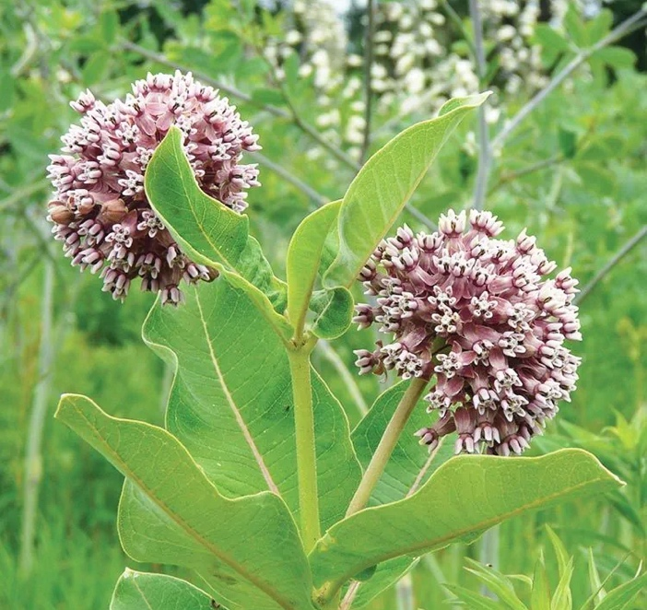
Milkweed
Milkweed
Milkweed
Milkweed
Milkweed
Milkweed
Ladybug
Ladybug

Slide 2
Eastern Tiger
Swallowtail Butterfly
Milkweed Bug
Milkweed Bug
Japanese Beetle
Honey Bee
Eastern Tiger
Swallowtail Butterfly
Eastern Tiger
Swallowtail Butterfly
Honey Bee

Slide 3
Monarch Caterpillar
Yellow Jacket
Yellow Jacket
Slug
Monarch Butterfly
Monarch Butterfly
Monarch Caterpillar

Slide 4
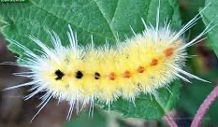
Robber Fly
Tussock Moth Caterpillar
Longhorn Beetle
Potter Wasp
Black and Yellow
Garden Spider
Dragonfly
Ant
Katydid
Monarch Butterfly

