Slide 1
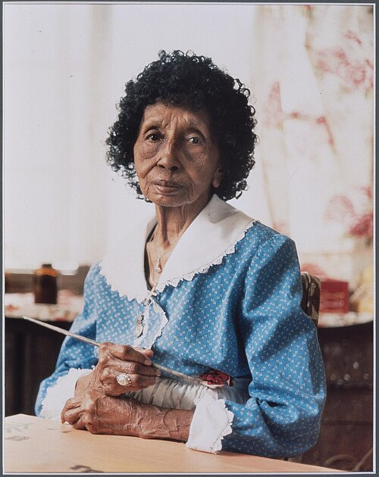
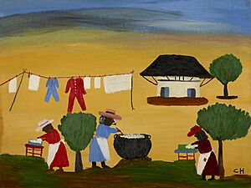
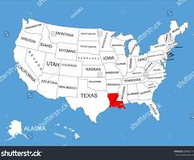
Clementine Hunter
Clementine Hunter lived to be 101 years old!
Dec 1886/Jan 1887 – Jan 1988
She lived and worked in Louisiana.
Notes:
1st photo – Photograph by Judith Sedwick as part of the Black Women Oral History Project
2nd photo – The Wash (c. 1950s), at the Minneapolis Institute of Art
3rd photo – Map of US, identifies Louisiana
PRESENTER NOTES:
Allow 10-15 minutes for presentation. Please feel free to cut and shorten where needed, focusing on the 3 BIG IDEAS.
BIG IDEA #1: Clementine Hunter was a talented, self-taught African-American folk artist from Louisiana. She is known for her bright, colorful, and joyful painting style depicting Black southern life in the early 1900s.
Clementine was born in Louisiana.
Where is Louisiana?
Louisiana is a state in the United States, located in the Deep South region of the southeastern United States.
She grew up on Hidden Hill Plantation. From a young age, she worked on farms and never learned to read or write.
She spent most of her life working on Louisiana plantations.
Hunter was a self-taught artist.
What does it mean to be a self-taught artist?
No formal art training.
Hunter was known as a folk artist.
What does it mean to be a folk artist?
An artist that often has no formal training; and uses simple techniques. An artist that is self-taught or learns informally from their community, producing handmade items like quilts, carvings, or paintings that tell stories or serve practical needs. Art based on tradition and daily life.
It was not until she was in 50s that she began to paint, using whatever supplies she could find. Eventually, she would sell her paintings.
She became famous locally and across the country. By the end of her life, her art was shown in museums and sold for thousands of dollars!
Clementine created an amazing number of paintings, possibly between 5,000 and 10,000!

Slide 2
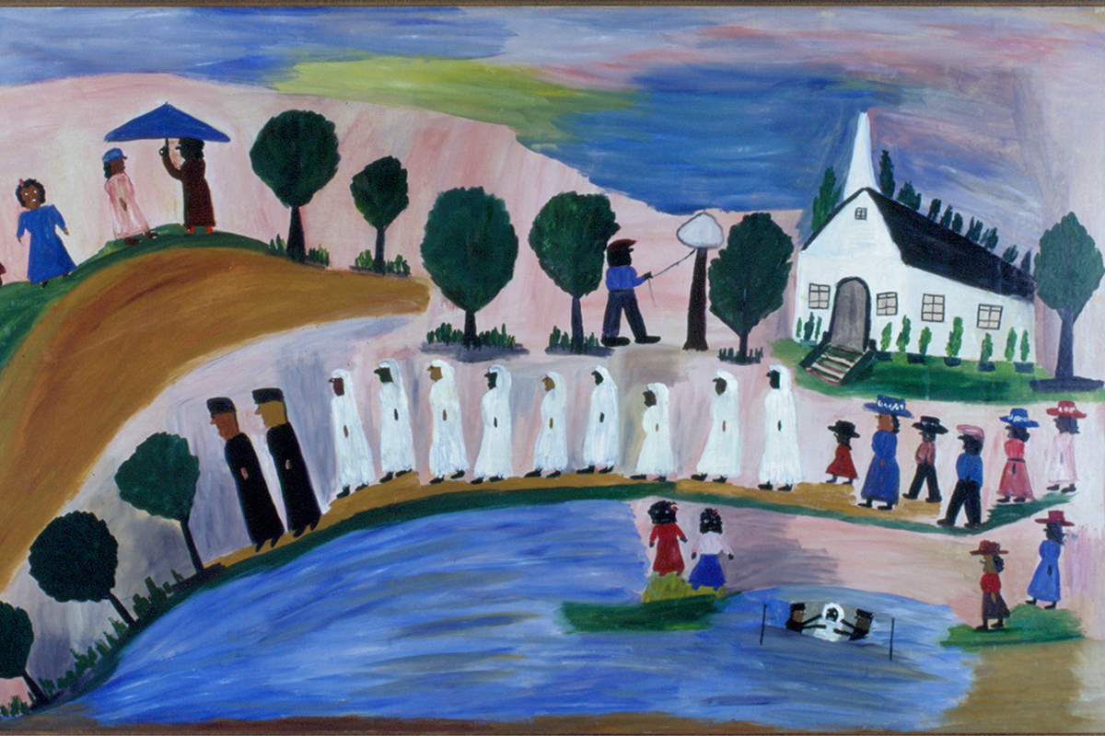
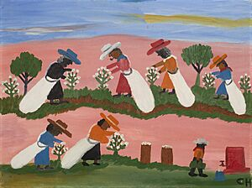
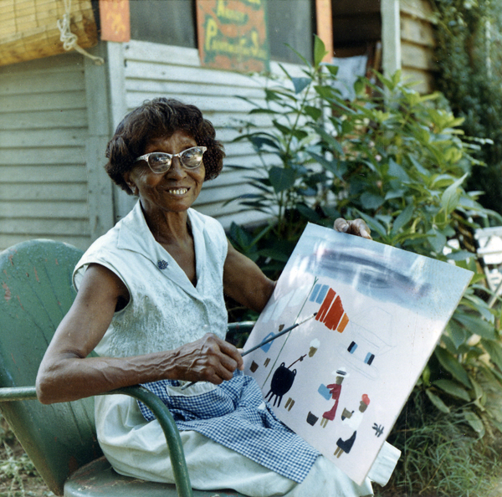

Clementine Hunter: Memory Painter
Notes:
1st photo – Picking Cotton (c. 1955), at the Minneapolis Institute of Art
2nd photo – Flowing River (detail), 1950, oil on canvas, gift of Dr. and Mrs. James Michael Fortino
3rd photo – Color reproduction of a photograph of Clementine Hunter on Melrose Plantation, in Natchitoches, Louisiana, in the 1960s
4th photo – Untitled (c. 1970) at the National Gallery of Art in 2022
BIG IDEA #2: THEME
Clementine Hunter is called a “memory painter.”
What do you think it means to be a memory painter?
An artist/painter that creates images/scenes from their memory.
What do you think these painting are about? What does it look like the people are doing? What do you notice about the landscape, rural/city/etc?
Her colorful and straightforward scenes are from her memories of life on a Southern plantation.
Hunter referred to her works as “memory paintings.” She painted from memory her everyday life on the plantation.
She worked on Melrose Plantation for most of her life as a laborer and maid. She showed what Black southern life was like.
Her most famous paintings show important events, including funerals, baptisms, and weddings. She painted everyday life, including painted people at work and at play, doing household chores, worshipping, dancing, and socializing. She also painted scenes of farm work, like picking cotton or pecans.
Hunter painted from her memories. She said, "I just get it in my mind and I just go ahead and paint." She didn't look at things while she painted. She made her own trees and scenes in her mind.
QUESTIONS:
How do you like to make artwork? Do you like to draw/paint from life or photographs? Do you prefer to create work based on memories?

Slide 3
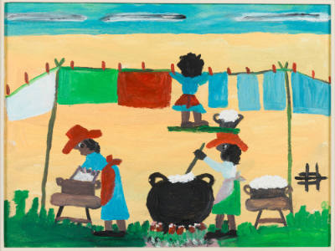
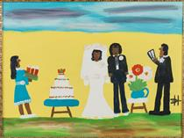
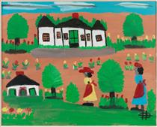
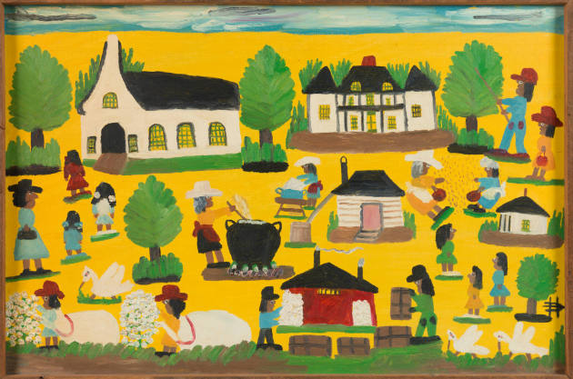
BOLD AND BRIGHT COLORS
Notes:
1st photo – Untitled (Wash Day), 1980-1987, oil on canvas board, 17 ½” x 23 ½”
2nd photo – The Wedding, 1950
3rd photo – Two Women, 1980 - 1986
4th photo – Planation Life, 1980-1986, oil on canvas board, 22 ½” x 35 ½”
What do you notice about Hunter’s paintings? (Bold, simple shapes, scenes from her everyday life, etc) What colors did she use (warm/cool, bright/dark)?
BIG IDEA #3: PAINTING STYLE AND MATERIALS
Hunter’s work is bright and colorful. She used vibrant paint colors and painted on all kinds of surfaces.
She depicted life in bright colors and simple shapes, but she also imposed her own vision as well.
Clementine Hunter did not have fancy art supplies, instead she used whatever she could find. She painted on all kinds of surfaces, including discarded objects: cardboard, bottles, plastic containers, window shades, buckets, ironing boards, even gourds.
Women also figured large in her work. She depicted strong African-American women active in many aspects of traditional country life: working and playing outdoors, marrying, tending to children, and attending church.

Slide 4
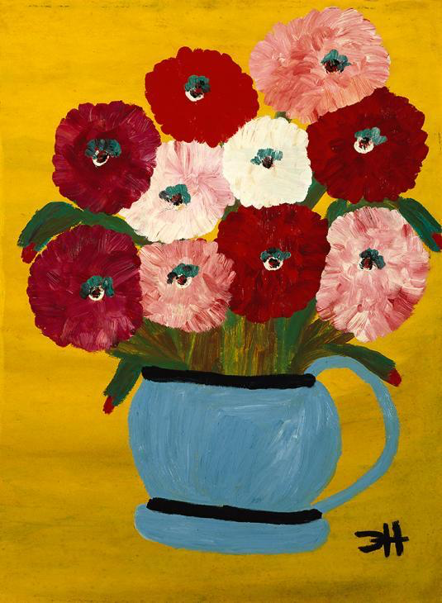
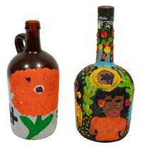
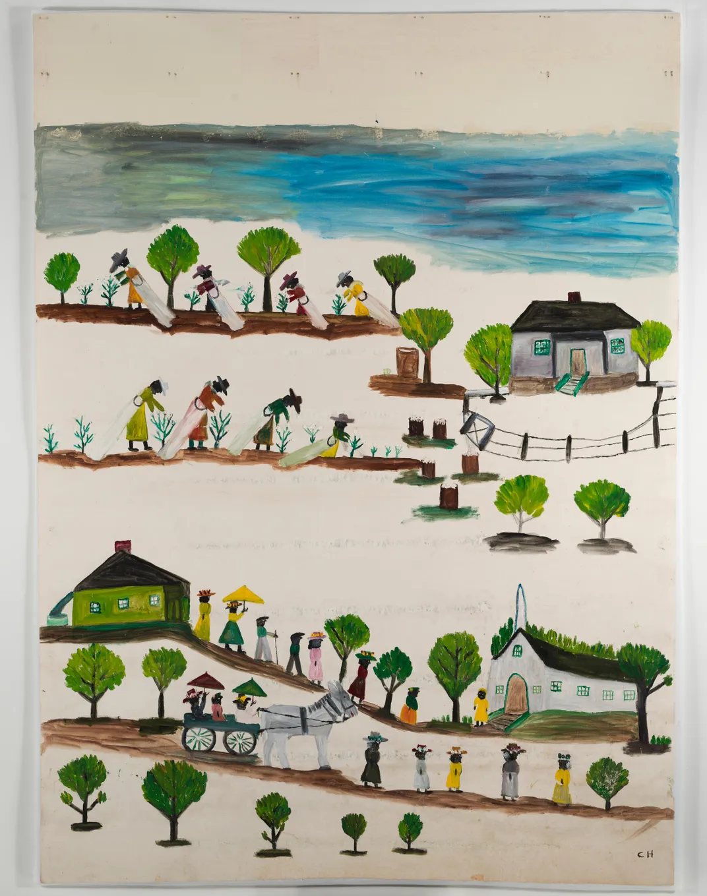
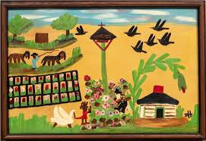
Notes:
1st photo – Zinnias in a pot
2nd photo – Two Painted Bottles
3rd photo – Window Shade by Clementine Hunter, 1950s NMAAHC, gift of the Rand and Dana Jack Family
4th photo – Flower Garden, oil on board, 23.75” x 16’ x 1.5”
Clementine Hunter was known for depicting everyday life, often outdoor activity. She also made paintings of everyday objects (known for her paintings of zinnias). And would paint on everyday, found objects.
She painted varied arrangements of zinnias, a flower that can commonly be found in the South. This vibrant flower often grew on the grounds of Melrose Plantation where she lived and worked. She continually returned to painting zinnias. Some of her most famous paintings were of zinnias.
Clementine Hunter's beautiful artwork tells the story of her life and the world she knew.
Hunter was a very productive artist. She lived a long life and lived to 101. She painted every day until toward the end of her life. Art was something she felt compelled to do. There are certain artists who can’t stop creating and she was one of those artists.
Hunter was the first African-American artist to have a solo exhibition at the New Orleans Museum of Art. She achieved significant recognition during her lifetime. Hunter's work can be found in numerous museums.
QUESTIONS:
Hunter was determined to paint and create art, so she used the materials available to her. What art materials do you like to use? Have you ever painted on something other than paper? Have you ever used non-traditional art materials? Do you think it would be challenging to use materials like Hunter used (see above photos – glass bottle, window shade)?

Slide 5
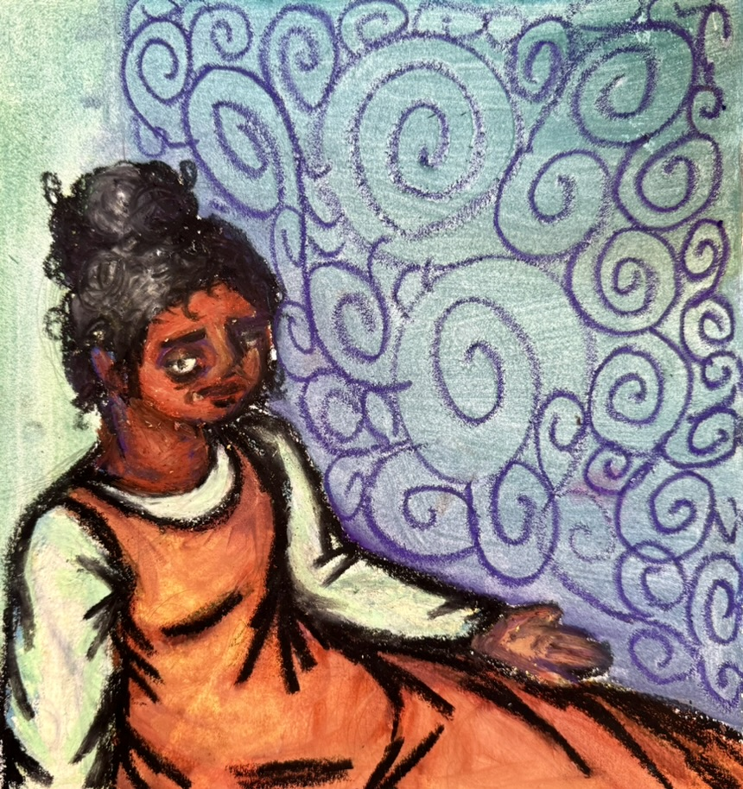
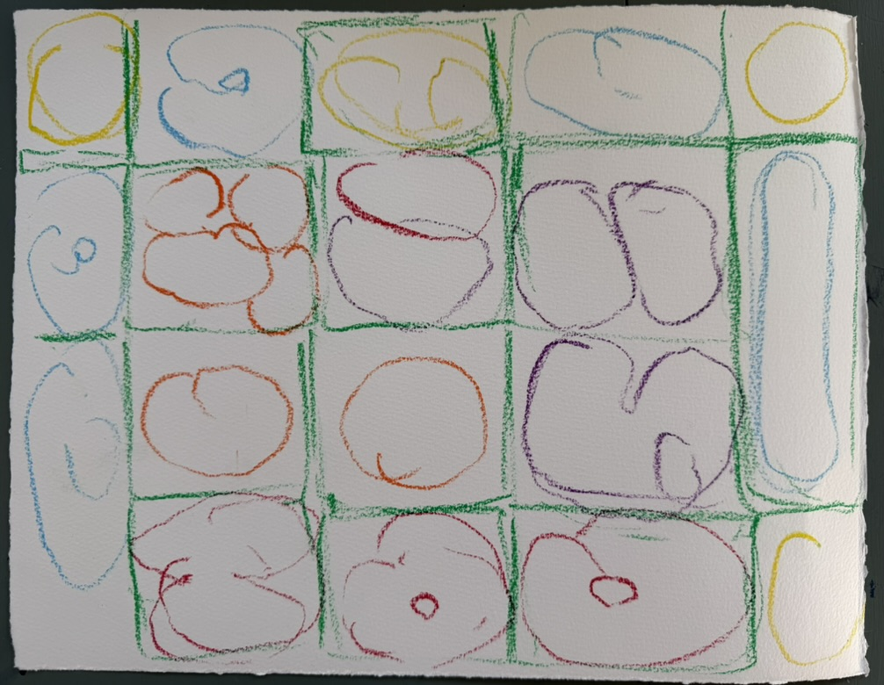
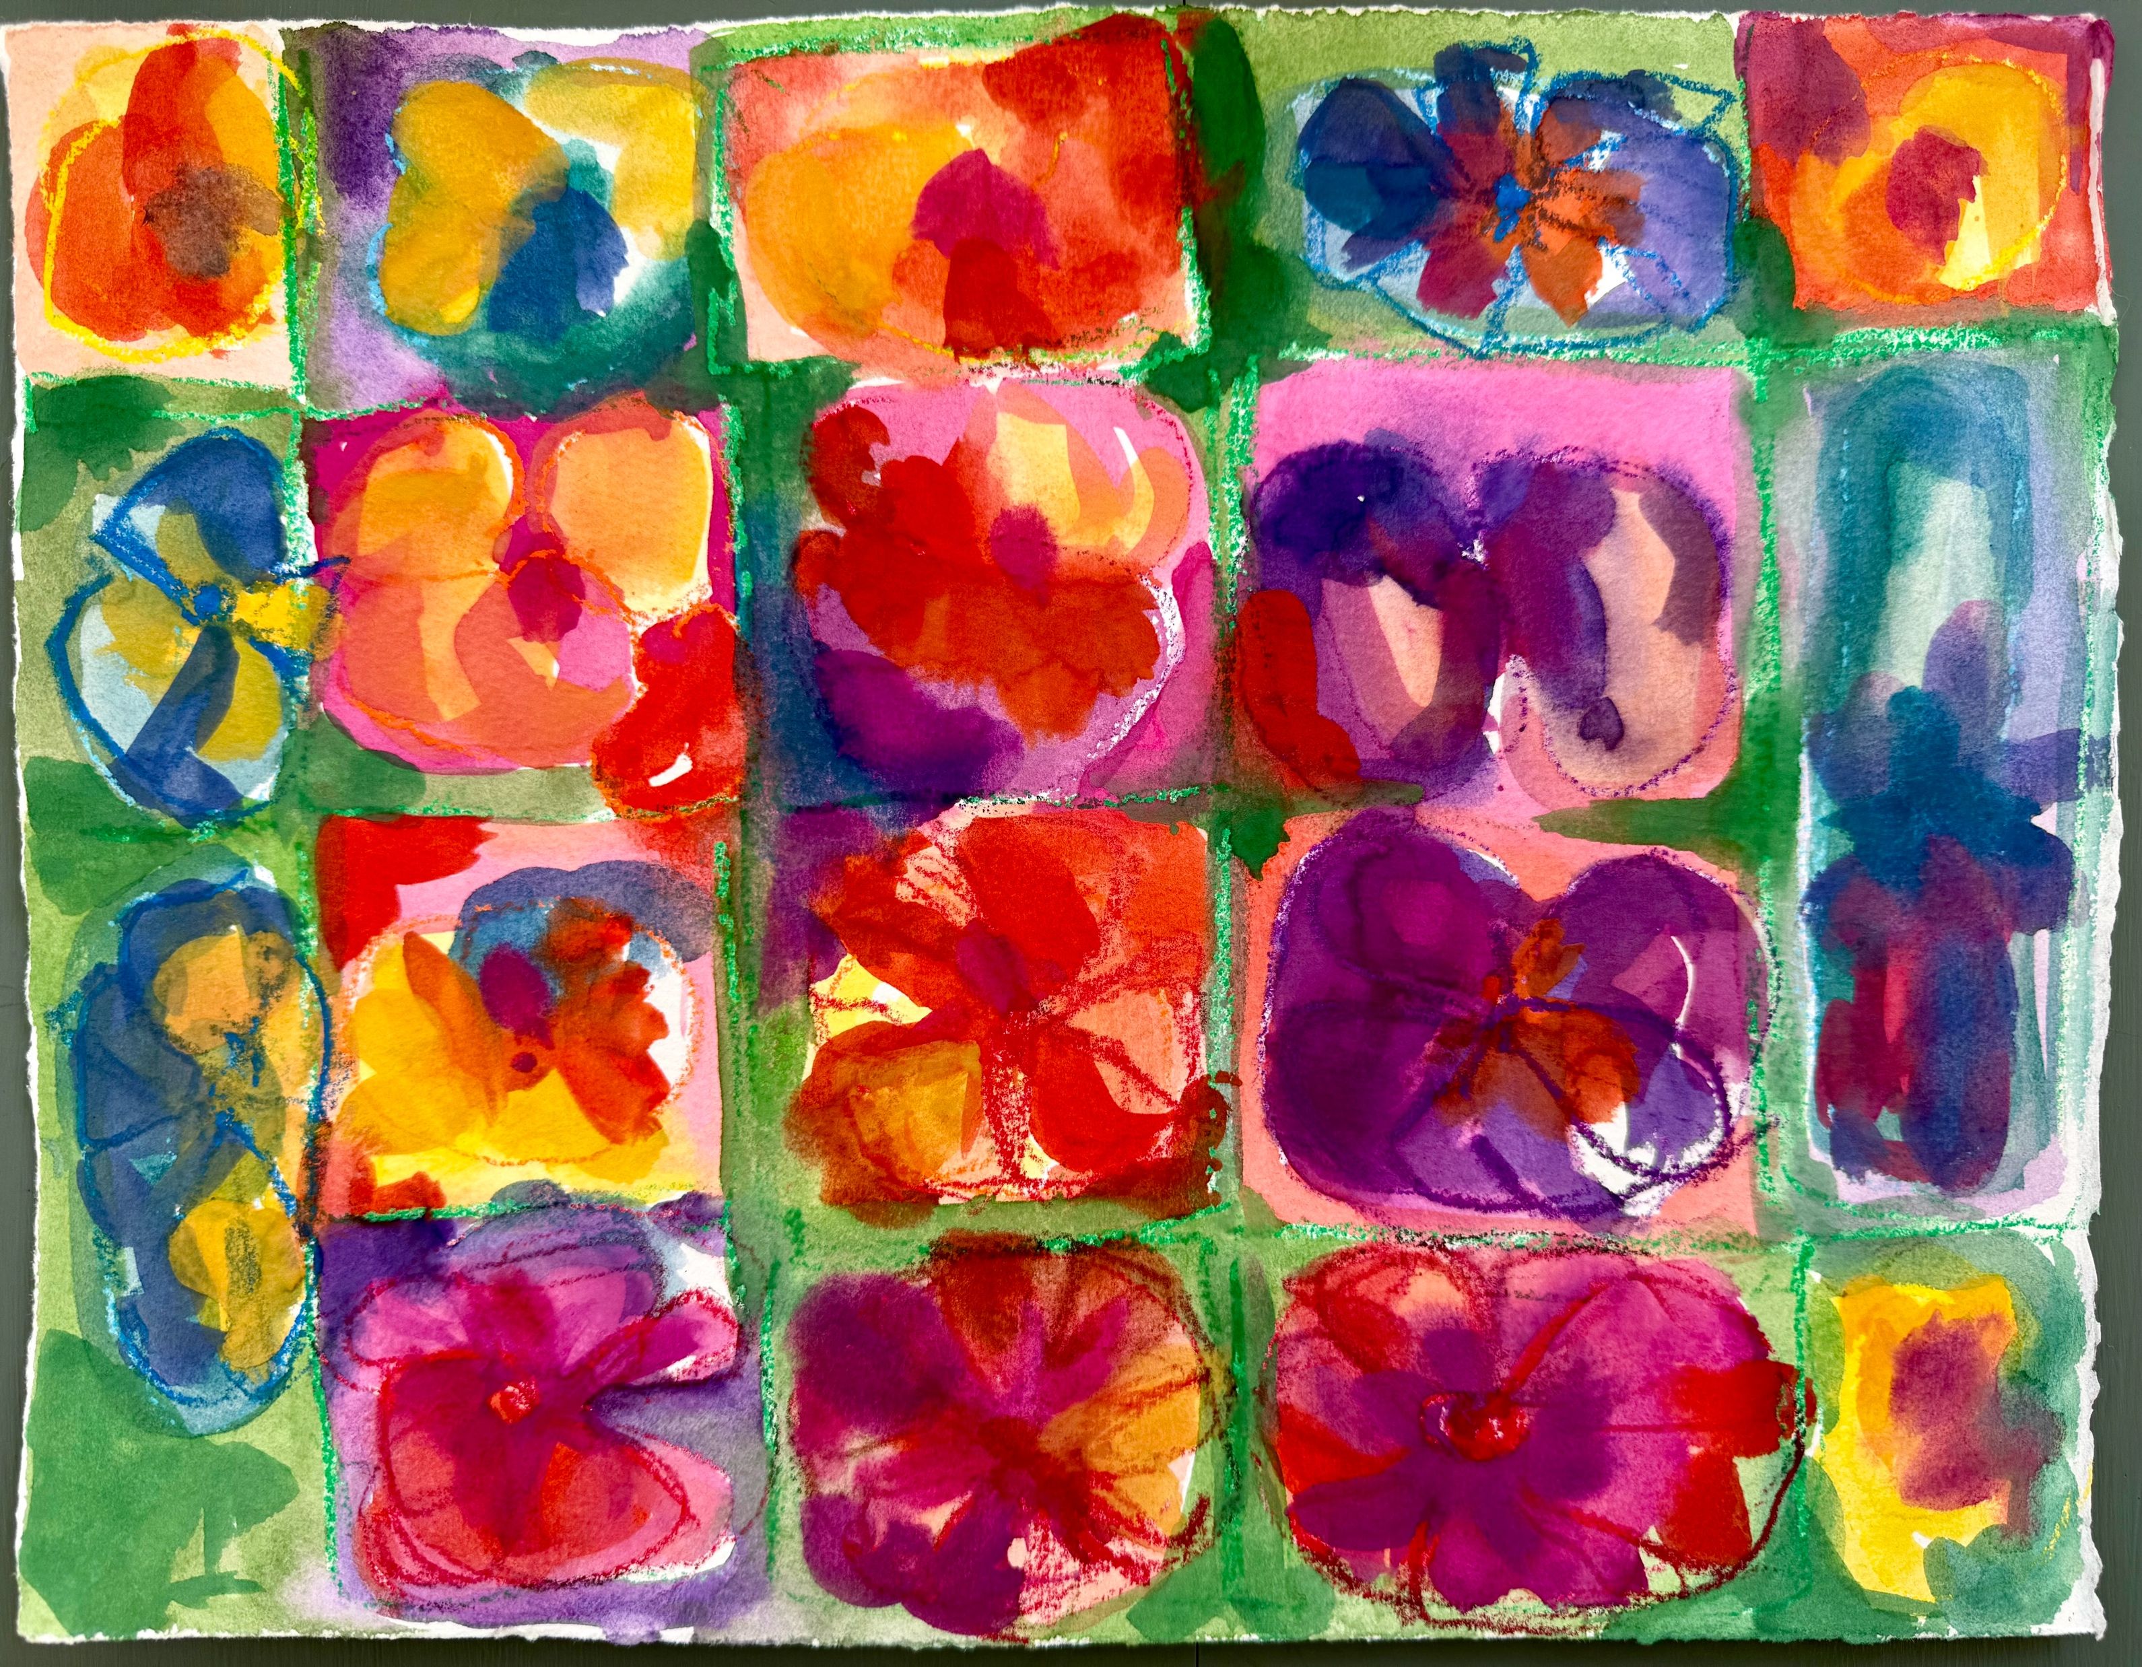
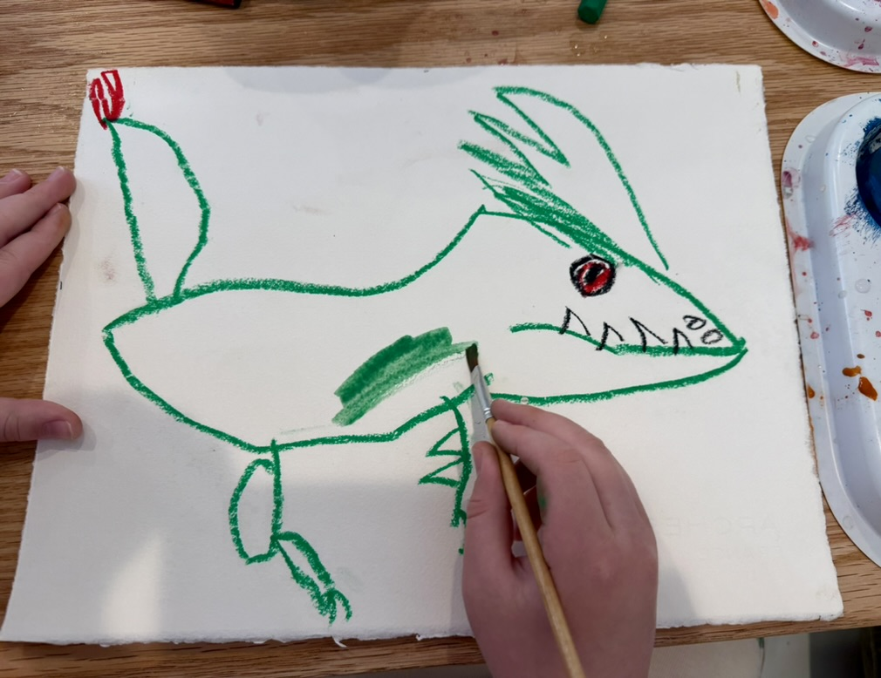
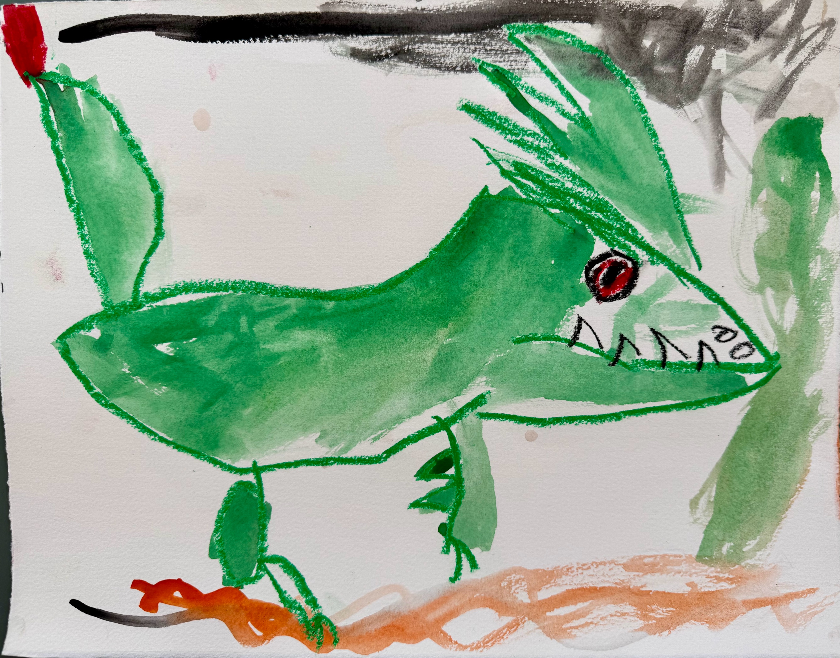
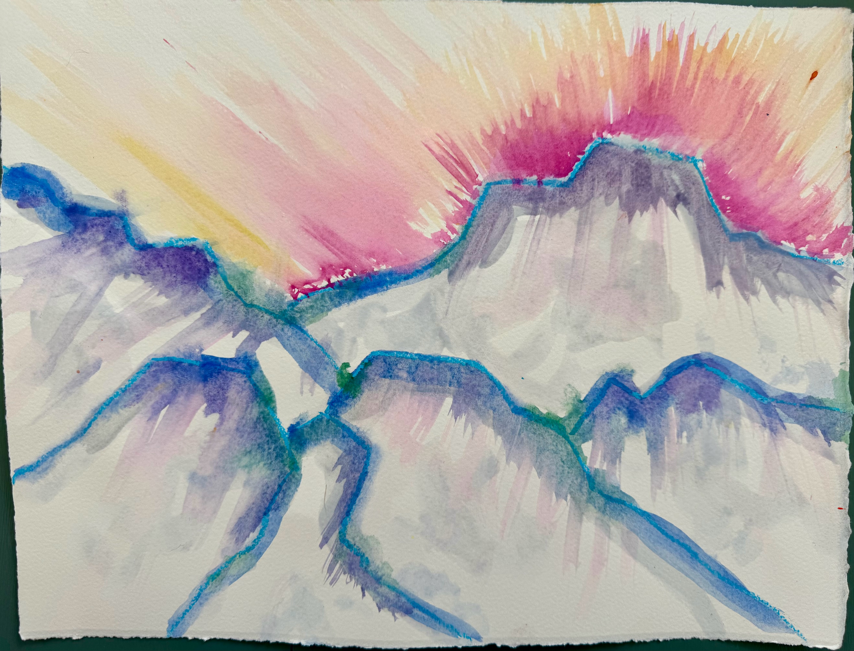
Art Project: Let’s be inspired by Clementine Hunter!
Create your own MEMORY PAINTING.
Can you think of a memory? An everyday activity? Is there an activity you like to do outside?
Hunter loved zinnias. Is there a flower you would like to paint? Maybe another type of plant or even an animal?
Hunter painted on cardboard, window shades, whatever she could find! If you want, cut your paper to replicate a “found object” or non-traditional material/shape.
You can use oil pastels to sketch out what you would like to paint. Remember oil pastels act as a resist.
Notes:
Great Art Project Instructions – Clementine Hunter
Project Description:
Students will learn about Clementine Hunter and create their own “memory painting” inspired by Hunter. Clementine Hunter was a talented self-taught African American folk artist from Louisiana. She is known for her bright, colorful, and joyful painting style depicting Black southern life in the early 1900s.
Grades: K - 6
Art Project: create your own “memory painting” using tempera paint.
Optional: the art may be collected and displayed (dependent on the teacher’s approval) at the end of the session.
Reminders: remind students to sign their artwork.
Materials: all grades will use the same project materials.
Per student: one sheet of watercolor paper
Shared by students: tempera cakes, oil pastels, paintbrushes, scissors
Cup for water, per student/or can share
Clean up: rinse off tempera cakes, clean brushes, rinse out and return cups (we reuse cups for water). Thank you!
Considerations/ideas:
Clementine Hunter depicted her everyday life and painted from memory. Can you think of a memory? Can you think of something from your life? An everyday activity? Is there activity you like to do outside?
Also, Hunter was inspired by zinnias. Is there a flower you would like to paint? Maybe another type of plant or even an animal?
Hunter used any materials she could freely find. She often painted on found objects and non-traditional paper, like cardboard and window shades. You can cut your paper to replicate a “found object” or non-traditional material/shape.
You can use oil pastels to sketch out what you would like to paint. Remember oil pastels act as a resist.
Tempera cakes – more water makes it like watercolors, use less water to make the paint more opaque.
Try bright colors, simple shapes.
Experiment and have fun!

Slide 6
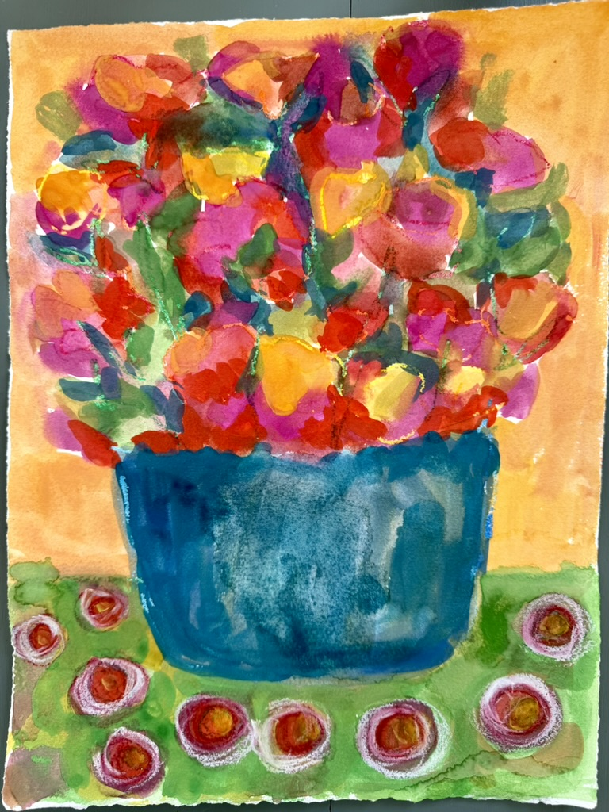
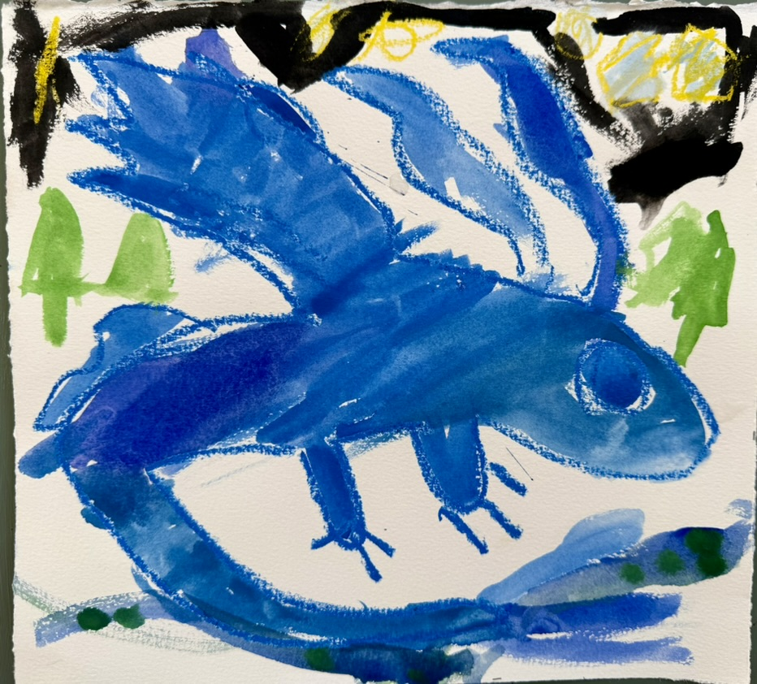
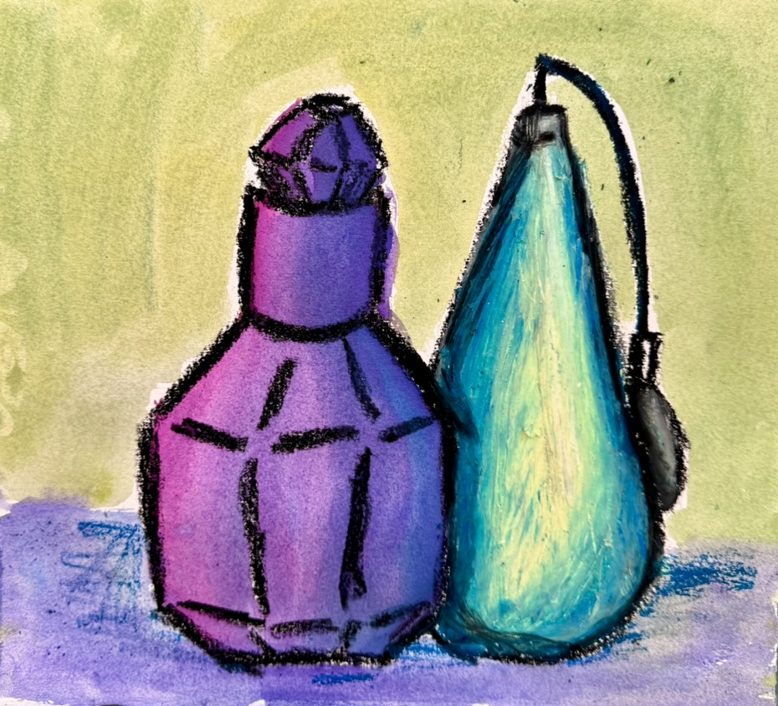
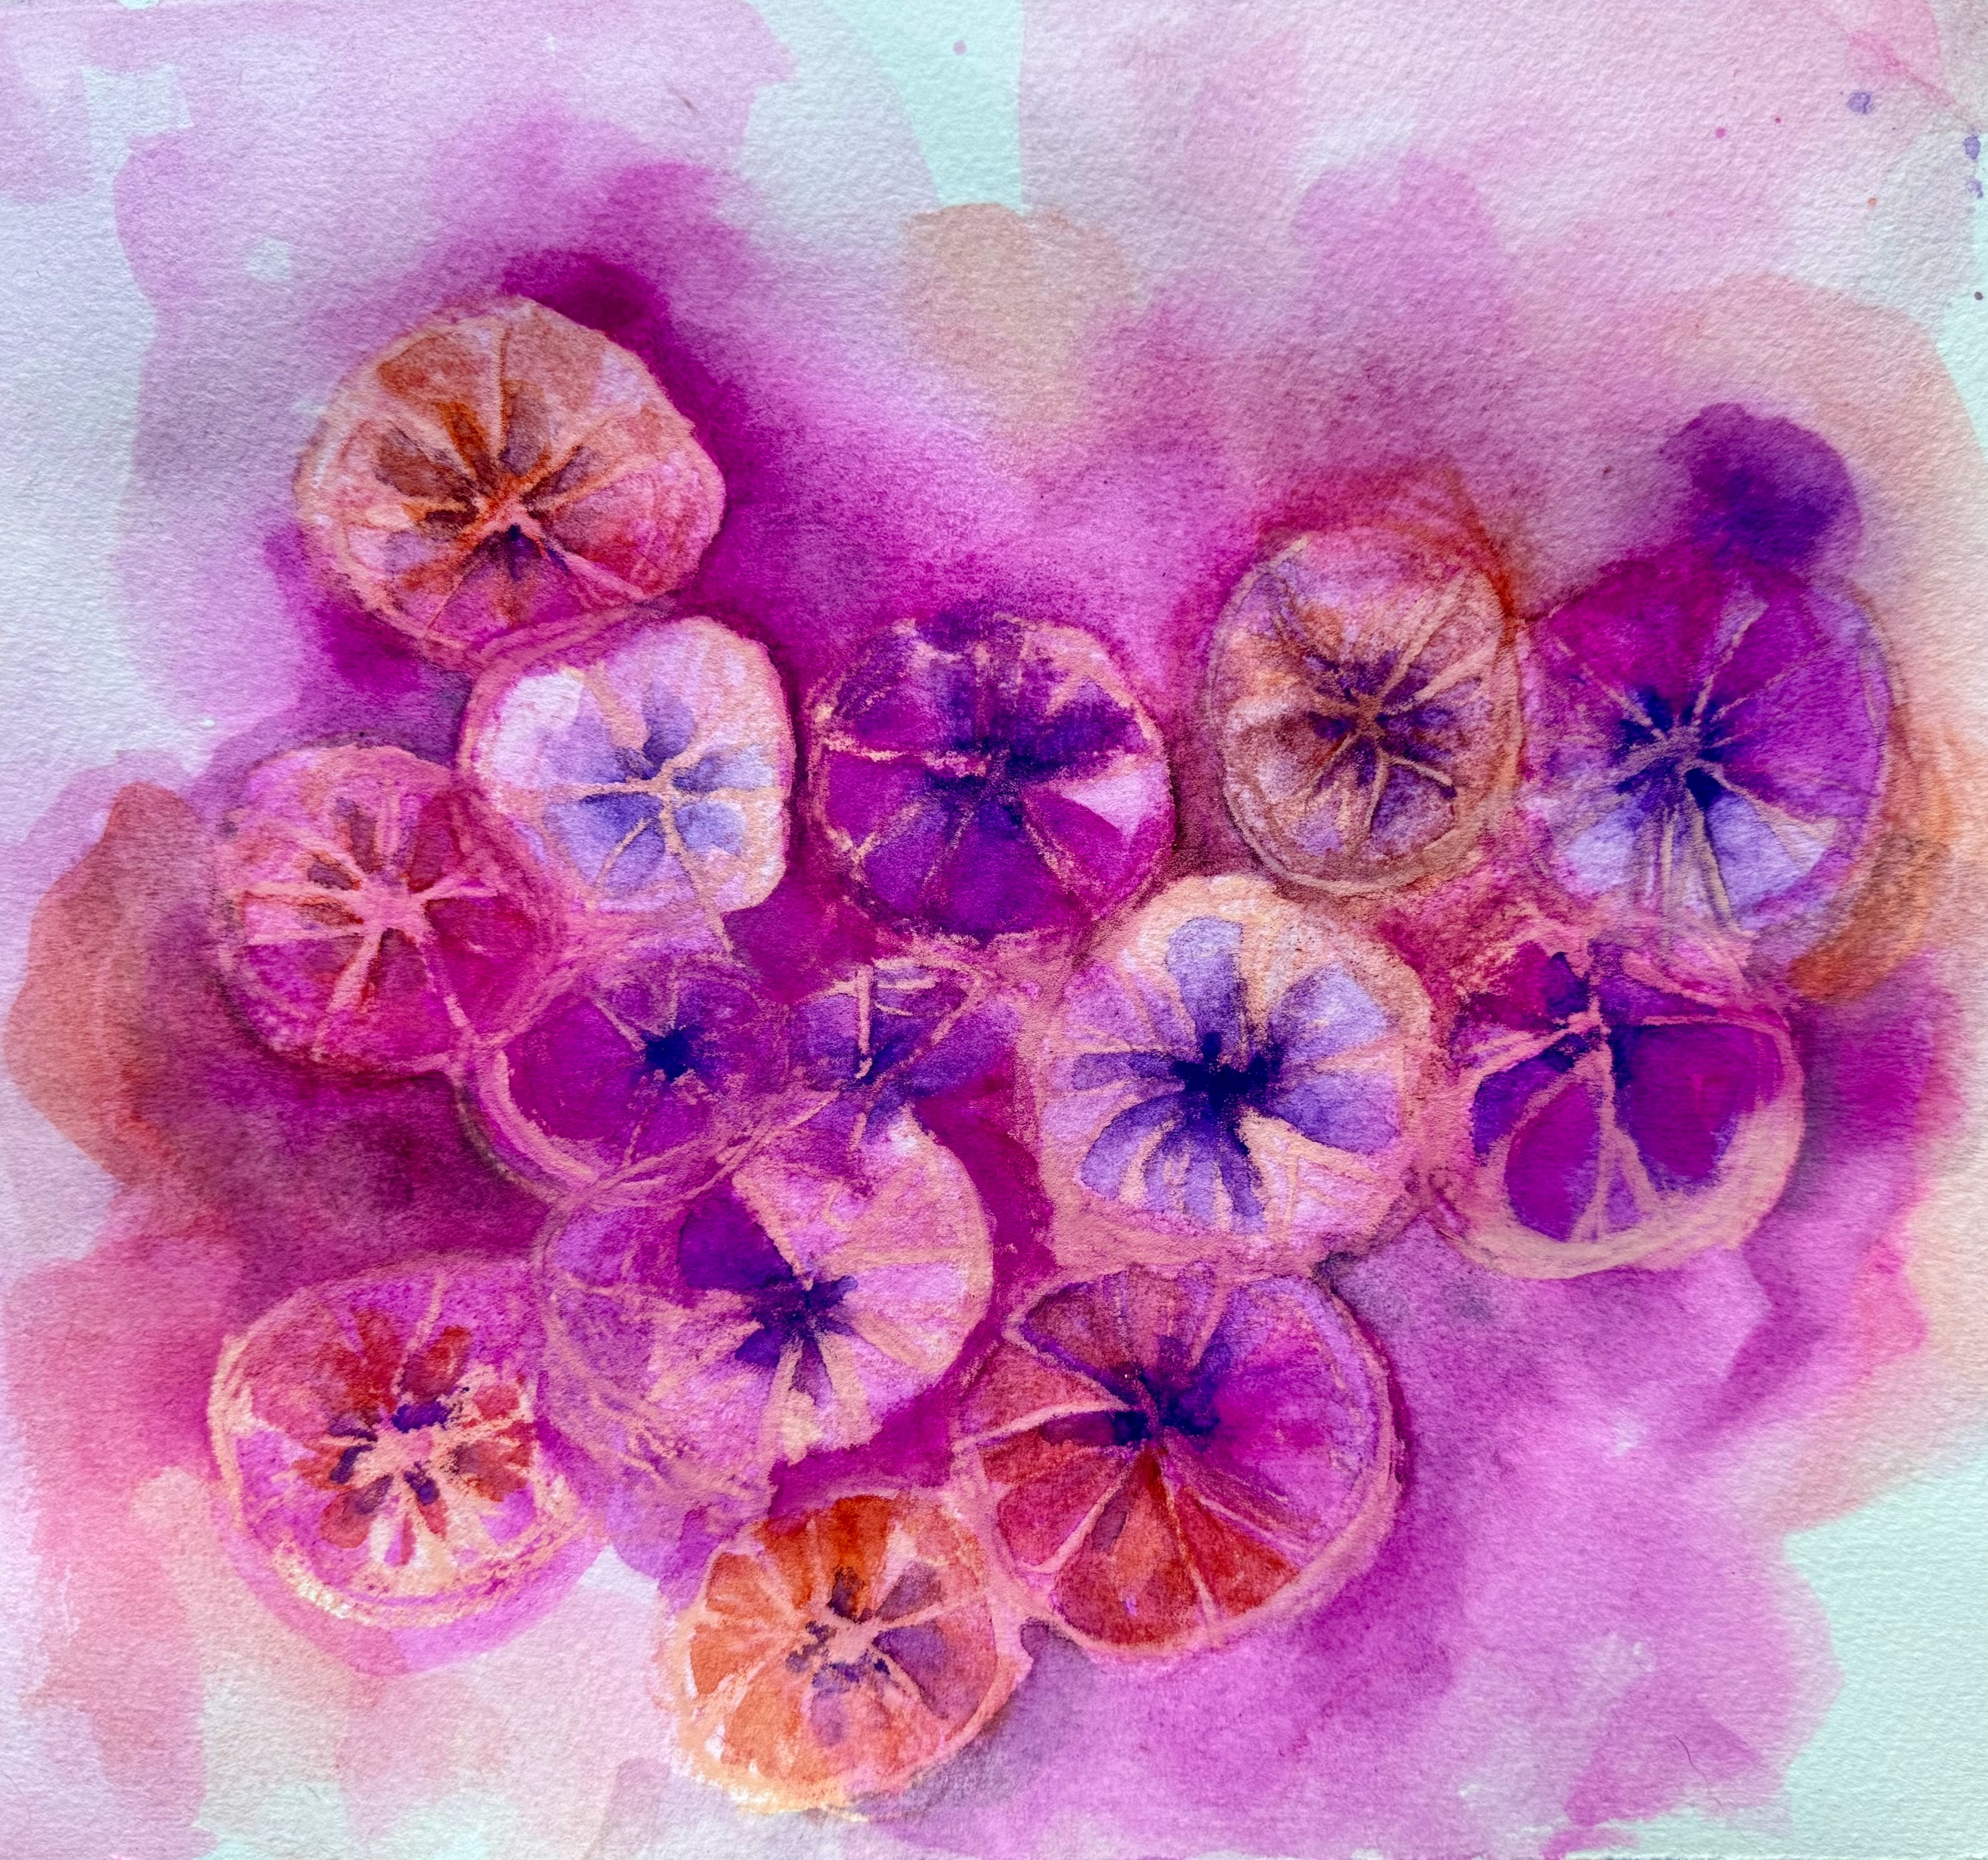
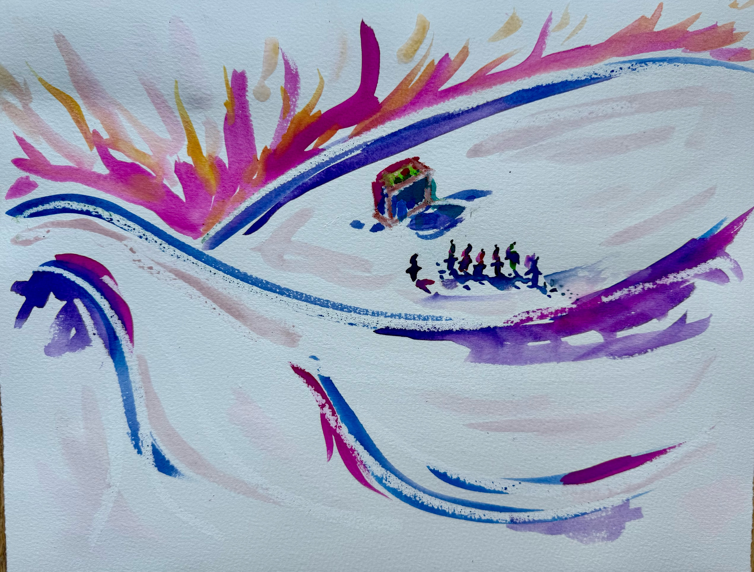
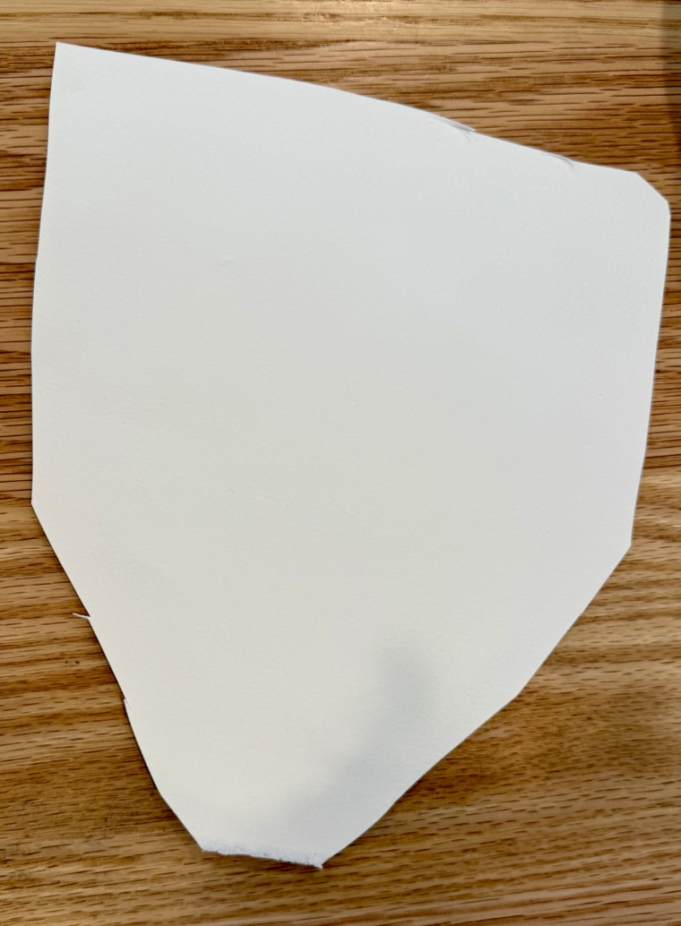
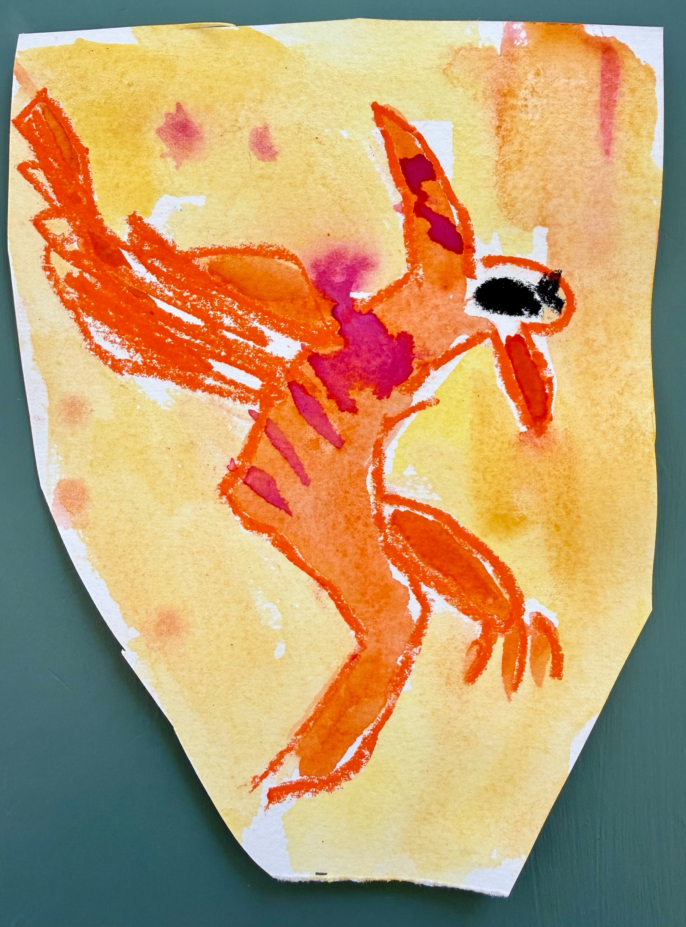
Art Project: Let’s be inspired by Clementine Hunter!
Create your own MEMORY PAINTING.
MORE PROJECT EXAMPLES
You can cut your paper to replicate a “found object” or non-traditional material/shape.

