Slide 1
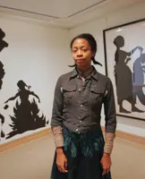
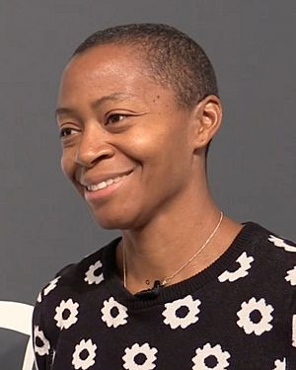
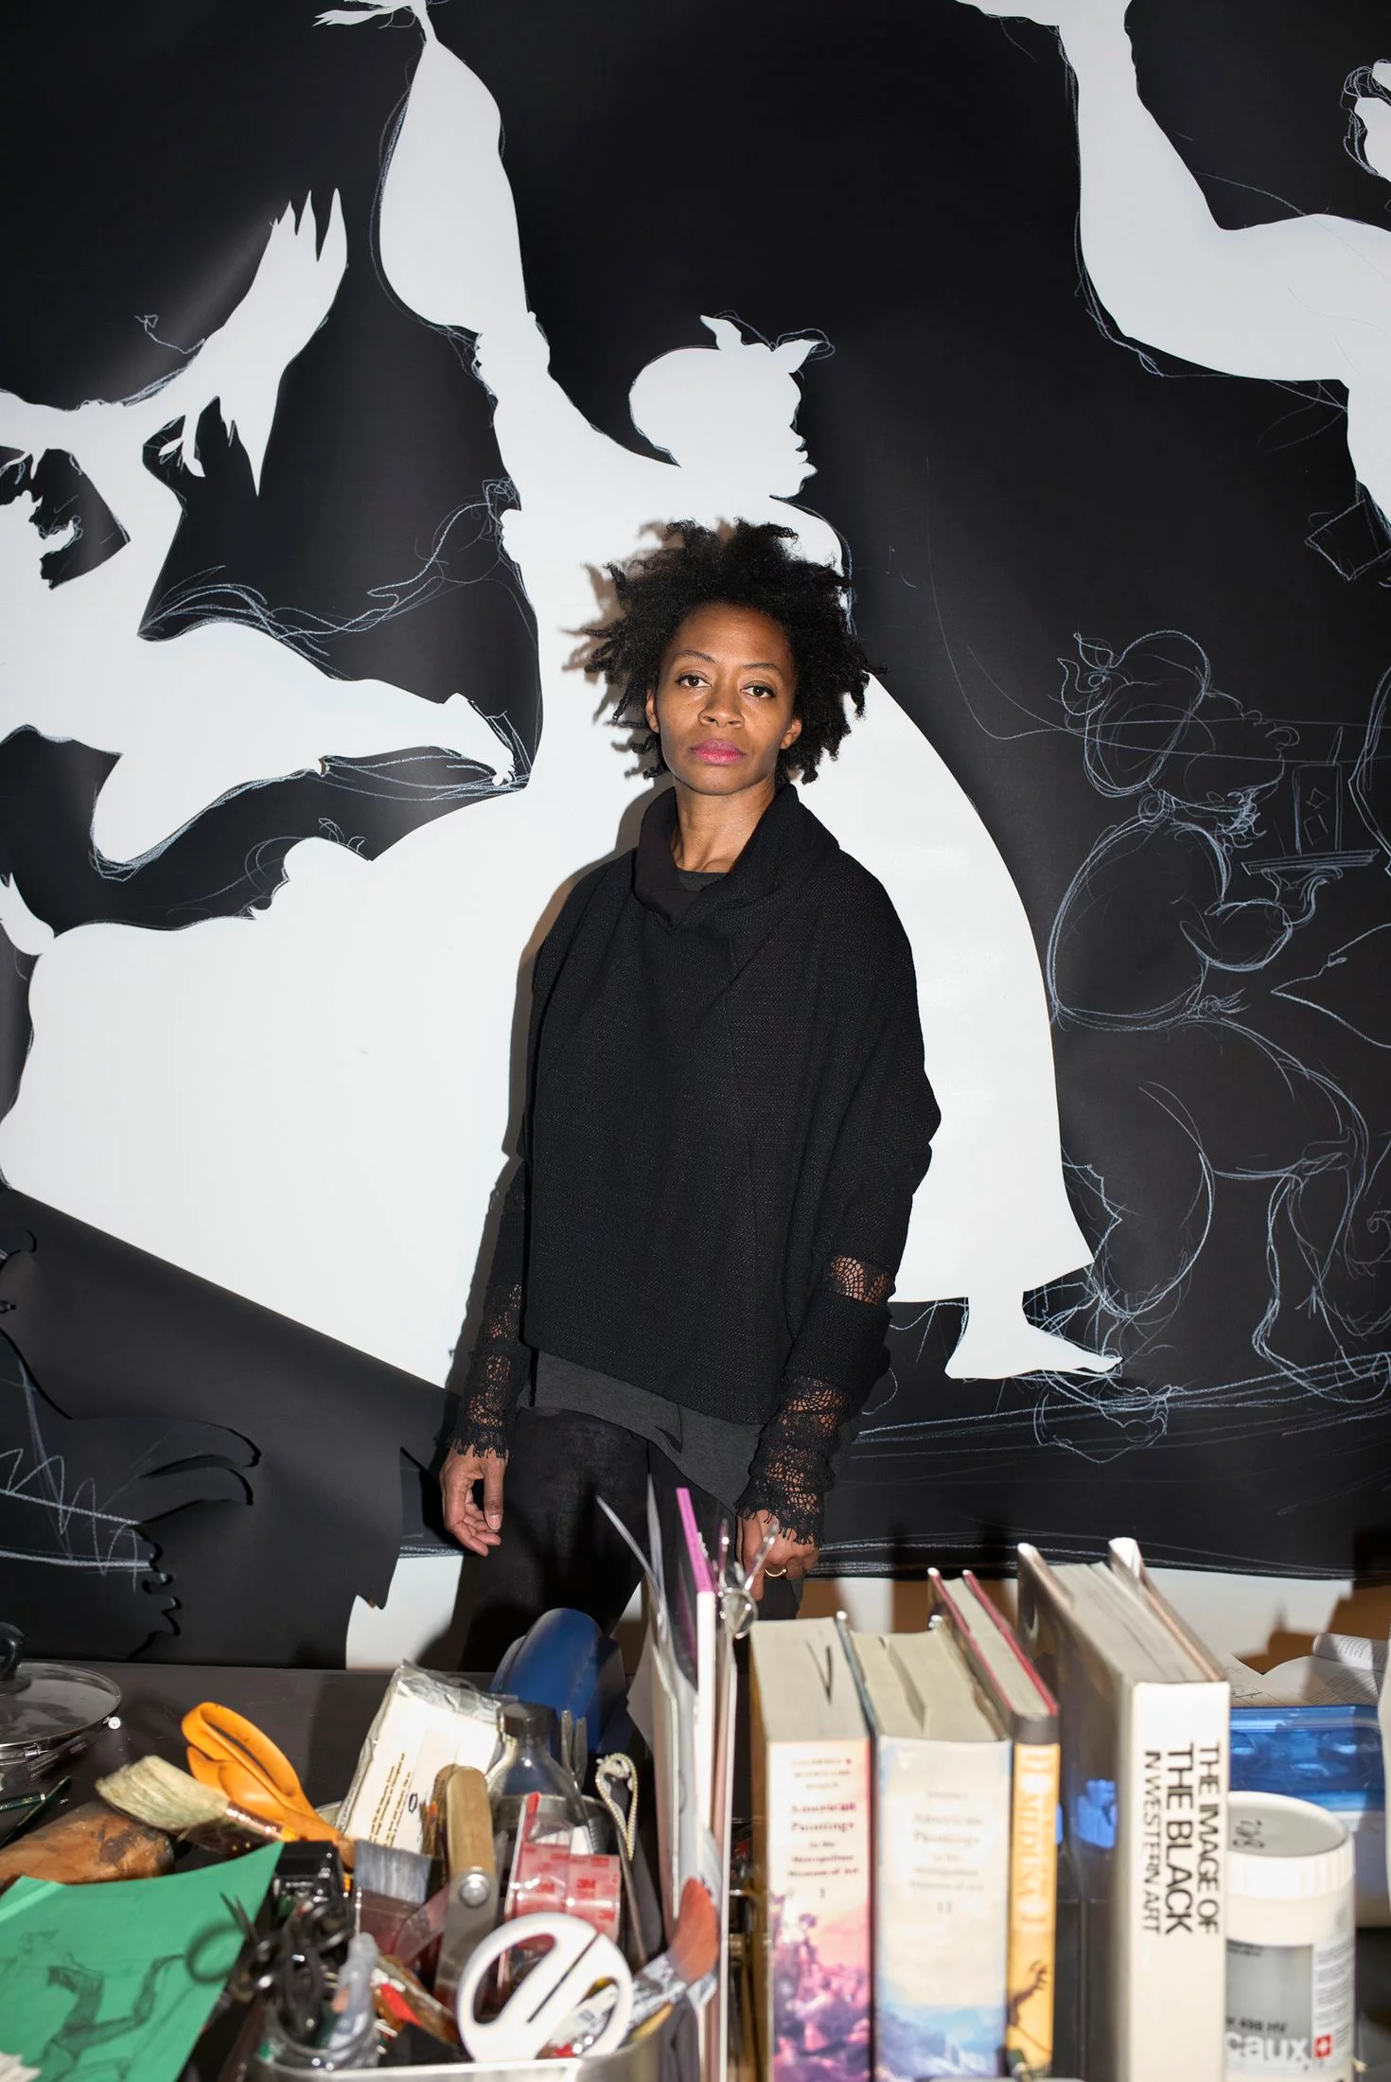
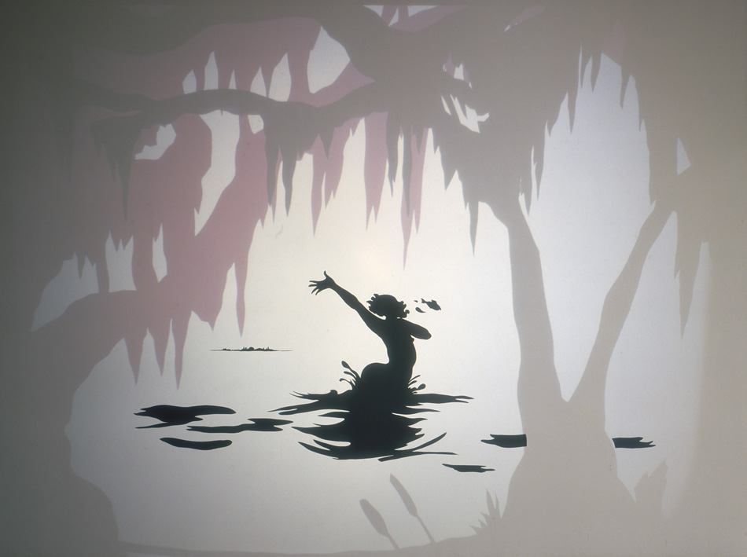
KARA WALKER
Born on November 26, 1969 in Stockton, California.
Notes:
1st photo – Kara Walker, 2006
2nd photo – Kara Walker, 2013
3rd photo – Kara Walker, image courtesy and © the artist and Sikkema Jenkins & Co., New York, photograph: Ari Marcopoulos
Salvation. 2000. The Baltimore Museum of Art: Friends of Modern Art Fund, BMA 2001.14. © Kara Walker
PRESENTER NOTES:
Allow 10-15 minutes for presentation. Please feel free to cut and shorten where needed, focusing on the 3 BIG IDEAS.
BIG IDEA #1: Kara Walker is a famous American installation artist known for her intricate cut-paper silhouettes. She is one of the most prominent and acclaimed Black American artists working today.
Walker was awarded a MacArthur Fellowship (known as the “genius grant”) in 1997, at the age of 28, becoming one of the youngest ever recipients of the award.
Her contemporary art practice spans over many decades.
Kara Walker is recognized internationally for her graphically striking work

Slide 2
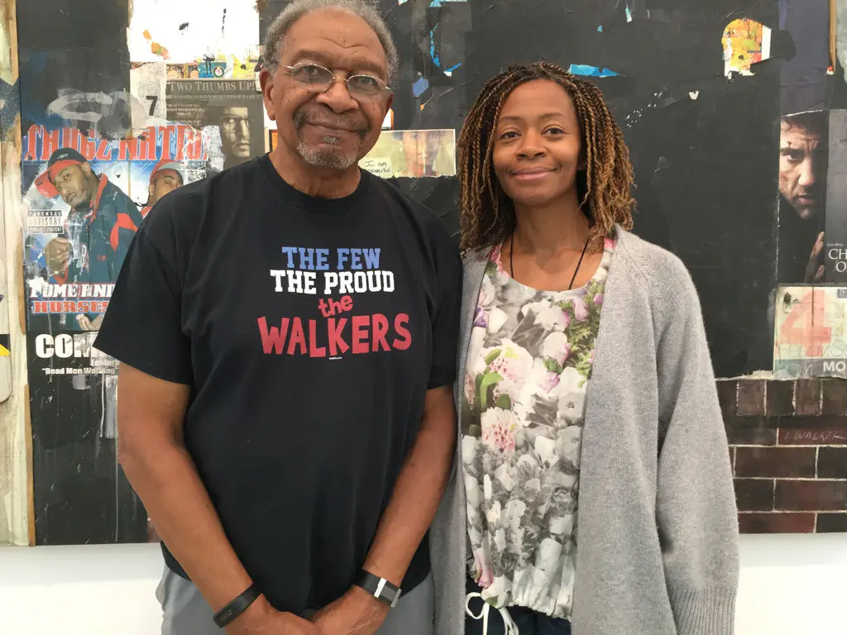
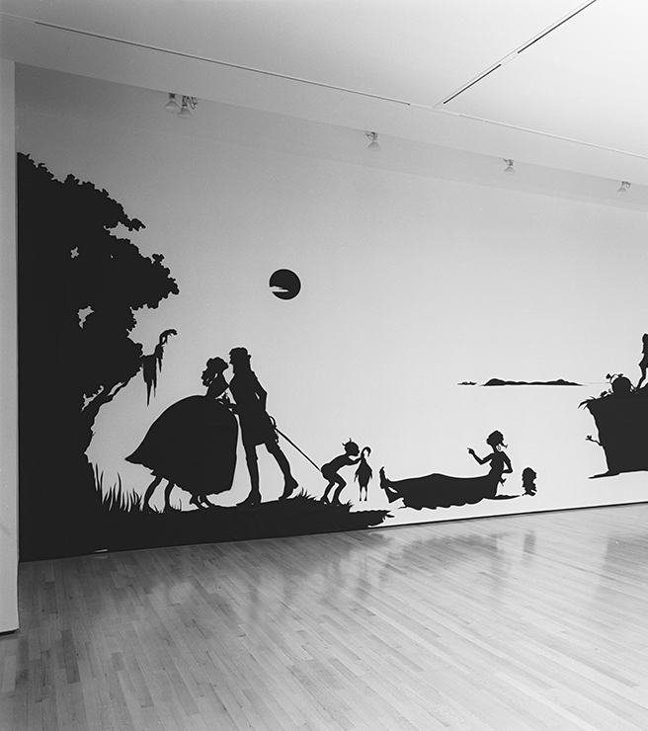
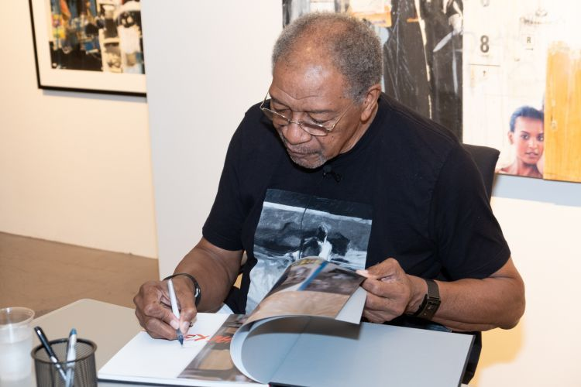
Kara Walker with one of her biggest influences – her father, Larry Walker
Original Installation at The Drawing Center, New York, 1994
Notes:
1st Photo – Larry and Kara Walker. Credit: Sascha Feldman, courtesy of Sikkema Jenkins & Co., New York
2nd Photo -- Larry Walker at an artist talk and catalogue signing at MOCA GA in 2018, Photo credit: John Ramspott
Gone: An Historical Romance of a Civil War…,The Drawing Center, New York. (Original Installation), 1994, Photo: Bill Orcutt
Early Training and Work:
Walker showed promise as an artist from a young age.
Her father, Larry Walker, was a painter and professor.
Walker’s father was a big influence, she said: "One of my earliest memories involves sitting on my dad's lap in his studio in the garage of our house and watching him draw. I remember thinking: 'I want to do that, too,' and I pretty much decided then and there at age 2½ or 3 that I was an artist just like Dad."
She grew up in an integrated California suburb.
Her family moved to Stone Mountain, Georgia when she was 13. It was then she began to focus her art on issues of race. The move was a culture shock for the young artist, as it was very different than her familiar, multi-cultural environment of California. In Stone Mountain, she experienced more racial tension and discrimination.
She went to college and graduate school for art.
QUESTIONS:
What/who inspired Walker to pursue art?
What are things that inspire you? Are you influenced by someone in your life?
What does integrated mean?
Things and people have been brought together. United, not apart or segregated.
What does culture shock mean?
Culture shock is a feeling people have when they are in a different and unknown culture or place, such as a different country.

Slide 3
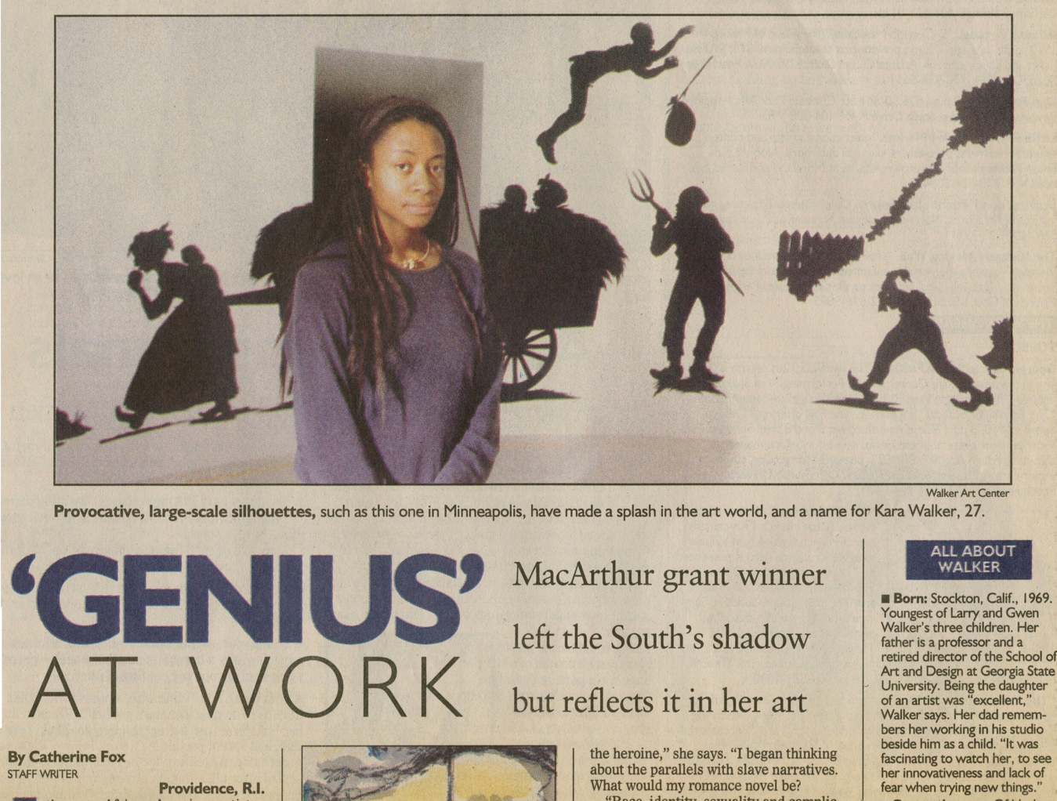
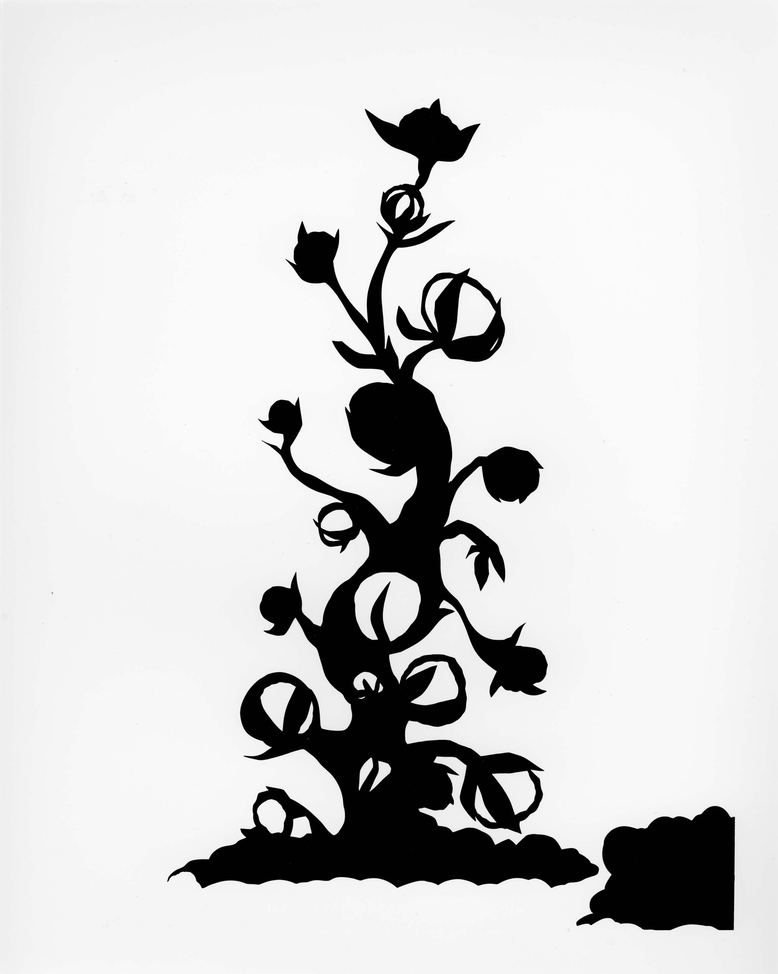
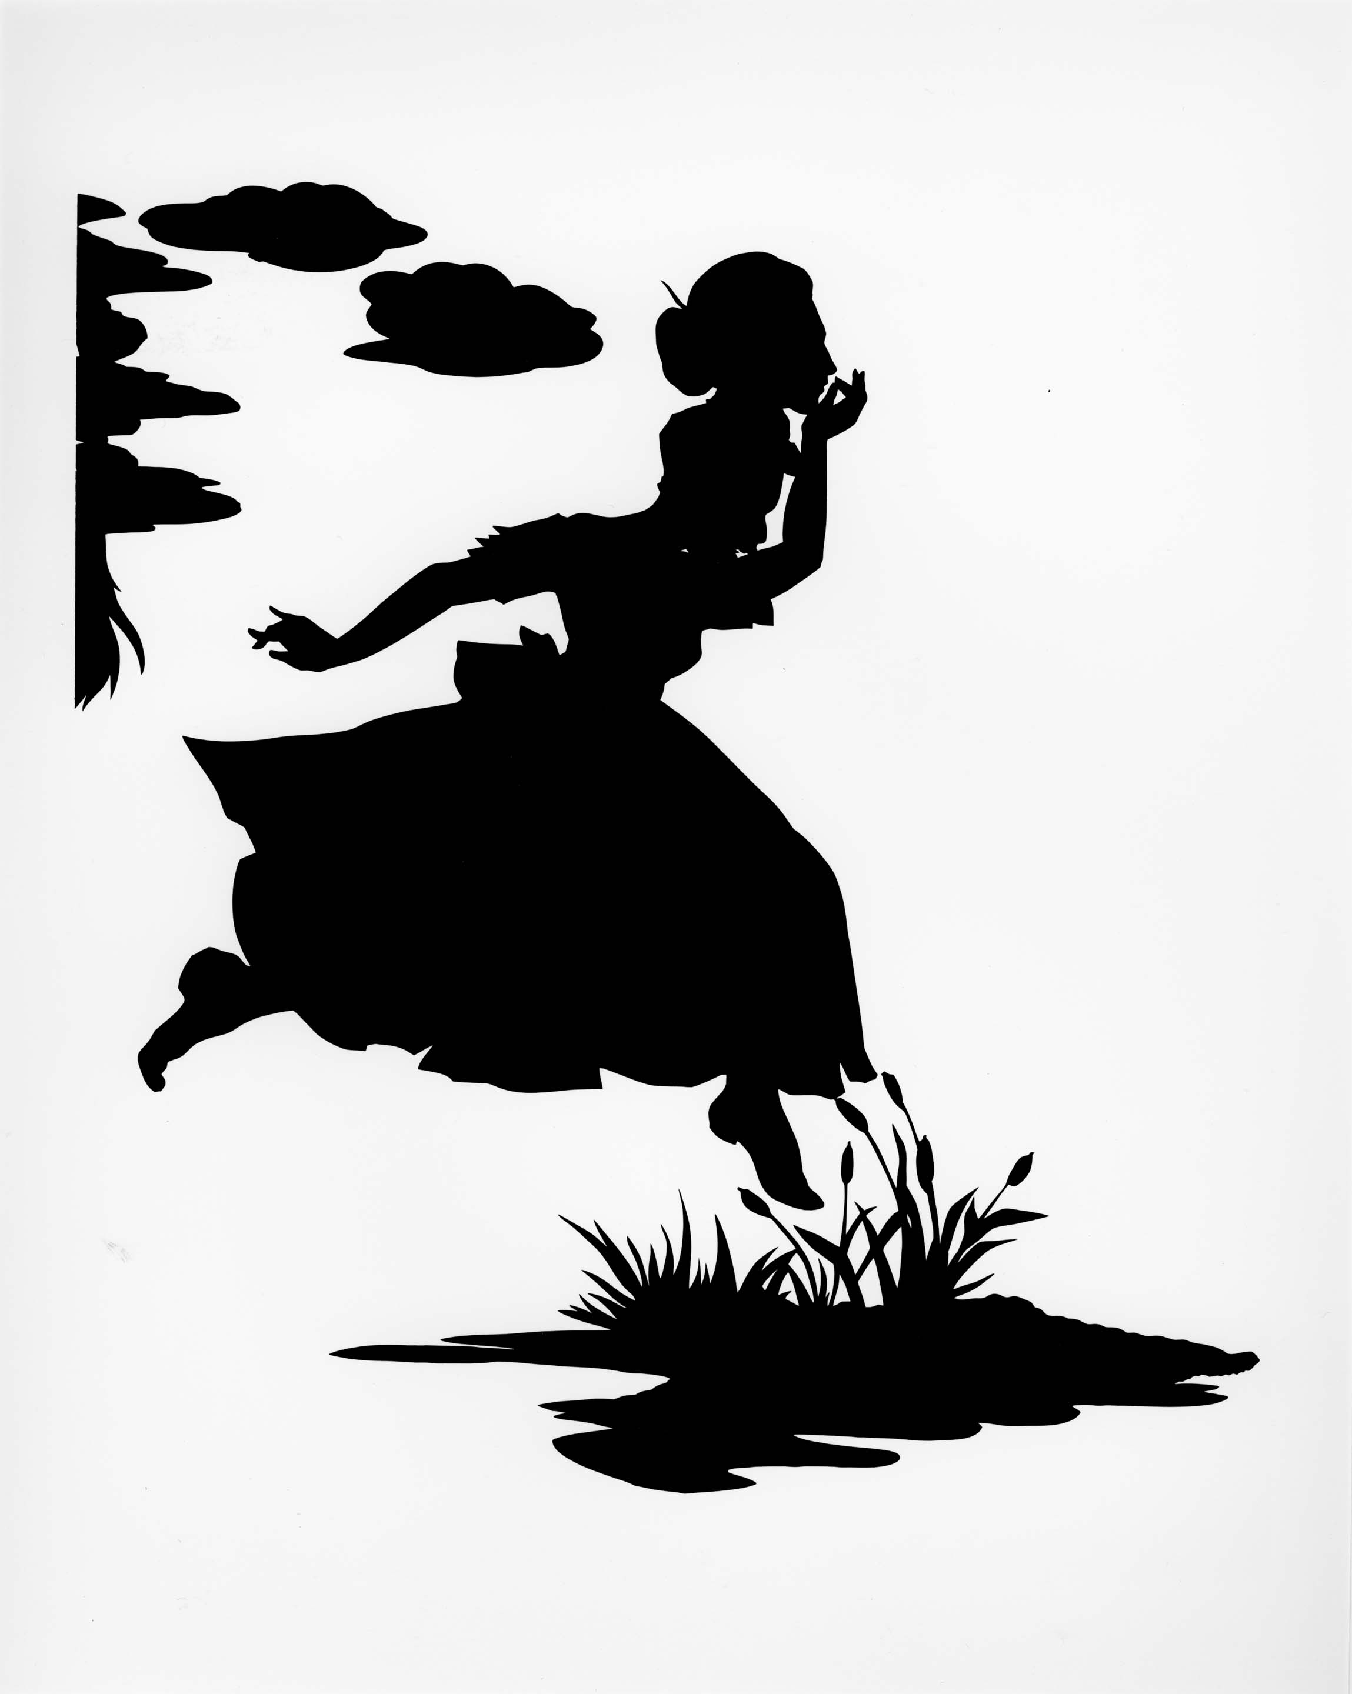
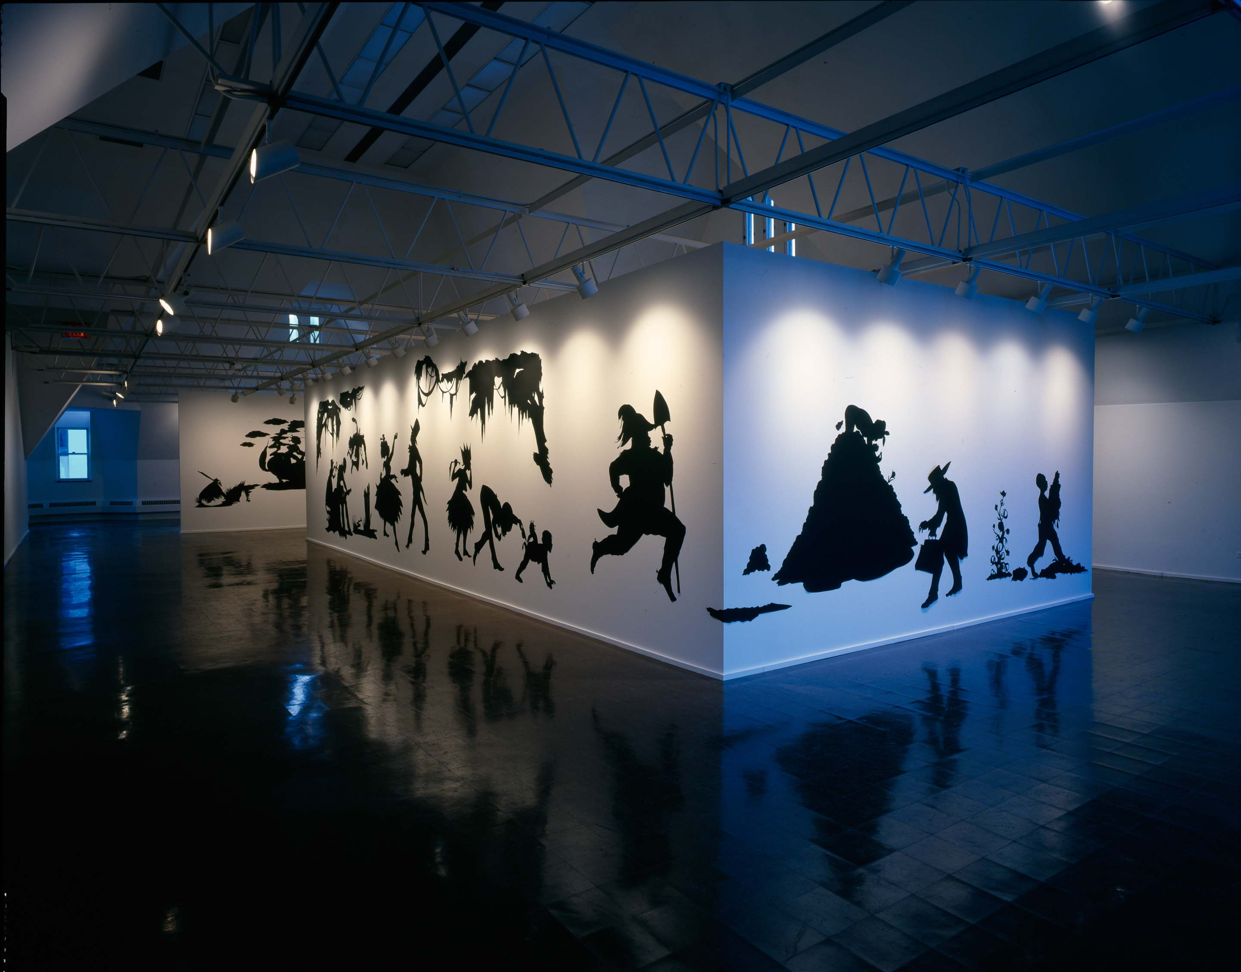
Notes:
Presenting Negro Scenes, installation view and details, 1997.
BIG IDEA #2: Walker is best known for her room-size installations of black cut-paper silhouettes.
What is a silhouette? What features does a silhouette have?
It is a solid shape. It shows the edge of an object. The inside of a silhouette is featureless. An image that is typically filled in as black and placed on a white background.
While Walker was in graduate school, she began working in the silhouette form.
She is known for her immersive site-specific installations.
Walker is best known for cut-paper silhouettes, but she also creates videos, paintings, drawings, and sculptures.
QUESTIONS:
What is an art installation?
Artworks that are often designed for a specific place (site-specific), can be three-dimensional, and can transform a space.
This fall we learned about Andy Goldsworthy’s art practice. How are Goldsworthy and Walker’s installations similar? How are they different?
Artworks that are often designed for a specific place (site-specific), can be three-dimensional, and can transform a space. Like Goldsworthy, Walker creates installations, however, most of her installations are created for a gallery space. She uses the flat walls like pages of a book to create an all-encompassing story that the viewer can “walk into.”

Slide 4

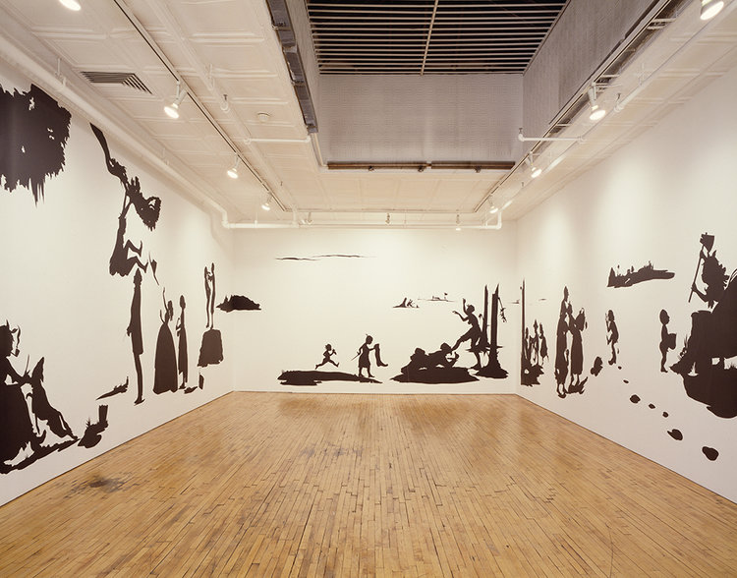
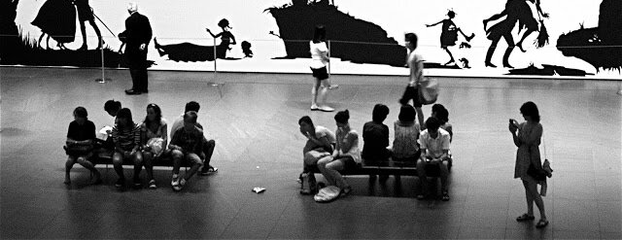
LARGE installations
storytelling
Notes:
From the Bowels to the Bosom, Wooster Gardens/Brent Sikkema, New York, NY, March 1 – April 13, 1996. (Solo)
Gone: An Historical Romance of a Civil War…, 1994. Shown here at MOMA in 2010.
Untitled (Girl with Bucket), 1998
BIG IDEA #3: Walker explores serious themes in her art. She is particularly interested in the history of American slavery and current issues on race.
Walker’s imagery can be violent and emotionally intense.
Her use of cut-paper silhouettes over large sections of the gallery wall creates a story. These stories can help us understand the past and current inequalities.
Walker has made it clear that her intent as an artist is not to create pleasing images or to raise questions with easy answers. Her work leads viewers to a critical understanding of the past, while also thinking about contemporary racial and gender stereotypes.
QUESTIONS:
What does Walker’s art make you think about?
Walker is interested in complex issues, but much of her work is black and white. What do you think about this?
Contrast between black and white imagery vs. complicated issues. Creates a tension. The work is black and white, but the themes explored are complex and nuanced.
Dig Deeper for upper grades
Walker used silhouettes to depict serious themes. Why? Do you think this is a good form to depict these serious themes?
The silhouette was typically a refined and respectable tradition in American art history. The silhouette was often used for family portraits and book illustrations. Walker carried on this portrait tradition but used them to create characters in a scary world. A world that revealed the violence of American racism and inequality. This creates an interesting contrast between form and concept.
She also explained her use of the silhouette by stating that “the silhouette says a lot with very little information, but that’s also what the stereotype does.”

Slide 5
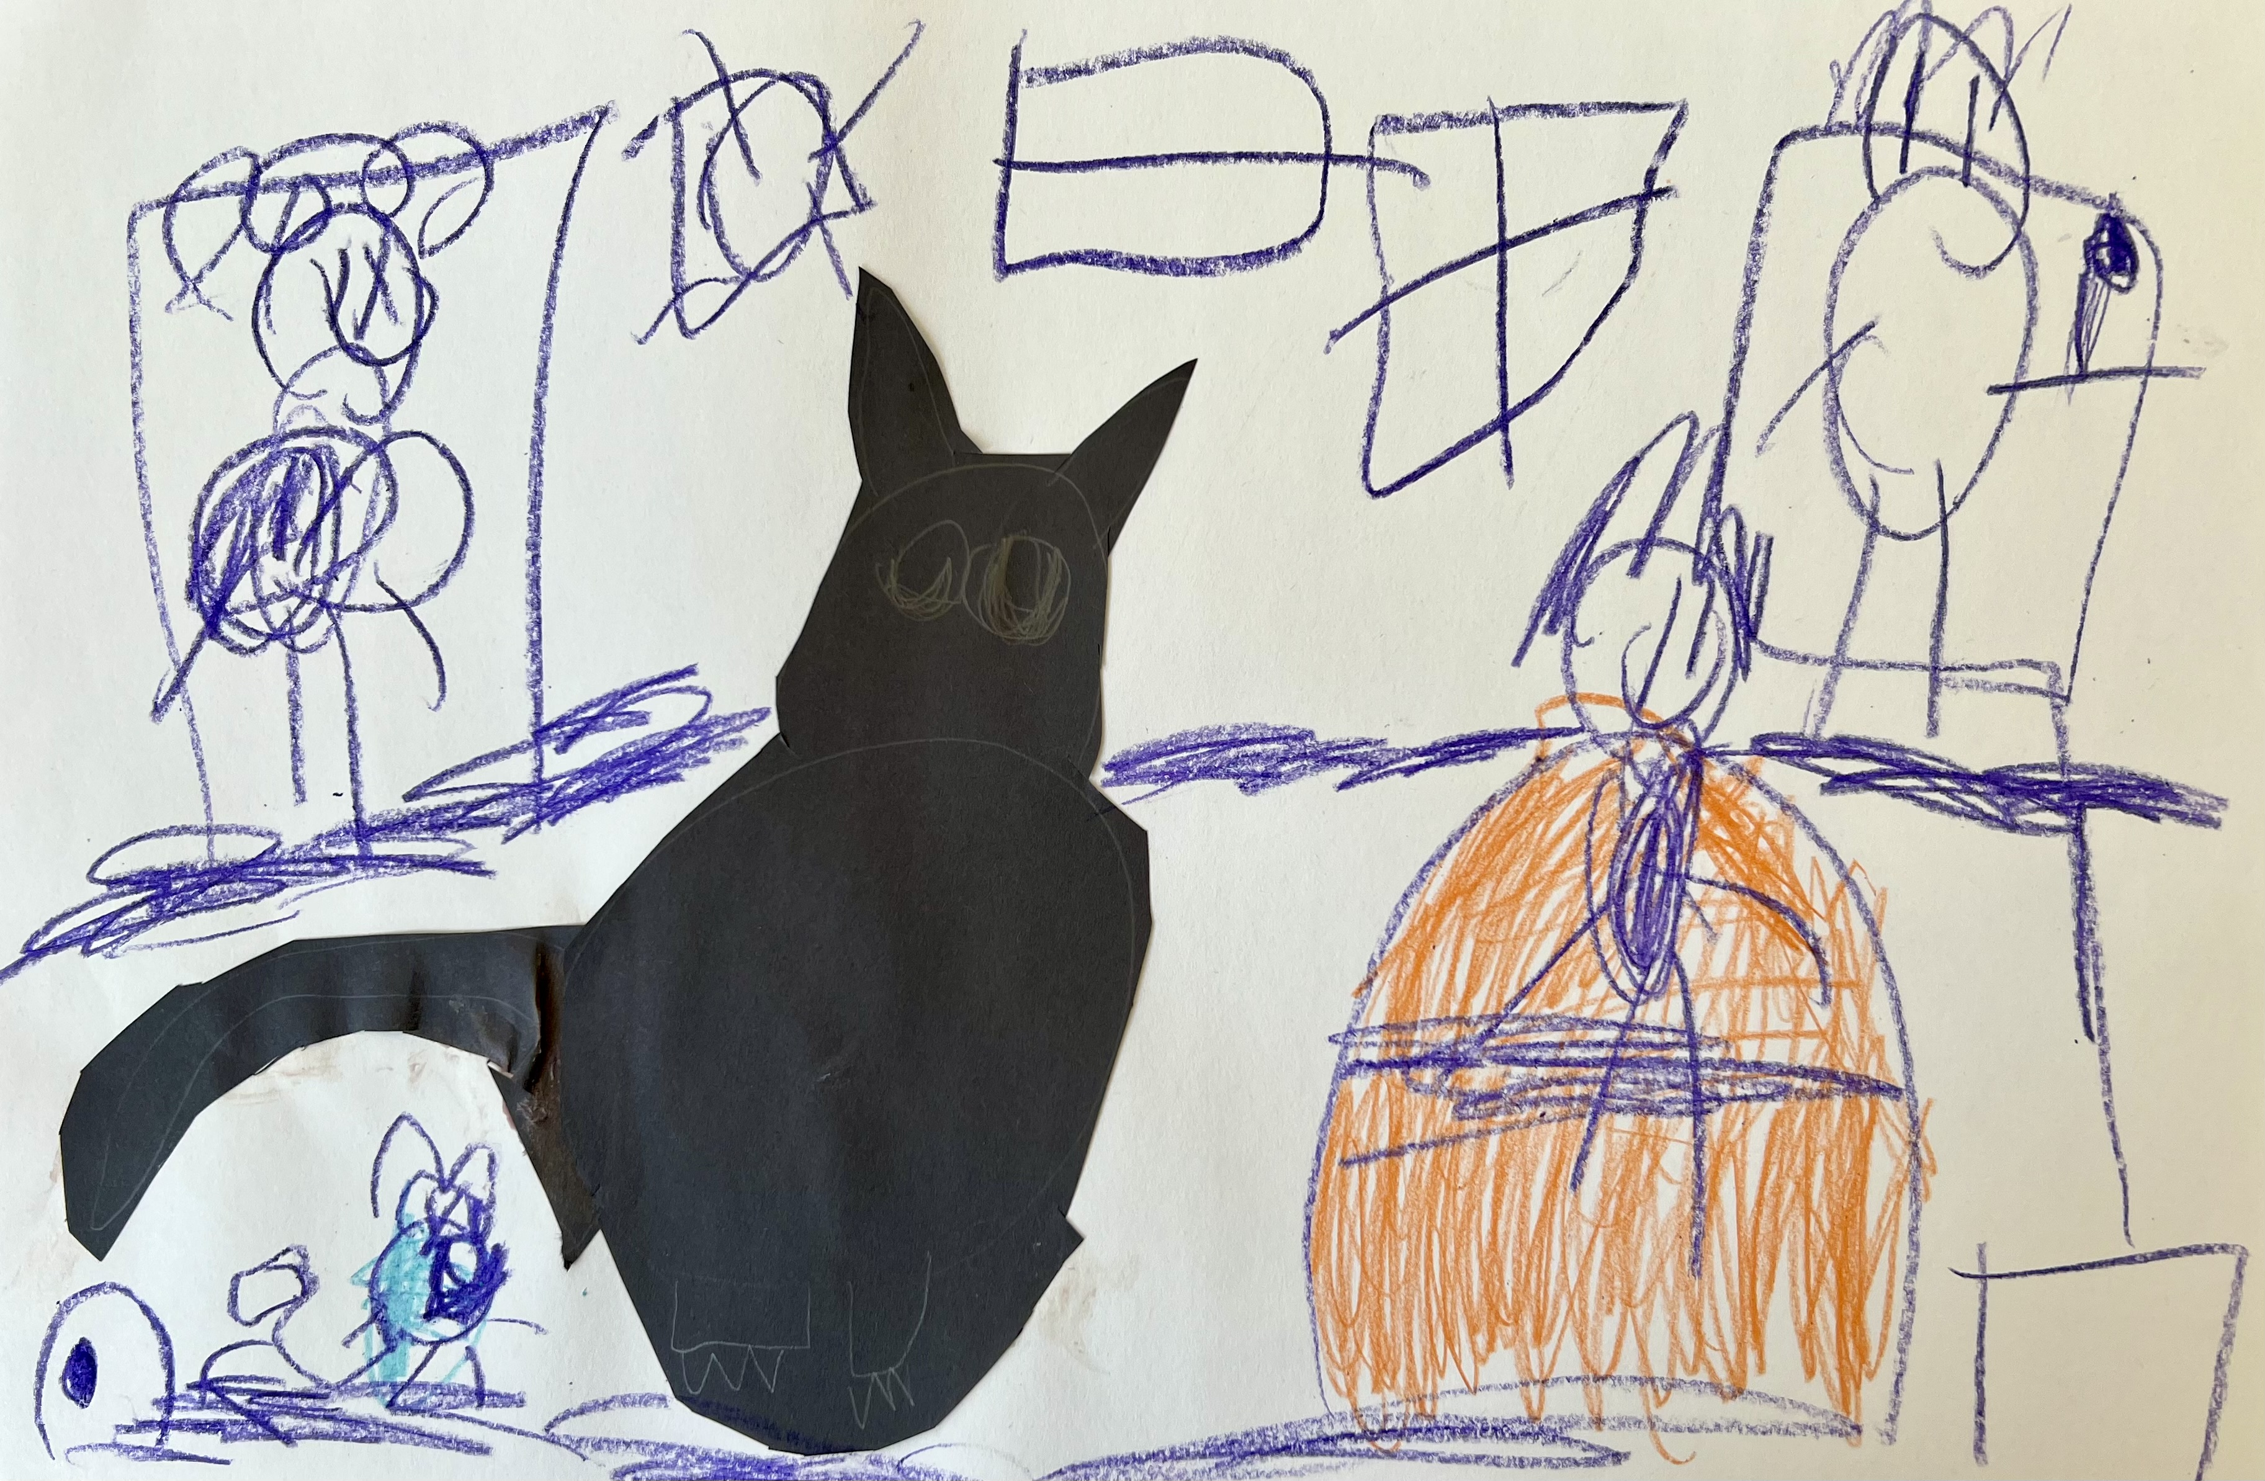
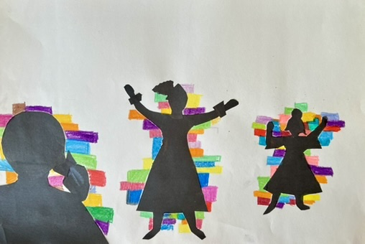
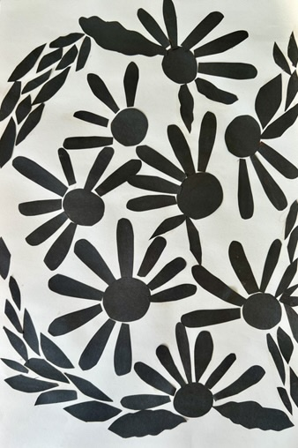
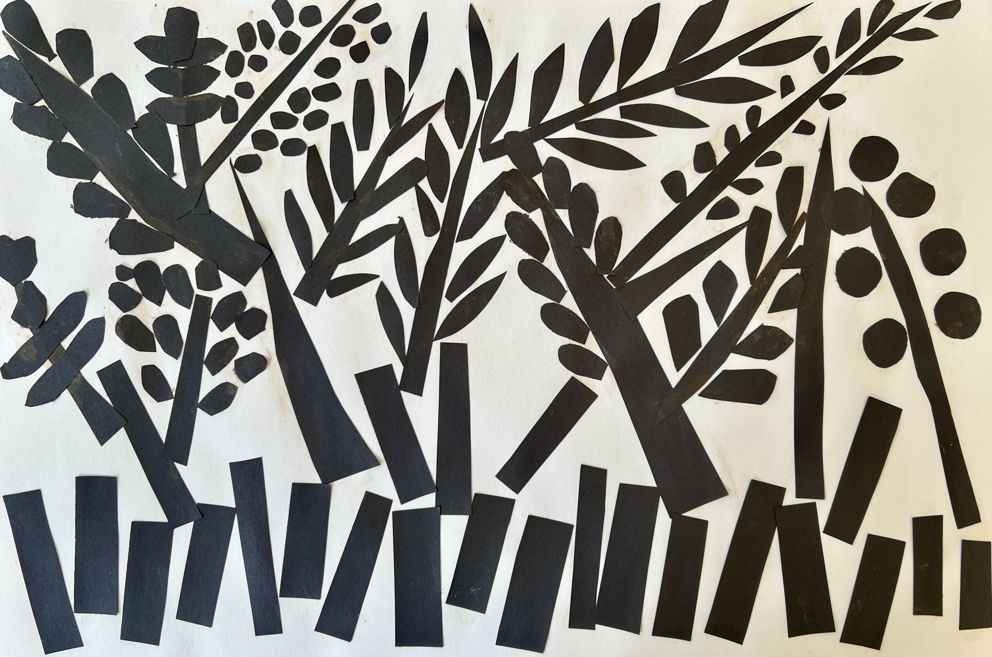
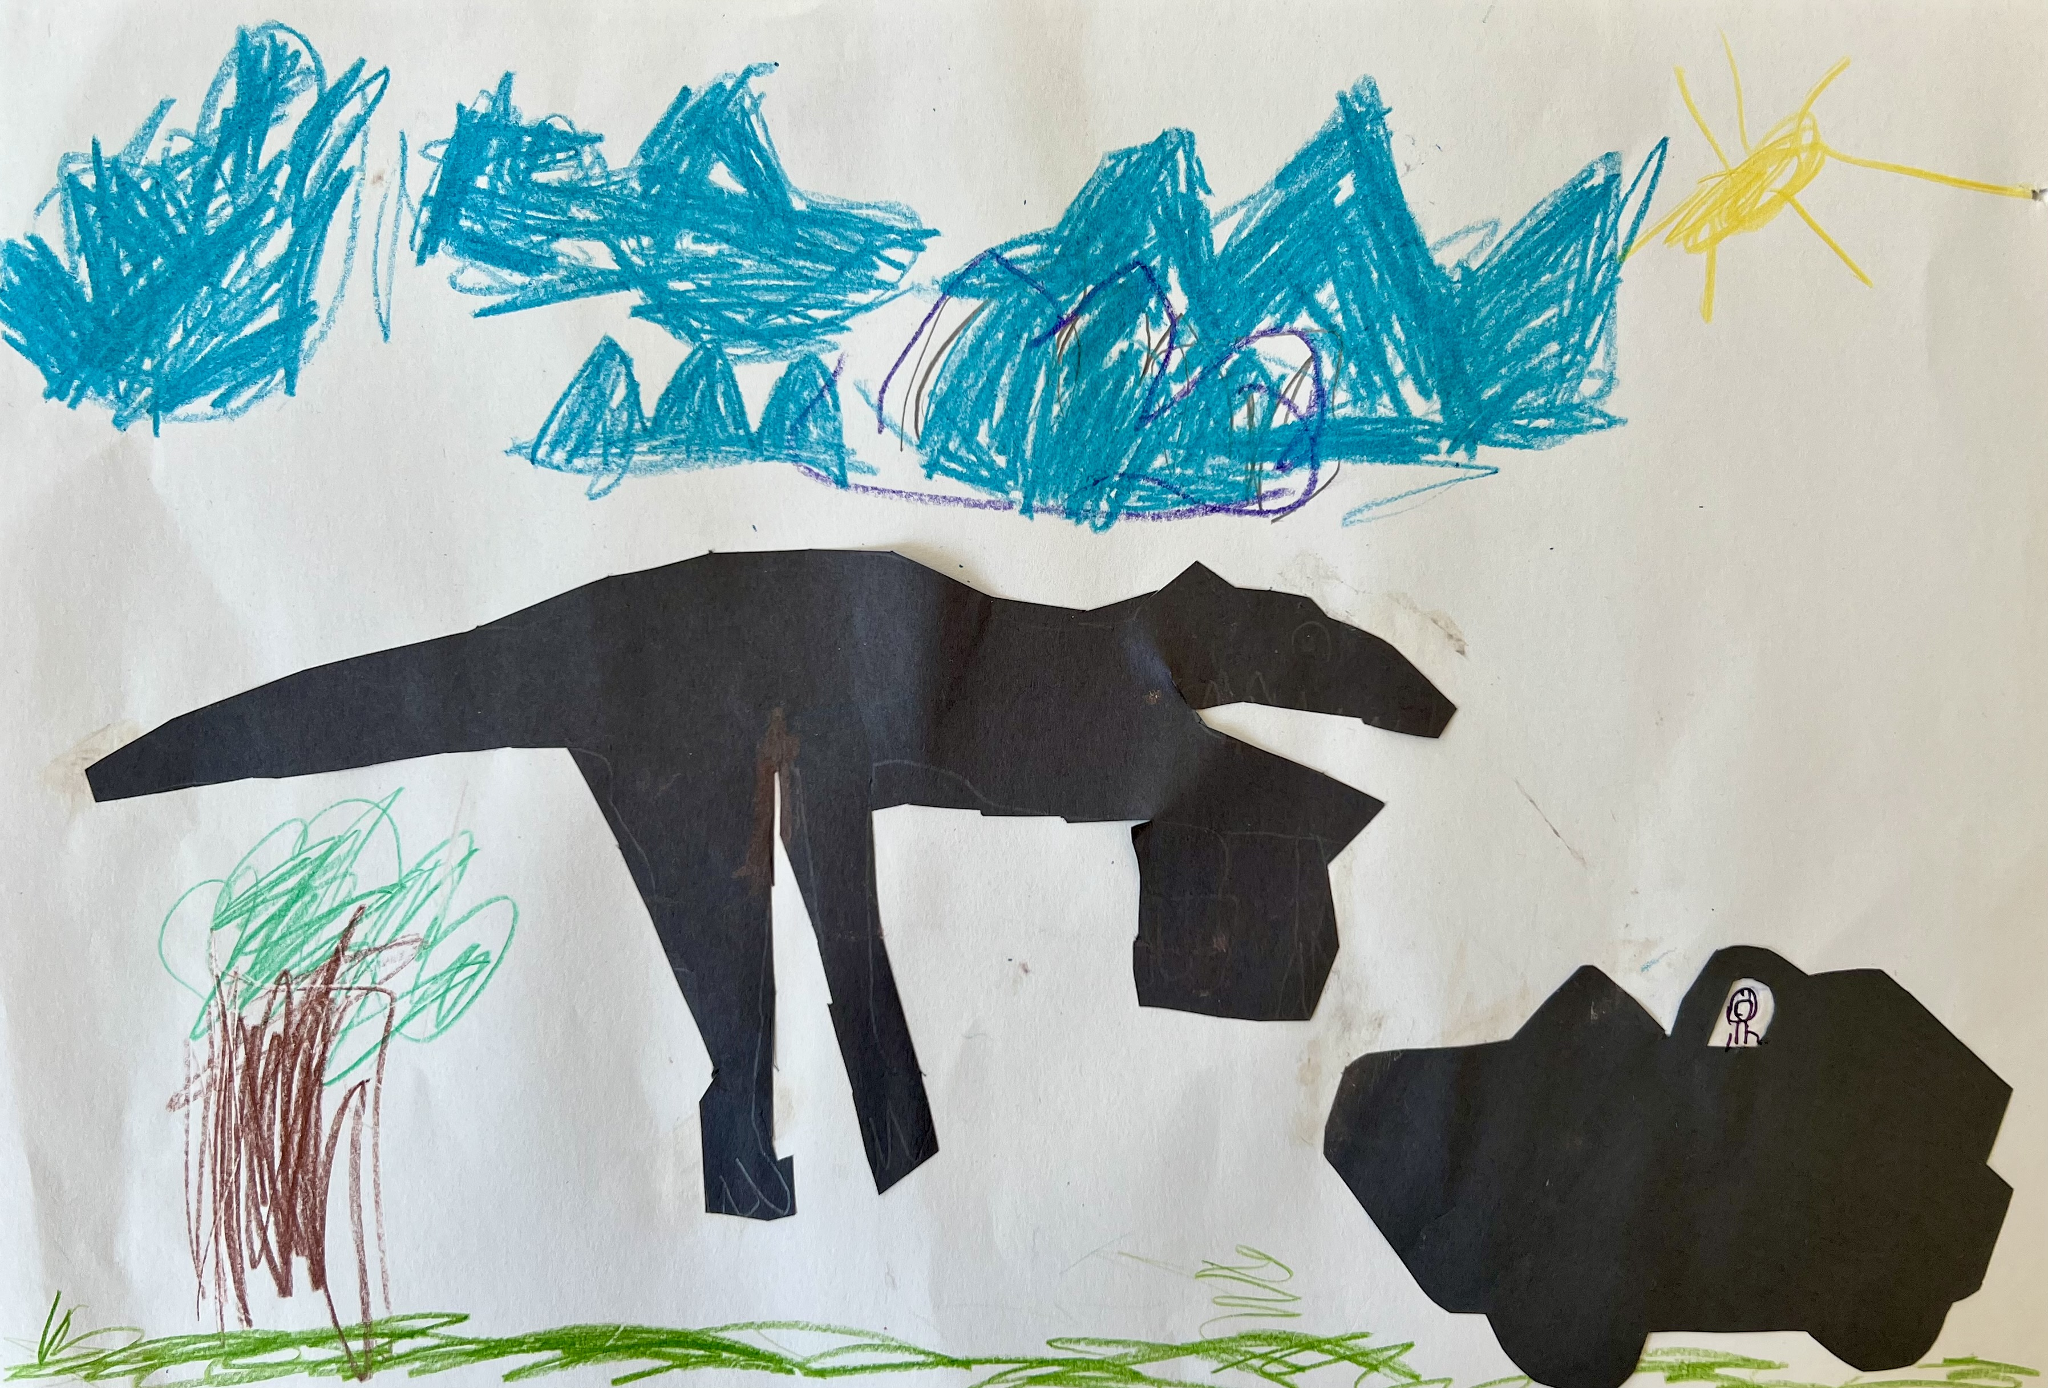
Art Project: Be inspired by Kara Walker!
Create your own silhouette story or scene.
What is important to you? What story do you want to tell?
Notes:
Great Art Project Instructions – Kara Walker
Project Description:
Students will learn about Kara Walker and create their own silhouette collage. Walker is a famous American installation artist known for her intricate cut-paper silhouettes. She is one of the most prominent and acclaimed Black American artists working today.
Grades: K - 6
Art Project: using black paper, students will cut silhouettes to create their own story or scene.
Optional: the art may be collected and displayed (dependent on the teacher’s approval) at the end of the session.
Reminders: remind students to sign their artwork.
Materials: all grades will use the same project materials, except K-2 will have some pre-cut black shapes.
Per student: one sheet of white paper, black paper
Shared by students: scissors, glue, crayons, pencils
Considerations/ideas:
Use these supplies to create your own story or scene. What matters to you?
Think about adding details. Use crayons for a background, or extra details to your story or scene.
Experiment and have fun!

