Slide 1
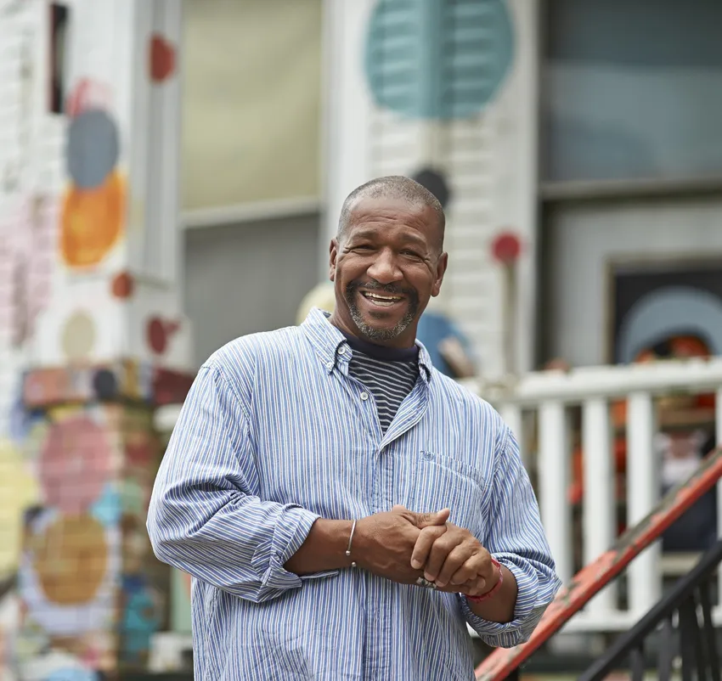
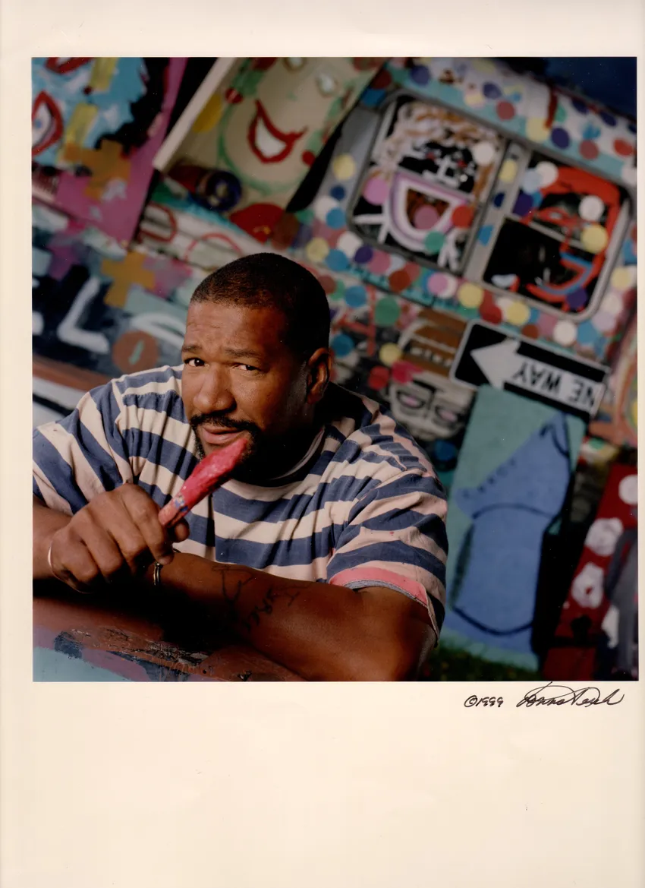
Tyree Guyton
Notes:
Photos – Photographs of Tyree Guyton, www.tyreeguyton.com
Many photos and information from Tyree Guyton’s website: www.tyreeguyton.com
PRESENTER NOTES:
Allow 10-15 minutes for presentation. Please feel free to cut and shorten where needed, focusing on the 3 BIG IDEAS.
BIG IDEA #1: Tyree Guyton is a famous artist from Detroit, Michigan. He is known for his unique and colorful art that often uses everyday found objects. He used his urban environment (the city around him) as his canvas.
Tyree Guyton (born August 24, 1955) was born and raised in Detroit. He currently lives in Detroit with his wife, Jenenne Whitfield.
When he was young, he loved drawing and being creative.
Before he became a full-time artist, he worked as a firefighter and in a car factory. He also served in the US Army. Guyton studied art at several places, including Marygrove College and Wayne State University. He says his grandfather, Sam Mackey, and artist Charles McGee were his biggest inspirations.
He makes art using things people throw away.

Slide 2
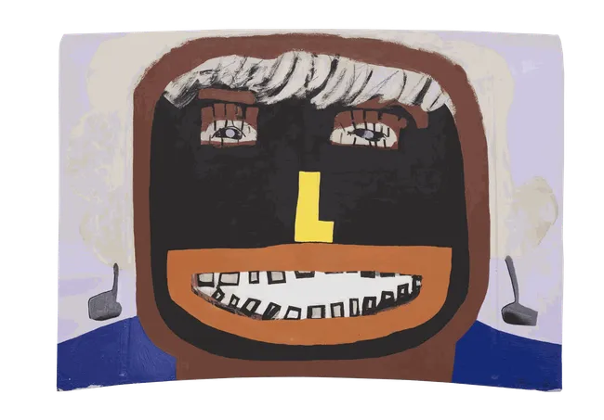
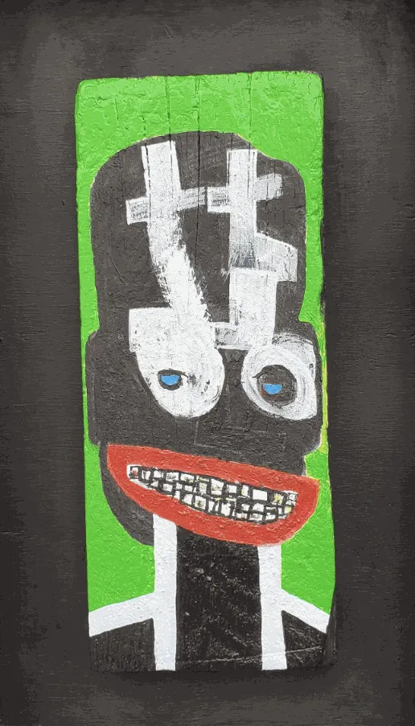
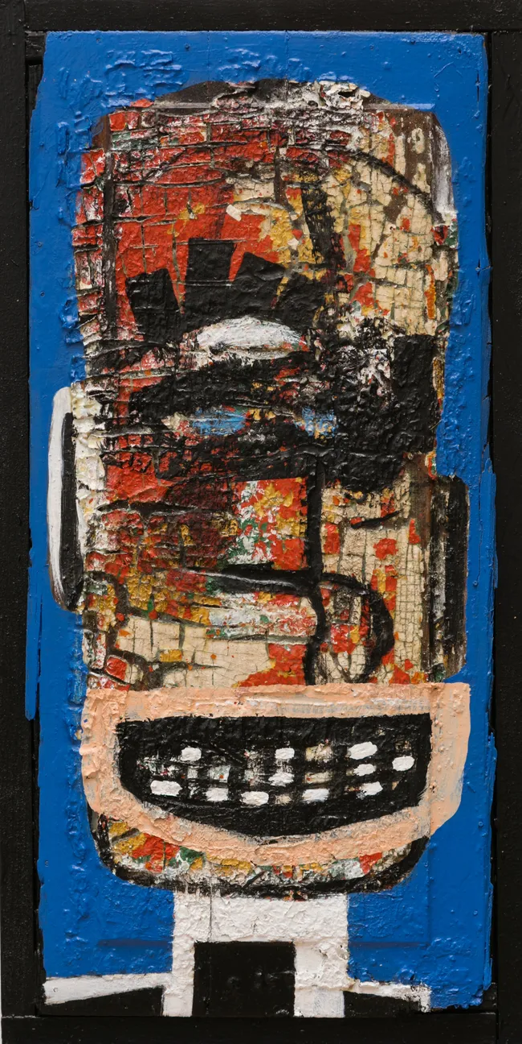
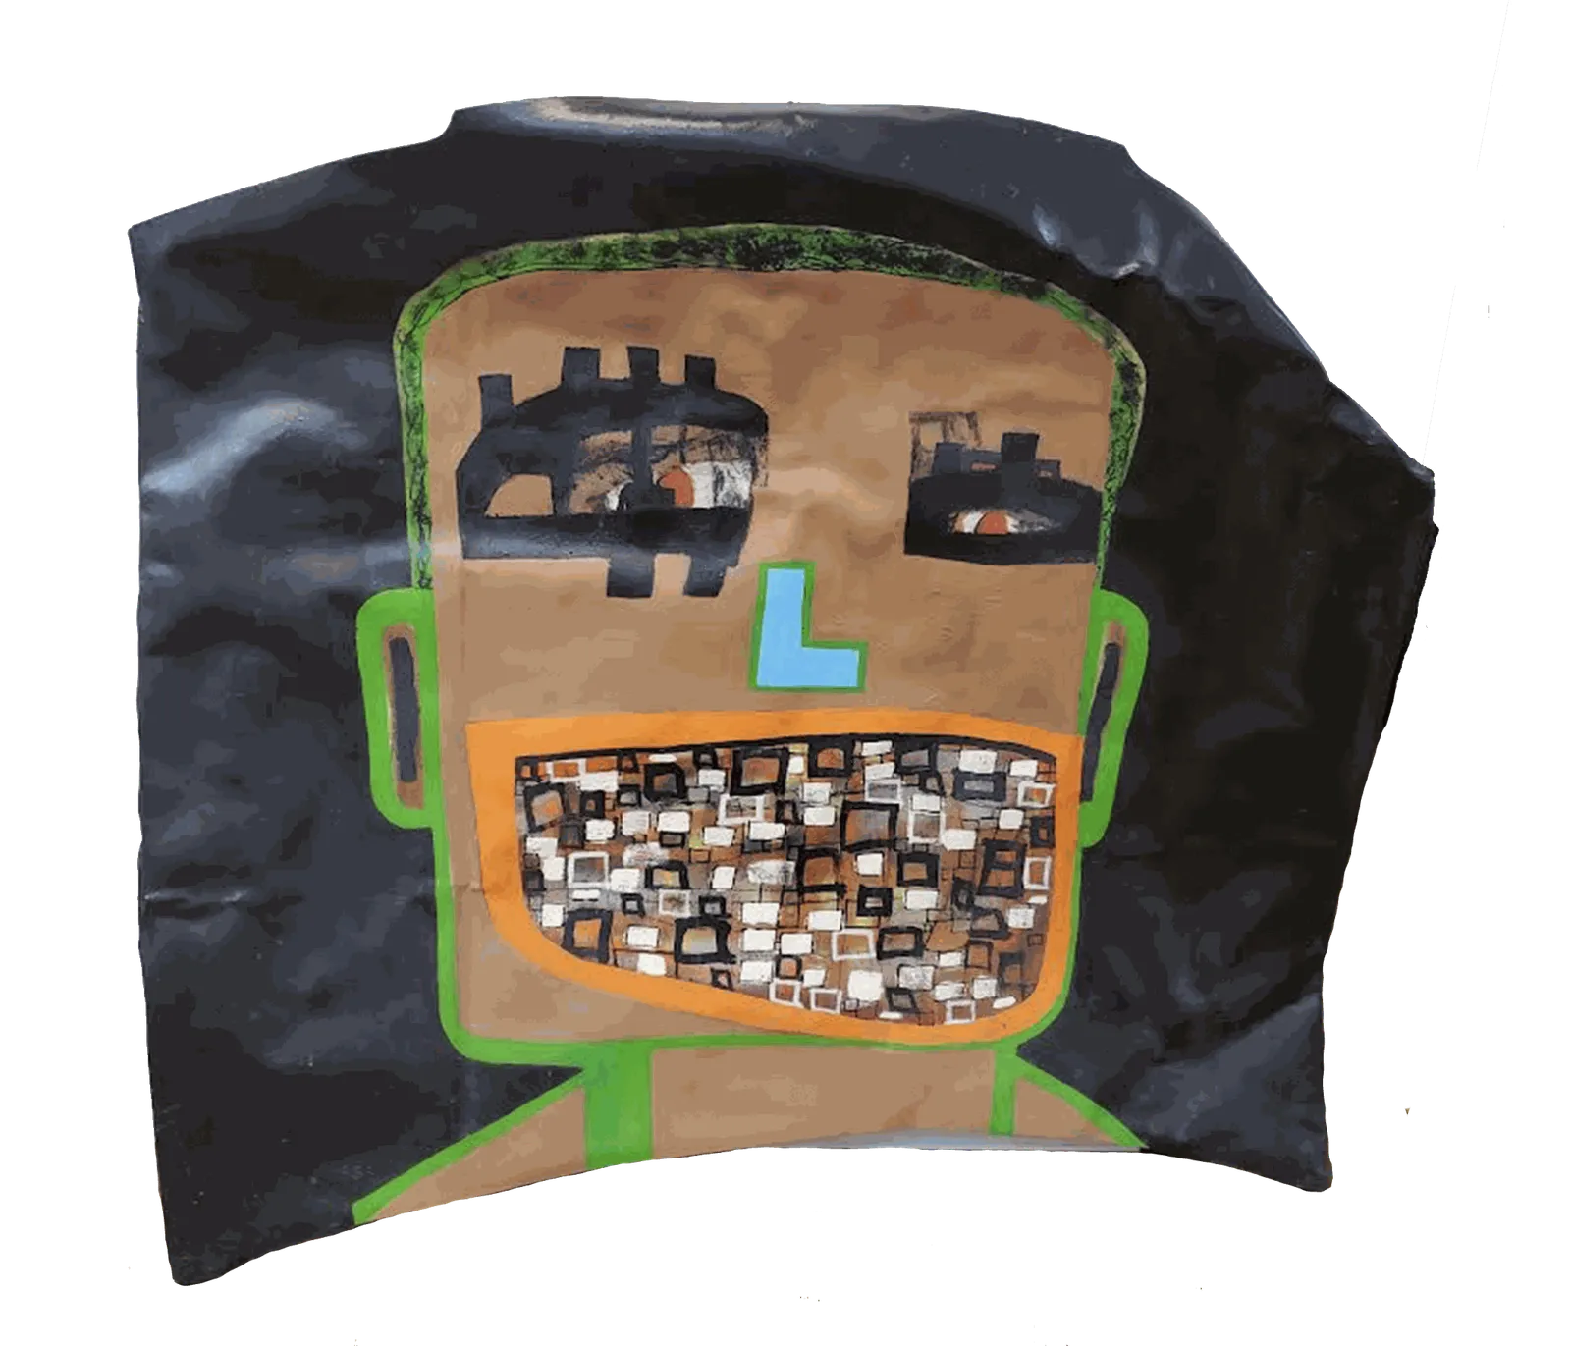
That’s My Mother, 2010
Peek-a-Boo, 2019
Faces
The Tooth Fairy, 2010
Life, 2018
Notes:
Mixed media faces, from Tyree Guyton’s website
Mixed media on wood, paint on wood, paint on aluminum
What do you notice about Guyton’s artwork of faces?
The faces are often big, bold, and colorful.
Bright colors, stripes, patterns—graffiti style painting.
Expressive mouths, exaggerated smiles, large and uneven.
They look silly, surprising, strange.
Cartoon like.
Use of mixed media like wood and aluminum.

Slide 3
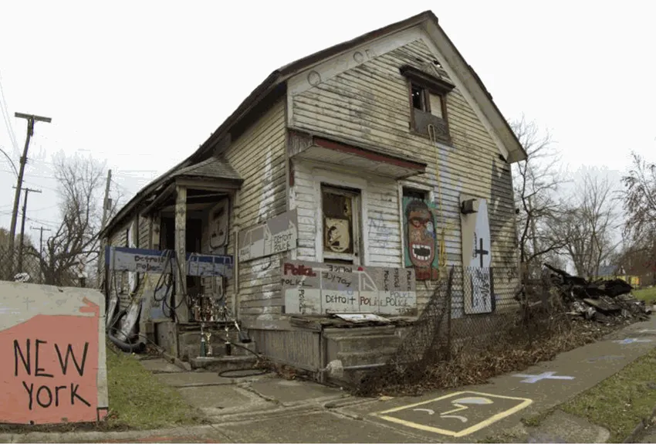
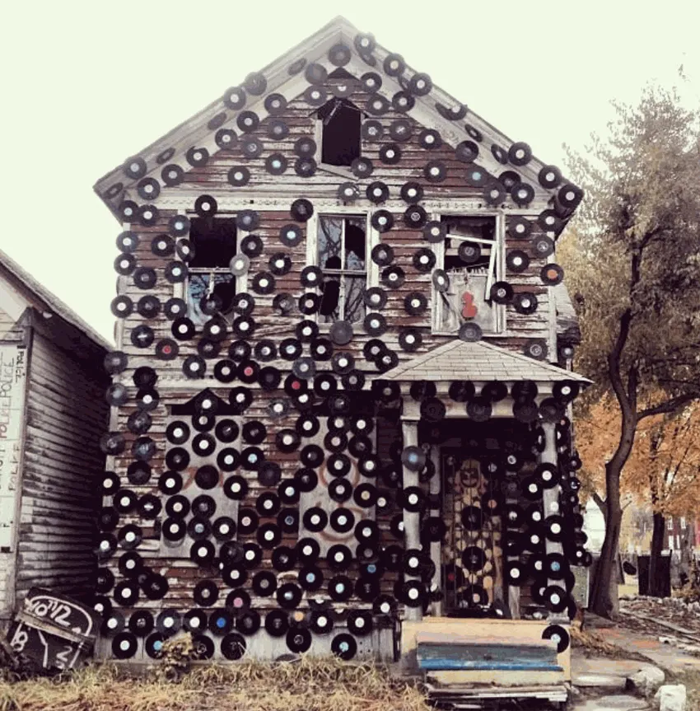
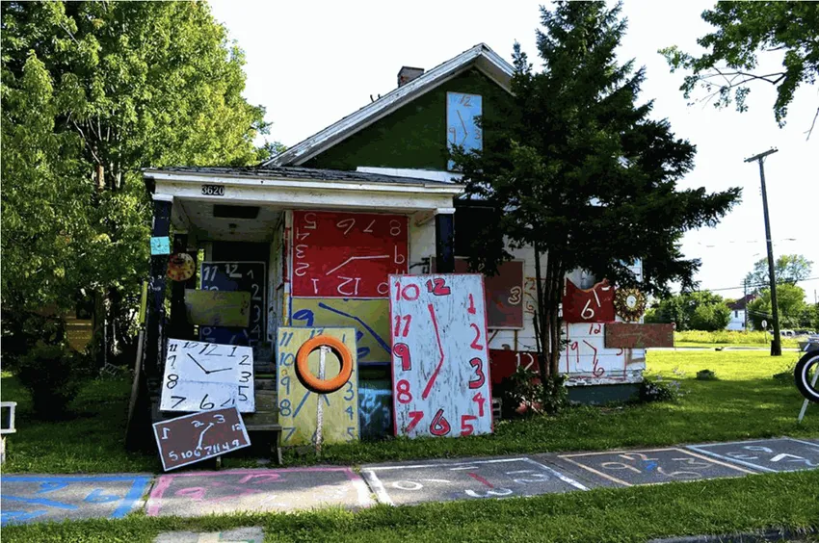
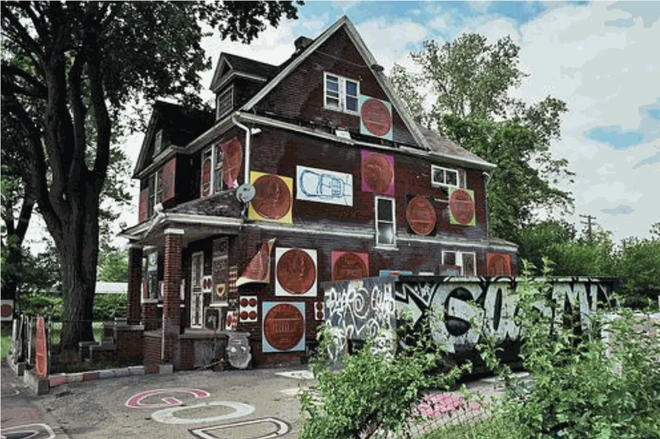
Heidelberg Project
Notes:
Photos – Heidelberg From the Archives: War Room, Lost in the fires of 2012/2013, from www.tyreeguyton.com
BIG IDEA #2: HEIDELBERG PROJECT
Recognized as one of the most powerful art environments in the world. Streets, sidewalks, and houses became his artwork. He turned empty or broken spaces into colorful places.
Guyton started the Heidelberg Project in 1986, built on a street called Heidelberg. He grew up on the main block of the project on Heidelberg Street and began making art with his grandfather, Sam Mackey, who also was an artist. He started the project with his grandfather. Neighbors also helped to create installations on Heidelberg.
He wanted to make his neighborhood more beautiful. Many houses were abandoned or falling apart. Trash was left in the streets. And some people felt unsafe or forgot about the neighborhood.
Instead of leaving, he decided to make it better by using art. Making (transforming) trash into art. Guyton wanted people to notice the neighborhood again.
Some of the projects has been since taken down and rebuilt. It is always growing and changing.
The project brought people together and gave hope to the neighborhood.
People from all over the world came to see it.
Guyton said he began the Heidelberg Project in 1986: "I took the street, Heidelberg Street, and transformed it into something whimsical ... something magical," he said.

Slide 4
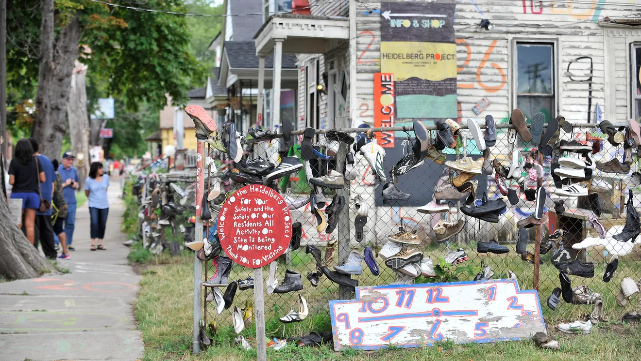
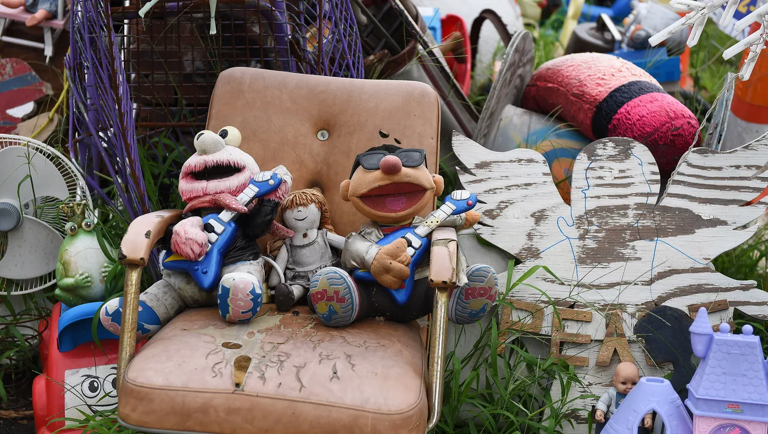
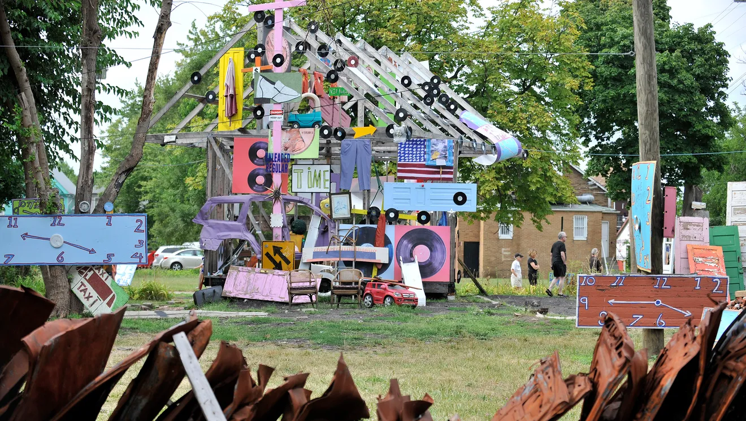
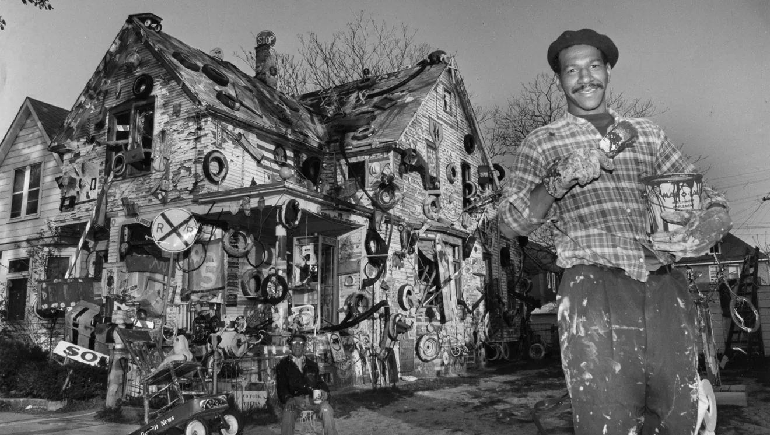
Heidelberg Project
Notes:
1st photo—Visitors check out the Heidelberg Project in Detroit on Aug. 14, 2016. Tyree Guyton is reportedly planning to dismantle his project over the next two years. The Detroit News.
2nd photo—Some of the many dolls, furniture and toys installed at the Heidelberg Project.
3rd photo—People walk through and look at the Heidelberg Project.
4th photo—Tyree Guyton in front of the Heidelberg Project in 1988. The Detroit News Archives.
“It’s not a museum inside a building—it’s art you can walk through outside.”
Building community!
Art can bring people together. Visitors from around the world came to see the project.
It helped people feel proud of their neighborhood.
It started conversations about change.
At first, not everyone agreed. Some people didn’t understand it. Isn’t it just trash?!
Parts of the project were taken down or destroyed. Guyton continued to rebuild and create anyway.
What do you think–is it just trash, or is it more than that?
What do you notice about the Heidelberg Project? What do you see? What are some characteristics of the project?
Bright colors everywhere! Bright colors bring joy and attention.
Polka dots on houses.
Old toys, shoes, and cars turned into art.
It feels like walking into a giant playground.
Each piece could tell a story. Old objects remind us of memories.
Highlights Heidelberg Street, brings attention to a neighborhood that was forgotten.

Slide 5
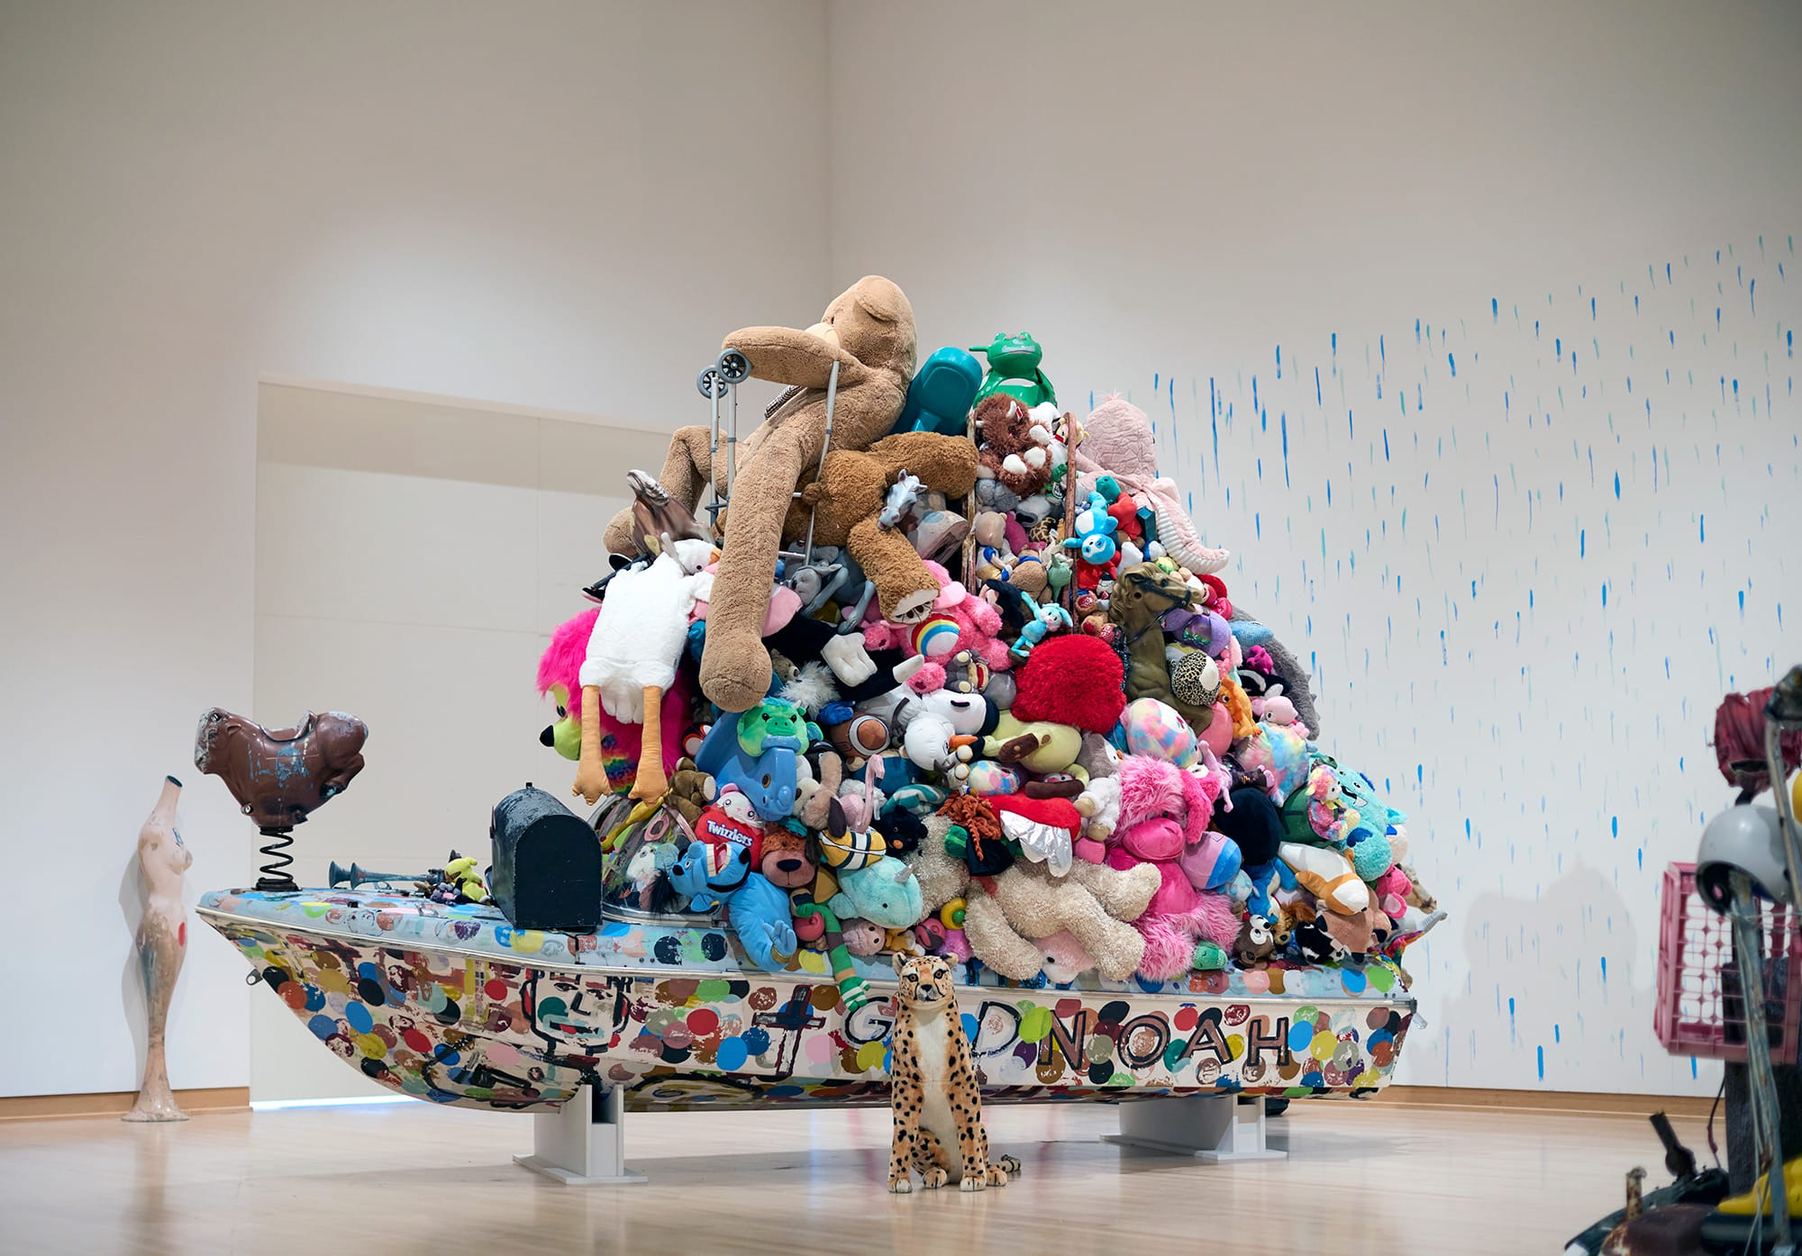
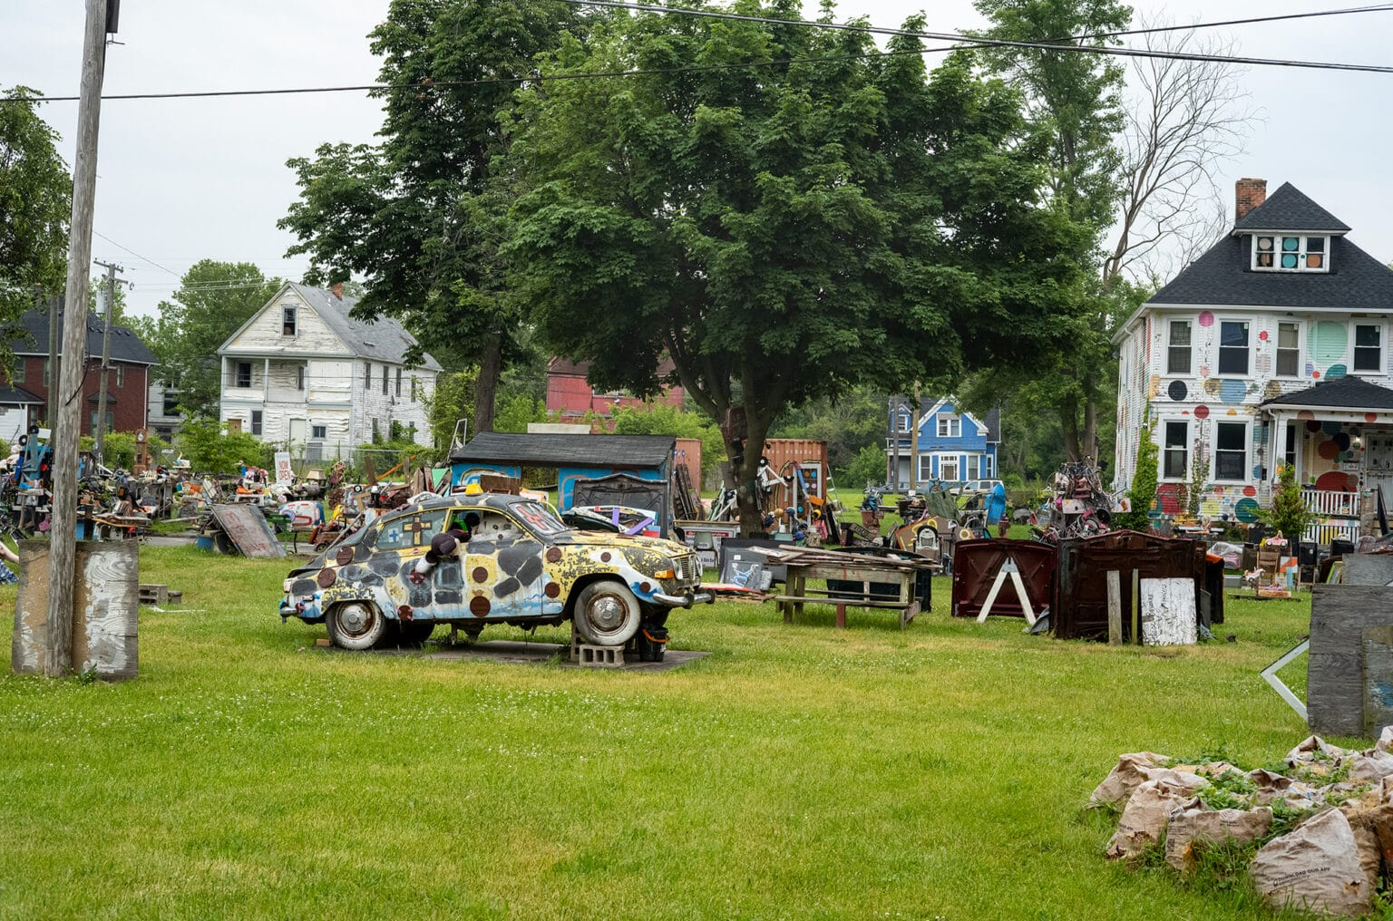
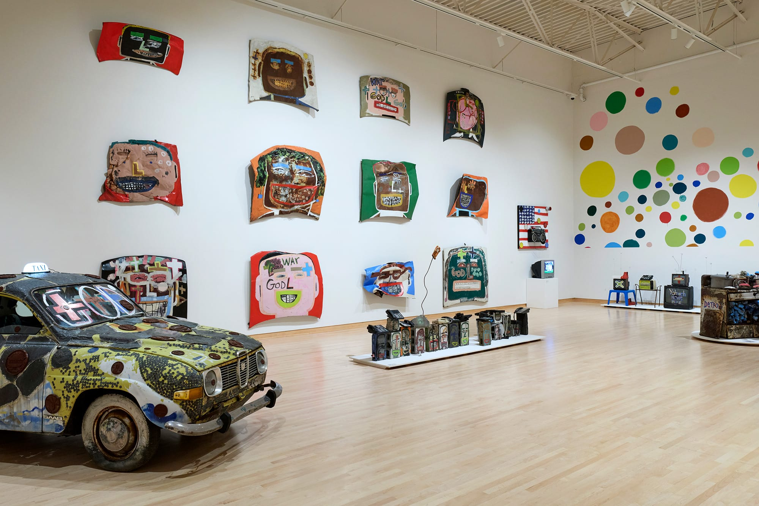
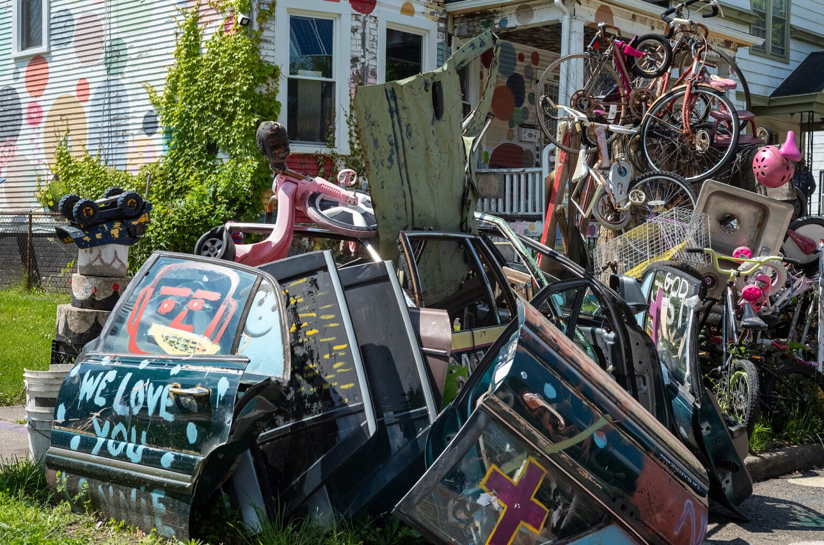
WHAT IS ART? Turning trash into treasure!
Notes:
1st photo—Heidelbergology: Is It Art Now?’ installation view (2025). John Michael Kohler Arts Center
2nd photo—Site view of ‘The Heidelberg Project’ (1986–ongoing)
3rd photo—Heidelbergology: Is It Art Now?’ installation view (2025)
4th photo—Site view of ‘The Heidelberg Project’ (1986–ongoing)
BIG IDEA #3: WHAT IS ART? Turning trash into treasure!
Guyton believed everything could have a second life. He reused things people threw away.
Guyton believed trash can become treasure.
He wanted to show that art can be made from anything. Just use your imagination!
It helps recycle and reuse materials.
WHY is this so important to Guyton? Why use ”trash” to make art? What do you think?
Reusing materials/found objects/trash helps the environment by recycling.
You don’t need expensive materials and supplies to make art. You can be creative with everyday found objects.
Use your imagination to turn something “ordinary” into art.
Giving a second life to something discarded.

Slide 6
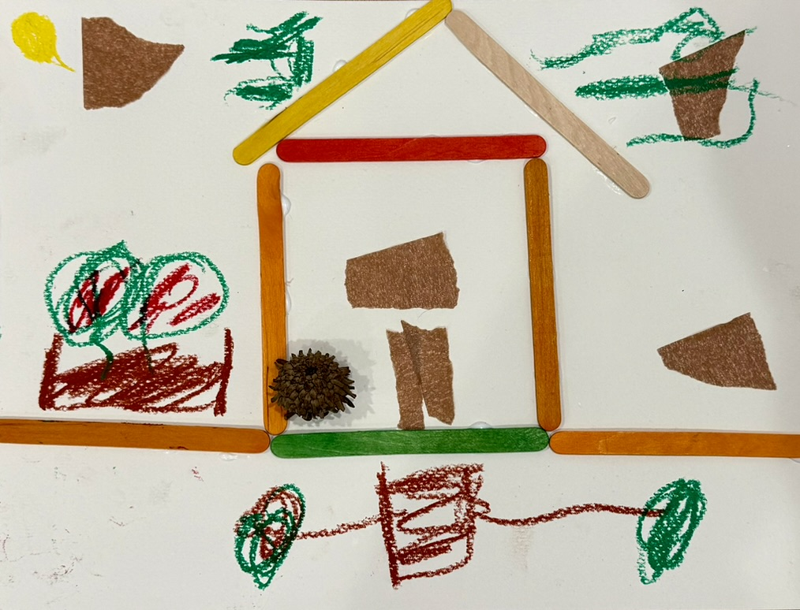
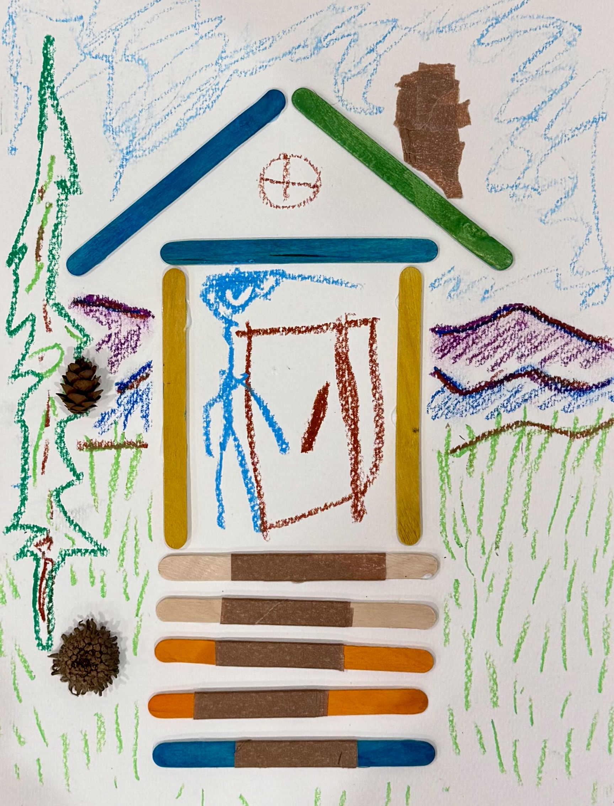
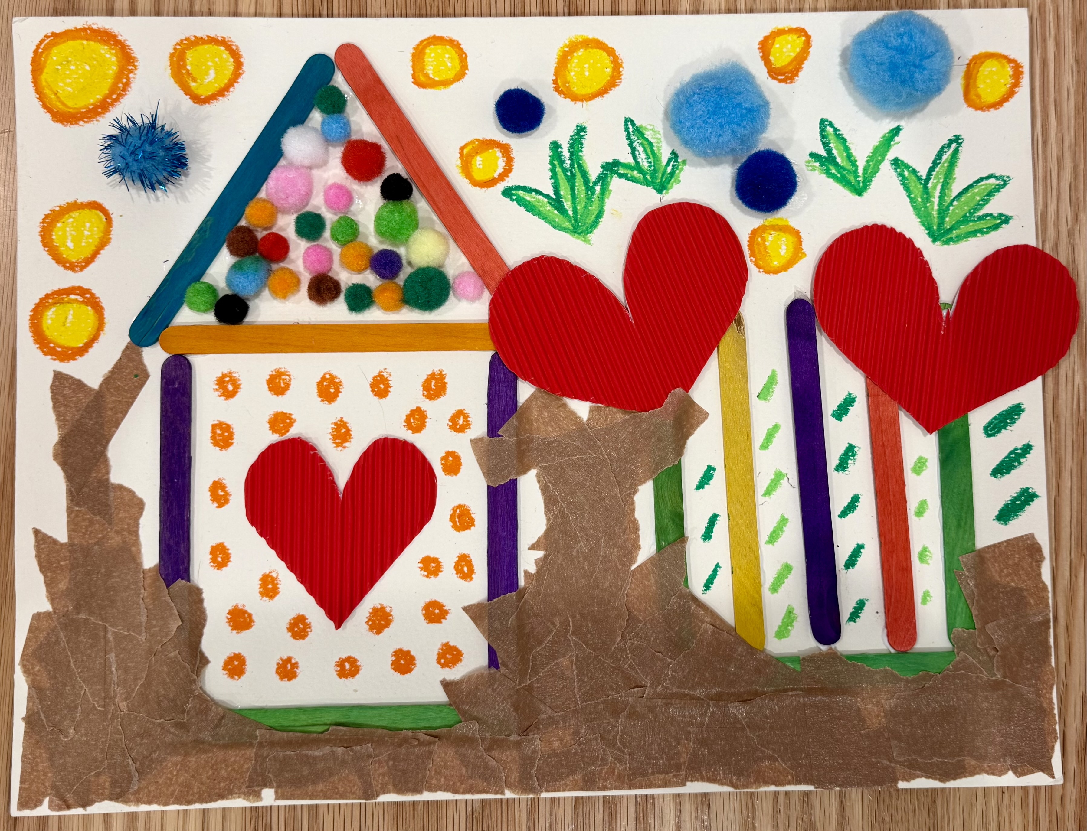
Art Project: be inspired by Tyree Guyton!
Let’s (re)use leftover Great Art materials to turn “trash into treasure!”
Notes:
Great Art Project Instructions – Tyree Guyton
Project Description:
Students will learn about Tyree Guyton and create a collage by “turning trash into treasure.”
Tyree Guyton is a famous artist from Detroit, Michigan. He is known for his unique and colorful art that often uses everyday found objects. He used his urban environment (the city around him) as his canvas.
Grades: K - 6
Art Project: using assorted leftover materials from Great Art students will create their own collages inspired by Guyton.
Optional: the art may be collected and displayed (dependent on the teacher’s approval) at the end of the session.
Reminders: remind students to sign their artwork.
Materials: all grades will use the same project materials.
Shared by students: assorted materials, paper, oil pastels, tape, and tacky glue (paint brushes for glue).
Per student/per table: use recycled cafeteria trays for materials distribution.
Use trays for glue, and paint brushes to paint glue on to surfaces. Remember to clean glue brushes, thanks!
Considerations/ideas:
Use various materials to create your own collage.
Guyton reused objects and other materials to make his art.
He used bright colors and bold patterns.
Experiment and have fun!

