Slide 1
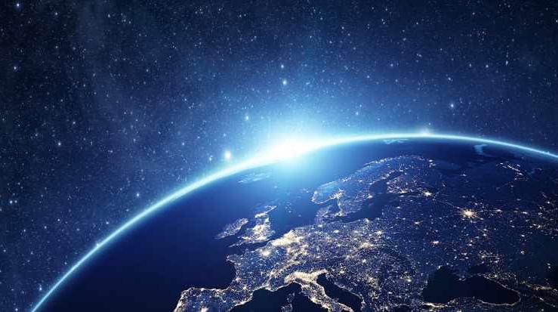
Our Solar System
Amazing Earth
4th Grade
Notes:
The presentation should take about 15-20 minutes to allow ample time for the experiment. There is a fair amount of planet info to share that is only interesting to know, so it can be reviewed rather quickly.
The key facts for the SOL standard we are reinforcing are: naming the planets; identifying if terrestrial or gas giant; the order of the planets; and the sequence of their sizes.
TIPS:
Have students sit on the carpet so the presentation can be set up at their desks.
Limit questions or the number of students who can answer a question if time runs short.
Ask helpers to:
set up during the presentation
familiarize themselves with the activity and its goal
Thank you for making Amazing Earth possible!
Updated 12/14/19

Slide 2
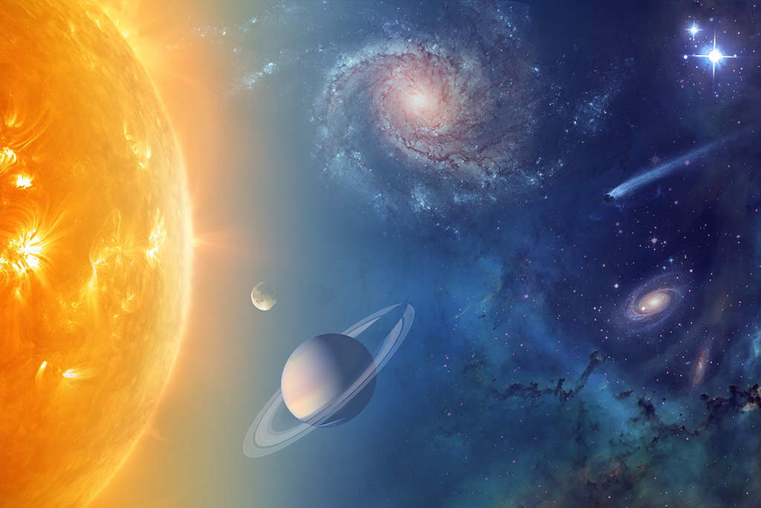
What is a Solar System?
A solar system is a star and all of the objects that travel around it:
planets
moons
asteroids
comets
Notes:
Optional Fact
“Solar System” is best explained when broken down into the two words that comprise the expression.
“Solar” means "of the Sun."
“System” is a collection of objects that interact to form a whole.

Slide 3
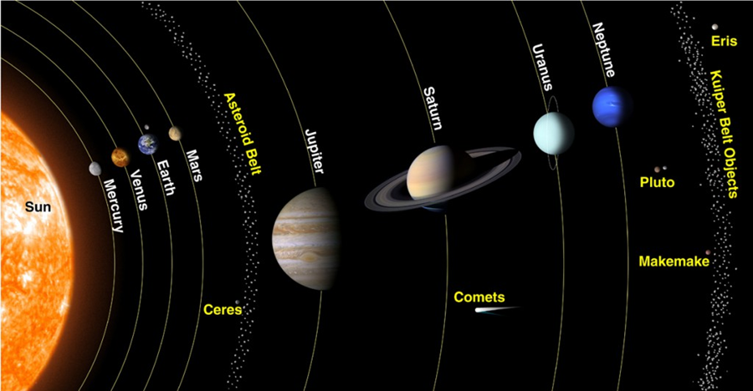
Our Solar System
Currently:
1 star: The Sun
8 planets
5 dwarf planets
200+ moons
856,810 asteroids
3,599 comets
countless particles of smaller debris
And there are always new discoveries…
Notes:
Facts updated from NASA site.
https://solarsystem.nasa.gov/solar-system/our-solar-system/overview/

Slide 4
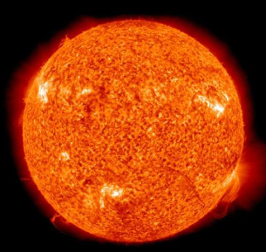
One Star: The Sun
Center of the solar system
A hot ball of glowing hydrogen and helium gases
Makes up 99.8% of the mass of the entire solar system
The Sun is huge. If the Sun were as tall as a door, Earth would be about the size of a nickel!
The seasons, ocean currents, weather, climate and life on Earth are driven by the connection and interactions between the Sun and Earth
The Sun’s core temperature is about 27,000,000° F

Slide 5
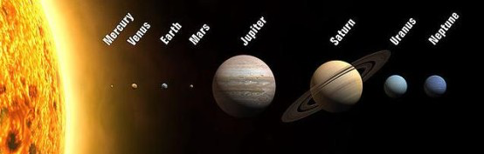
What are the names of our Planets?
The image sizes are to scale but the relative distances are not
Notes:
ASK: can anyone name the 8 planets? Or name them in order?
ADVANCE to reveal.
Identify the 8 planets on the slide.
Share a mnemonic that some use to help them remember the order:
My Very Excellent Mother Just Served Us Noodles (or Nachos or Nutella)

Slide 6
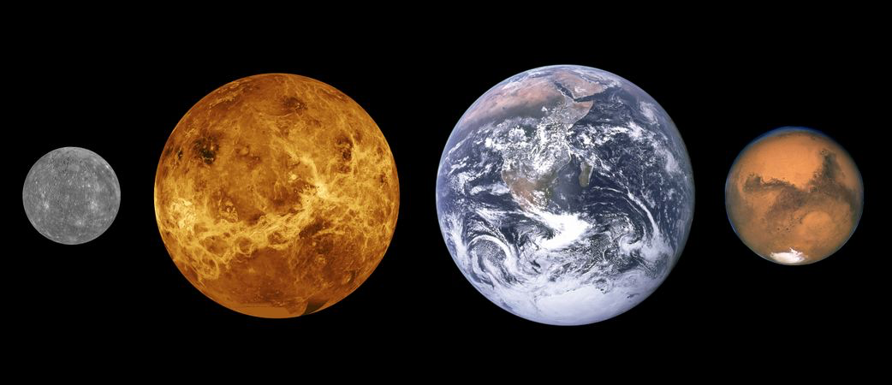
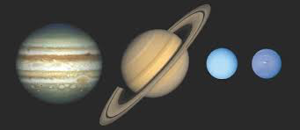
What are the Differences? Terrestrial Planets vs Gas Giants
Terrestrial Planets:
Mostly made of rocks with a hard surface (Earth-like)
Surface and atmospheres can be much hotter or colder than Earth’s
May or may not have water or much atmosphere
Have canyons, craters, mountains and volcanoes
Gas Giants:
Very large
Mostly made up of gas
Do not have a solid surface like Earth’s
Very thick atmosphere (gas)
Might have a small solid core
Mercury, Venus, Earth and Mars, sized to scale
Jupiter, Saturn, Uranus and Neptune, sized to scale
Notes:
SAY: Our 8 planets are divided into two types: terrestrial and gas giants.
ASK: Can anyone tell me some of the differences between a Terrestrial Planet and a Gas Giant?
ADVANCE to reveal the bullet points and images
Background/Optional Fact
The term Terrestrial is derived from the Greek/Latin word for Earth, "Terra”, therefore “Earth-like”.

Slide 7
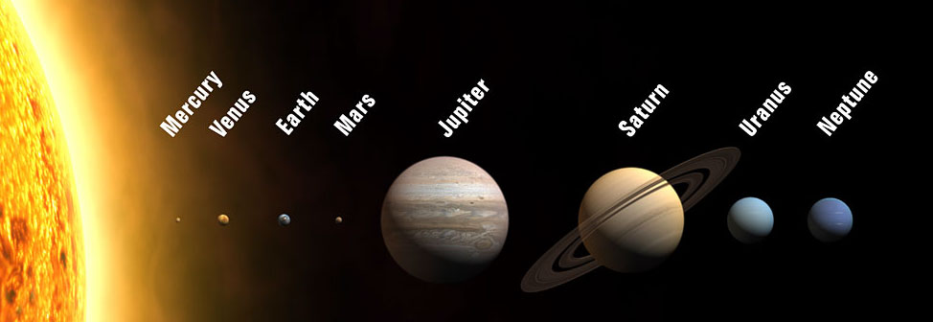
Terrestrial
Gas Giants
Let’s quickly review each planet in order from the Sun
Notes:
Terrestrial planets are the first four closest to the Sun and the Gas Giants are the four farthest.

Slide 8
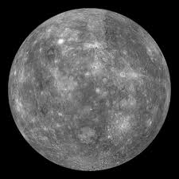
Mercury
Terrestrial
Closest planet to the Sun
Smallest of the 8 planets
Heavily cratered, looks like our Moon and is similar in size
Days on Mercury are very long because the planet rotates very slowly. One day-long spin lasts for 59 Earth days
Has no moons

Slide 9
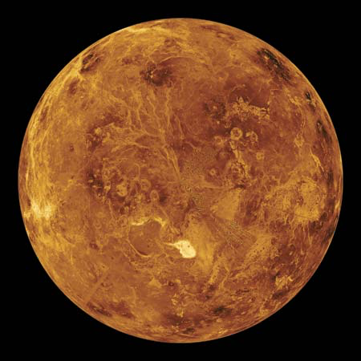
Venus
Terrestrial
Second planet from the Sun
Second brightest object in the night sky after the Moon
Has a permanent blanket of clouds
The hottest planet in our solar system with surface temps about 867°F, which is hot enough to melt lead!
Sometimes referred to as the Earth's sister planet due to their similar size and mass
Spins backwards with the Sun rising in the west and setting in the east

Slide 10
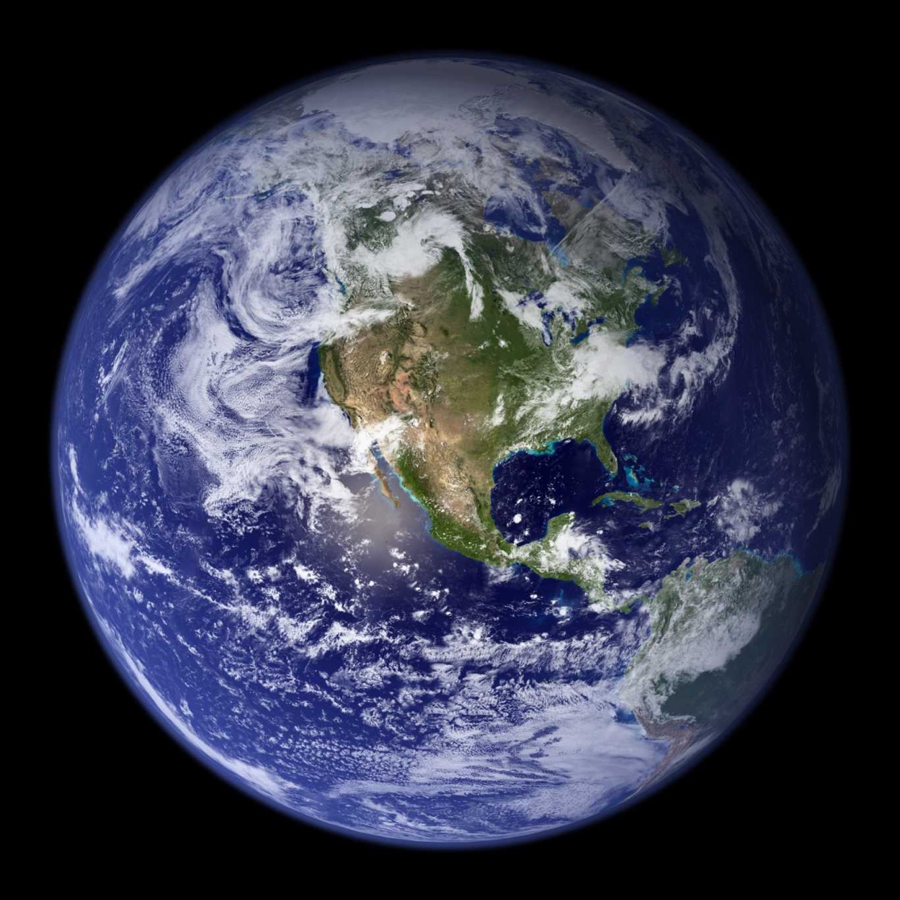
Earth
Terrestrial
Third planet from the Sun
Largest of the terrestrial planets
Earth is the only planet in our solar system not named after a Greek or Roman god or goddess
Only known planet to support life
Light from the sun reaches Earth in 8 minutes
Notes:
Background/Optional Fact
Earth’s atmosphere, its liquid water and its distance from the sun are several key factors that make Earth a haven for life.

Slide 11
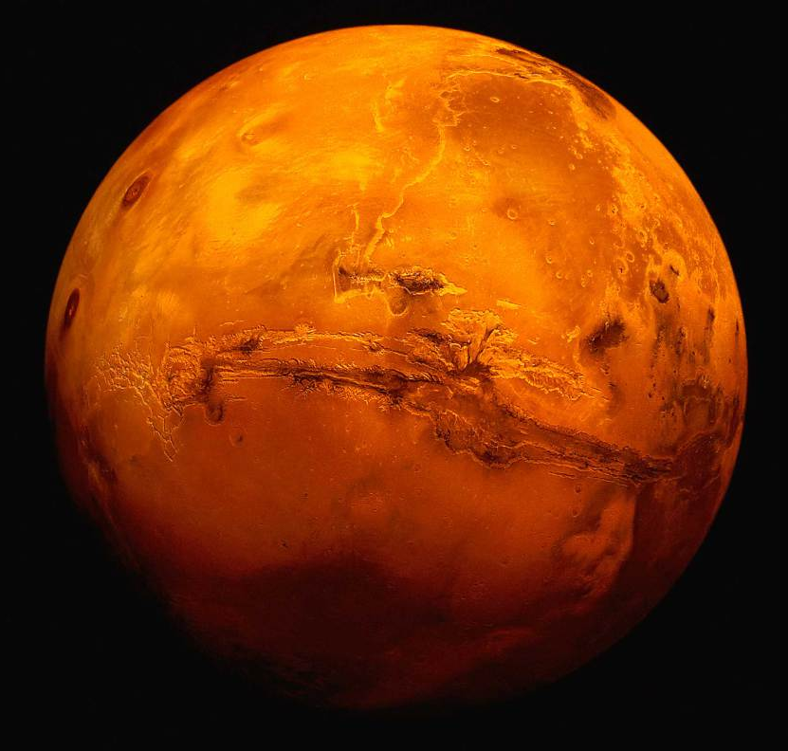
Mars
Terrestrial
Fourth planet from the Sun
It is cold with surface temps from −28° F to −118° F
Dynamic planet with seasons, polar ice caps, extinct volcanoes, canyons and weather
Lots of evidence that Mars was much wetter and warmer, with a thicker atmosphere, billions of years ago
Called the “Red Planet” due to its reddish appearance
Notes:
.

Slide 12
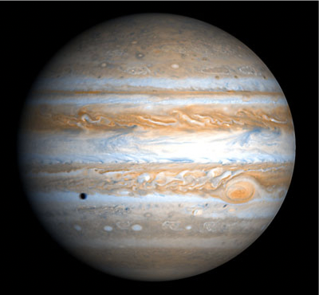
Jupiter
Gas Giant
Fifth planet from the Sun and the largest and most massive
More than 1,300 Earths can fit inside Jupiter
Has the most moons of all the planets: 79
Jupiter's Great Red Spot is a gigantic storm
About twice the size of Earth
Winds blow over 400mph
Has lasted over 150 years
Gas Giants have no surface;
These are layers of clouds
Great Red Spot
Notes:
Background if asked the difference:
In a scientific context, Large refers simply to its physical size. Massive refers to an object's mass, which in everyday scenarios corresponds to its weight.

Slide 13
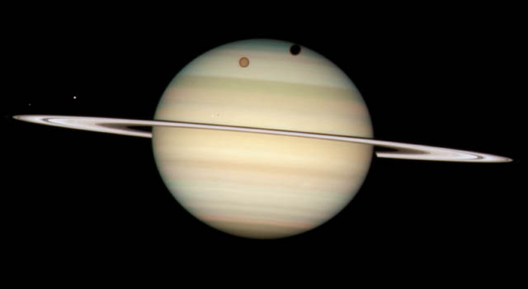
Saturn
Gas Giant
Sixth planet from the Sun
Second largest planet in the solar system
While all gas giants have rings, Saturn has the most spectacular
There are seven rings made of chunks of ice and rock with several gaps and divisions between them
Saturn is very light for its size; It would float if placed in water

Slide 14
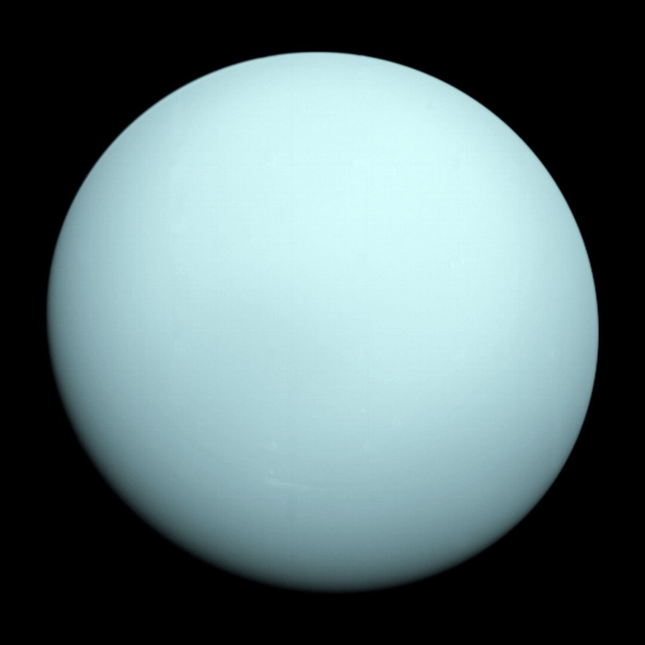
Uranus
Gas Giant
Seventh planet from the Sun
This ice giant is very cold and windy
Uranus is tipped over on its side with an axial tilt of 98 degrees. It is often described as “rolling around the Sun on its side”
First planet discovered with the use of a telescope

Slide 15
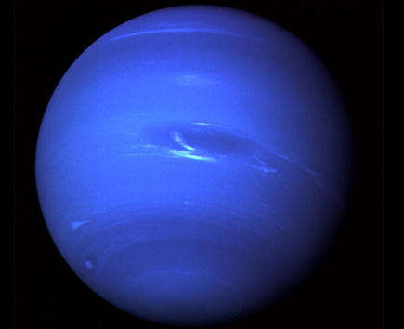
Neptune
Gas Giant
Eighth planet from the Sun
This ice giant is dark, cold and whipped by supersonic winds
Windiest planet with wind speeds of more than 1,200 mph
Takes 60,190 Earth days for Neptune to orbit the Sun once
Only planet not visible to the naked eye

Slide 16
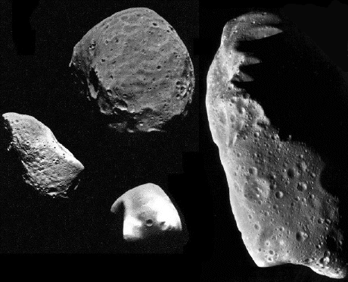
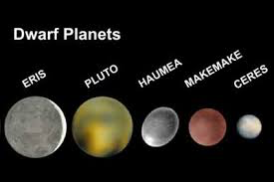
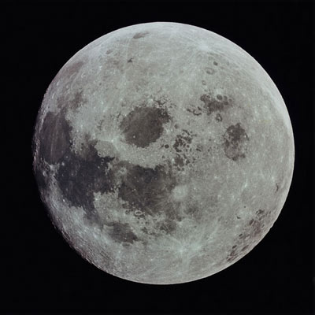
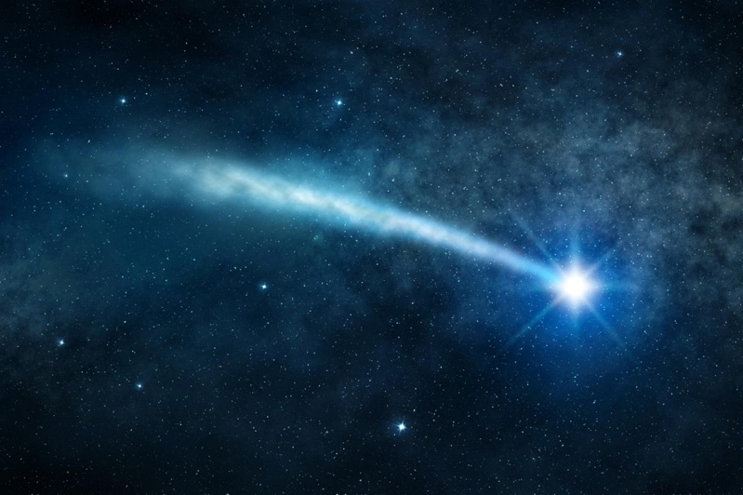
Dwarf Planets, Moons, Asteroids and Comets
Dwarf planets are a lot like regular planets except their orbital path around the Sun is full of other objects like asteroids
Moons are natural objects that orbit planets. There are over 200 moons in our Solar System, most orbiting the gas giants Jupiter and Saturn
Asteroids and comets are small chunks of ice, rock and metal leftover from the formation of our solar system 4.6 billion years ago

Slide 17
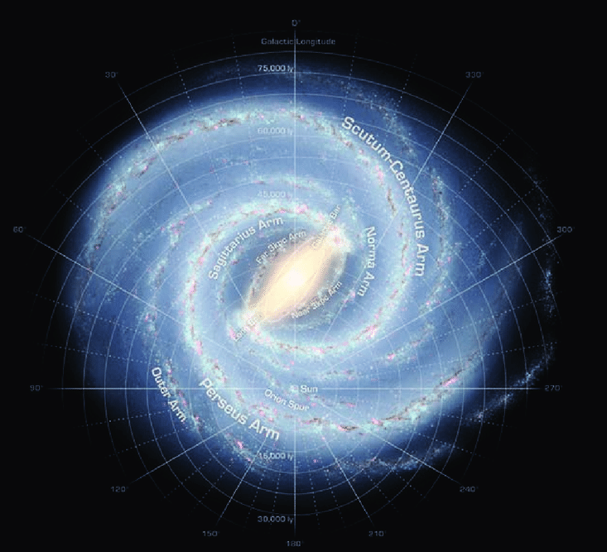
What is the Milky Way Galaxy?
Our Solar System itself is only a small part of a huge system of stars and other objects called the Milky Way galaxy
Most stars host their own planets, so there are likely tens of billions of other solar systems in the Milky Way galaxy alone
Our “Amazing Earth” is part of this “Amazing” Galaxy
Notes:
ASK: what is the Milky Way galaxy?
ADVANCE to reveal bullet points.

Slide 18
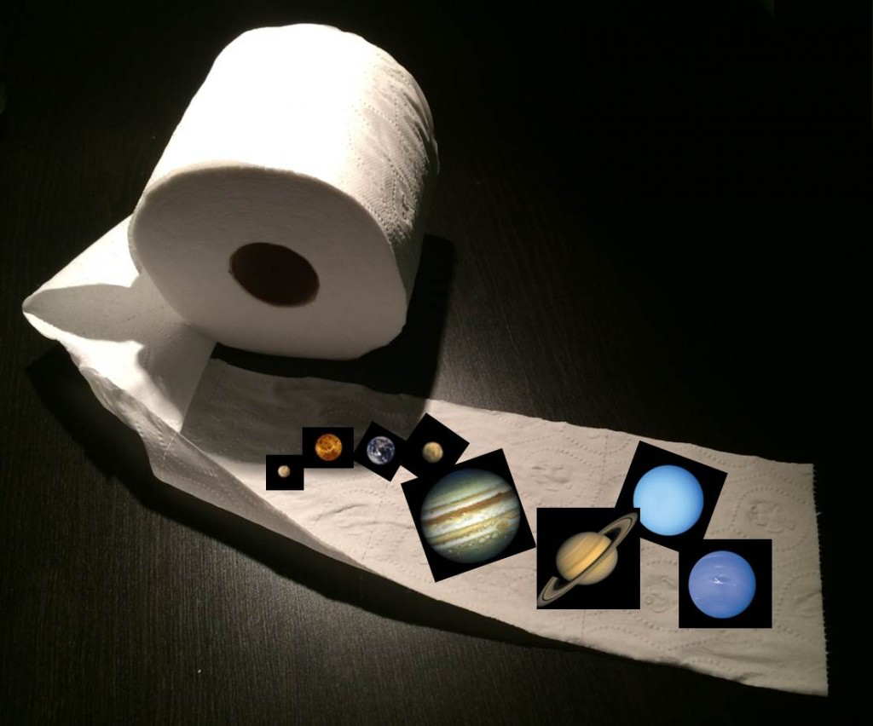
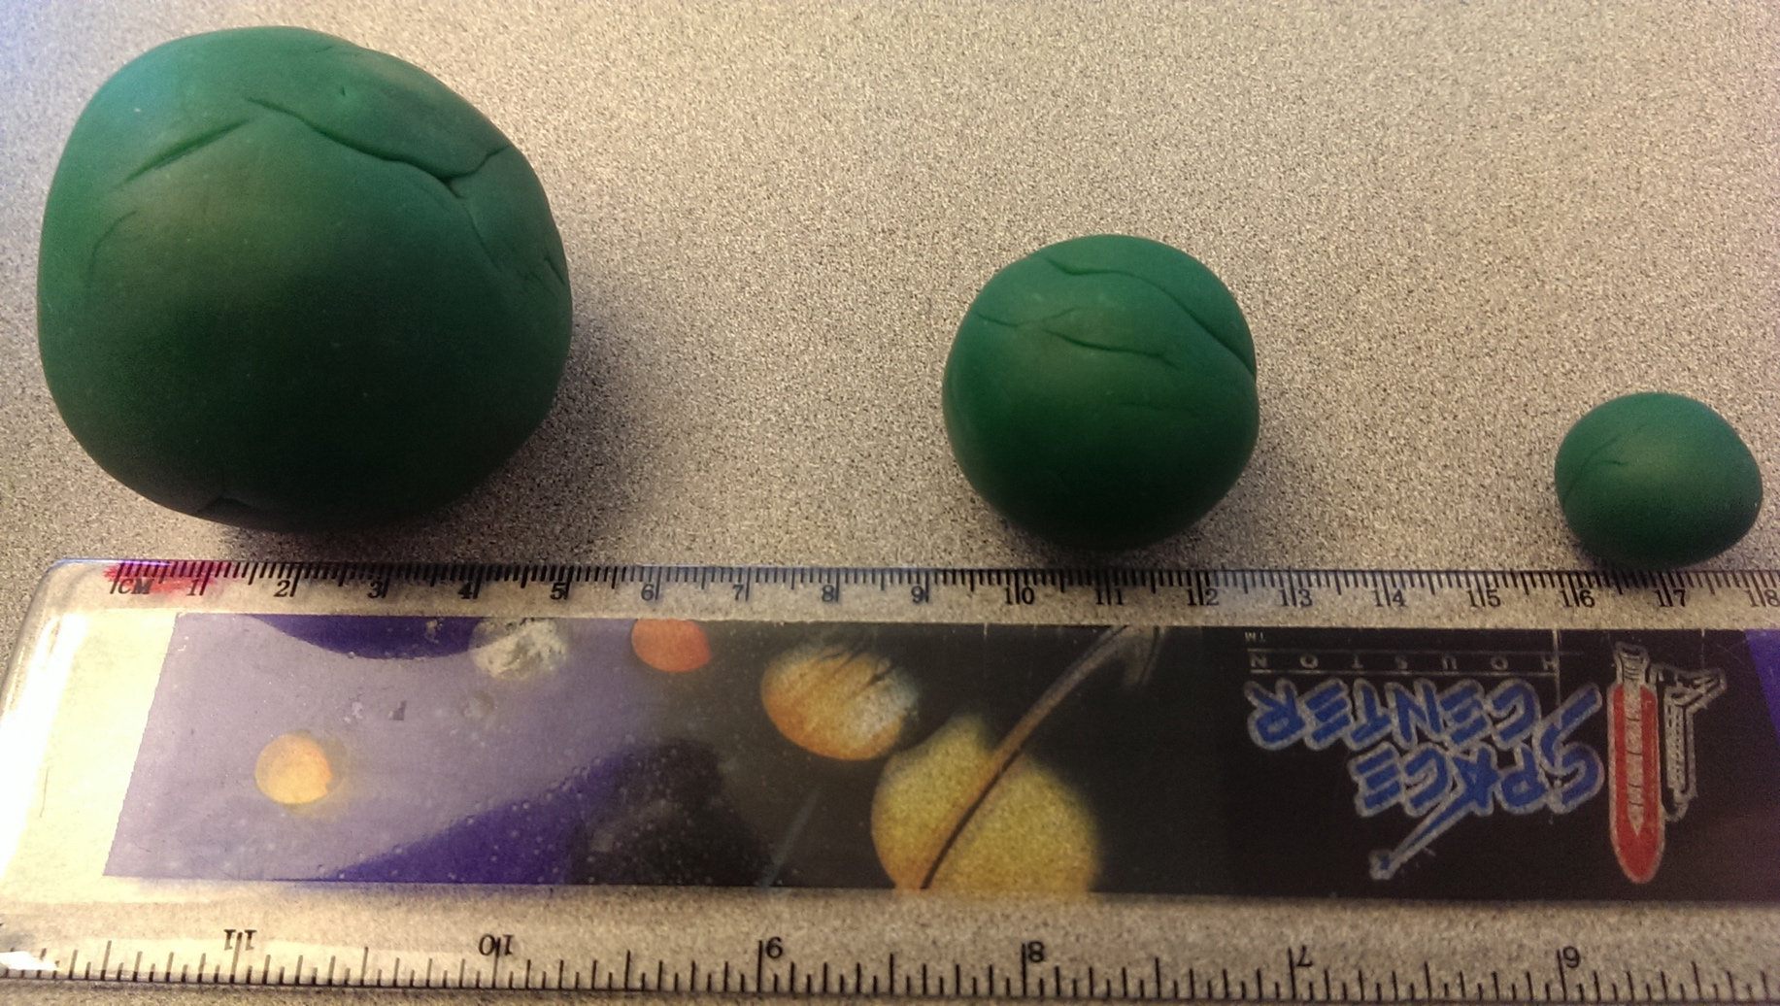
Activities: Planet Size and Distance Models
Play-Doh Planets
Teams of Two
Toilet Paper Solar System
Group Activity
Notes:
While the students are still seated on the carpet, review the activity.

Slide 19

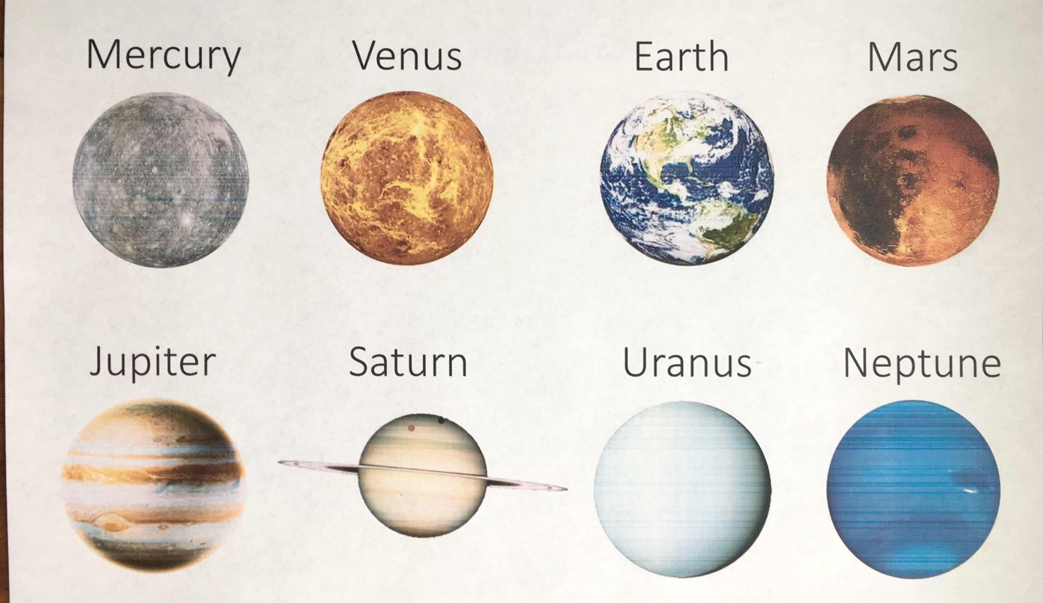

Planet Size Model
Step 1
Roll Play-Doh into a hot dog shape
Step 2
Cut in half and cut each half again until you have 8 equal parts
Roll 5 parts together to create the planet Jupiter Roll 1 part to create the planet Saturn
Place Play-Doh parts on the correct planet on the map as you create
Step 3
Combine the remaining 2 parts
Then cut into 8 equal parts
Take 2 parts and add to Jupiter
Take 2 parts and add to Saturn Take 1 part to create Neptune
Take 1 part to create Uranus
Place Play-Doh parts on the map
Steps 4-10 on activity sheet
Planet Map
Notes:
Review the first few steps with the students as an introduction and then the students can begin.
Select one team’s planets to be used to mark the distances in the next activity.

