Slide 1
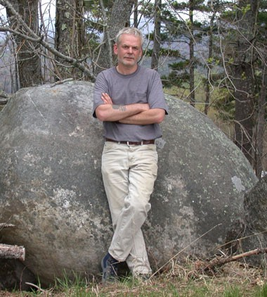
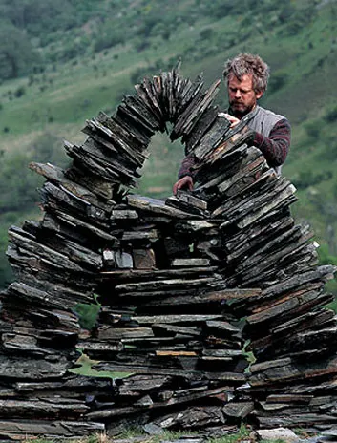
Andy Goldsworthy
Born in Cheshire, England in 1956. Currently lives in Scotland.
Notes:
1st photo – Andy Goldsworthy photo by Jacob Ehrenberg
Artist Biography: Andy Goldsworthy, National Gallery of Art
2nd photo – Andy Goldsworthy photo by Julian Calder
Smithsonian Magazine, 35 Who Made a Difference: Andy Goldsworthy, Nov, 2005
PRESENTER NOTES:
Allow 10-15 minutes for presentation. Please feel free to cut and shorten where needed, focusing on the 3 BIG IDEAS.
BIG IDEA #1: Andy Goldsworthy is a famous British artist known for his environmental sculptures and photography.
He is known for his Land Art, specifically as an Environmentalist Artist.
He works in nature and with nature.
He has produced more than 70 exhibitions and projects all over the world.
QUESTIONS:
What is an environmentalist? What do you think an Environmentalist Artist means?
A person who wants to protect and care for the environment around them.
Goldsworthy started using his work to better understand his own life and environment. His ephemeral (temporary) and intensely personal practice is more about what he can learn from the landscape than the monuments he can leave behind.

Slide 2
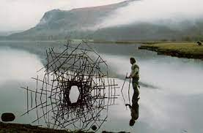
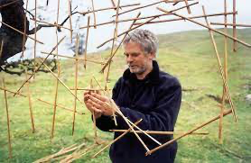
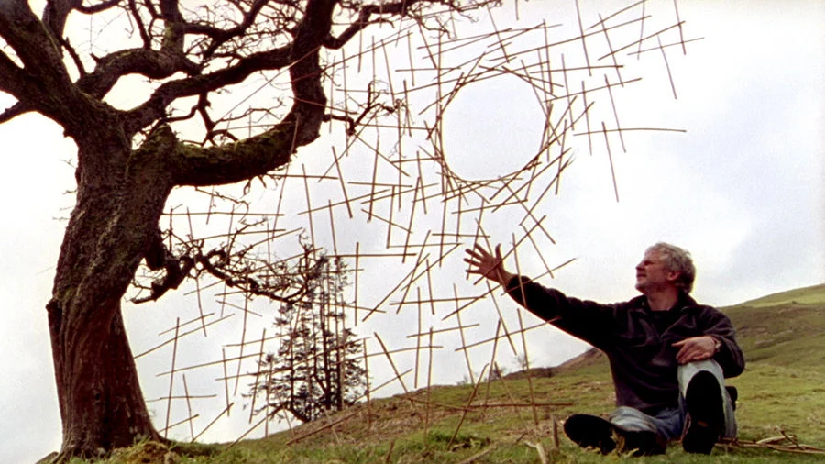
Derwent Water, Cumbria,
northwest England
Rivers and Tides: Andy Goldsworthy Working with Time
Notes:
Photo – Derwent Water, Cumbria, March 8, 1988
Stills from the film River and Tides: Andy Goldsworthy Working with Time, 2001
Early Training and Work:
Goldsworthy thought art would be a hobby, and that he would become a gardener or a farmer.
At age 13, he worked on a farm picking potatoes. Later he said farming was good training for his work as an artist!
He eventually applied to art school. While in art school he disliked working in the studio, and he yearned to be outside in nature.
While in art school, Goldsworthy found escape in the northern England landscape.
He constructed temporary structures in Morecambe Bay that the incoming tide would collapse.

Slide 3
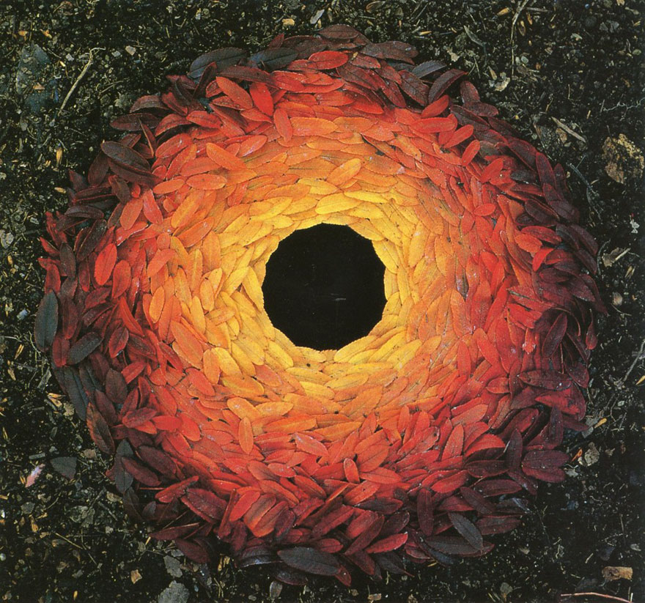
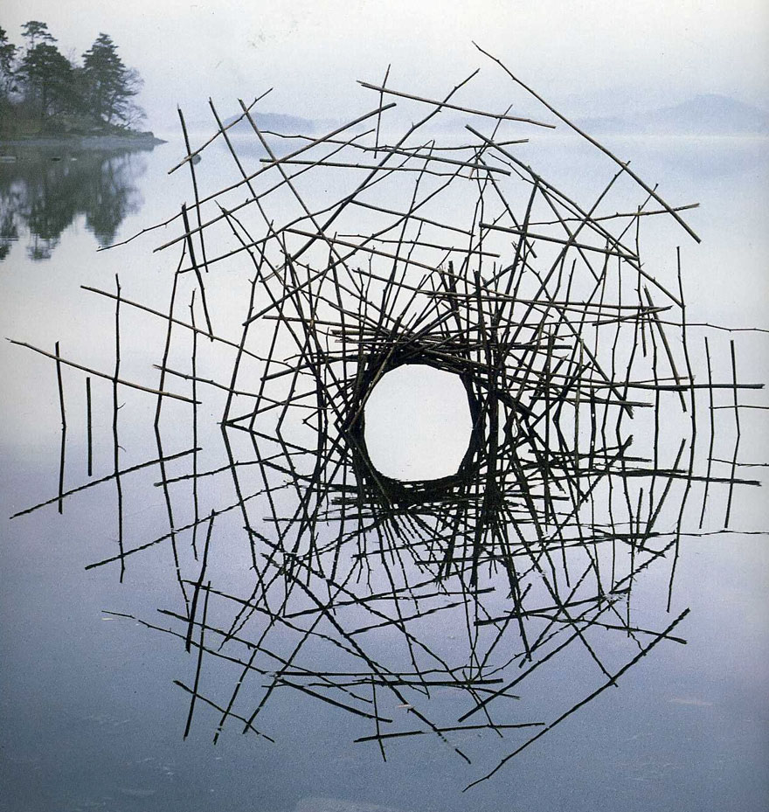
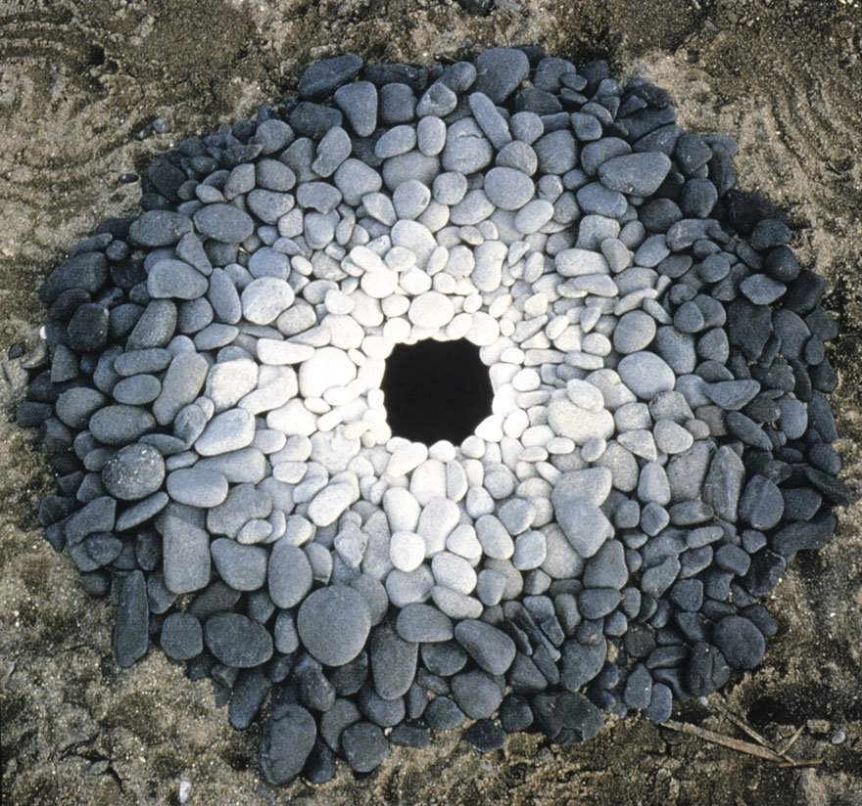
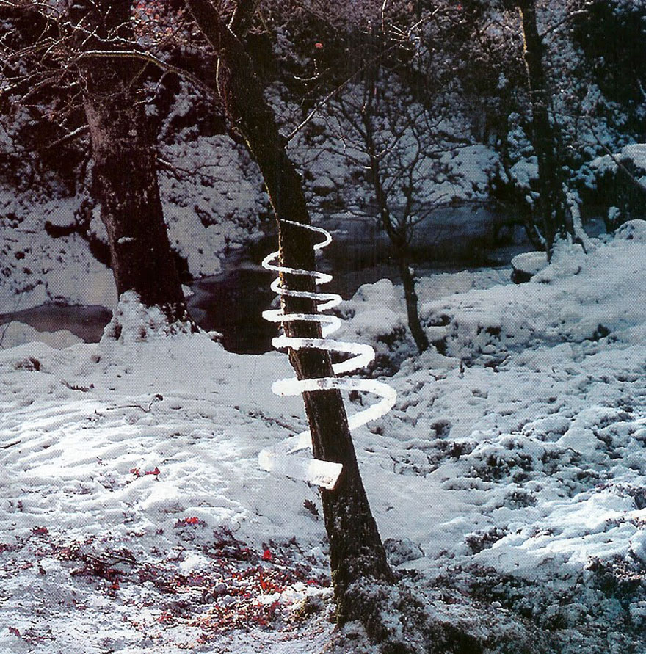
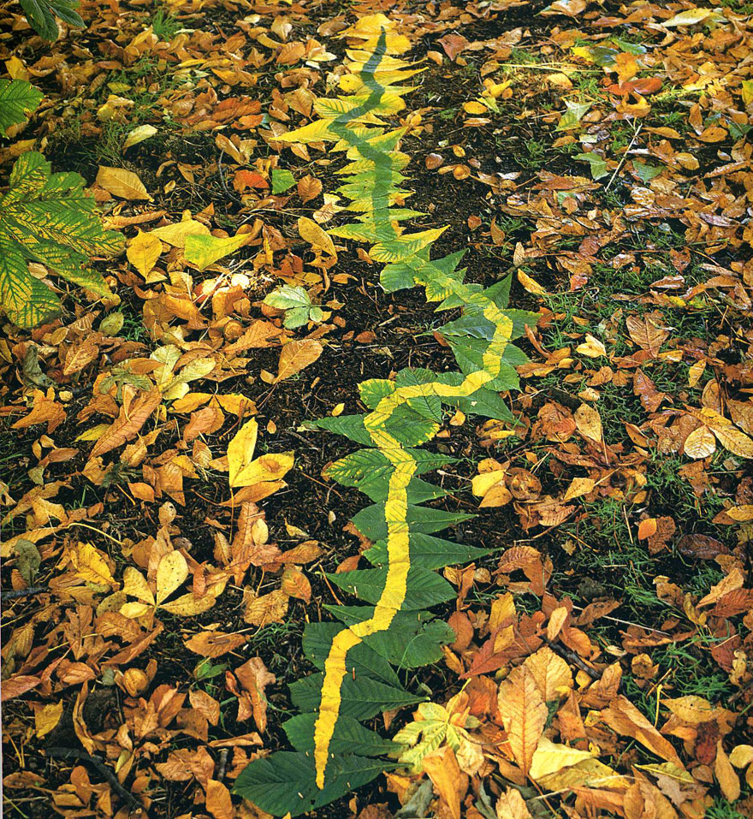
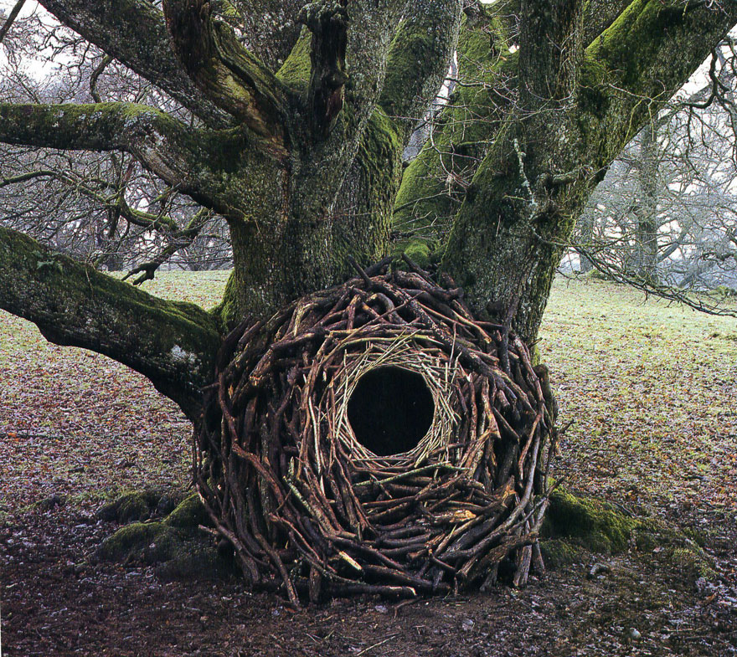
Goldsworthy uses objects found in nature to make his art installations.
Notes:
BIG IDEA #2: Goldsworthy makes outdoor sculptures/installations using natural objects. His work is a collaboration with nature.
Goldsworthy produces artwork using natural material found in nature. Such as flowers, mud, ice, leaves, twigs, pebbles, boulders, snow, thorns, bark, grass, and pinecones.
The balanced boulders and twigs, snow and ice designs, and leaf-rimmed holes that he crafted were his versions of making sketches. Instead of representing the landscape on paper, however, he was drawing on the landscape itself.
He crafts pieces that are intended to exist harmoniously within their surroundings and eventually return to nature.
QUESTIONS:
Can you name some of the natural objects Goldsworthy used in the above artworks?
Leaves, twigs, branches, rocks, pebbles, ice, snow
What shapes does Goldsworthy like to use?
Circle, spiral, serpent, arch
How is his work a collaboration with nature?
Uses what he finds in nature. Responds to a site.
What is an art installation?
Art works that are often designed for a specific place (site-specific), three-dimensional, and can transform a space.

Slide 4
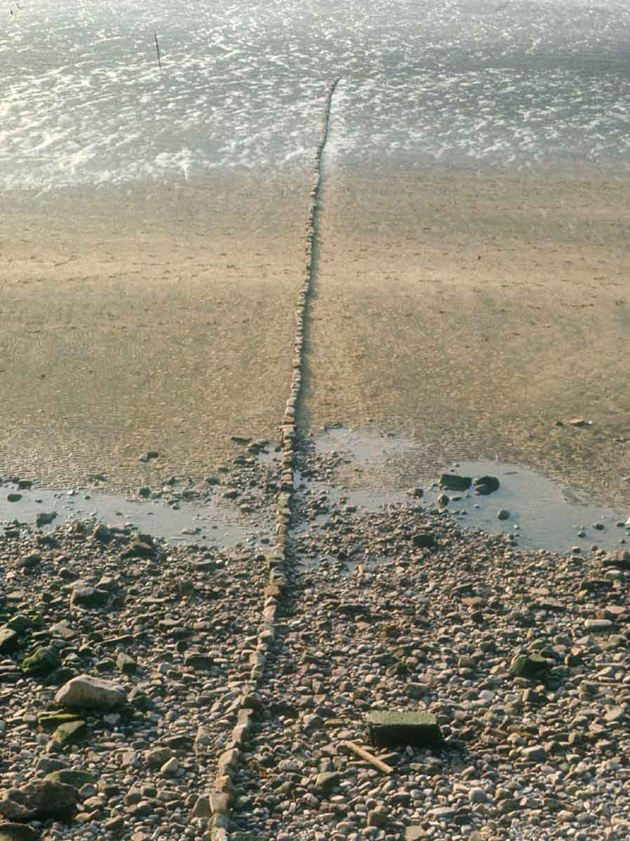
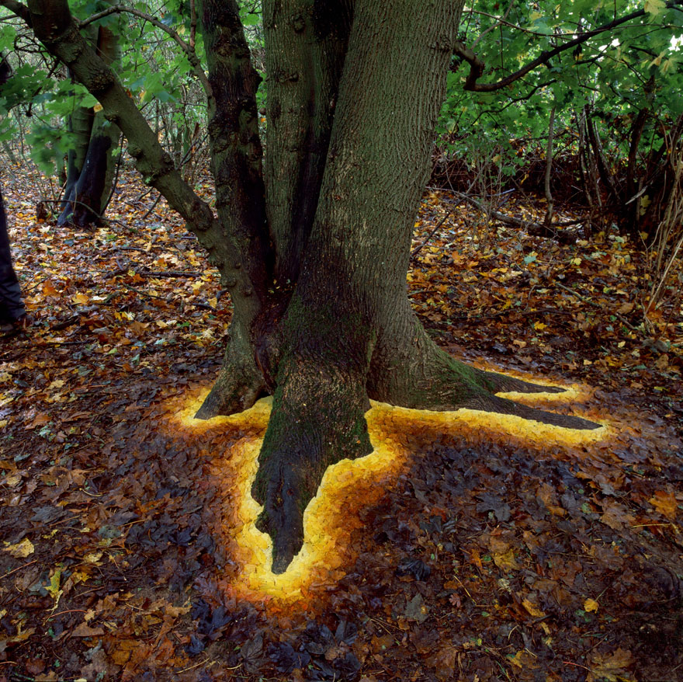
Many of Goldsworthy’s artworks are TEMPORARY.
Notes:
Stone Line Sinking in Sand by Andy Goldsworthy, Lancashire, 1976, via Andy Goldsworthy Digital Catalogue (AGDC)
Sycamore leaves edging the roots of a sycamore tree, Hampshire, 1 November 2013 (Andy Goldsworthy)
BIG IDEA #3: Goldsworthy creates his outdoor sculptures/installations knowing that they will be temporary. Photography plays an important role in Goldsworthy’s work. He takes photos to document his temporary work.
His photographs capture his fleeting artwork in a more permanent way.
Goldsworthy’s art reflects a deep respect for nature, often involving careful observation of the environment. His artmaking process reflects a mindfulness, and a meditative way to create art.
QUESTIONS:
What does temporary mean?
Not permanent, will not last forever.
Goldsworthy painstakingly made his art installations. Even though he spent so much time making the work, he was not bothered if it quickly disappeared. Why wasn’t he concerned if his artworks disappeared? Would you be able to make work like this? Would it be hard to let it go?
He was interested in his artworks evolving, showing the passage of time. He watched work melt, blow away, or decay.
Through the making of work – specifically work that is temporary and made of natural materials – he learns about himself, life, death, and our place in nature.
Do you think making art can be a form of meditation?
Art can be relaxing. You might calm yourself and find focus while making artwork.

Slide 5
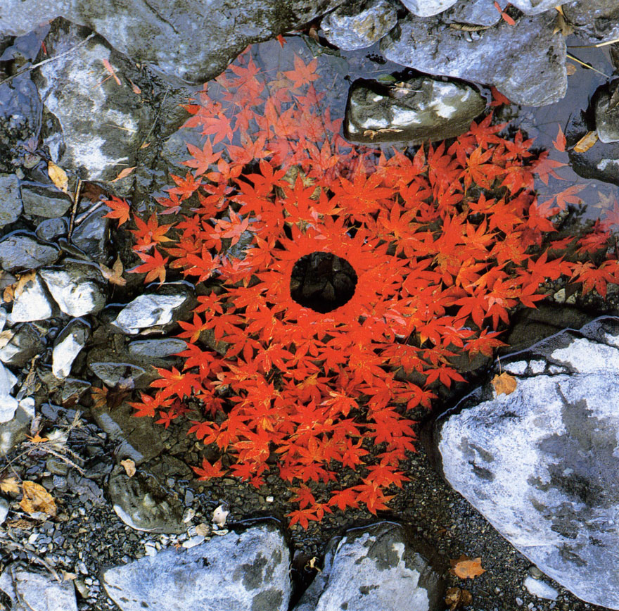
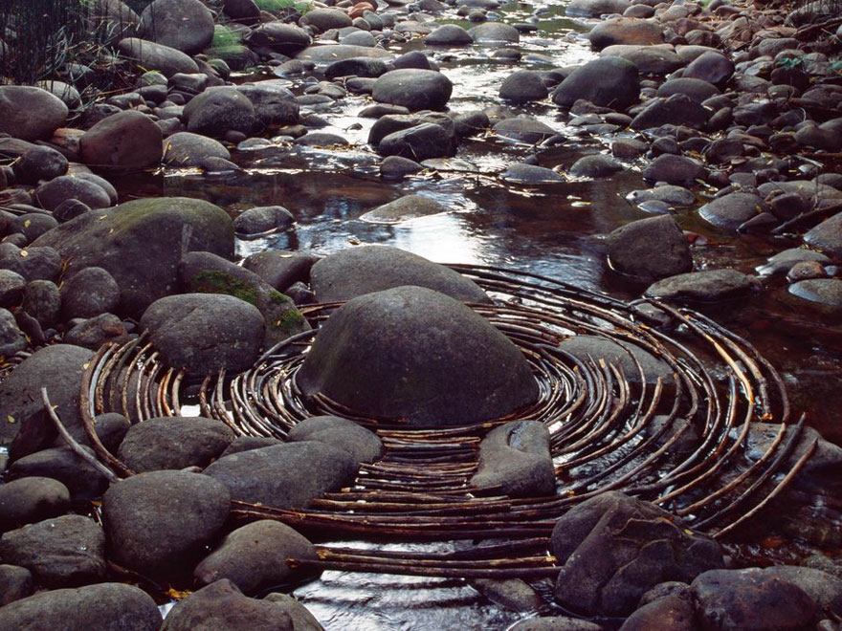
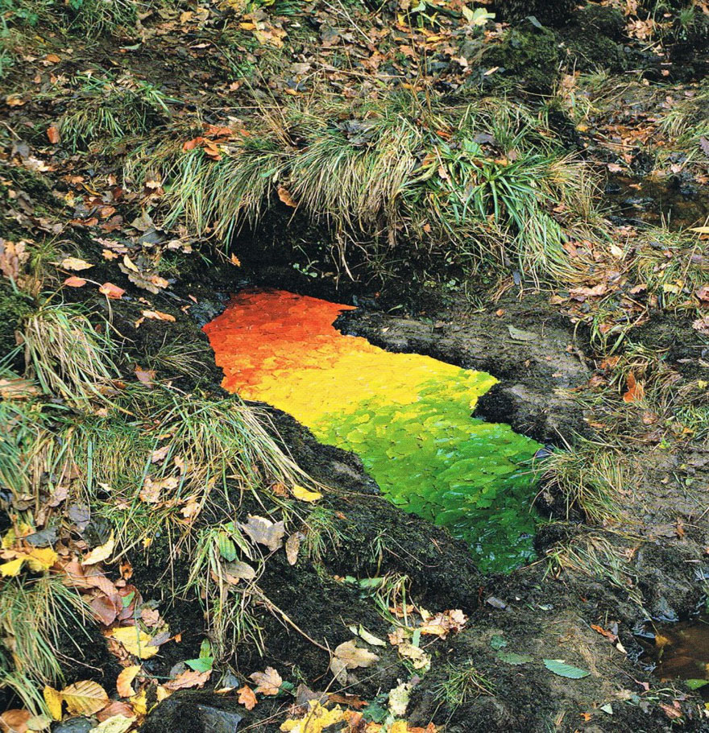
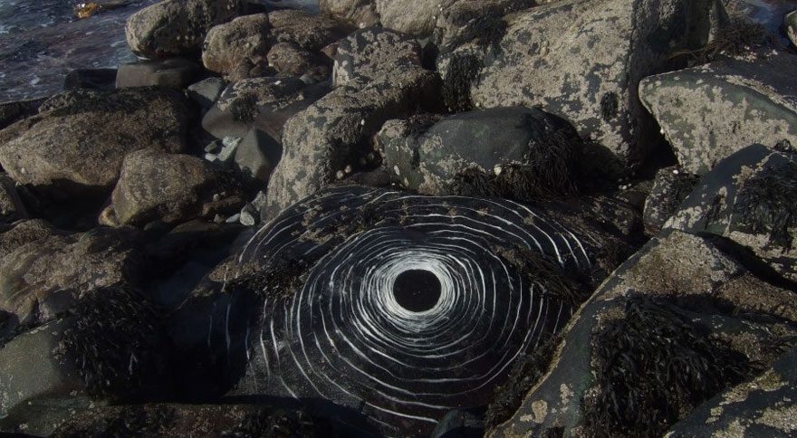
Notes:
Most of Goldsworthy's works are small in scale and temporary in their installation.
Goldsworthy’s works often survive for less than a day.
He knows that nothing can or should last forever.
Goldsworthy often uses only his bare hands, teeth, and found tools to prepare and arrange the materials.

Slide 6
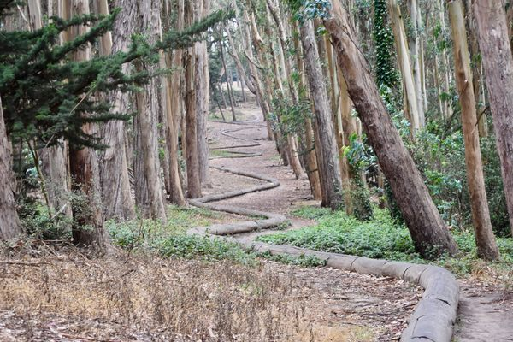
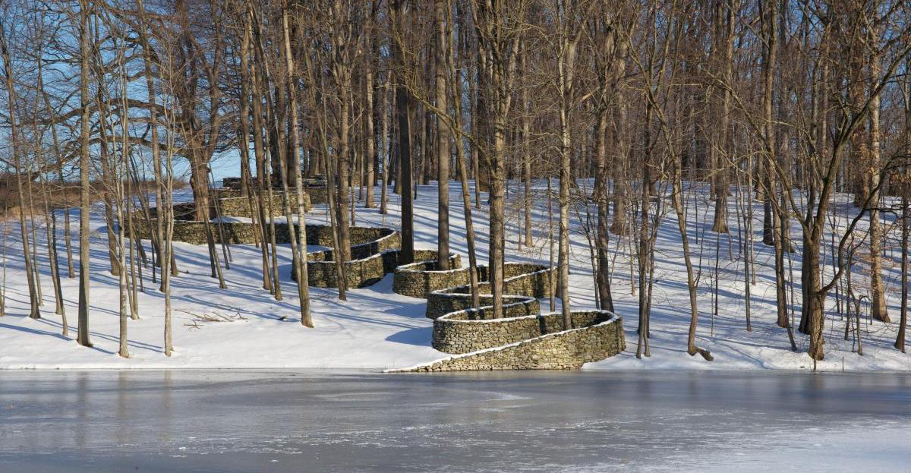
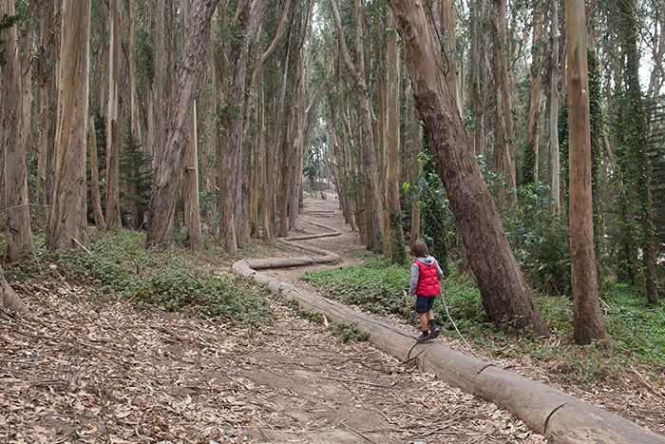
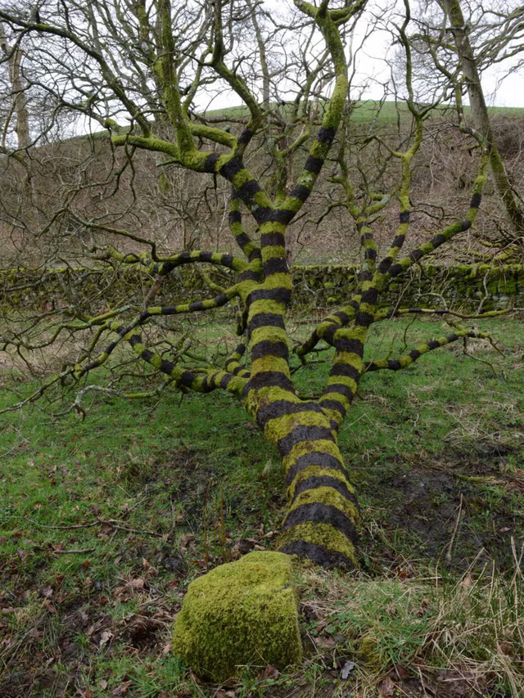
Wood Line
Storm King
Tree painted with black mud
Notes:
Wood Line in Park Presidio, San Francisco, 2011. Wood Line is a snaking sculptural installation of eucalyptus trunks and branches.
Storm King Wall, New York’s Hudson Valley, 1997 – 1998
Tree painted with black mud, Dumfriesshire, 21 March 2014 (Andy Goldsworthy)
Storm King Wall is one of the Goldsworthy’s most iconic works. Goldsworthy speculated that, gradually, these trees would cause the wall to collapse
Goldsworthy wanted his audience to experience the natural world – to feel how we all exist as a part of the natural world.
His work is a part of the landscape, he works with natural materials, allowing for the natural materials over time to tell their own stories.
QUESTIONS:
What does Goldsworthy’s art make you think about?
Does it make you feel connected to nature?
Does it make you think of the life cycle?

Slide 7
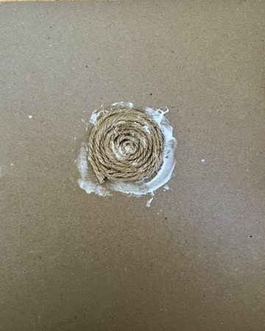
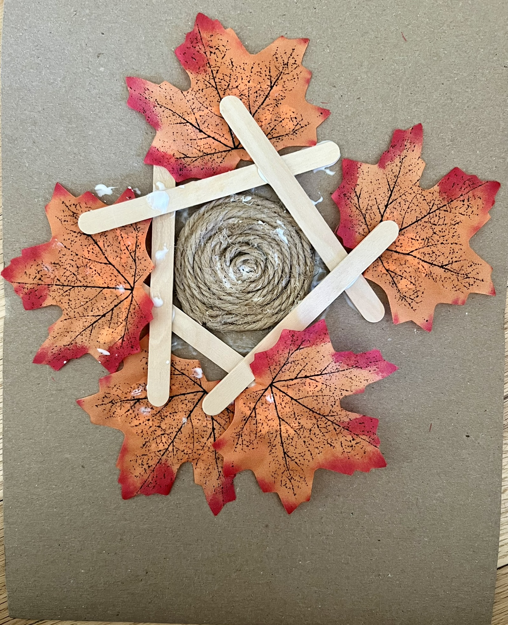
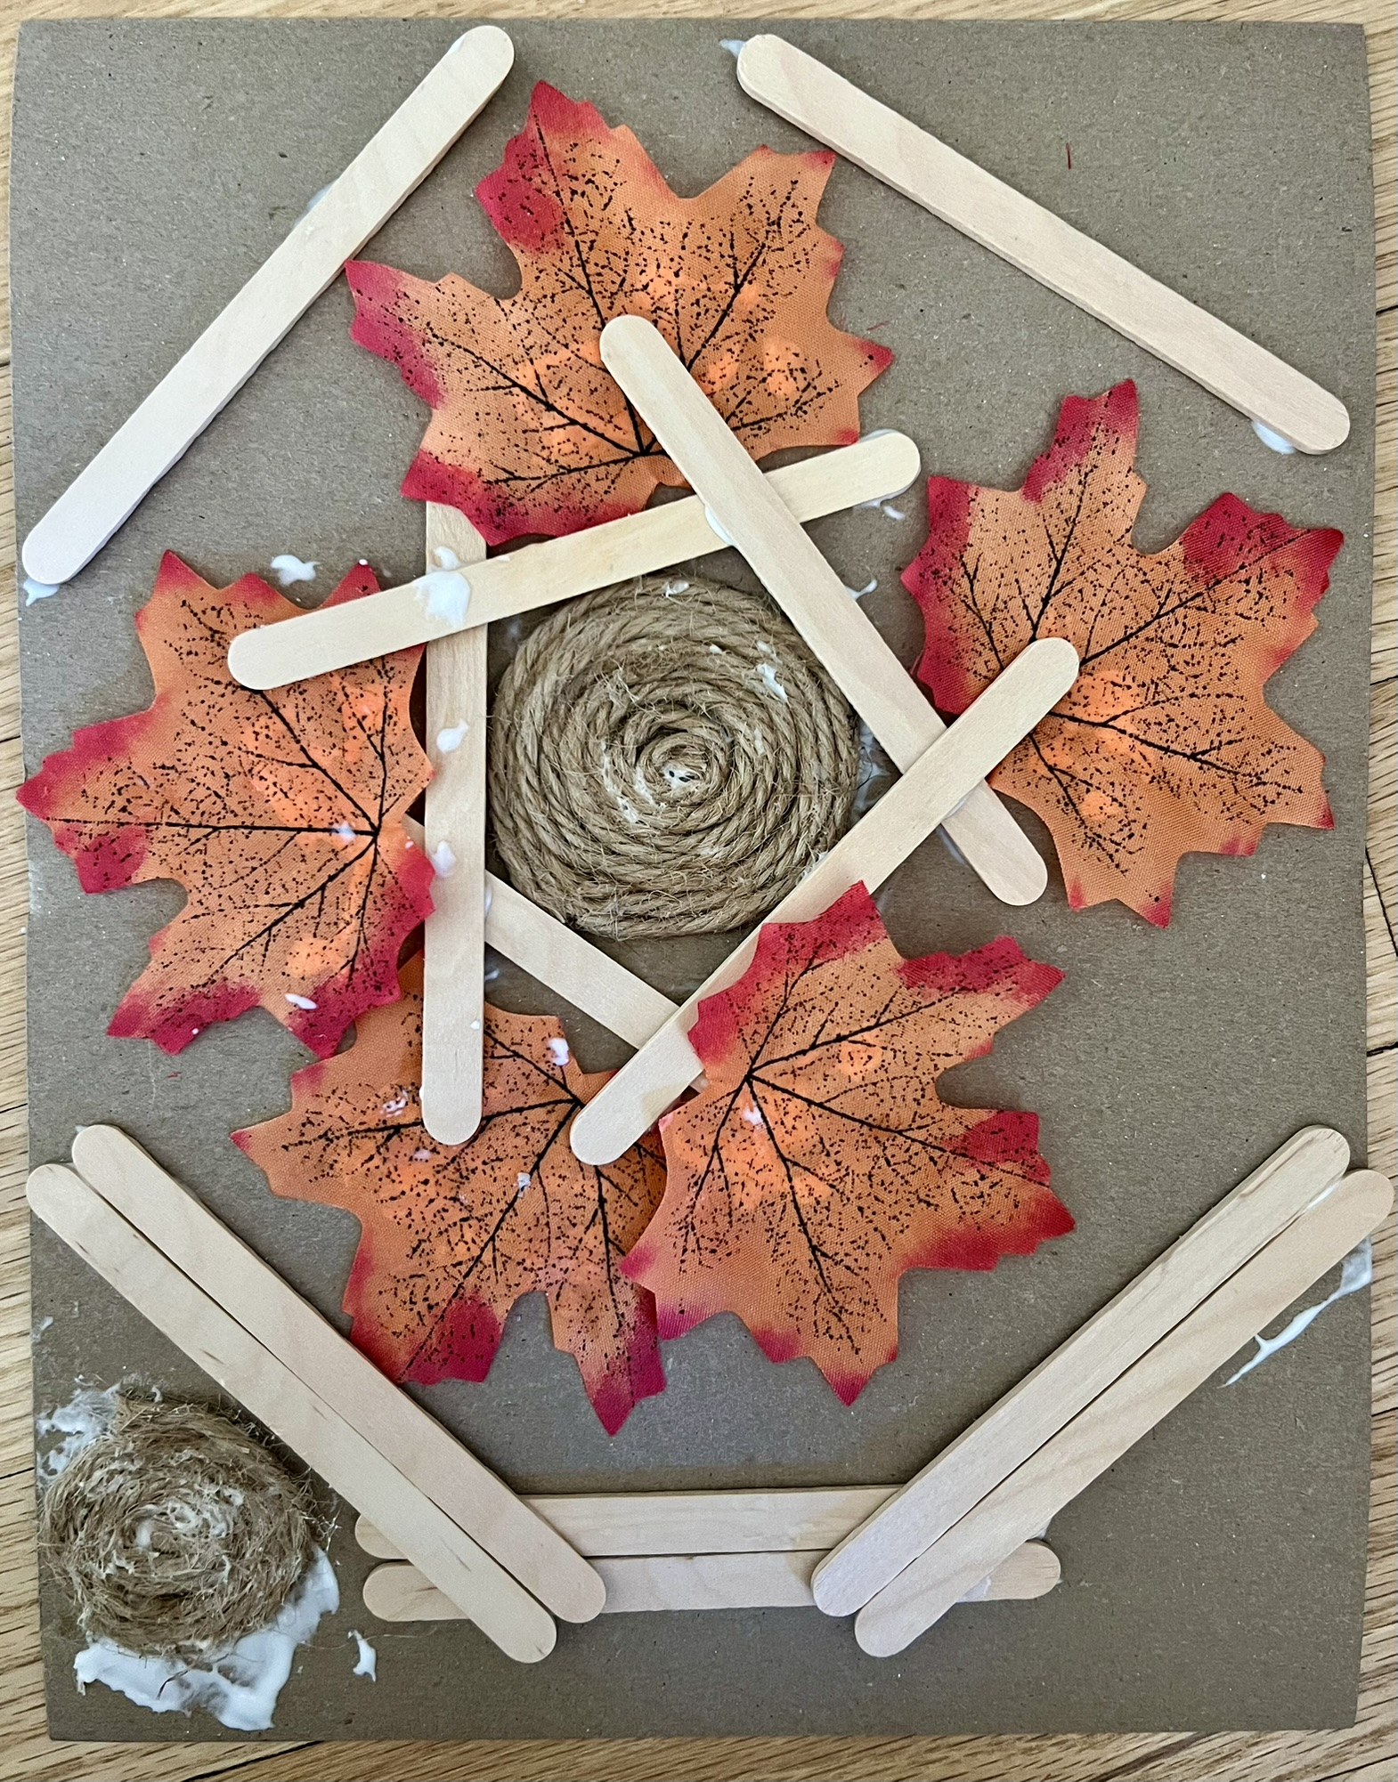
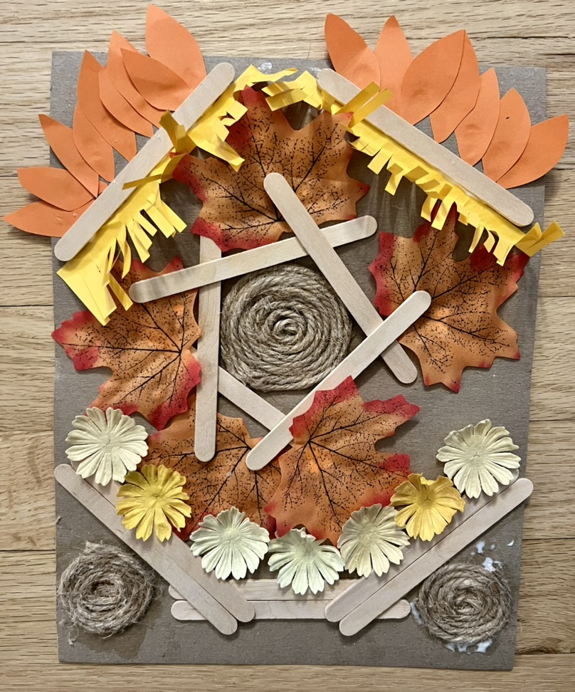
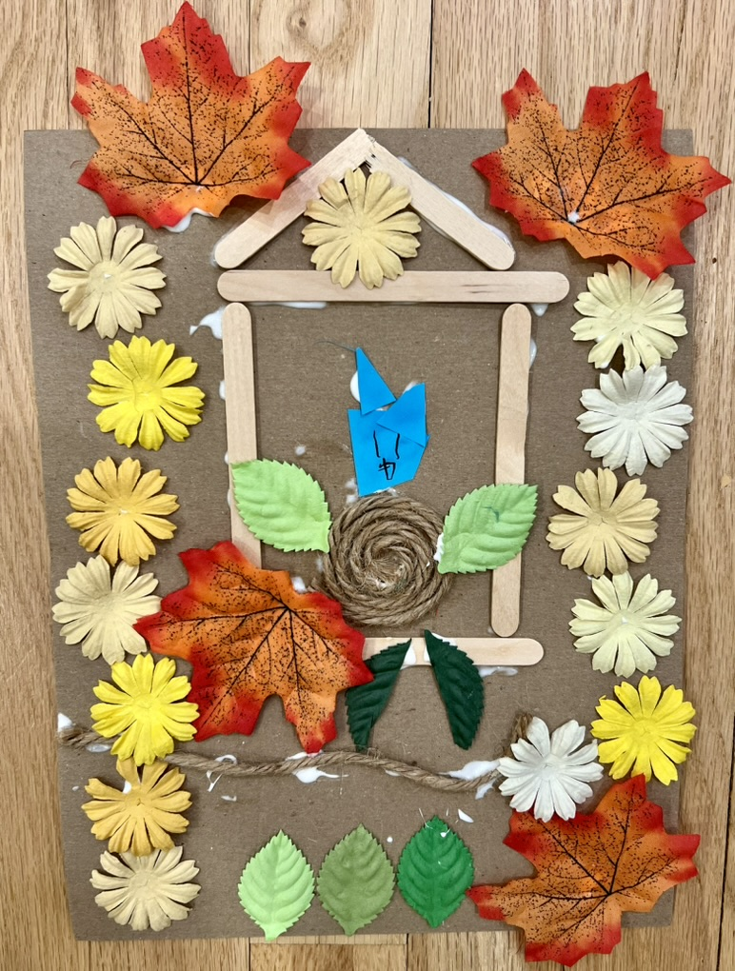
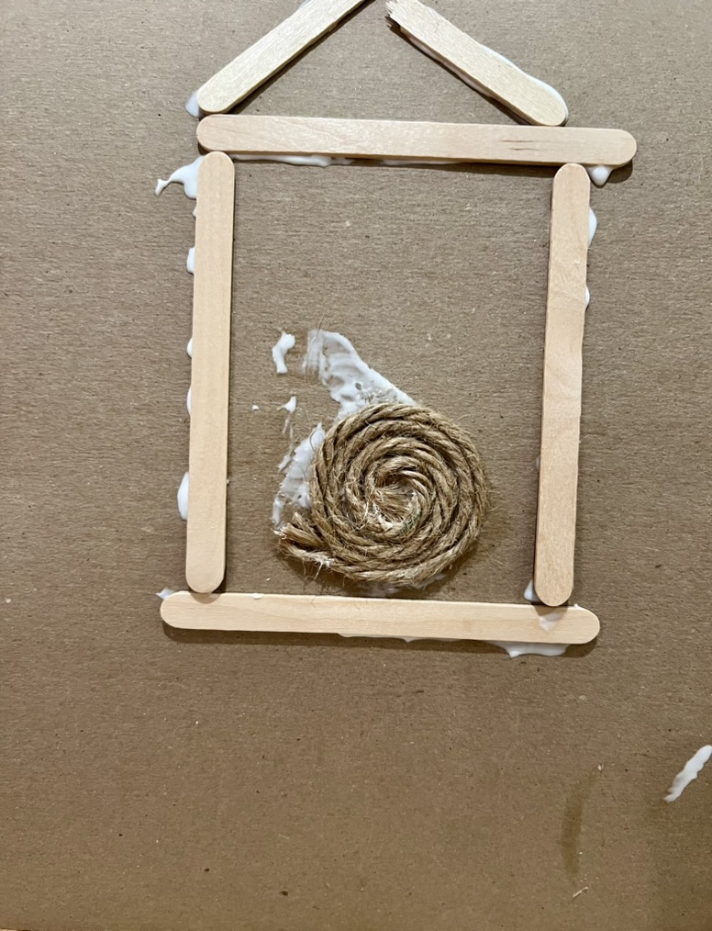
Art Project: Be inspired by Andy Goldsworthy! Create your own nature collage.
Using the collage materials provided, imagine you are outside, what would you make?
Project for later: when outside look for natural materials and make a temporary artwork!
Notes:
Great Art Project Instructions – Andy Goldsworthy
Project Description:
Students will learn about Andy Goldsworthy and create their own nature inspired collage. Goldsworthy is a famous British artist known for his outdoor art installations. He creates temporary art installations from found, natural materials.
Grades: K - 6
Art Project: using a variety of collage materials students will create a nature inspired collage.
Optional: the art may be collected and displayed (dependent on the teacher’s approval) at the end of the session.
Reminders: remind students to sign their artwork.
Materials: all grades will use the same project materials.
Per student: one sheet of brown paper, glue (or share if not enough to go around)
Shared by students: variety of collage materials, scissors, glue, markers
Considerations/ideas:
If we were outside, what would you make? Could you find twigs and leaves like Goldsworthy to make an art installation?
What shapes did Goldsworthy like to use? Could you repeat patterns?
Use these supplies to imagine what you would make outside. Experiment and have fun!
Project for later: when outside look for some natural materials and make a temporary artwork!

