Slide 1
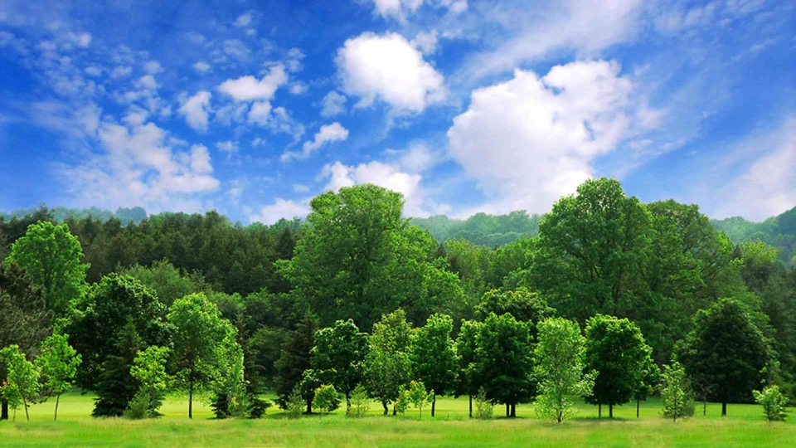
Trees
Amazing Earth
1st grade
Notes:
The presentation should take no longer than 15-20 minutes as the activity is the main objective. Please keep an eye on the clock.
TIPS:
Have students sit on the carpet so the activity can be set up at their desks.
Limit questions/answers if time runs short.
Ask helpers to:
set up during the presentation.
familiarize themselves with the activity and its goal.
Thank you for making Amazing Earth possible!
Updated 10/28/19

Slide 2
What is a tree?
Trees are tall plants.
Trees have a woody trunk and branches.
Notes:
ASK: What makes a tree a tree?
The key points are that trees are plants, tall and have woody trunks.
Other answers (trees have flowers, trees shed their leaves in the winter, trees grow fruit) may be true but they aren’t unique to trees.
ADVANCE slide and reveal information

Slide 3
What 5 things do plants needs to grow?
Sunlight
Water
Nutrients
Space to Grow
Air
Plants compete to get the best sunlight.
Notes:
REVIEW the slide.
OPTIONAL:
Say, There are many ways plants compete against other plants:
Plants might steal nutrients from other plants.
Grow on top of other plants to get more sunlight.
Make themselves more attractive to pollinators or animals that will spread their seeds.
Plants are very creative.

Slide 4
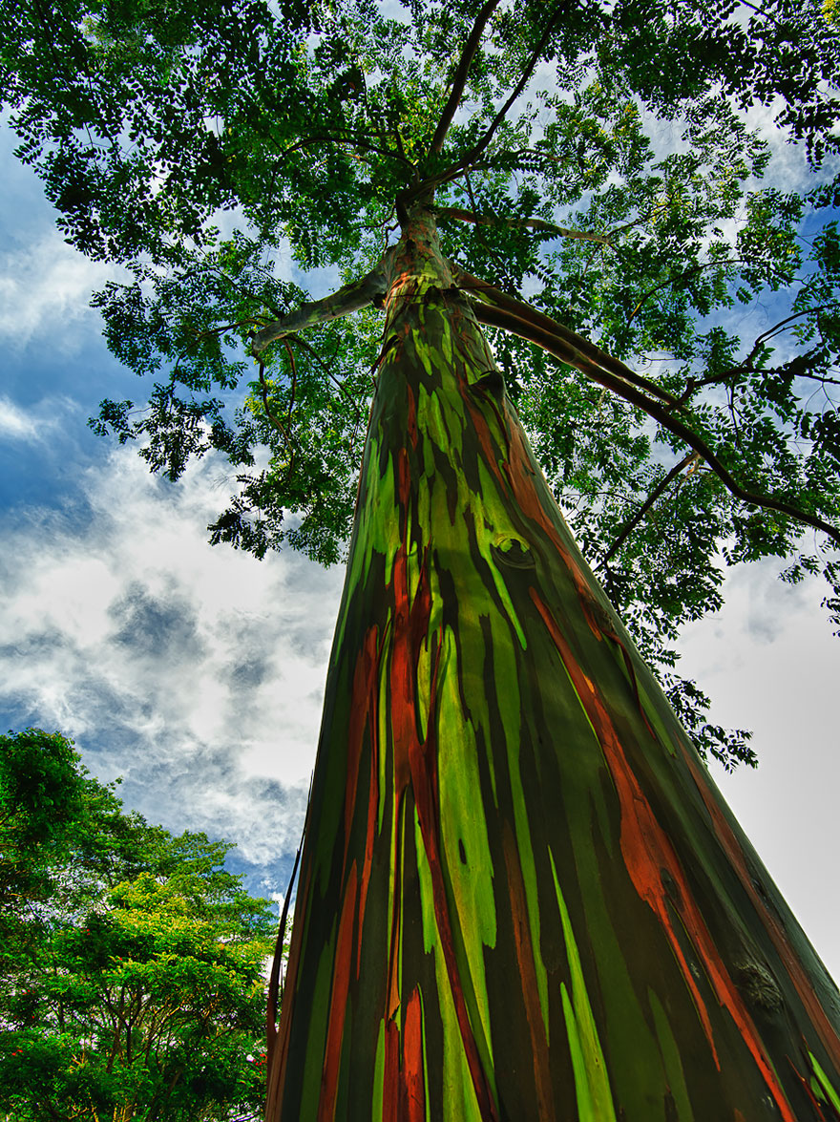
Trees are tall
The best way to get sunlight is to be the tallest plant.
Rainbow Eucalyptus trees are the tallest trees growing more than 300 feet high.
That’s the same as a 33 story building!

Slide 5
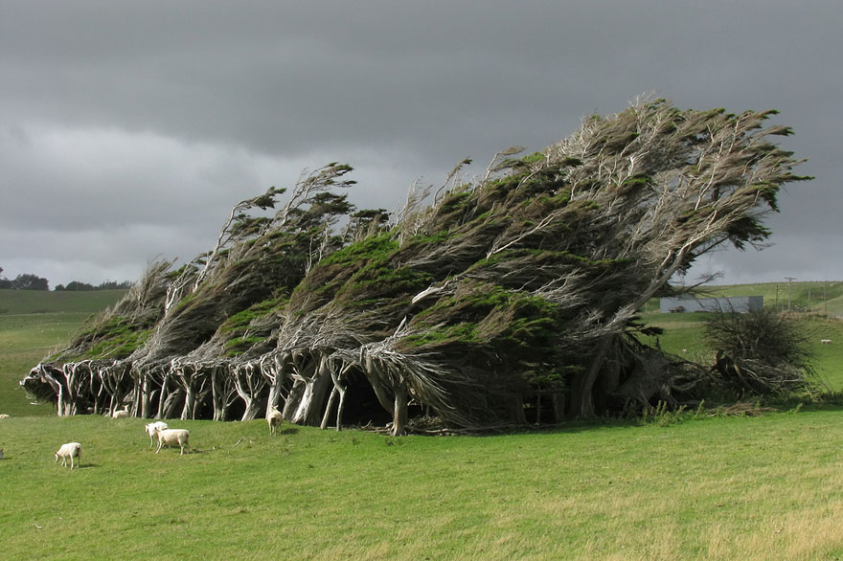
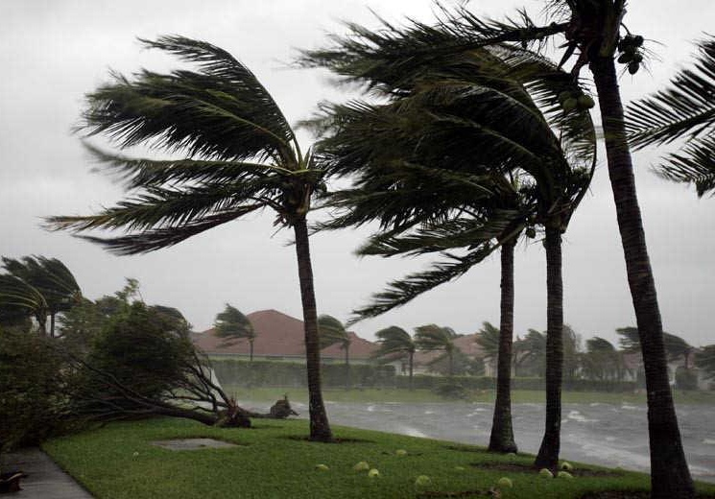
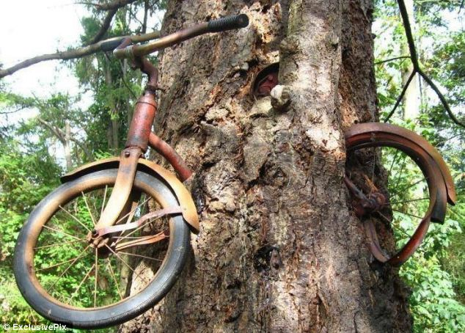
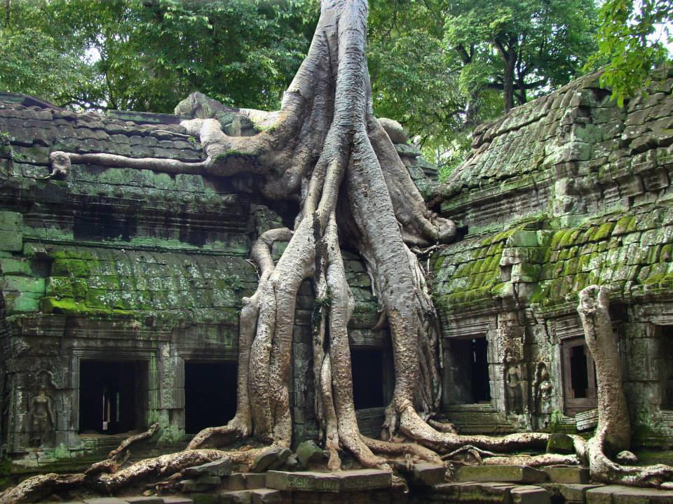
Trees are woody
To grow tall and adapt to their environment, tree trunks need to be strong and flexible.
And trees are adaptable. They can even grow around structures.

Slide 6
Two main groups of trees
Deciduous Trees
Lose their leaves in the fall.
Evergreen Trees
Keep their leaves year round.

Slide 7
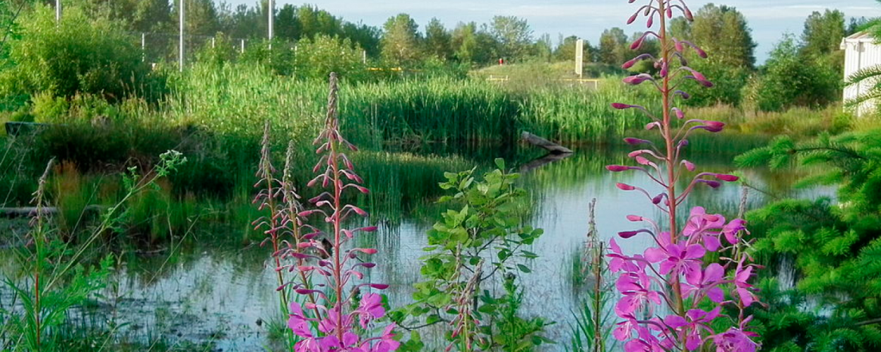
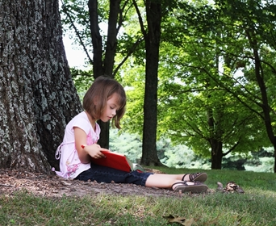
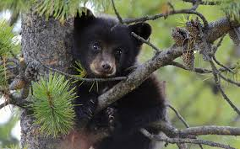
Why are trees important?
Produce oxygen
Improve water quality
Provide homes for animals
Provide food and building materials
Prevent soil from washing away
Create shade
Reduce noise pollution
Let’s Take Care of Trees!
Notes:
ASK: Why are trees important? What do they do to help animals, people and the environment?
CLICK to reveal the answers.

Slide 8
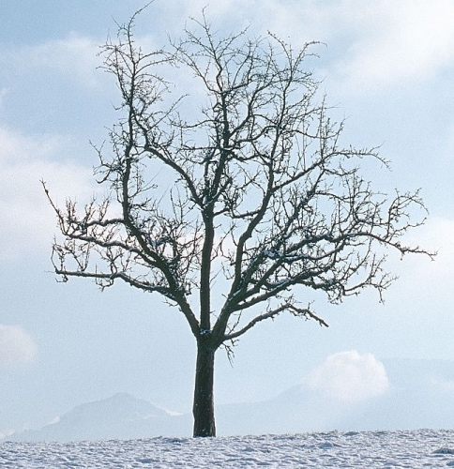
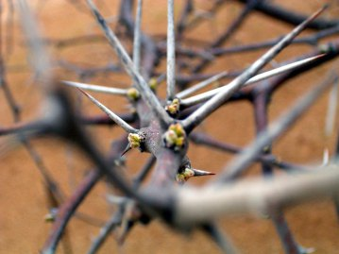
How trees protect themselves
Dormancy (inactive) in the winter
Grow in shapes
Thorns or spikes
Produce chemicals to make the leaves taste bad
Produce toxins to kill other plants
Notes:
OPTIONAL
In Fall, trees drop their leaves and start to store their energy. They won’t grow during the winter when there aren’t as many nutrients available.
Some trees grow in unique shapes so animals can’t reach all their leaves. (In the top right picture, the animals can reach leaves on the edges but the leaves in the middle are protected.)
Some trees have spikes or thorns to protect themselves from animals or birds.
Some trees produce chemicals to make their leaves taste bitter.
Walnut shells are poisonous – the walnut tree drops nuts, and the shell dissolves into the soil, killing other plants so that the new walnut tree has less competition.

Slide 9
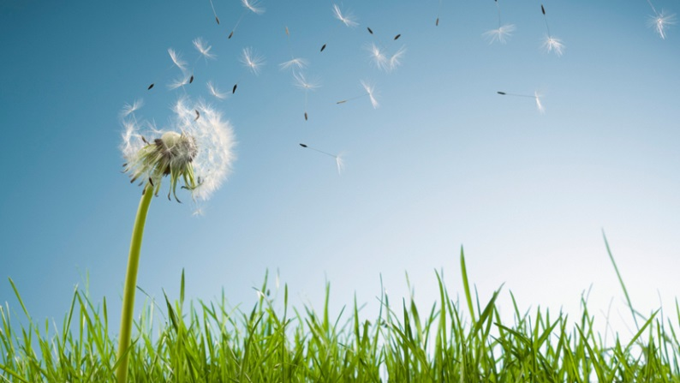
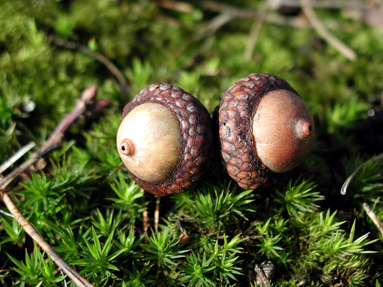
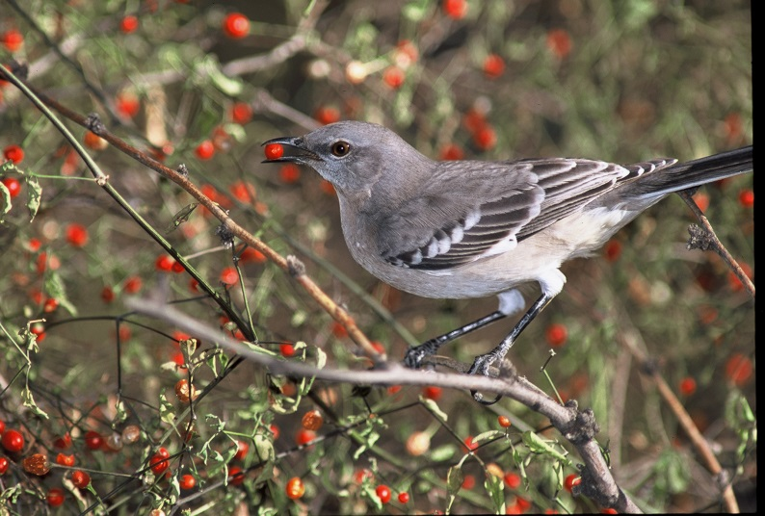
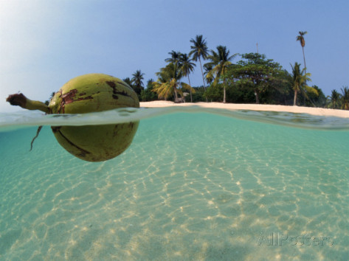
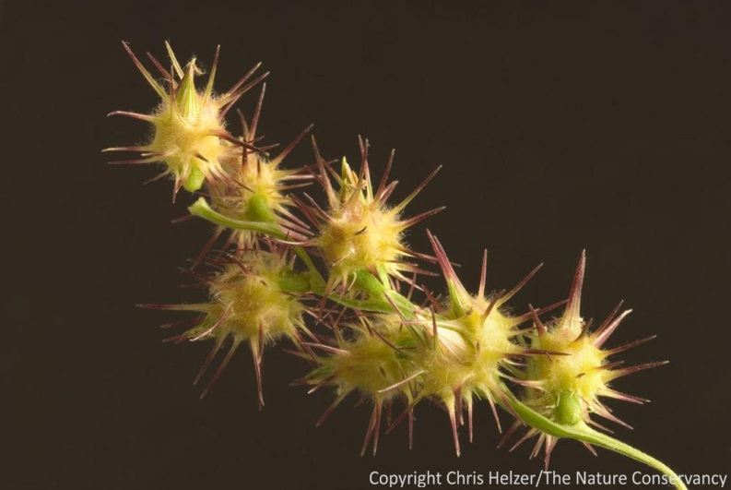
How trees spread their seeds
Seeds hold new baby plants.
Where does a tree want to drop its seeds?
Ways seeds travel:
  Gravity
  Wind
  Humans / Animals
  Water
Notes:
REVIEW the Slide
Ask: Where does a tree want to drop it’s seeds?
Answer
Trees produce a lot of seeds but trees don’t want their seeds to grow near them. Since trees are competing for sunlight and nutrients – the tree doesn’t want to compete with its own baby trees.
When seeds travel from humans and animals: seeds stick to fur, clothing; also when an animal eats, the seed travels through the body and back out again.

Slide 10
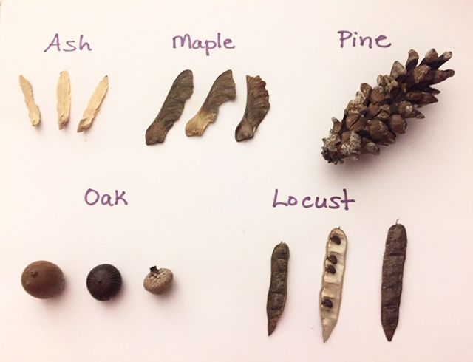
Let’s do an experiment!
What types of seeds travel best by wind?
As Scientists we record:
Our guesses (predictions/hypothesis)
What we see (observations)
Our measurements (data collection)
Look at the seeds and gently feel them.
Turn and talk to another scientist and guess/predict which seed will travel the farthest in the wind.
Draw each seed species on your recording sheet.
Notes:
Allow 20-25 minutes to explain and conduct seed experiment.
While the students are still seated on the carpet, review the activity.
Have them return to their seats to record.
After recording, they can return to the carpet for the seed travel experiment.

Slide 11
Let’s do an experiment!
What types of seeds travel best by wind?
  Helpers needed for the experiment:
  Seed dropper – drops one seed type in front of fan.
  Recorder – marks with tape and measures how far the seed traveled.
  All students record the results on their sheet.
  Select additional students to test the four remaining seed types.
Notes:
*Before you begin the experiment, please remind students they are not allowed to touch the fan at all.
Select students (or ask the teacher to help select) to test a seed (per the chart).
Student One to drop seed into fan at high setting (no longer testing both low and high setting).
Student Two to mark seed location with duct tape and measure distance with measuring tape or the classroom’s nonstandard measurement tool (i.e. some classes use cubes).
All Students record results on their sheet; an adult can record on a chart on the board for student’s to reference.
Repeat with next seed type and set of students until all 5 seeds have been dropped once.

Slide 12
Let’s make a connection!
  Why did some seeds travel farther than others?
  How does traveling by wind help seeds?
  Why are winged seeds (Maple, Ash) heavier on one end?
  How do the seeds that are too heavy for the wind to blow travel?
Notes:
Discussion Questions:
Why did some seeds travel further than others?
They are lighter, they have features/adaptations (wings) that help them go farther.
How does traveling by wind help seeds?
It enables the seed to travel away from the mother tree thus having a better chance of survival because it is not competing with the mother tree for sunlight, water and nutrients.
Why are winged seeds (Maple, Ash) heavier on one end?
So that when they fall to the ground the seed end will land first and become embedded in the soil. This will help the seed grow and keep it from drying out too fast.
How do the seeds that are too heavy for the wind travel?
Some are eaten by birds and animals and then passed through their bodies; some get washed away by rain and float down rivers; some have prickly stickers and attach to humans or animal and will travel away with them.

Slide 13
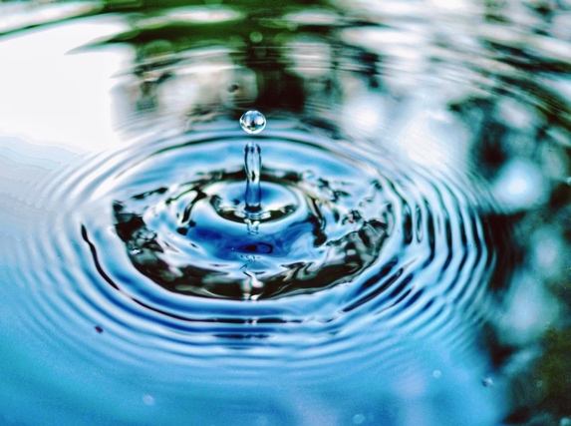
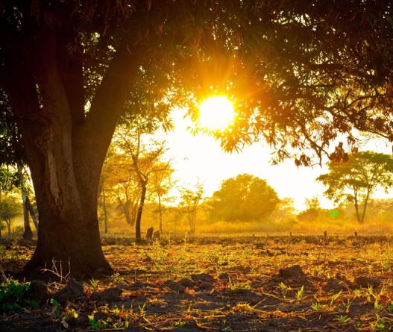
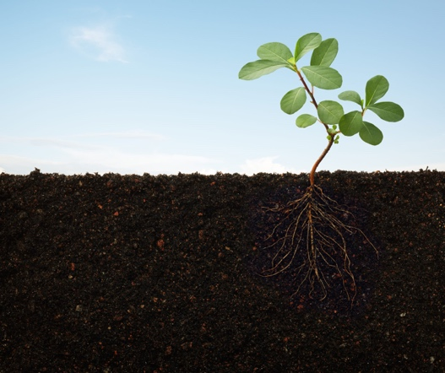
Tree Needs
Let’s Play!
Overview
You are a tree standing in the forest.
I am Mother Nature.
I have these colored tiles which represent 3 of the things that you need to grow:
  Water (blue)
  Sunlight (yellow)
  Food/Nutrients (red)
Rules
While your eyes are closed, Mother Nature may drop squares near you.
Your feet are roots so they have to stay planted – no walking.
When I say GO, open your eyes and gather as many as you can to grow.
Grow/Survive
1 of each color = healthy
2 of the 3 colors = sick
1 color = not a survivor
Notes:
If time allows play the tree needs game.
After playing, make the connection by saying:
Mother Nature can be harsh and not every seed or tree will grow or survive. That is why trees defend themselves and have ways to spread their seeds.
Optional Fact
Oaks produce more than 2000 acorns every year, but only one in 10,000 acorns will manage to develop into an oak tree. A lot of animals (pigeons, duck, pigs, deer, squirrels, mice) feed on acorns.

Slide 14
Review
What is something you learned about trees today?
Notes:
If time allows, review.

